Slide 1
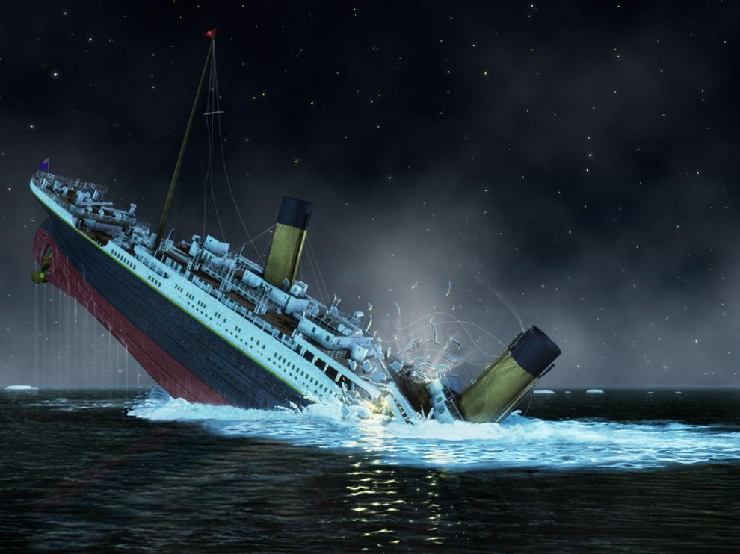
TITANC!!!
10 Mistakes why the Titanic

Slide 2
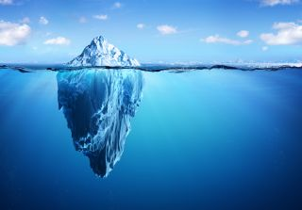
ICEBERG!!!
The Titanic hit a ice berg because the binoculars where not at the look out!!!!!

Slide 3
THE FIRE
The fire was on for 10 days

Slide 4
THE BULKS!!!
The bulks got weakened by the fire which will come in another one

Slide 5
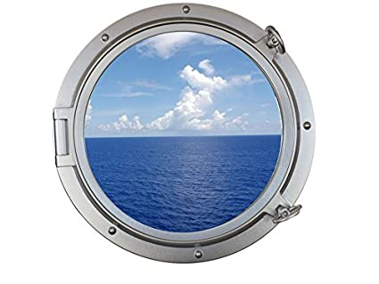
Open port holes!!!!
There were 300 port holes open on the Titanic!!!

Slide 6
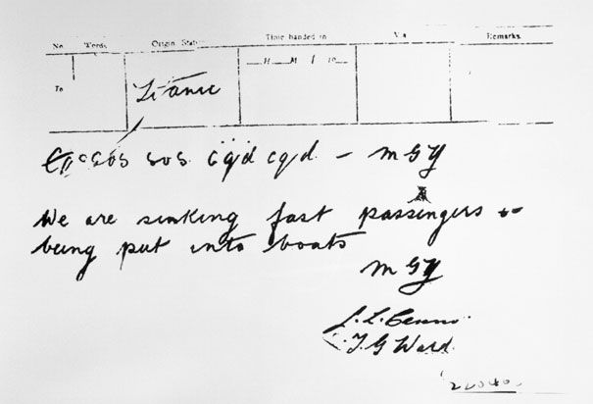
THREE LITTLE LETERS
msg are the tree little litters.

Slide 7
THE NEWYORK
The new York was a big boat and almost HIT!! The Titanic.

Slide 8
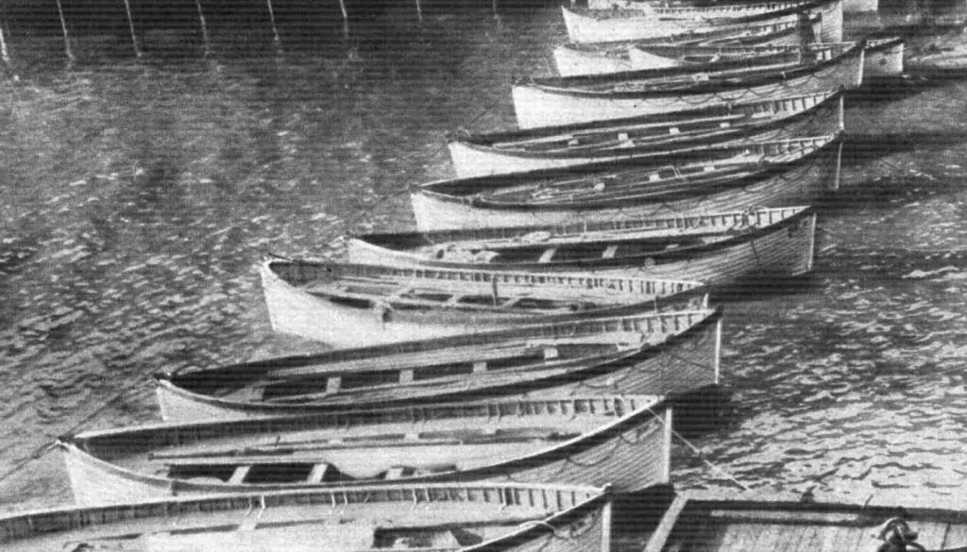
NOT ENOUGH LIFE BOAT,S
THE Titanic did not have enough boats on it

Slide 9
THE END!!!

