Slide 1
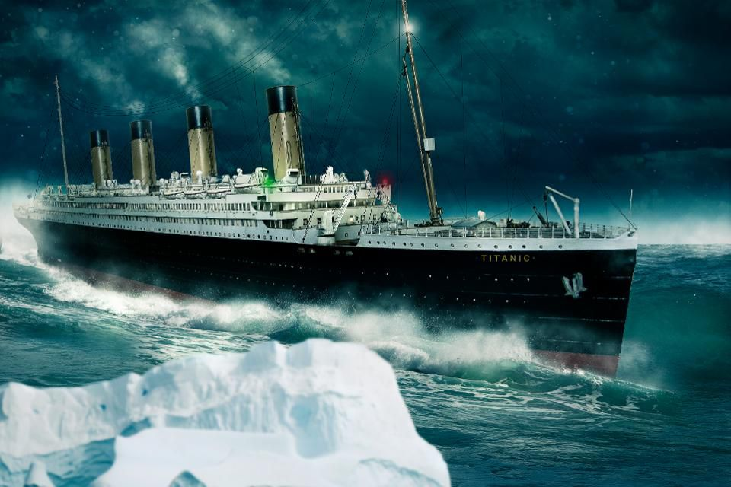
How the Titanic sank

Slide 2
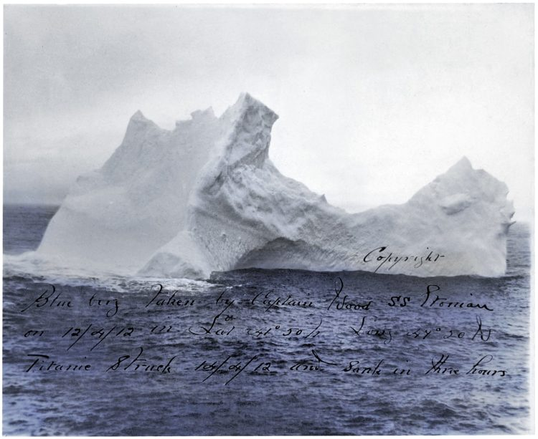
Ice berg
The Titanic hit the ice berg in 1912 April 14th
The Titanic sank at the Atlantic ocean
After the Titanic sank the Ice berg melted

Slide 3
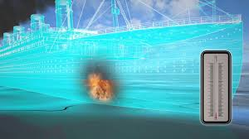
The Fire
The fire started on boiler room 5
THE FIRE ended in 10 days the day before it crashed
The Titanic was on fire when it left Belfast

Slide 4
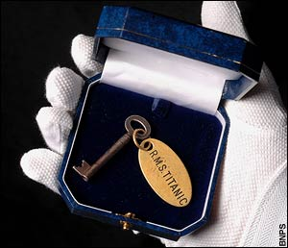
Missing binoculars
The old officer took the binoculars key so they couldn't see the ice berg

Slide 5
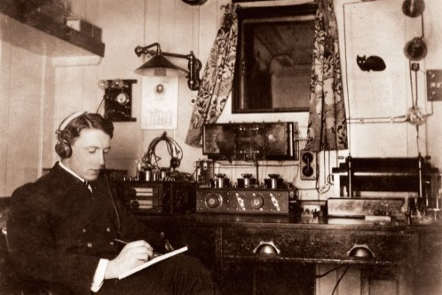
Three little Letters
They got a lot of messages about warnings but it didn't say MSG so it was not told to the captain

Slide 6
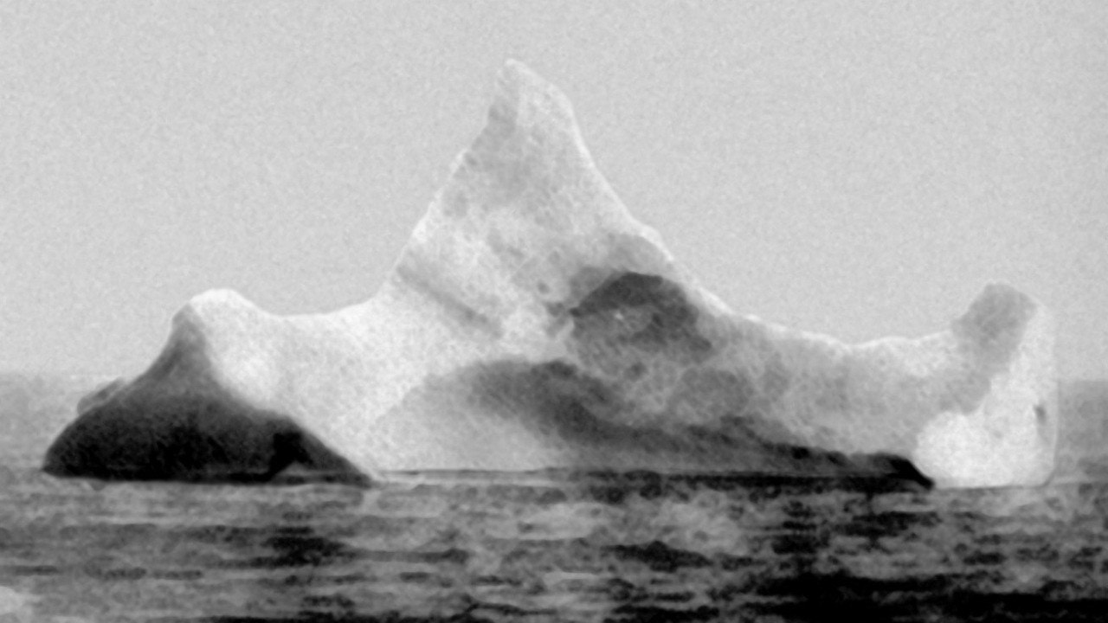
Evasive actions
Nobody heard that the Titanic struck the ice berg because some people were asleep or reading

Slide 7
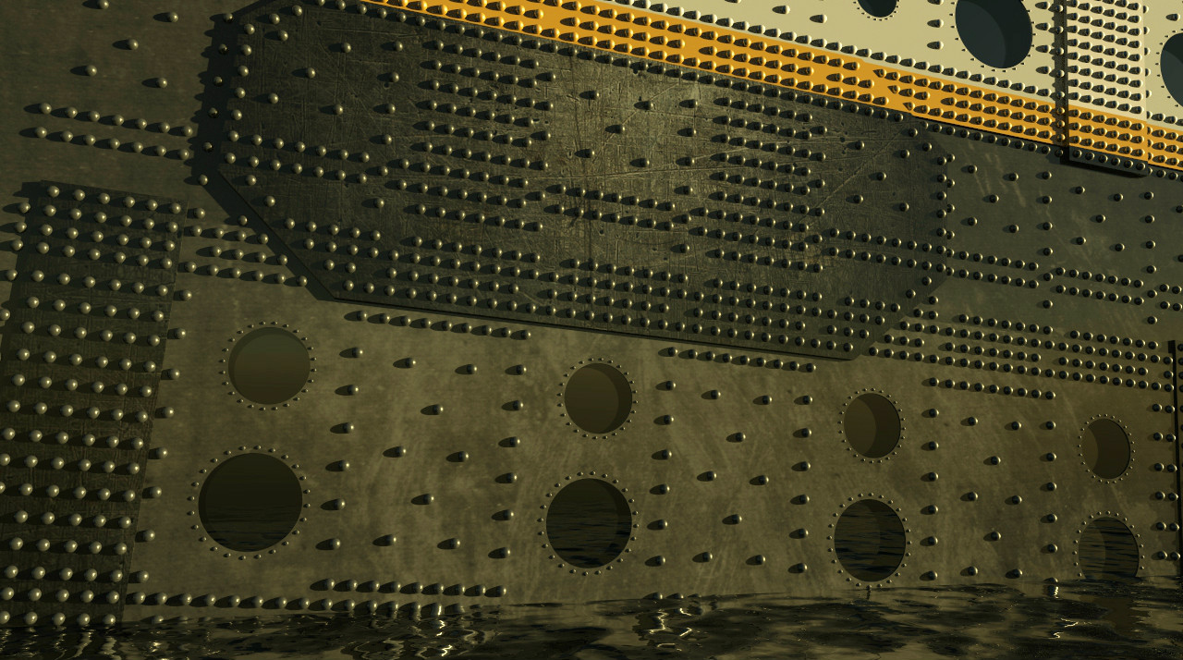
Brittle rivets
the ice berg hit the rivets so hard that rivets came off and that opens the water and it started to flood

Slide 8
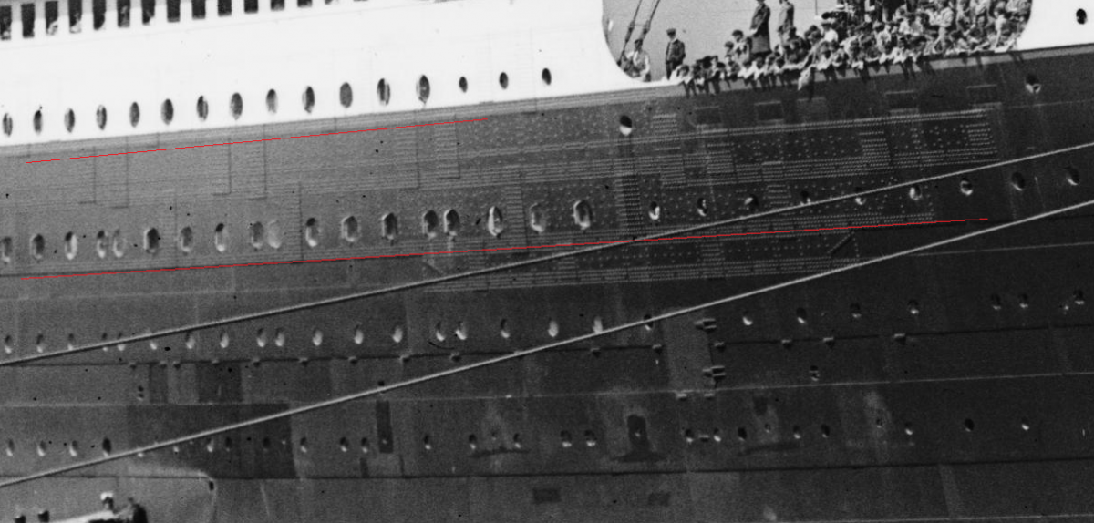
Open port holes
when they went to the life boats they left the port holes open

Slide 9
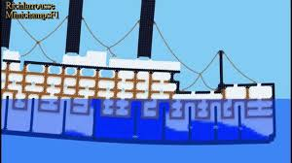
Bulk heads
The bulkheads were useless when the titanic sank because the bulkheads were at the bottom

Slide 10
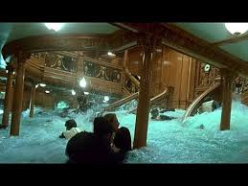
dodging the Ice berg
The Titanic scraped the Ice berg and that made it flood

Slide 11
Thank you for watching
Any questions?

Slide 12
hope you enjoyed our slideshow about the Titanic The End

