Slide 1
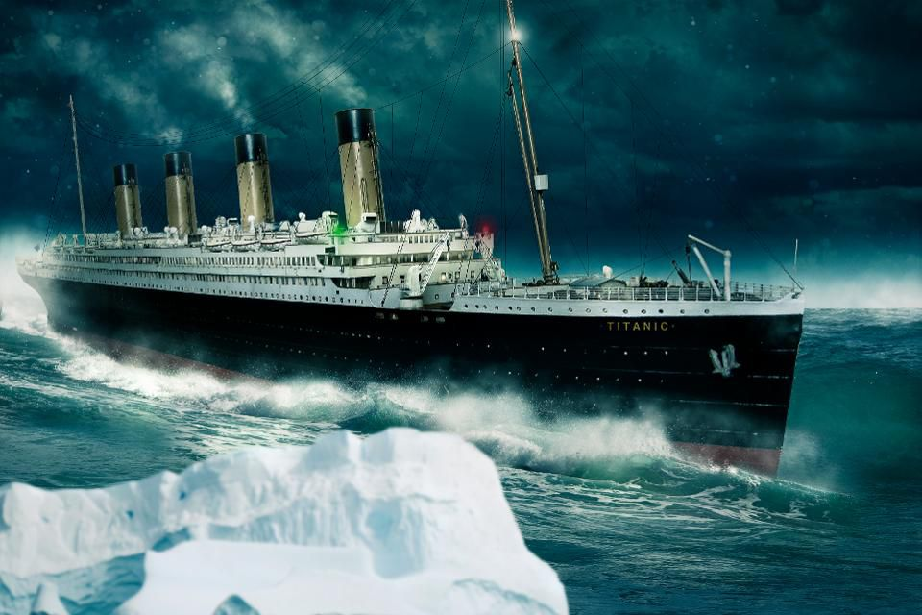
10 reasons the titanic sank

Slide 2
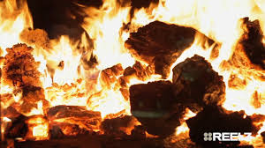
The Titanic was on fire.
The titanic was on fire for ten days. The fire was down below.

Slide 3
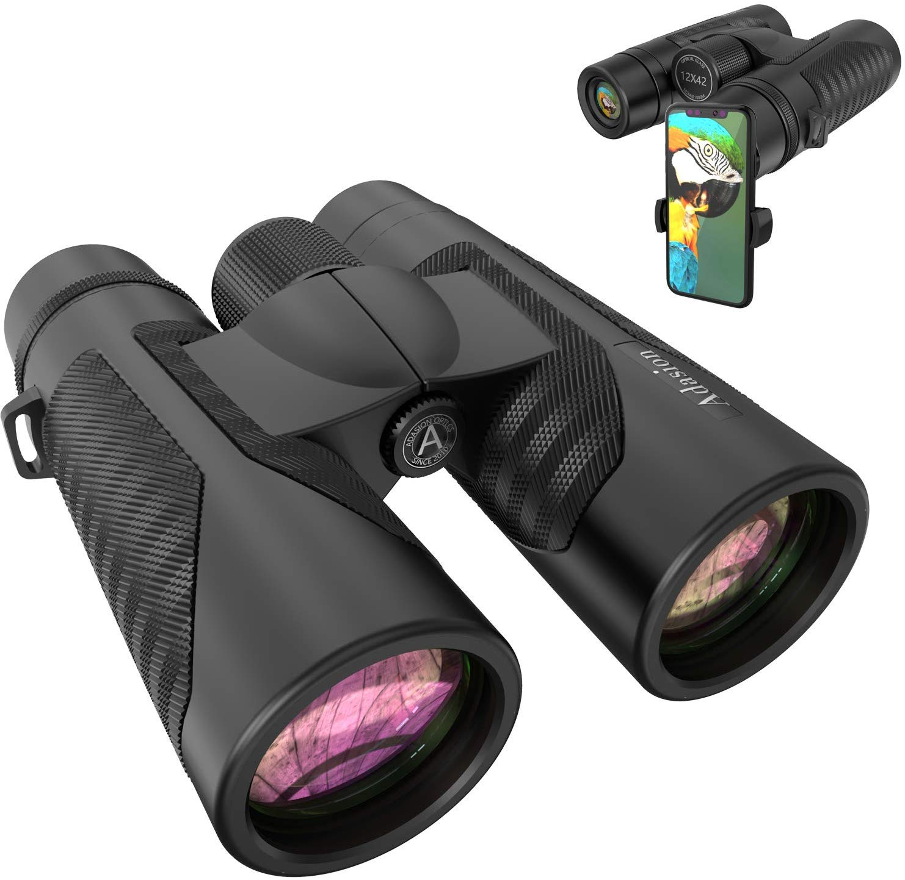
Missing binoculars
There were no binoculars when the look out men saw the ice berg.
The missing binoculars where in the captions pocket but he left.

Slide 4
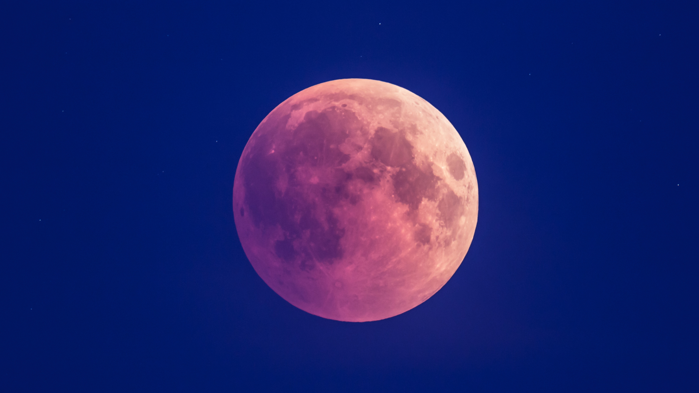
Moon light
The moon was closer than ever in 1,400 years.
There was a lack of moon light.

Slide 5
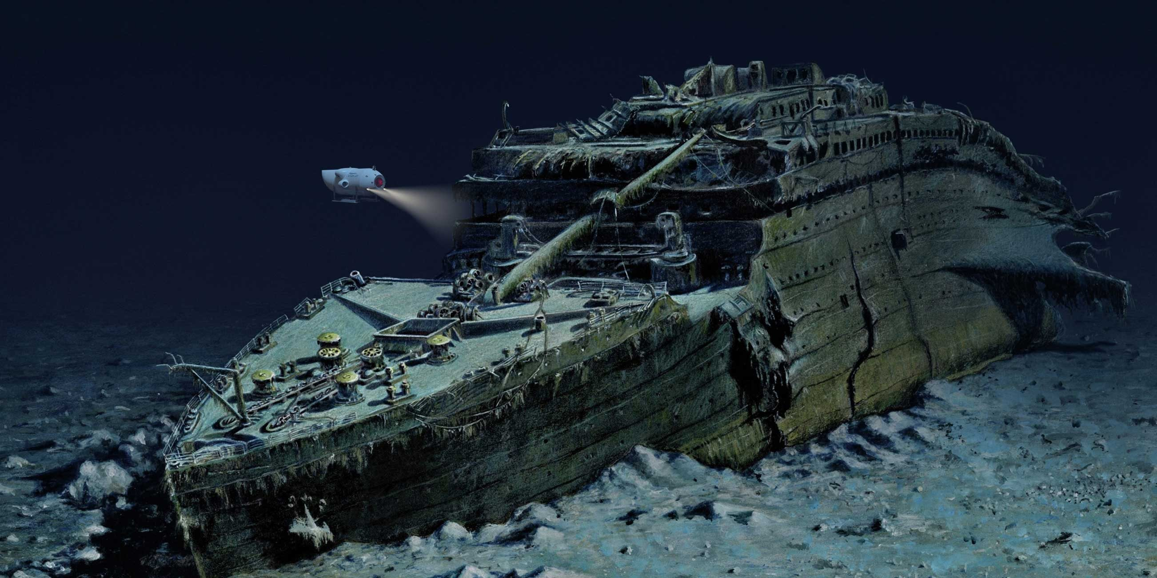
Delay
The weather was bad. It was ice berg season. The Olympic was racing a war ship.

Slide 6
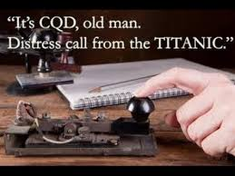
Thee little letters
The three little letters where m.s.g.

Slide 7
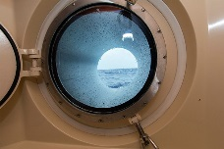
portholes
Passengers were looking out of there portholes. There was 300 port holes open.

Slide 8
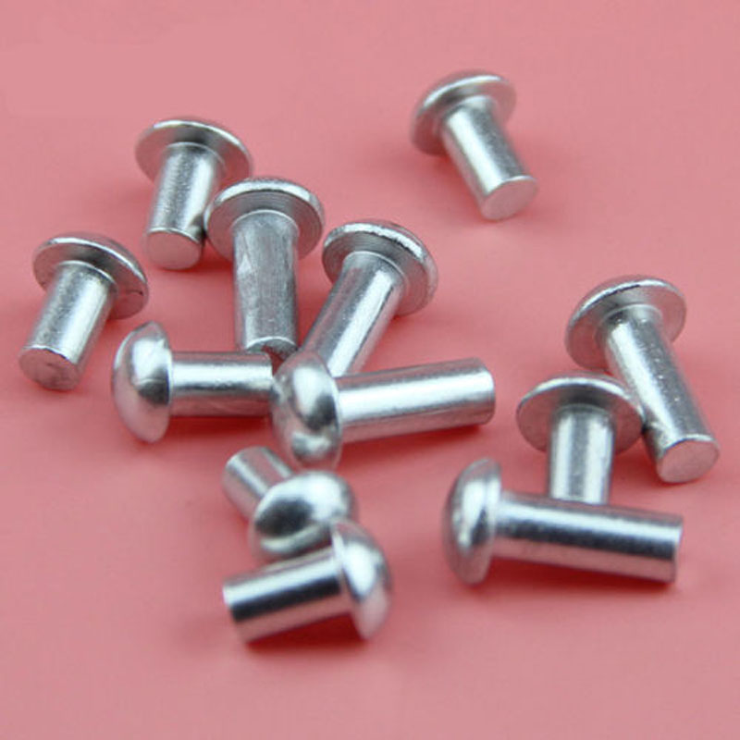
Rivets
The rivets broke because of the cold.

Slide 9
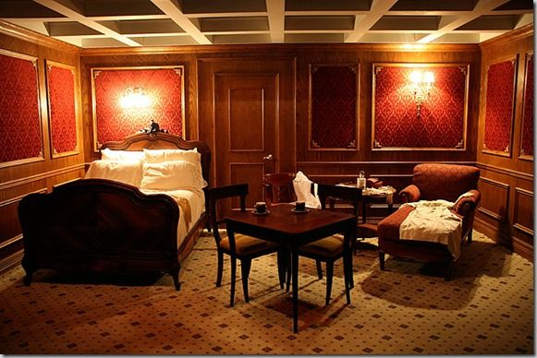
First class
First class were rely rich .

Slide 10
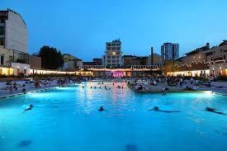
Swimming pool
The Titanic had a swimming pool. It is so big .

