Slide 1
RETRIEVAL PRACTICE IDEAS

Slide 2
STARTER (RETRIEVAL PRACTICE)
LAST LESSON
LAST WEEK
LAST TERM
LAST YEAR

Slide 3
STARTER (RETRIEVAL PRACTICE)
LAST LESSON
2 LESSONS AGO
3 LESSONS AGO
4 LESSONS AGO

Slide 4
STARTER (RETRIEVAL PRACTICE)
THIS TOPIC
LAST TOPIC
2 TOPICS AGO
3 TOPICS AGO

Slide 5
STARTER (RETRIEVAL PRACTICE)
LAST LESSON
Draw and label a lithium atom.
Describe how you would make it an ion
LAST WEEK
Describe how to separate a solvent from a solution
LAST MONTH
What are the 3 types of radiation? What are they made up of? What are their charges?
LAST YEAR
Draw and label an animal cell.
Notes:
ALTERNATIVE FORMAT

Slide 6
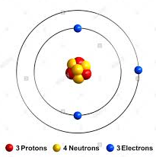
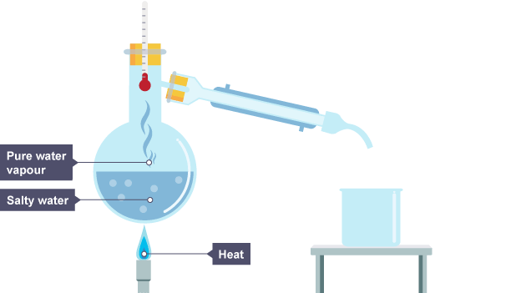
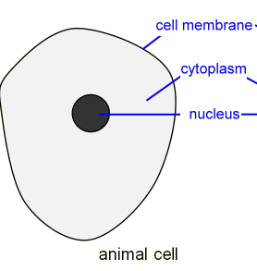
Spaced Learning Starter
Last lesson Draw and label a lithium atom. Describe how you would make it an ion | Last week
Last Month What are the 3 types of radiation? What are they made up of? What are their charges | This time last year
Describe how to separate a solvent from a solution
When the solution is heated, the water evaporates. It is then cooled and condensed into a separate container. The salt does not evaporate and so it stays behind.
Lose 1 electron
Draw and label an animal cell.
Alpha – 2 protons, 2 neutrons. Positively charges
Beta – 1 electron. Negatively charges
Gamma – a wave. No charge

Slide 7
STARTER (RETRIEVAL PRACTICE)
LAST LESSON
BIOLOGY
CHEMISTRY
PHYSICS

Slide 8
STARTER (RETRIEVAL PRACTICE)
Describe the function of a root hair cell and explain how it is adapted.
Define ‘diffusion’. (Can you give an example?)
State the charge of the three sub-atomic particles.
State the mass of the three sub-atomic particles.
1. Describe the energy transfers taking place when a book falls off a shelf.
BIOLOGY
CHEMISTRY
PHYSICS

Slide 9

RETRIEVAL PRACTICE – NO NOTES ALLOWED!
Name …
State …
Identify …
Describe …
Explain …
Suggest …
Link …
Analyse …

Slide 10

(WRITE QUESTION / TOPIC / KEYWORD HERE)
RETRIEVAL PRACTICE – NO NOTES ALLOWED!

Slide 11
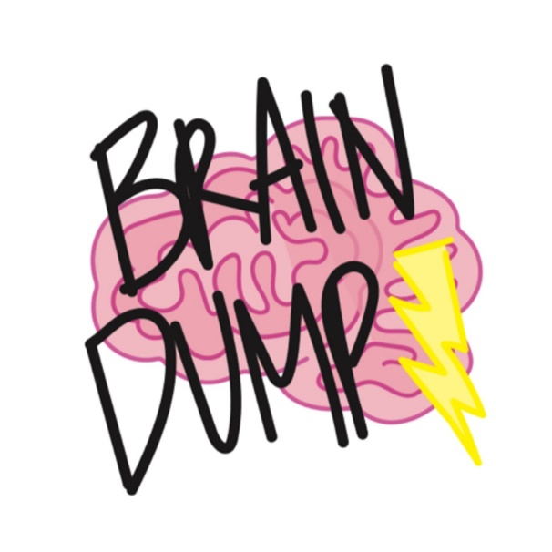
RETRIEVAL PRACTICE – NO NOTES ALLOWED!
Without looking in your books .. Write down everything you remember about the following…

Slide 12
RETRIEVAL PRACTICE – NO NOTES ALLOWED!
Explain how each image is connected to ___________. Explain in your own words, from memory.
Image goes here
Image goes here
Image goes here
Notes:
Adapted from RETREIVAL PRACTICE - KATE JONES

Slide 13
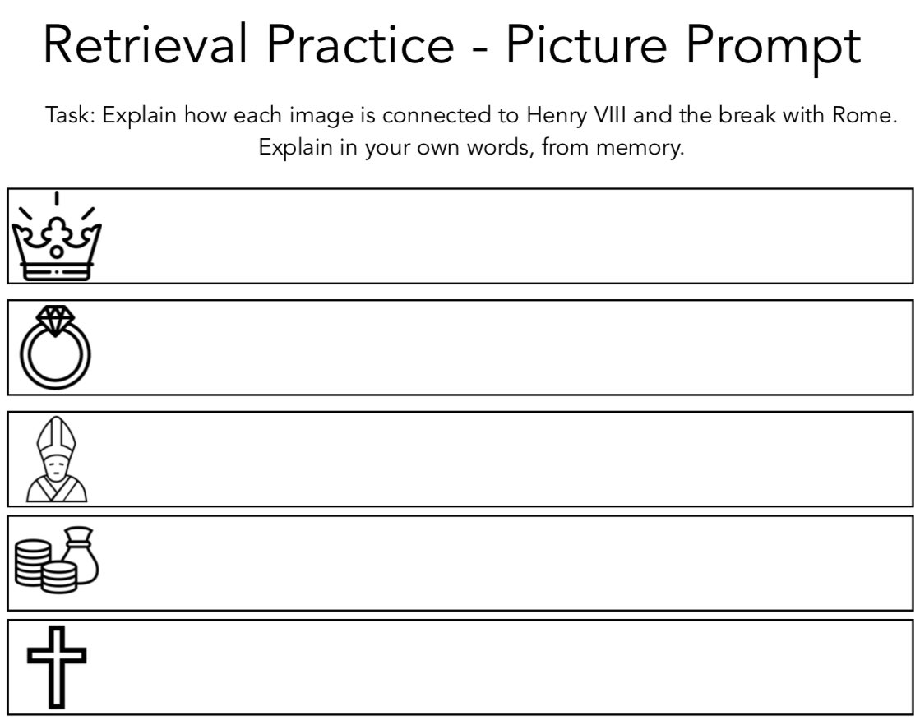
Notes:
Kate jones
@87history

Slide 14
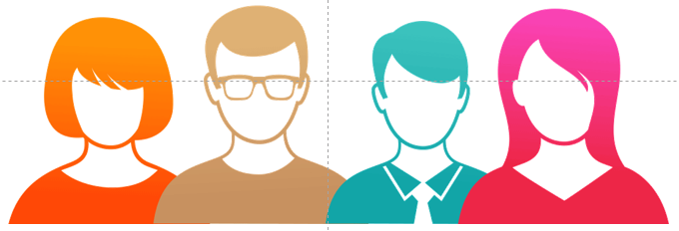
What keywords did you use or learn last lesson?
State 3 key facts from last lesson.
Describe a key concept or idea from last lesson in your own words.
Explain a key concept or idea from last week in your own words.
RETRIEVAL PRACTICE – NO NOTES ALLOWED!
Notes:
Adapted from RETREIVAL PRACTICE - KATE JONES

Slide 15

RETRIEVAL PRACTICE – NO NOTES ALLOWED!
Cops and robbers
(5mins)
Your own knowledge and recall
(5mins)
‘Steal’ information from your partner!
Write as much as you can from memory about ____________.
Notes:
Adapted from RETREIVAL PRACTICE - KATE JONES

Slide 16
RETRIEVAL PRACTICE – NO NOTES ALLOWED!
Cops and robbers
Diffusion
Your own knowledge and recall
‘Steal’ information from your partner!
Osmosis
Your own knowledge and recall
‘Steal’ information from your partner!
Write as much as you can from memory about the topics in the yellow boxes!
Active transport
Your own knowledge and recall
‘Steal’ information from your partner!
Notes:
More specific. Change topic according to class and lesson.
Adapted from RETREIVAL PRACTICE - KATE JONES

Slide 17

RETRIEVAL PRACTICE – NO NOTES ALLOWED!
List it!
List as many keywords as you can connected to our current topic.
Notes:
Adapted from RETREIVAL PRACTICE - KATE JONES

Slide 18
RETRIEVAL PRACTICE – NO NOTES ALLOWED!
List it!
List as many key facts as you can linked to our current topic.
Notes:
Adapted from RETREIVAL PRACTICE - KATE JONES

Slide 19
RETRIEVAL PRACTICE – NO NOTES ALLOWED!
List it!
List as many key facts as you can about our previous topic.
Notes:
Adapted from RETREIVAL PRACTICE - KATE JONES

Slide 20
RETRIEVAL PRACTICE – NO NOTES ALLOWED!
List it!
List as many causes of _______ as you can.
Notes:
Adapted from RETREIVAL PRACTICE - KATE JONES

Slide 21
RETRIEVAL PRACTICE – NO NOTES ALLOWED!
List it!
List as many causes of _______ as you can.
Notes:
Adapted from RETREIVAL PRACTICE - KATE JONES

Slide 22
RETRIEVAL PRACTICE – NO NOTES ALLOWED!
List it! Link it!
Can you form any links between the keywords?
List as many key words from (insert topic)
List as many key words from (insert 2nd topic)
Notes:
Adapted from RETREIVAL PRACTICE - KATE JONES

Slide 23
RETRIEVAL GRID – NO NOTES ALLOWED! WHATS YOUR SCORE?
Where does aerobic respiration occur? | What is an enzyme? | Write the symbol equation for aerobic respiration. | State the three main uses of energy in your body.
How is energy transferred used in plants? | What are the reactants of aerobic respiration? | Why does a teenage boy need more energy than a girl? | What are the products of aerobic respiration?
Explain why muscle cells have many mitochondria while fat cells have very few. | Aerobic respiration is an exothermic reaction. What does this mean? | State the word equation for aerobic respiration. | How are the mitochondria adapted for their function?
1 point | 2 points | 3 points | 4 points
Notes:
Harder the question the more points.
Spaced retrieval = more points
Adapted from RETREIVAL PRACTICE - KATE JONES

Slide 24
C3 REVISON (TRIPLE)
RETRIEVAL – DEFINE THE KEYWORDS WHATS YOUR SCORE?
State of matter | Giant covalent structure | Nanoparticle | Covalent bonding
Ionic bonding | Atom | Metallic bonding | Molten
Delocalised electrons | Fullerene | Intermolecular forces | Alloy
1 point | 2 points | 3 points | 4 points
Notes:
Harder the question the more points.
Spaced retrieval = more points
Adapted from RETREIVAL PRACTICE - KATE JONES

Slide 25
C3 REVISON
RETRIEVAL – WRITE 3-5 KEYFACTS ABOUT THE KEYWORDS
WHATS YOUR SCORE?
State of matter | Giant covalent structure | Intermolecular forces | Covalent bonding
Ionic bonding | Atom | Metallic bonding | Molten
Delocalised electrons | Fullerene | Polymers | Alloy
1 point | 2 points | 3 points | 4 points
Notes:
Harder the question the more points.
Spaced retrieval = more points
Adapted from RETREIVAL PRACTICE - KATE JONES

Slide 26
RETRIEVAL GRID WHATS YOUR SCORE?
1 point (last lesson) | 2 points (last week) | 3 points (2 weeks ago) | 4 points (further back)
Notes:
Harder the question the more points.
Spaced retrieval = more points
Adapted from RETREIVAL PRACTICE - KATE JONES

Slide 27
RETRIEVAL GRID AIM TO GET 15 POINTS!
1 point (last lesson) | 2 points (last week) | 3 points (2 weeks ago) | 4 points (further back)
Notes:
Harder the question the more points.
Spaced retrieval = more points
Adapted from RETREIVAL PRACTICE - KATE JONES

Slide 28
RETRIEVAL GRID WHATS YOUR SCORE?
1 point (last lesson) | 2 points (last month) | 3 points (last term) | 4 points (last year)
Notes:
Harder the question the more points.
Spaced retrieval = more points
Adapted from RETREIVAL PRACTICE - KATE JONES

Slide 29

RETRIEVAL PRACTICE – NO NOTES ALLOWED!
THINK AND LINK
BOX 1 | BOX 2 | What is the link between the two?
Notes:
Adapted from RETREIVAL PRACTICE - KATE JONES

Slide 30
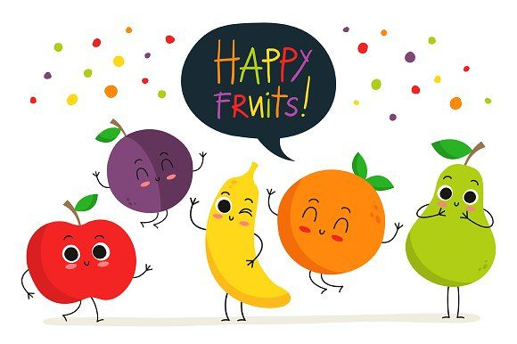
TOPIC:
5 a day retrieval challenge!
Notes:
Adapted from another resource – cannot remember which

Slide 31


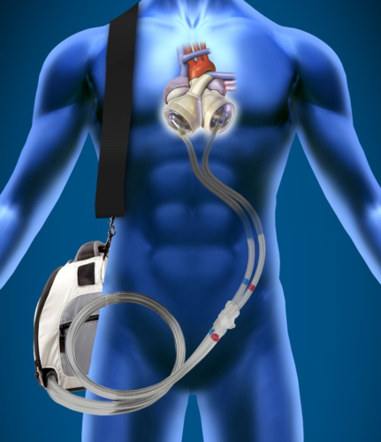
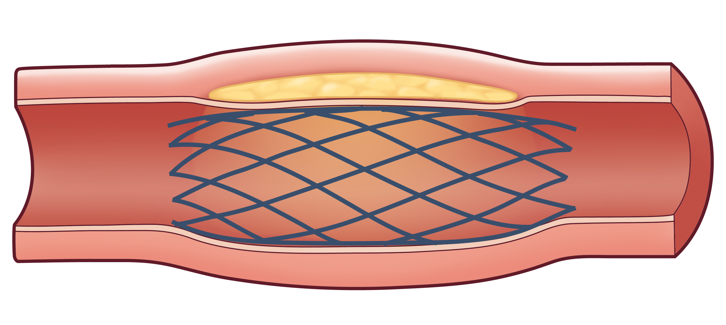
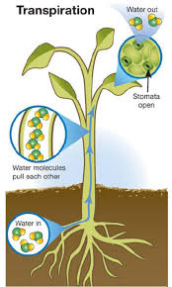
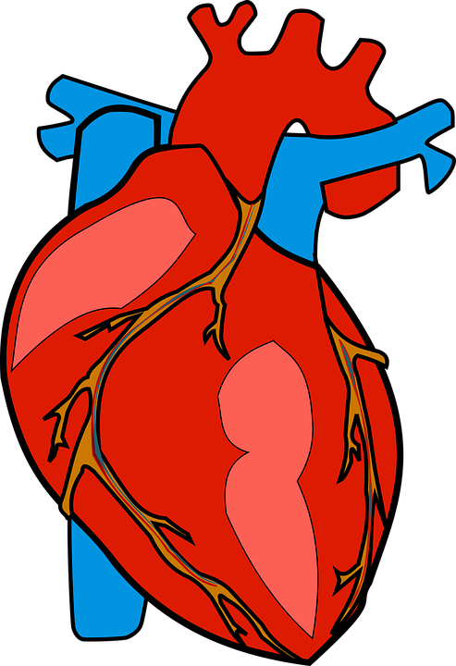

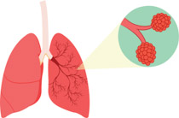
RETRIEVAL PRACTICE – NO NOTES ALLOWED!
B4
Notes:
ATE resource
Can be used a revision tool for making notes.
Student can be given a print out of the pictures or can be used as a picture prompt.

Slide 32
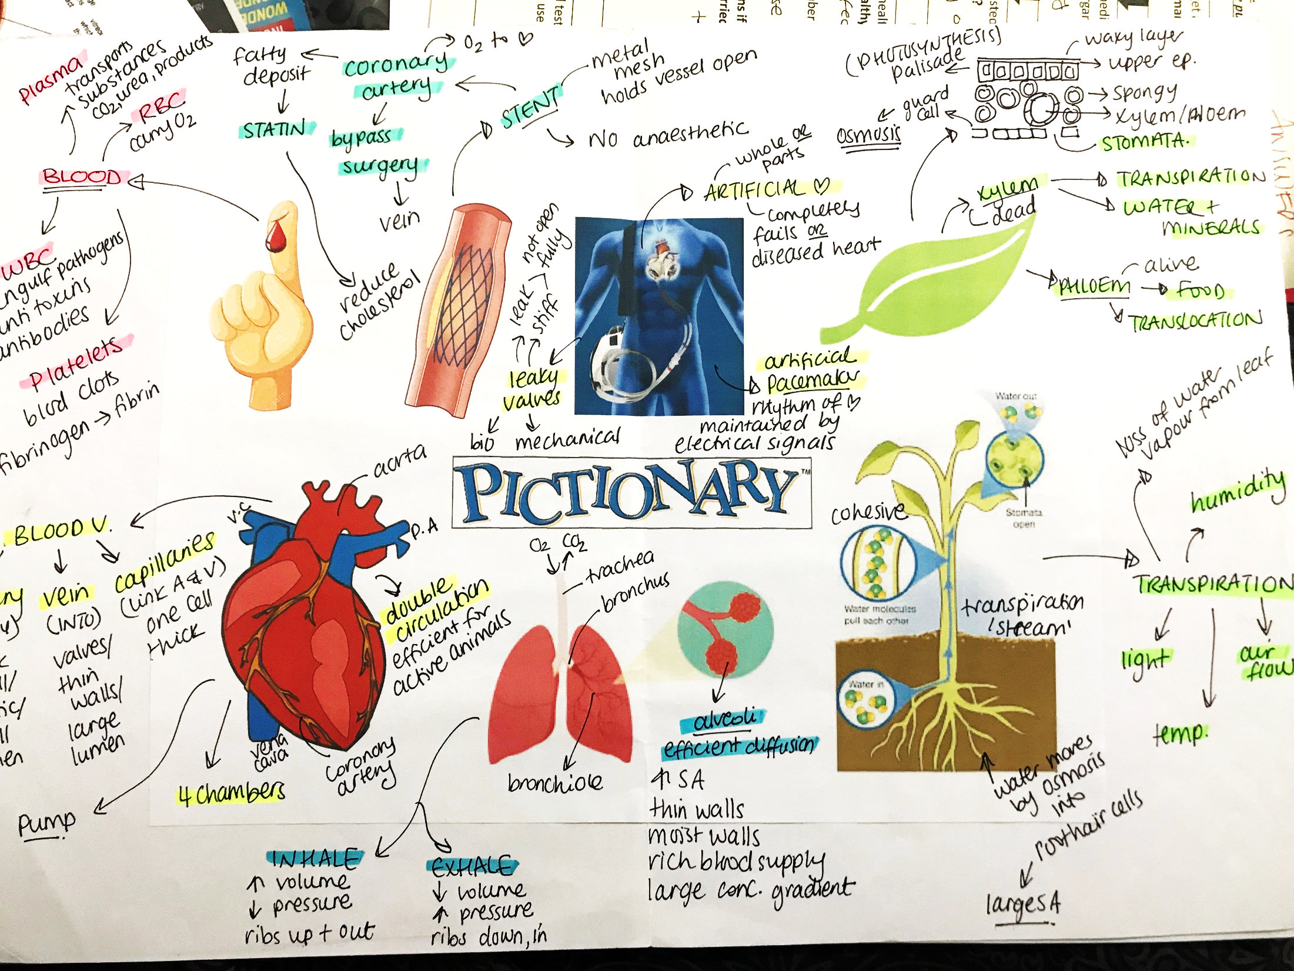

Slide 33

RETRIEVAL PRACTICE – NO NOTES ALLOWED!
Keyword | Definition
 | Agents that cause cancer or significantly increase the risk of developing cancer
 | Tiny hair-like projections from a cell that usually allow it to move a substance past the cell.
 | A serious disease in which the body is unable to regulate blood sugar.
 | The type and amount of food consumed by people.
 | A change in the genetic material of an organism.
 | A disease that is not transferred between people or other organisms.
 | Something (person’s lifestyle or a substance) that increases a person's chances of developing a disease.
Notes:
ATE resource

Slide 34
RETRIEVAL PRACTICE – NO NOTES ALLOWED!
Keyword | Definition
Carcinogens
Cilia
Diabetes
Diet
Mutation
Non-communicable disease
Risk factor
Notes:
ATE resource

Slide 35
RETRIEVAL PRACTICE – NO NOTES ALLOWED!
Keyword | Definition
Carcinogens | Agents that cause cancer or significantly increase the risk of developing cancer
Cilia | Tiny hair-like projections from a cell that usually allow it to move a substance past the cell.
Diabetes | A serious disease in which the body is unable to regulate blood sugar.
Diet | The type and amount of food consumed by people.
Mutation | A change in the genetic material of an organism.
Non-communicable disease | A disease that is not transferred between people or other organisms.
Risk factor | Something (person’s lifestyle or a substance) that increases a person's chances of developing a disease.
Notes:
ATE resource

Slide 36
RETRIEVAL PRACTICE – NO NOTES ALLOWED!
Keyword | Definition
 | Agents that cause cancer or significantly increase the risk of developing cancer
Cilia
 | A serious disease in which the body is unable to regulate blood sugar.
 | The type and amount of food consumed by people.
Mutation
 | A disease that is not transferred between people or other organisms.
Risk factor
Notes:
ATE resource

Slide 37

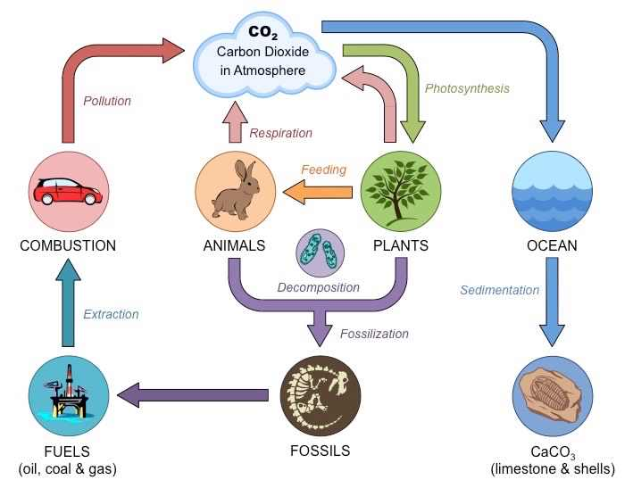
RETRIEVAL PRACTICE – NO NOTES ALLOWED!
Carbon compounds in dead organisms
Fossilisation
Carbon compounds in fossil fuels
E
E
Carbon compounds in producers
Carbon compounds in consumers
B
A
A
C
D
CO2 in the air and dissolved oceans
F
Notes:
ATE resource
A= Respiration
B = Feeding
C = Photosynthesis
D = Burning / combustion
E = Death
F = Decay / decomposition

Slide 38

Odd one out
RETRIEVAL PRACTICE – NO NOTES ALLOWED!
ENERGY RESOURCES: Circle the odd one out – then explain why! |  |  |  | Justify why.
1 | Coal | Oil | Uranium
2 | Fossil fuel | Solar panels | Nuclear energy
3 | Fossil fuel | Nuclear energy | Geothermal
4 | Geothermal | Fossil fuels | Wave
5 | Hydroelectric | Tidal | Wave
6 | Solar panel | Wind | Tides
Notes:
Also a think hard strategy.
ATE resource
There may be some variation in answers.

Slide 39
ENERGY RESOURCES: Circle the odd one out – then explain why! |  |  |  | Justify why.
1 | Coal | Oil | Uranium | Uranium is a nuclear fuel, the other two are fossil fuels.
2 | Fossil fuel | Solar panels | Nuclear energy | Solar panel is renewable source- the other two are not.
3 | Fossil fuel | Nuclear energy | Geothermal | Fossil fuel produces greenhouse gases (carbon dioxide.
4 | Geothermal | Fossil fuels | Wave | Geothermal and fossil fuels involve water turning into steam to turn a turbine.
5 | Hydroelectric | Tidal | Wave | Hydroelectric involves water changing from a gravitational potential store to a kinetic store to turn the turbine and generator.
6 | Solar panel | Wind | Tides | Tides are reliable – solar panels will not work in the dark and wind turbines will not work if its windy.

Slide 40

RETRIEVAL PRACTICE – NO NOTES ALLOWED!
How much do you remember?
Notes:
ATE resource

Slide 41

RETRIEVAL PRACTICE – NO NOTES ALLOWED!
Read the information and spot the errors! Write down the corrections in your books.

Slide 42
RETRIEVAL PRACTICE – NO NOTES ALLOWED!
Read the answer to the exam question. Can you spot any errors?
QUESTION
ANSWER

Slide 43

What am I?
RETRIEVAL PRACTICE – NO NOTES ALLOWED!
1
2
3
I am a low, sometimes even minus, number in most simple molecules.
I am a way of drawing covalent bonds to show the electrons.
I am the type of element that exists in covalent bonds
4
5
6
I am the reason why most simple molecules are gases or liquids.
I am the number of electrons on a full shell.
I am the word to say some elements exist in pairs of atoms.
7
8
9
I am what is shared in a covalent bond.
I am the reason simple molecules cannot conduct electricity.
I am different way of drawing covalent bonds, with straight lines.
Notes:
Adapted from Twinkl

Slide 44
What am I?
RETRIEVAL PRACTICE – NO NOTES ALLOWED!
1
2
3
Boiling point or melting point.
Dot and cross diagram.
non-metal
4
5
6
Weak intermolecular forces.
Eight, or in the first shell, only one.
diatomic
ANSWERS
7
8
9
electrons
No overall charge/no free ions.
displayed formula
Notes:
Adapted from Twinkl

Slide 45


Choose any two tasks!
NO NOTES ALLOWED!
RETRIEVAL
3. Give me three key facts about _________:
1. Guess the keywords
Definition 1:
Definition 2:
4. On the other hand: Two different opinions on the use of embryonic stem cells.
2. Find and fix the mistakes
Crystallisation separates an insoluble solid from a solvent.
Neutrons have a mass of 1 and a charge of +1
Sodium + chlorine → sodium chlorine
Notes:
Adapted from Matt Lynch
@Mathew_Lynch44
·

Slide 46
Choose any two tasks!
NO NOTES ALLOWED!
RETRIEVAL
3. Give me three:
1. Guess the keywords
Structures that are ONLY found in plant cells.
Ways energy can be conserved.
Properties of Group 1 metals.
Definition 1:
Definition 2:
4. On the other hand: Two different opinions on the use of embryonic stem cells.
2. Find and fix the mistakes
Crystallisation separates an insoluble solid from a solvent.
Neutrons have a mass of 1 and a charge of +1
Sodium + chlorine → sodium chlorine
Notes:
Adapted from Matt Lynch
@Mathew_Lynch44
·

Slide 47

RETRIEVAL PRACTICE – NO NOTES ALLOWED!
Answer the question, then RAG rate in terms of your confidence.
Topic: Energy |  | Answer | RAG | What is the actual answer?
1 | List 5 different energy stores.
2 | State the law of conservation of energy.
3 | Describe three ways thermal energy can be transferred.
4 | Solve: The energy supplied to a light bulb is 200 J. A total of 28 J of this is usefully transferred. How efficient is the light bulb?
5 | Construct a flow diagram to show how a fossil fuel power station works.
Notes:
ATE resource
Sheet can be printed for students.

Slide 48

RETRIEVAL PRACTICE – NO NOTES ALLOWED!
NAME: FIND IT, FIX IT C3 STRUCTURE AND BONDING | Particles in a gas move around at high speeds in one direction. The more frequency and energetic collisions are between the particles, the lower the pressure of the gas. | The hotter the liquid, the faster the molecules move around. More energy is transferred from the surroundings to the particles and they escape from the bottom of the liquid. | The group number gives the number of shells in an element. For elements in groups 1, 2 and 3 the charge on the ion is +1. For elements in group 6 and 7, the charge is equal to (8 minus 2)
Simple molecules have high boiling and melting points. The electrostatic forces between the molecules are weak. Overcoming these forces does not require much energy. | Each carbon in diamond is ionically bonded to 3 other carbon atoms. This is why it is an extremely hard substance and can be used in drill heads. | The delocalised electrons in graphite allow it to conduct electricity. The electrons move from the positive terminal of a battery to the negative terminal when put in a circuit. | Atoms react to achieve a stable arrangement of electrons (like atoms in Group 7) . They either share electrons (metallic bonding) or transfer electrons (ionic bonding between non-metals).
Ionic compounds have high melting points as lots of energy is needed to overcome the intermolecular forces acting in all directions. They will only conduct electricity when solid. | Metals are good conductors as the metal ions are able to move through the lattice. Metals are ductile because the irregular layers in the structure can slide over each other. | 1 nanometre is equal to 1 x 10⁻⁵ of a metre. Nanoscience is the science of small things. | Silver nanoparticles are used in industry to grow microorganisms. Equipment and substances coated in the nanoparticles release high level silver ions to grow bacteria.
Notes:
ATE resource
Sheet is printed out for students

Slide 49
NAME: FIND IT, FIX IT C3 STRUCTURE AND BONDING | Particles in a gas move around at high speeds in one direction. The more frequency and energetic collisions are between the particles, the lower the pressure of the gas. | The hotter the liquid, the faster the molecules move around. More energy is transferred from the surroundings to the particles and they escape from the bottom of the liquid. | The group number gives the number of shells in an element. For elements in groups 1, 2 and 3 the charge on the ion is +1. For elements in group 6 and 7, the charge is equal to (8 minus 2)
Simple molecules have high boiling and melting points. The electrostatic forces between the molecules are weak. Overcoming these forces does not require much energy. | Each carbon in diamond is ionically bonded to 3 other carbon atoms. This is why it is an extremely hard substance and can be used in drill heads. | The delocalised electrons in graphite allow it to conduct electricity. The electrons move from the positive terminal of a battery to the negative terminal when put in a circuit. | Atoms react to achieve a stable arrangement of electrons (like atoms in Group 7) . They either share electrons (metallic bonding) or transfer electrons (ionic bonding between non-metals).
Ionic compounds have high melting points as lots of energy is needed to overcome the intermolecular forces acting in all directions. They will only conduct electricity when solid. | Metals are good conductors as the metal ions are able to move through the lattice. Metals are ductile because the irregular layers in the structure can slide over each other. | 1 nanometre is equal to 1 x 10⁻⁵ of a metre. Nanoscience is the science of small things. | Silver nanoparticles are used in industry to grow microorganisms. Equipment and substances coated in the nanoparticles release high level silver ions to grow bacteria.

Slide 50
NAME: FIND IT, FIX IT C3 STRUCTURE AND BONDING | Particles in a gas move around at high speeds in all directions. The more frequency and energetic collisions are between the particles, the higher the pressure of the gas. | The hotter the liquid, the faster the particles move around. More energy is transferred from the surroundings to the particles and they escape from the surface of the liquid. | The group number gives the number of electrons in the outershell. For elements in groups 1, 2 and 3 the charge on the ion is the same as the group number. For elements in group 6 and 7, the charge is equal to (8 minus group number)
Simple molecules have low boiling and melting points. The intermolecular forces between the molecules are weak. Overcoming these forces does not require much energy. | Each carbon in diamond is covalently bonded to 4 other carbon atoms. This is why it is an extremely hard substance and can be used in drill heads. | The delocalised electrons in graphite allow it to conduct electricity. The electrons move from the negative terminal of a battery to the positve terminal when put in a circuit. | Atoms react to achieve a stable arrangement of electrons (like atoms in Group 0) . They either share electrons (covalent bonding) or transfer electrons (ionic bonding between non-metal and metal).
Ionic compounds have high melting points as lots of energy is needed to overcome the electrostatic forces of attraction acting in all directions. They will only conduct electricity when molten or dissolved. | Metals are good conductors as the delocalised electrons are able to move through the lattice. Metals are ductile because the regular layers in the structure can slide over each other. | 1 nanometre is equal to 1 x 10⁻⁹ of a metre. Nanoscience is the science of very tiny things. | Silver nanoparticles are used in industry to inhibit growth of microorganisms. Equipment and substances coated in the nanoparticles release low level silver ions to protect against bacteria.

Slide 51

Roll the dice (or pick two numbers between 1-6). Write 5 facts you know about that image.
RETRIEVAL PRACTICE – NO NOTES ALLOWED!
1 | 2 | 3 | 4 | 5 | 6
2
3
4
5
6
Notes:
Do not know source.
Images can relate to a single topic or a mixture of topics/
Roll 2 dice, find and look at the picture on the grid.
Roll 2 dice, and find the picture. Roll the dice again to get another picture. Can you explain how they are linked?

Slide 52
Roll the dice (or pick two numbers between 1-6). Write 5 facts you know about that keyword.
RETRIEVAL PRACTICE – NO NOTES ALLOWED!
1 | 2 | 3 | 4 | 5 | 6
2
3
4
5
6
Notes:
Do not know source.
Images can relate to a single topic or a mixture of topics/
Roll 2 dice, find and look at the picture on the grid.
Roll 2 dice, and find the picture. Roll the dice again to get another picture. Can you explain how they are linked?

Slide 53

LEARN &
RETRIEVAL PRACTICE
Take the sheet home and learn the information, you will be tested on your recall soon!
Date | Scientist | Discovery
1803 | John Dalton | Matter was made of particles called atoms
1903 | JJ Thomson | Discovered the electron and suggested the plum pudding model as a model for the structure of the atom
1909 | Ernest Rutherford | Tested the plum pudding model and found it was incorrect. He used alpha particles and suggested the new model for the atom called the nuclear model
1912 | Niels Bohr | Found that electrons orbit the nucleus in shells. He also found that protons are in the centre of the nucleus
1932 | James Chadwick | Found out about neutrons
Notes:
Do not know source.
Give the students information to revise - lesson 1
Students recall information in a later lesson for them to fill in the gaps

Slide 54
Can you fill in the gaps?
LEARN &
RETRIEVAL PRACTICE – NO NOTES ALLOWED!
Date | Scientist | Discovery
1803 | John Dalton
1903 | JJ Thomson
1909 | Ernest Rutherford
1912 | Niels Bohr
1932 | James Chadwick
Notes:
Do not know source.
Give the students information to revise - lesson 1
Students recall information in a later lesson for them to fill in the gaps
This can de done by dual coding too! (Draw pictures as well as write down what these scientists discovered)

Slide 55

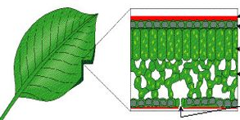
SPILL!
RETRIEVAL PRACTICE – NO NOTES ALLOWED!
Last year/ week/ month we looked at this…
Stick the picture in your book. Draw a mind map around it with everything you know about this picture!

Slide 56

ELABORATION
RETRIEVAL PRACTICE – NO NOTES ALLOWED!
Explain how the central ideas are similar and how they are different. You may draw diagrams if you wish.
Differences
Similarities
Differences
Central idea 1
Central idea 2
Notes:
https://www.researched.org.uk/wp-content/uploads/2016/11/rEDDC_YanaWeinstein-LearningScis2.pdf
Give the students two ideas and ask them to explain how they are similar and how they are different

Slide 57
ELABORATION
RETRIEVAL PRACTICE – NO NOTES ALLOWED!
Explain how the central ideas are similar and how they are different. You may draw diagrams if you wish.
Differences
Similarities
Differences
Covalent bonding
Ionic bonding
Notes:
https://www.researched.org.uk/wp-content/uploads/2016/11/rEDDC_YanaWeinstein-LearningScis2.pdf
Give the students two ideas and ask them to explain how they are similar and how they are different

Slide 58
ELABORATION
RETRIEVAL PRACTICE – NO NOTES ALLOWED!
Explain how the central ideas are similar and how they are different. You may draw diagrams if you wish.
Differences
Similarities
Differences
Aerobic respiration
Anaerobic respiration
Notes:
https://www.researched.org.uk/wp-content/uploads/2016/11/rEDDC_YanaWeinstein-LearningScis2.pdf
Give the students two ideas and ask them to explain how they are similar and how they are different

Slide 59
ELABORATION
RETRIEVAL PRACTICE – NO NOTES ALLOWED!
Explain how the central ideas are similar and how they are different. You may draw diagrams if you wish.
Differences
Similarities
Differences
Mitosis
Meiosis
Notes:
https://www.researched.org.uk/wp-content/uploads/2016/11/rEDDC_YanaWeinstein-LearningScis2.pdf
Give the students two ideas and ask them to explain how they are similar and how they are different

Slide 60
ELABORATION
RETRIEVAL PRACTICE – NO NOTES ALLOWED!
Explain how the central ideas are similar and how they are different. You may draw diagrams if you wish.
Differences
Similarities
Differences
Solar power
Fossil fuels
Notes:
https://www.researched.org.uk/wp-content/uploads/2016/11/rEDDC_YanaWeinstein-LearningScis2.pdf
Give the students two ideas and ask them to explain how they are similar and how they are different

Slide 61
ELABORATION
RETRIEVAL PRACTICE – NO NOTES ALLOWED!
Explain how the central ideas are similar and how they are different. You may draw diagrams if you wish.
Differences
Similarities
Differences
Solar power
Fossil fuels
Notes:
https://www.researched.org.uk/wp-content/uploads/2016/11/rEDDC_YanaWeinstein-LearningScis2.pdf
Give the students two ideas and ask them to explain how they are similar and how they are different

