Slide 1

THANK YOU
Dear teacher, thank you for choosing this resource from The Teaching Toolbox. I really hope it can help to support you in making your lessons more engaging, effective and fun as well as providing some relief from the work-related pressure!
TERMS OF USE
This product is a digital download from my TES store and can only be used for the personal use of the teacher, his or her classroom and students. Please, respect the time and energy I have invested in preparing my products. ALL my resources are FREE so please encourage colleagues or friends to download for themselves from my store to support me in being able to continue producing FREE resources!

Slide 2
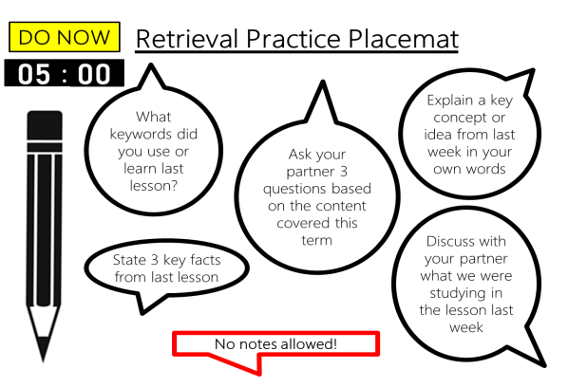
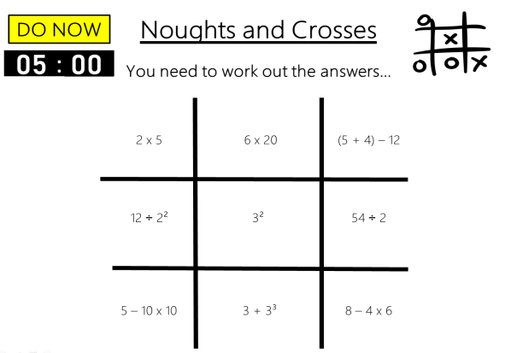
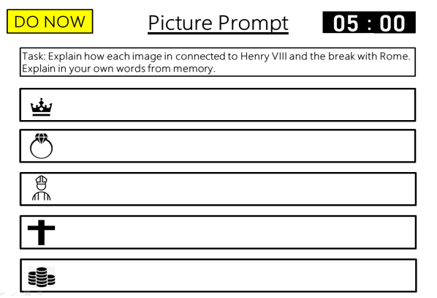
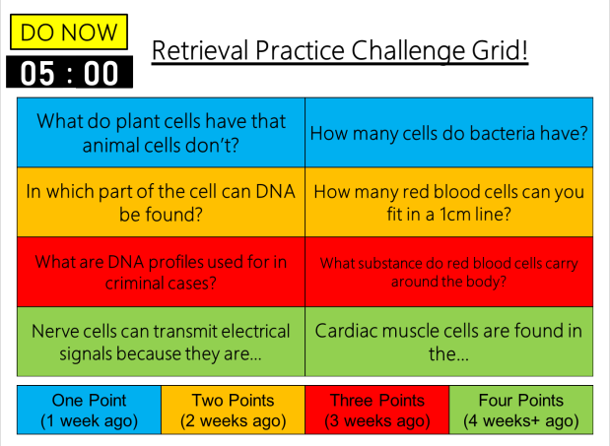
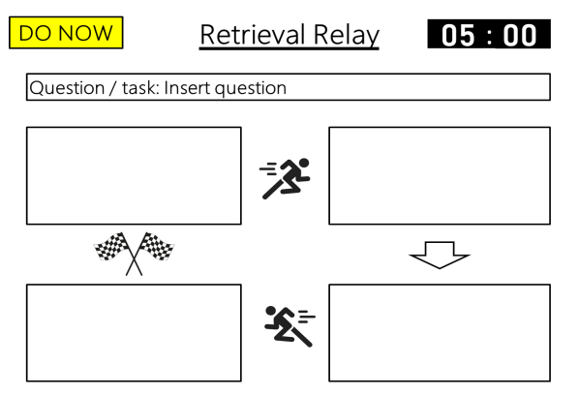
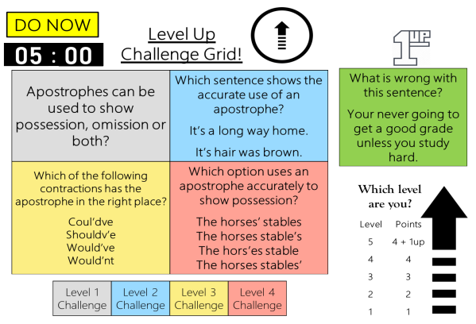
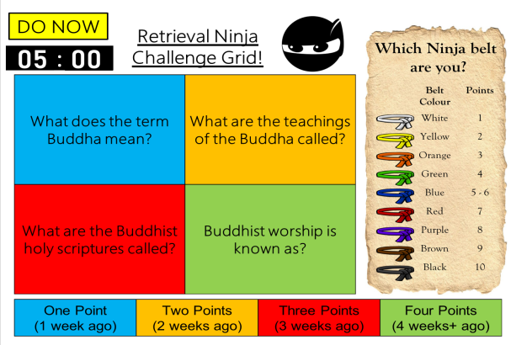
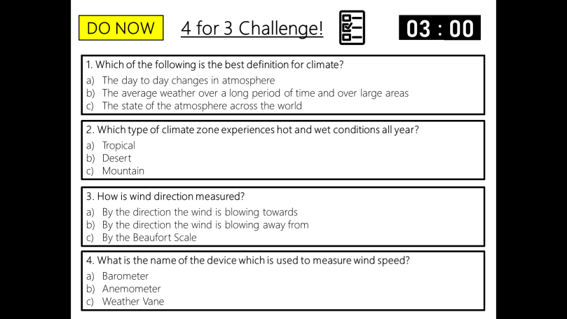
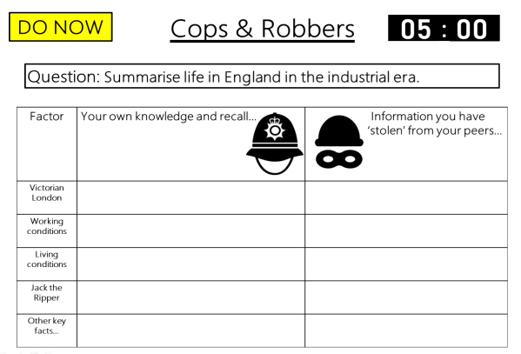
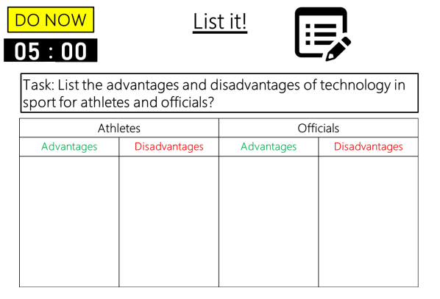

DO NOW
Retrieval Practice
Retrieval Relay
Editable template slides, Exemplar slides & Timers – all ready to go!

Slide 3


Example
DO NOW
Retrieval Relay
00
01
02
03
04
05
:
00
01
02
03
04
05
06
07
08
09
10
11
12
13
14
15
16
17
18
19
20
21
22
23
24
25
26
27
28
29
30
31
32
33
34
35
36
37
38
39
40
41
42
43
44
45
46
47
48
49
50
51
52
53
54
55
56
57
58
59
00
01
02
03
04
05
06
07
08
09
10
11
12
13
14
15
16
17
18
19
20
21
22
23
24
25
26
27
28
29
30
31
32
33
34
35
36
37
38
39
40
41
42
43
44
45
46
47
48
49
50
51
52
53
54
55
56
57
58
59
00
01
02
03
04
05
06
07
08
09
10
11
12
13
14
15
16
17
18
19
20
21
22
23
24
25
26
27
28
29
30
31
32
33
34
35
36
37
38
39
40
41
42
43
44
45
46
47
48
49
50
51
52
53
54
55
56
57
58
59
00
01
02
03
04
05
06
07
08
09
10
11
12
13
14
15
16
17
18
19
20
21
22
23
24
25
26
27
28
29
30
31
32
33
34
35
36
37
38
39
40
41
42
43
44
45
46
47
48
49
50
51
52
53
54
55
56
57
58
59
00
01
02
03
04
05
06
07
08
09
10
11
12
13
14
15
16
17
18
19
20
21
22
23
24
25
26
27
28
29
30
31
32
33
34
35
36
37
38
39
40
41
42
43
44
45
46
47
48
49
50
51
52
53
54
55
56
57
58
59
00
Question / task: Insert question
Notes:
Retrieval relay race: Fill in the first box with as much information as you can about the topic. Then you must ask someone else to complete the second box – remember they cannot repeat information already in the first box! Do the same for boxes 3 and four.
For each retrieval relay race there will be a key topic, event, individual or idea.
Four boxes represent each member of the relay team.
Once they complete their first box they will need to find 3 other members of the class to fill in the rest of the boxes – retrieving information.
They cannot repeat any material in the boxes or they will be disqualified, so the task requires to read the filled in box/boxes in order to retrieve different information.
Once the second box has been has been filled in with different information , the third box will be filled in by another student. Whilst students are filling in their relay box they can be doing the same for another student (so no one is waiting around with nothing to do). As no information can be repeated that is in any other box, therefore, becomes more challenging.

Slide 4
Example
DO NOW
Retrieval Relay
Answers
Question / task: Insert question
Possible answers: Insert answers

Slide 5
Template
DO NOW
Retrieval Relay
00
01
02
03
04
05
:
00
01
02
03
04
05
06
07
08
09
10
11
12
13
14
15
16
17
18
19
20
21
22
23
24
25
26
27
28
29
30
31
32
33
34
35
36
37
38
39
40
41
42
43
44
45
46
47
48
49
50
51
52
53
54
55
56
57
58
59
00
01
02
03
04
05
06
07
08
09
10
11
12
13
14
15
16
17
18
19
20
21
22
23
24
25
26
27
28
29
30
31
32
33
34
35
36
37
38
39
40
41
42
43
44
45
46
47
48
49
50
51
52
53
54
55
56
57
58
59
00
01
02
03
04
05
06
07
08
09
10
11
12
13
14
15
16
17
18
19
20
21
22
23
24
25
26
27
28
29
30
31
32
33
34
35
36
37
38
39
40
41
42
43
44
45
46
47
48
49
50
51
52
53
54
55
56
57
58
59
00
01
02
03
04
05
06
07
08
09
10
11
12
13
14
15
16
17
18
19
20
21
22
23
24
25
26
27
28
29
30
31
32
33
34
35
36
37
38
39
40
41
42
43
44
45
46
47
48
49
50
51
52
53
54
55
56
57
58
59
00
01
02
03
04
05
06
07
08
09
10
11
12
13
14
15
16
17
18
19
20
21
22
23
24
25
26
27
28
29
30
31
32
33
34
35
36
37
38
39
40
41
42
43
44
45
46
47
48
49
50
51
52
53
54
55
56
57
58
59
00
Question / task: Insert question
Notes:
Editable question slide template.
Editable answer slide template.
Set your own tasks.
Set your own time limit.

Slide 6
Template
DO NOW
Retrieval Relay
Answers
Question / task: Insert question
Possible answers: Insert answers

