Slide 1

THANK YOU
Dear teacher, thank you for choosing this resource from The Teaching Toolbox. I really hope it can help to support you in making your lessons more engaging, effective and fun as well as providing some relief from the work-related pressure!
TERMS OF USE
This product is a digital download from my TES store and can only be used for the personal use of the teacher, his or her classroom and students. Please, respect the time and energy I have invested in preparing my products. ALL my resources are FREE so please encourage colleagues or friends to download for themselves from my store to support me in being able to continue producing FREE resources!

Slide 2
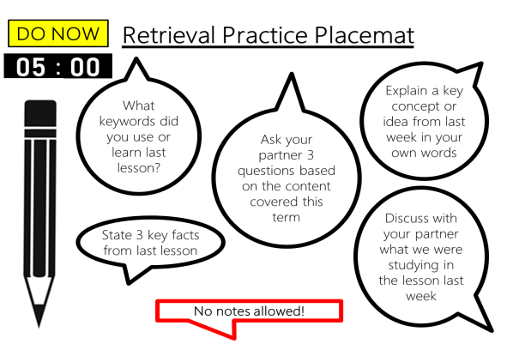
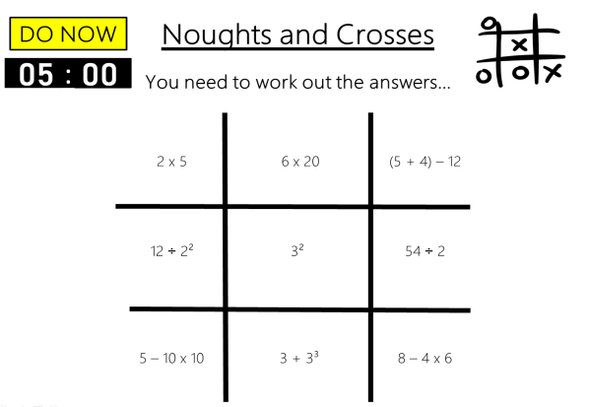
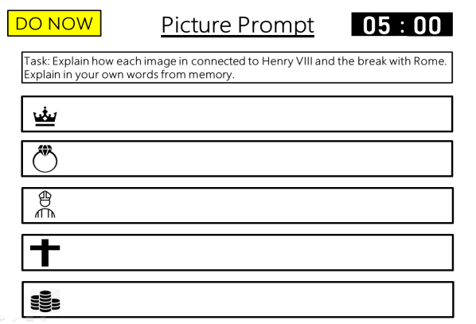
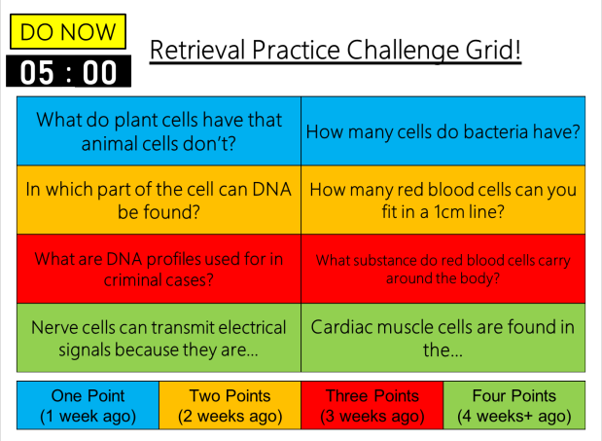
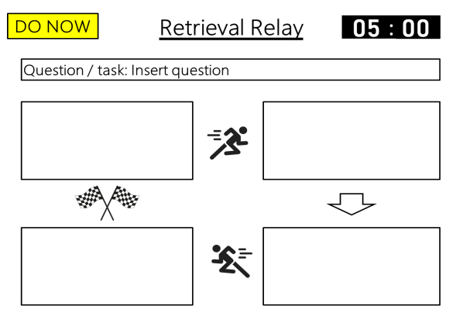
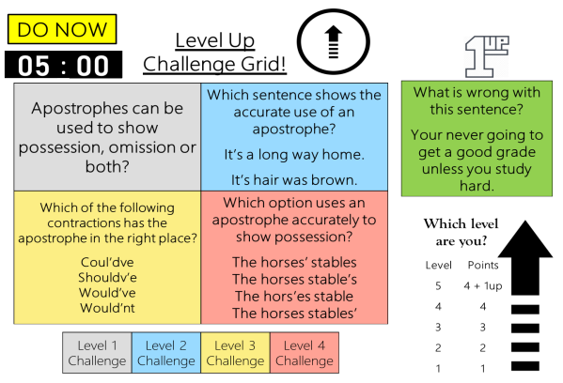
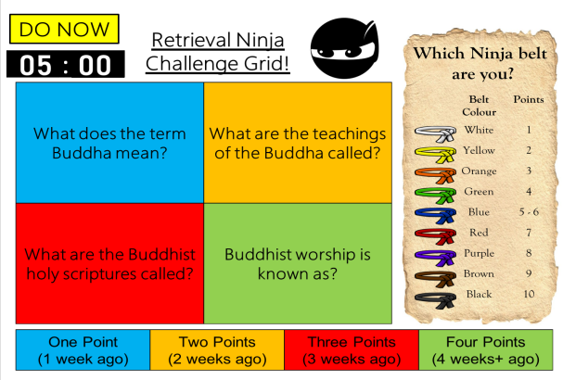
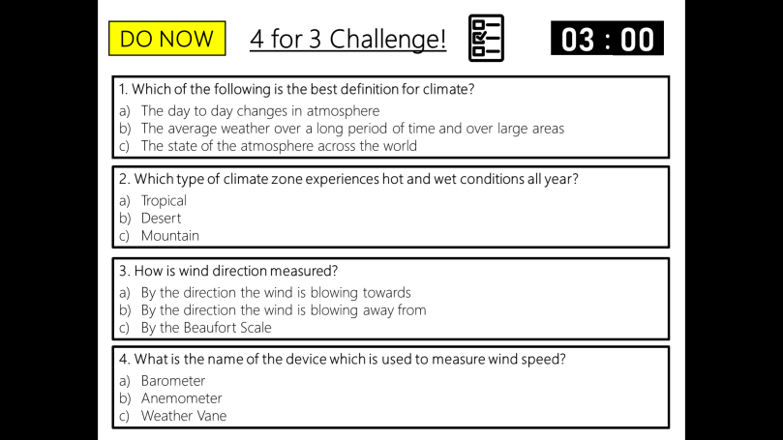
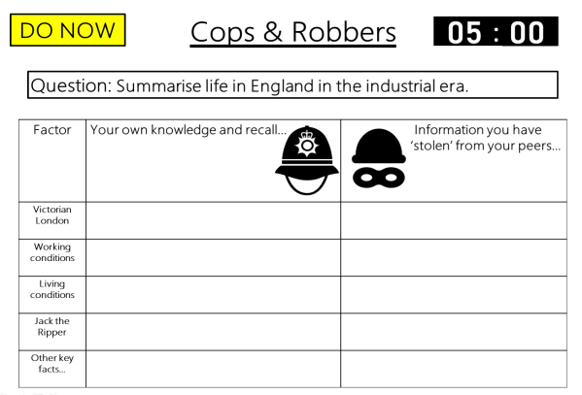
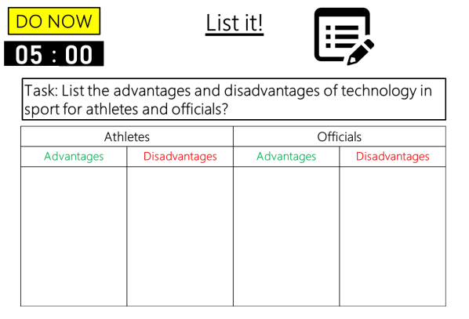

DO NOW
Retrieval Practice
Placemat
Editable template slides, Exemplar slides & Timers – all ready to go!

Slide 3

Example
DO NOW
Retrieval Practice Placemat
00
01
02
03
04
05
:
00
01
02
03
04
05
06
07
08
09
10
11
12
13
14
15
16
17
18
19
20
21
22
23
24
25
26
27
28
29
30
31
32
33
34
35
36
37
38
39
40
41
42
43
44
45
46
47
48
49
50
51
52
53
54
55
56
57
58
59
00
01
02
03
04
05
06
07
08
09
10
11
12
13
14
15
16
17
18
19
20
21
22
23
24
25
26
27
28
29
30
31
32
33
34
35
36
37
38
39
40
41
42
43
44
45
46
47
48
49
50
51
52
53
54
55
56
57
58
59
00
01
02
03
04
05
06
07
08
09
10
11
12
13
14
15
16
17
18
19
20
21
22
23
24
25
26
27
28
29
30
31
32
33
34
35
36
37
38
39
40
41
42
43
44
45
46
47
48
49
50
51
52
53
54
55
56
57
58
59
00
01
02
03
04
05
06
07
08
09
10
11
12
13
14
15
16
17
18
19
20
21
22
23
24
25
26
27
28
29
30
31
32
33
34
35
36
37
38
39
40
41
42
43
44
45
46
47
48
49
50
51
52
53
54
55
56
57
58
59
00
01
02
03
04
05
06
07
08
09
10
11
12
13
14
15
16
17
18
19
20
21
22
23
24
25
26
27
28
29
30
31
32
33
34
35
36
37
38
39
40
41
42
43
44
45
46
47
48
49
50
51
52
53
54
55
56
57
58
59
00
Explain a key concept or idea from last week in your own words
What keywords did you use or learn last lesson?
Ask your partner 3 questions based on the content covered this term
Discuss with your partner what we were studying in the lesson last week
State 3 key facts from last lesson
No notes allowed!
Notes:
All the tasks are quite generalised—They can be applied across a multitude of subjects and ability levels.
The laissez-faire nature of tasks—Notice how there’s very little subject specific ‘help’ from the question to assist the learner, forcing the student to recall all of the information. We don’t want the question doing the cognitive work for the students. Provide the framework for answering the question, but allow the student to do all the domain-specific work. Learning should be effortful.
The potential for quality study habits to be formed—If students can keep these general questioning prompts in their mind, they can always be used for study/practice, no matter the subject. This questioning is much better for providing feedback to the students and for retention of material than simply re-reading or highlighting their notes.

Slide 4
Template
DO NOW
Retrieval Practice Placemat
00
01
02
03
04
05
:
00
01
02
03
04
05
06
07
08
09
10
11
12
13
14
15
16
17
18
19
20
21
22
23
24
25
26
27
28
29
30
31
32
33
34
35
36
37
38
39
40
41
42
43
44
45
46
47
48
49
50
51
52
53
54
55
56
57
58
59
00
01
02
03
04
05
06
07
08
09
10
11
12
13
14
15
16
17
18
19
20
21
22
23
24
25
26
27
28
29
30
31
32
33
34
35
36
37
38
39
40
41
42
43
44
45
46
47
48
49
50
51
52
53
54
55
56
57
58
59
00
01
02
03
04
05
06
07
08
09
10
11
12
13
14
15
16
17
18
19
20
21
22
23
24
25
26
27
28
29
30
31
32
33
34
35
36
37
38
39
40
41
42
43
44
45
46
47
48
49
50
51
52
53
54
55
56
57
58
59
00
01
02
03
04
05
06
07
08
09
10
11
12
13
14
15
16
17
18
19
20
21
22
23
24
25
26
27
28
29
30
31
32
33
34
35
36
37
38
39
40
41
42
43
44
45
46
47
48
49
50
51
52
53
54
55
56
57
58
59
00
01
02
03
04
05
06
07
08
09
10
11
12
13
14
15
16
17
18
19
20
21
22
23
24
25
26
27
28
29
30
31
32
33
34
35
36
37
38
39
40
41
42
43
44
45
46
47
48
49
50
51
52
53
54
55
56
57
58
59
00
Insert task / question
Insert task / question
Insert task / question
Insert task / question
Insert task / question
No notes allowed!
Notes:
Editable template.
Set your own tasks.
Set your own time limit.

