Slide 1

THANK YOU
Dear teacher, thank you for choosing this resource from The Teaching Toolbox. I really hope it can help to support you in making your lessons more engaging, effective and fun as well as providing some relief from the work-related pressure!
TERMS OF USE
This product is a digital download from my TES store and can only be used for the personal use of the teacher, his or her classroom and students. Please, respect the time and energy I have invested in preparing my products. ALL my resources are FREE so please encourage colleagues or friends to download for themselves from my store to support me in being able to continue producing FREE resources!

Slide 2
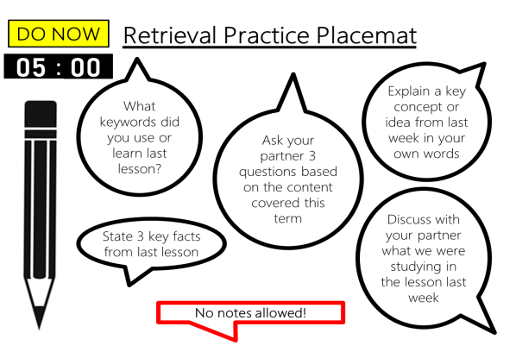
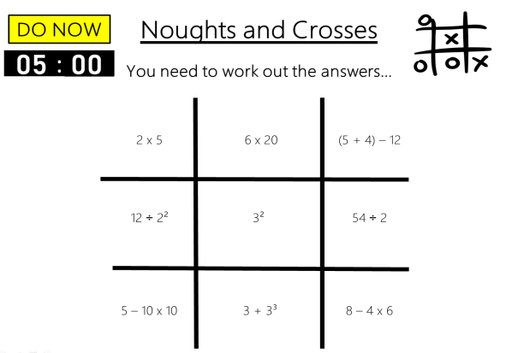
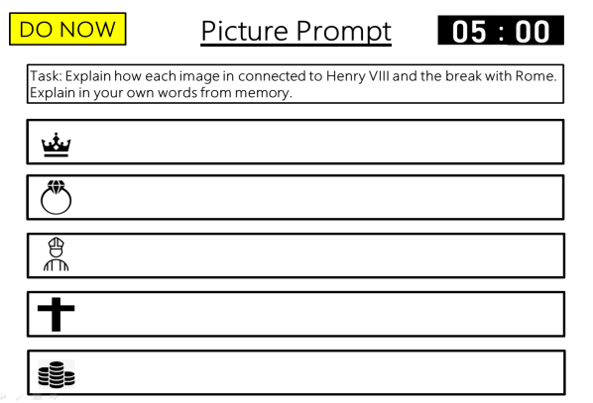
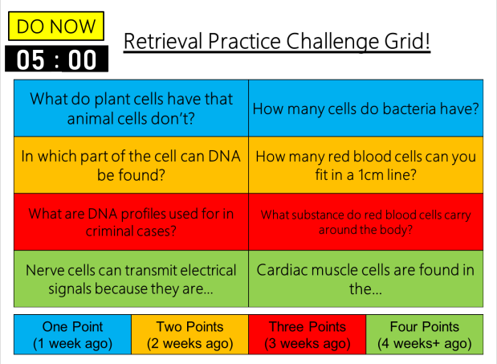
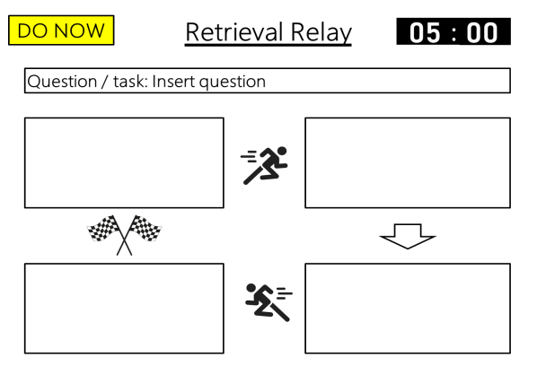
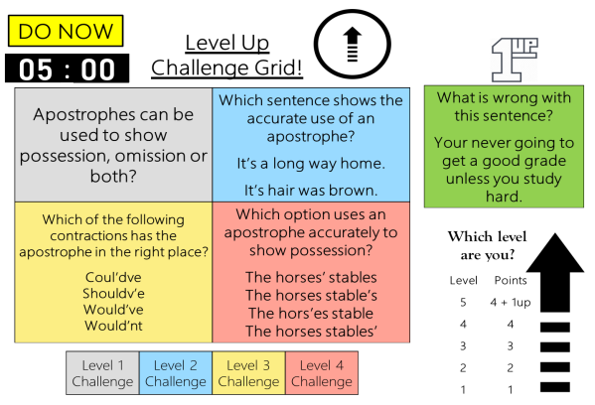
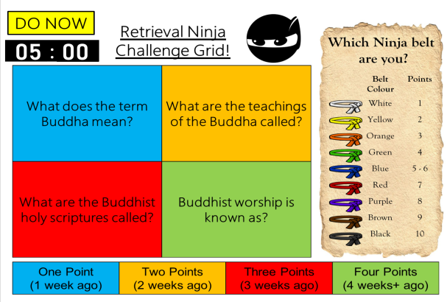
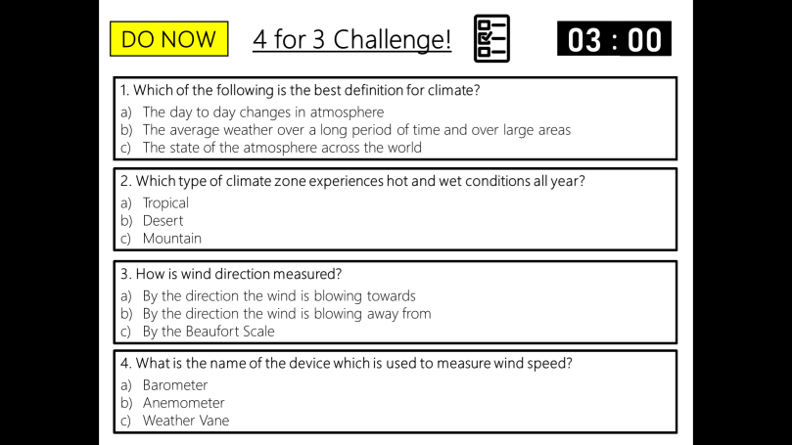
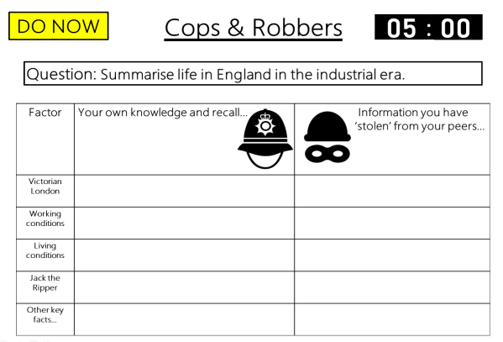
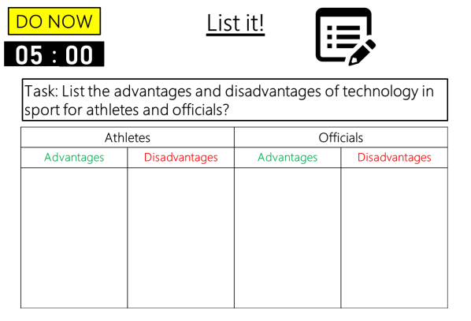

DO NOW
Retrieval Practice
Picture Prompt
Editable template slides, Exemplar slides & Timers – all ready to go!

Slide 3
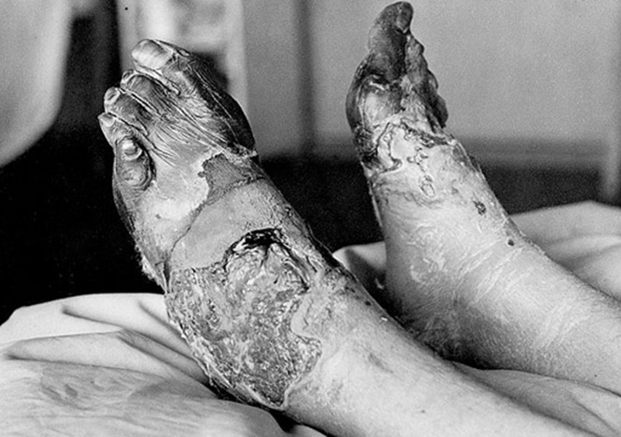
Example
DO NOW
Picture Prompt
00
01
02
03
04
05
:
00
01
02
03
04
05
06
07
08
09
10
11
12
13
14
15
16
17
18
19
20
21
22
23
24
25
26
27
28
29
30
31
32
33
34
35
36
37
38
39
40
41
42
43
44
45
46
47
48
49
50
51
52
53
54
55
56
57
58
59
00
01
02
03
04
05
06
07
08
09
10
11
12
13
14
15
16
17
18
19
20
21
22
23
24
25
26
27
28
29
30
31
32
33
34
35
36
37
38
39
40
41
42
43
44
45
46
47
48
49
50
51
52
53
54
55
56
57
58
59
00
01
02
03
04
05
06
07
08
09
10
11
12
13
14
15
16
17
18
19
20
21
22
23
24
25
26
27
28
29
30
31
32
33
34
35
36
37
38
39
40
41
42
43
44
45
46
47
48
49
50
51
52
53
54
55
56
57
58
59
00
01
02
03
04
05
06
07
08
09
10
11
12
13
14
15
16
17
18
19
20
21
22
23
24
25
26
27
28
29
30
31
32
33
34
35
36
37
38
39
40
41
42
43
44
45
46
47
48
49
50
51
52
53
54
55
56
57
58
59
00
01
02
03
04
05
06
07
08
09
10
11
12
13
14
15
16
17
18
19
20
21
22
23
24
25
26
27
28
29
30
31
32
33
34
35
36
37
38
39
40
41
42
43
44
45
46
47
48
49
50
51
52
53
54
55
56
57
58
59
00
Task: The image shows a soldier from WW1 with trench foot. Explain why the disease was common, the side effects and how it was treated.
Notes:
Starting a lesson with a photo, for example of a World War 1 soldier with trench foot (a common disease and problem that occurred as a result of cold, wet and damp living conditions in the trenches) then students through writing – retrieve what they know about trench foot. This could include why the disease was common, the side effects, how it was treated and so on. This information won’t be provided from the image, it comes from their subject knowledge and from prior learning. However, if students were simply to describe the condition of trench foot with swelling and its visual appearance then this is simply providing a description. A good way to ensure retrieval and not description takes place is through explicit modelling of an example to the class to make the difference clear.

Slide 4
Example
DO NOW
Picture Prompt
Answers
Task: The image shows a soldier from WW1 with trench foot. Explain why the disease was common, the side effects and how it was treated.
Why was it common | Side effects | How it was treated | Any other explanations
In the trenches men stood for hours on end in waterlogged trenches without being able to remove wet socks or boots. | Tingling and itching sensation Burning sensation Loss of feeling Pain Swelling Cold and blotchy skin Numbness Foot can appear cyanotic (grey) Prickly or heavy feeling Red as well as painful after warming | The only remedy for trench foot was for the soldiers to dry their feet and change their socks several times a day. By the end of 1915 British soldiers in the trenches had to have three pairs of socks with them and were under orders to change their socks at least twice a day. As well as drying their feet, soldiers were told to cover their feet with a grease made from whale-oil.

Slide 5





Example
DO NOW
Picture Prompt
00
01
02
03
04
05
:
00
01
02
03
04
05
06
07
08
09
10
11
12
13
14
15
16
17
18
19
20
21
22
23
24
25
26
27
28
29
30
31
32
33
34
35
36
37
38
39
40
41
42
43
44
45
46
47
48
49
50
51
52
53
54
55
56
57
58
59
00
01
02
03
04
05
06
07
08
09
10
11
12
13
14
15
16
17
18
19
20
21
22
23
24
25
26
27
28
29
30
31
32
33
34
35
36
37
38
39
40
41
42
43
44
45
46
47
48
49
50
51
52
53
54
55
56
57
58
59
00
01
02
03
04
05
06
07
08
09
10
11
12
13
14
15
16
17
18
19
20
21
22
23
24
25
26
27
28
29
30
31
32
33
34
35
36
37
38
39
40
41
42
43
44
45
46
47
48
49
50
51
52
53
54
55
56
57
58
59
00
01
02
03
04
05
06
07
08
09
10
11
12
13
14
15
16
17
18
19
20
21
22
23
24
25
26
27
28
29
30
31
32
33
34
35
36
37
38
39
40
41
42
43
44
45
46
47
48
49
50
51
52
53
54
55
56
57
58
59
00
01
02
03
04
05
06
07
08
09
10
11
12
13
14
15
16
17
18
19
20
21
22
23
24
25
26
27
28
29
30
31
32
33
34
35
36
37
38
39
40
41
42
43
44
45
46
47
48
49
50
51
52
53
54
55
56
57
58
59
00
Task: Explain how each image in connected to Henry VIII and the break with Rome. Explain in your own words from memory.

Slide 6
Example
DO NOW
Picture Prompt
Answers
Task: Explain how each image in connected to Henry VIII and the break with Rome. Explain in your own words from memory.
Henry became king in 1509.
Henry married Catherine of Aragon from Spain. Catherine gave birth to Mary but could not give birth to a son so Henry divorced her. But divorce wasn’t so easy.
Henry fell out with the pope because the pope wouldn’t let him divorce his wife.
Henry created the Church of England. Made himself the head of the church so that he could have his divorce.
Becoming the head of the Church of England made Henry VIII a lot of money and even more powerful than before. In 1536 Henry used his new power to begin to close down the monasteries and take their land and money.

Slide 7
Template
DO NOW
Picture Prompt
00
01
02
03
04
05
:
00
01
02
03
04
05
06
07
08
09
10
11
12
13
14
15
16
17
18
19
20
21
22
23
24
25
26
27
28
29
30
31
32
33
34
35
36
37
38
39
40
41
42
43
44
45
46
47
48
49
50
51
52
53
54
55
56
57
58
59
00
01
02
03
04
05
06
07
08
09
10
11
12
13
14
15
16
17
18
19
20
21
22
23
24
25
26
27
28
29
30
31
32
33
34
35
36
37
38
39
40
41
42
43
44
45
46
47
48
49
50
51
52
53
54
55
56
57
58
59
00
01
02
03
04
05
06
07
08
09
10
11
12
13
14
15
16
17
18
19
20
21
22
23
24
25
26
27
28
29
30
31
32
33
34
35
36
37
38
39
40
41
42
43
44
45
46
47
48
49
50
51
52
53
54
55
56
57
58
59
00
01
02
03
04
05
06
07
08
09
10
11
12
13
14
15
16
17
18
19
20
21
22
23
24
25
26
27
28
29
30
31
32
33
34
35
36
37
38
39
40
41
42
43
44
45
46
47
48
49
50
51
52
53
54
55
56
57
58
59
00
01
02
03
04
05
06
07
08
09
10
11
12
13
14
15
16
17
18
19
20
21
22
23
24
25
26
27
28
29
30
31
32
33
34
35
36
37
38
39
40
41
42
43
44
45
46
47
48
49
50
51
52
53
54
55
56
57
58
59
00
Task: Insert task/question.
Insert picture
Notes:
Editable question slide template.
Editable answer slide template.
Set your own time limit.
Create or edit your own structure or format.

Slide 8
Template
DO NOW
Picture Prompt
Answers
Task: The image shows a soldier from WW1 with trench foot. Explain why the disease was common, the side effects and how it was treated.
Insert answers

Slide 9
Template
DO NOW
Picture Prompt
00
01
02
03
04
05
:
00
01
02
03
04
05
06
07
08
09
10
11
12
13
14
15
16
17
18
19
20
21
22
23
24
25
26
27
28
29
30
31
32
33
34
35
36
37
38
39
40
41
42
43
44
45
46
47
48
49
50
51
52
53
54
55
56
57
58
59
00
01
02
03
04
05
06
07
08
09
10
11
12
13
14
15
16
17
18
19
20
21
22
23
24
25
26
27
28
29
30
31
32
33
34
35
36
37
38
39
40
41
42
43
44
45
46
47
48
49
50
51
52
53
54
55
56
57
58
59
00
01
02
03
04
05
06
07
08
09
10
11
12
13
14
15
16
17
18
19
20
21
22
23
24
25
26
27
28
29
30
31
32
33
34
35
36
37
38
39
40
41
42
43
44
45
46
47
48
49
50
51
52
53
54
55
56
57
58
59
00
01
02
03
04
05
06
07
08
09
10
11
12
13
14
15
16
17
18
19
20
21
22
23
24
25
26
27
28
29
30
31
32
33
34
35
36
37
38
39
40
41
42
43
44
45
46
47
48
49
50
51
52
53
54
55
56
57
58
59
00
01
02
03
04
05
06
07
08
09
10
11
12
13
14
15
16
17
18
19
20
21
22
23
24
25
26
27
28
29
30
31
32
33
34
35
36
37
38
39
40
41
42
43
44
45
46
47
48
49
50
51
52
53
54
55
56
57
58
59
00
Task: Insert question
Insert
image
Insert
image
Insert
image
Insert
image
Insert
image
Notes:
Editable question slide template.
Editable answer slide template.
Set your own time limit.
Create or edit your own structure or format.

Slide 10
Template
DO NOW
Picture Prompt
Answers
Task: Insert question
Insert answer
Insert
image
Insert answer
Insert
image
Insert answer
Insert
image
Insert answer
Insert
image
Insert answer
Insert
image

