Slide 1

THANK YOU
Dear teacher, thank you for choosing this resource from The Teaching Toolbox. I really hope it can help to support you in making your lessons more engaging, effective and fun as well as providing some relief from the work-related pressure!
TERMS OF USE
This product is a digital download from my TES store and can only be used for the personal use of the teacher, his or her classroom and students. Please, respect the time and energy I have invested in preparing my products. ALL my resources are FREE so please encourage colleagues or friends to download for themselves from my store to support me in being able to continue producing FREE resources!

Slide 2
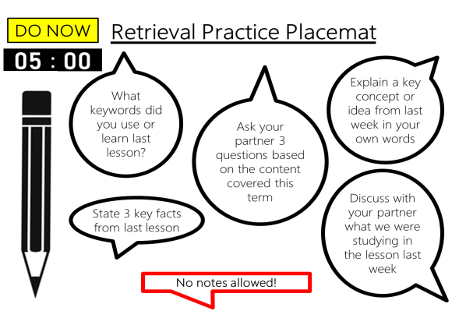
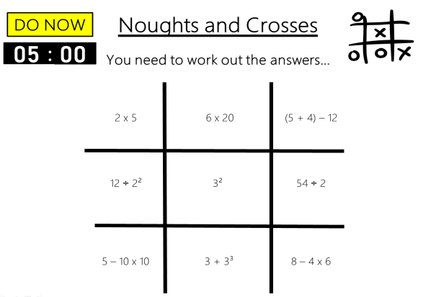
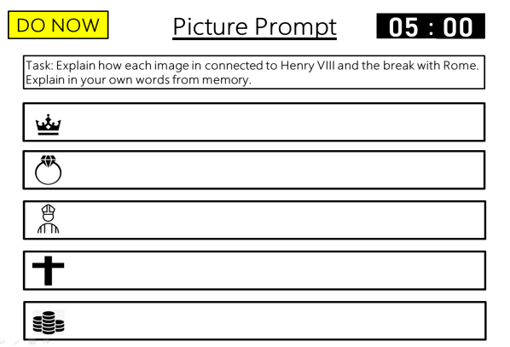
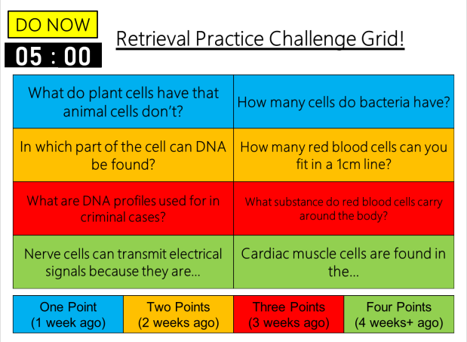
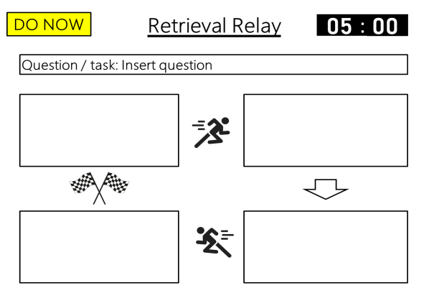
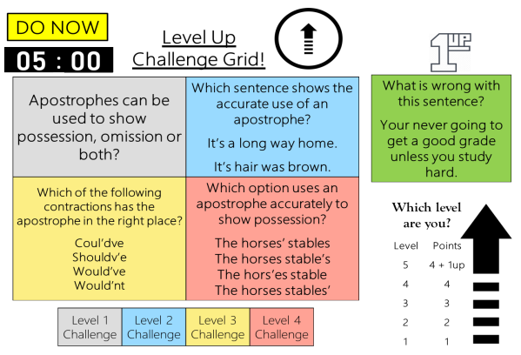
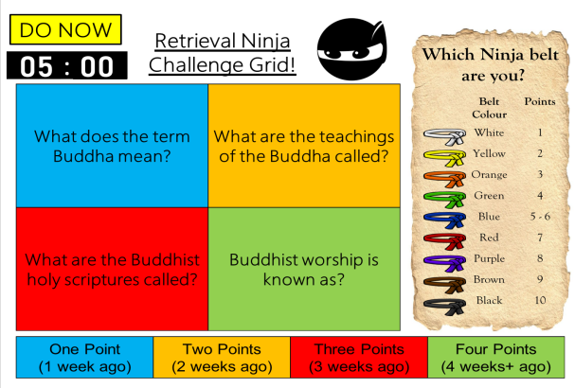
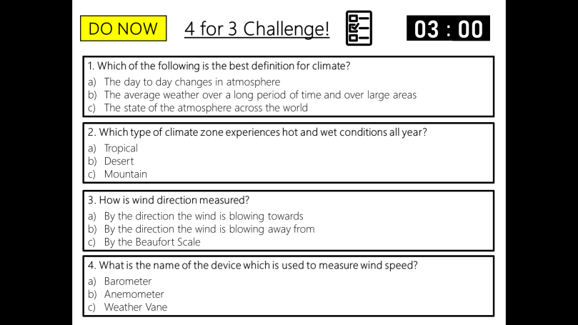
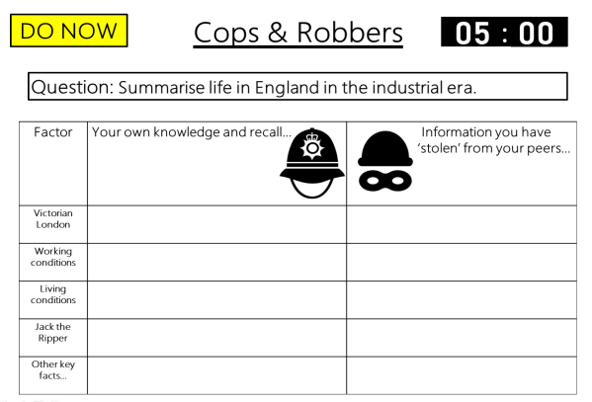
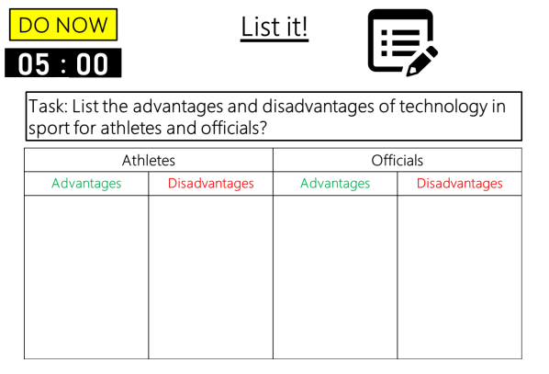

DO NOW
Retrieval Practice
Noughts & Crosses
Editable template slides, Exemplar slides & Timers – all ready to go!

Slide 3
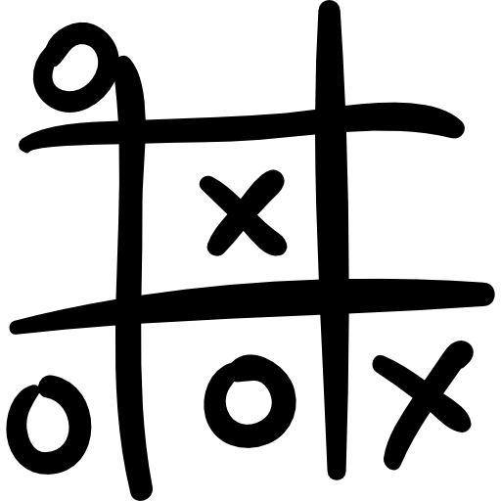
Example
DO NOW
Noughts and Crosses
00
01
02
03
04
05
:
00
01
02
03
04
05
06
07
08
09
10
11
12
13
14
15
16
17
18
19
20
21
22
23
24
25
26
27
28
29
30
31
32
33
34
35
36
37
38
39
40
41
42
43
44
45
46
47
48
49
50
51
52
53
54
55
56
57
58
59
00
01
02
03
04
05
06
07
08
09
10
11
12
13
14
15
16
17
18
19
20
21
22
23
24
25
26
27
28
29
30
31
32
33
34
35
36
37
38
39
40
41
42
43
44
45
46
47
48
49
50
51
52
53
54
55
56
57
58
59
00
01
02
03
04
05
06
07
08
09
10
11
12
13
14
15
16
17
18
19
20
21
22
23
24
25
26
27
28
29
30
31
32
33
34
35
36
37
38
39
40
41
42
43
44
45
46
47
48
49
50
51
52
53
54
55
56
57
58
59
00
01
02
03
04
05
06
07
08
09
10
11
12
13
14
15
16
17
18
19
20
21
22
23
24
25
26
27
28
29
30
31
32
33
34
35
36
37
38
39
40
41
42
43
44
45
46
47
48
49
50
51
52
53
54
55
56
57
58
59
00
01
02
03
04
05
06
07
08
09
10
11
12
13
14
15
16
17
18
19
20
21
22
23
24
25
26
27
28
29
30
31
32
33
34
35
36
37
38
39
40
41
42
43
44
45
46
47
48
49
50
51
52
53
54
55
56
57
58
59
00
You need to work out the answers…
2 x 5
6 x 20
(5 + 4) – 12
12 ÷ 2²
3²
54 ÷ 2
5 – 10 + 10
3 + 3³
8 – 4 x 6
Notes:
Students must work out the correct answers to the questions and follow the rules as below.
Noughts and crosses: working in pairs, draw the grid lines above into the back of one person’s book. Number 1 goes first – they are playing noughts (0). They can put a 0 anywhere they want IF they get their first question correct!

Slide 4
Example
DO NOW
Noughts and Crosses
Answers
You need to work out the answers…
2 x 5
6 x 20
(5 + 4) – 12
10
120
-3
12 ÷ 2²
3²
54 ÷ 2
3
9
27
5 – 10 + 10
3 + 3³
8 – 4 x 6
5
30
-16

Slide 5
Example
DO NOW
Noughts and Crosses
00
01
02
03
04
05
:
00
01
02
03
04
05
06
07
08
09
10
11
12
13
14
15
16
17
18
19
20
21
22
23
24
25
26
27
28
29
30
31
32
33
34
35
36
37
38
39
40
41
42
43
44
45
46
47
48
49
50
51
52
53
54
55
56
57
58
59
00
01
02
03
04
05
06
07
08
09
10
11
12
13
14
15
16
17
18
19
20
21
22
23
24
25
26
27
28
29
30
31
32
33
34
35
36
37
38
39
40
41
42
43
44
45
46
47
48
49
50
51
52
53
54
55
56
57
58
59
00
01
02
03
04
05
06
07
08
09
10
11
12
13
14
15
16
17
18
19
20
21
22
23
24
25
26
27
28
29
30
31
32
33
34
35
36
37
38
39
40
41
42
43
44
45
46
47
48
49
50
51
52
53
54
55
56
57
58
59
00
01
02
03
04
05
06
07
08
09
10
11
12
13
14
15
16
17
18
19
20
21
22
23
24
25
26
27
28
29
30
31
32
33
34
35
36
37
38
39
40
41
42
43
44
45
46
47
48
49
50
51
52
53
54
55
56
57
58
59
00
01
02
03
04
05
06
07
08
09
10
11
12
13
14
15
16
17
18
19
20
21
22
23
24
25
26
27
28
29
30
31
32
33
34
35
36
37
38
39
40
41
42
43
44
45
46
47
48
49
50
51
52
53
54
55
56
57
58
59
00
You need to work out the answers…
3 + 2 x 5
6 x (20 – 18)
(5 + 4) – 12
12 ÷ 2²
25 ÷ (2 + 3)²
5 x 4 ÷ 2
5 – 10 x 10
3 x 5 + (3³ - 17)²
8 – 4 x 6

Slide 6
Example
DO NOW
Noughts and Crosses
Answers
3 + 2 x 5
6 x (20 – 18)
(5 + 4) – 12
13
12
-3
12 ÷ 2²
25 ÷ (2 + 3)²
5 x 4 ÷ 2
3
0
10
5 – 10 x 10
3 x 5 + (3³ - 17)²
8 – 4 x 6
-95
115
-16

Slide 7
Template
DO NOW
Noughts and Crosses
00
01
02
03
04
05
:
00
01
02
03
04
05
06
07
08
09
10
11
12
13
14
15
16
17
18
19
20
21
22
23
24
25
26
27
28
29
30
31
32
33
34
35
36
37
38
39
40
41
42
43
44
45
46
47
48
49
50
51
52
53
54
55
56
57
58
59
00
01
02
03
04
05
06
07
08
09
10
11
12
13
14
15
16
17
18
19
20
21
22
23
24
25
26
27
28
29
30
31
32
33
34
35
36
37
38
39
40
41
42
43
44
45
46
47
48
49
50
51
52
53
54
55
56
57
58
59
00
01
02
03
04
05
06
07
08
09
10
11
12
13
14
15
16
17
18
19
20
21
22
23
24
25
26
27
28
29
30
31
32
33
34
35
36
37
38
39
40
41
42
43
44
45
46
47
48
49
50
51
52
53
54
55
56
57
58
59
00
01
02
03
04
05
06
07
08
09
10
11
12
13
14
15
16
17
18
19
20
21
22
23
24
25
26
27
28
29
30
31
32
33
34
35
36
37
38
39
40
41
42
43
44
45
46
47
48
49
50
51
52
53
54
55
56
57
58
59
00
01
02
03
04
05
06
07
08
09
10
11
12
13
14
15
16
17
18
19
20
21
22
23
24
25
26
27
28
29
30
31
32
33
34
35
36
37
38
39
40
41
42
43
44
45
46
47
48
49
50
51
52
53
54
55
56
57
58
59
00
You need to work out the answers…
Insert question
Insert question
Insert question
Insert question
Insert question
Insert question
Insert question
Insert question
Insert question
Notes:
Editable question slide template.
Editable answer slide template.
Set your own time limit.
Create or edit your own structure or format.

Slide 8
Template
DO NOW
Noughts and Crosses
Answers
Insert question
Insert question
Insert question
Insert answer
Insert answer
Insert answer
Insert question
Insert question
Insert question
Insert answer
Insert answer
Insert answer
Insert question
Insert question
Insert question
Insert answer
Insert answer
Insert answer

Slide 9
Example
DO NOW
Noughts and Crosses
00
You will see the definition…
You need to work out the keyword…
01
02
03
04
05
:
00
01
02
03
04
05
06
07
08
09
10
11
12
13
14
15
16
17
18
19
20
21
22
23
24
25
26
27
28
29
30
31
32
33
34
35
36
37
38
39
40
41
42
43
44
45
46
47
48
49
50
51
52
53
54
55
56
57
58
59
00
01
02
03
04
05
06
07
08
09
10
11
12
13
14
15
16
17
18
19
20
21
22
23
24
25
26
27
28
29
30
31
32
33
34
35
36
37
38
39
40
41
42
43
44
45
46
47
48
49
50
51
52
53
54
55
56
57
58
59
00
01
02
03
04
05
06
07
08
09
10
11
12
13
14
15
16
17
18
19
20
21
22
23
24
25
26
27
28
29
30
31
32
33
34
35
36
37
38
39
40
41
42
43
44
45
46
47
48
49
50
51
52
53
54
55
56
57
58
59
00
01
02
03
04
05
06
07
08
09
10
11
12
13
14
15
16
17
18
19
20
21
22
23
24
25
26
27
28
29
30
31
32
33
34
35
36
37
38
39
40
41
42
43
44
45
46
47
48
49
50
51
52
53
54
55
56
57
58
59
00
01
02
03
04
05
06
07
08
09
10
11
12
13
14
15
16
17
18
19
20
21
22
23
24
25
26
27
28
29
30
31
32
33
34
35
36
37
38
39
40
41
42
43
44
45
46
47
48
49
50
51
52
53
54
55
56
57
58
59
00
The money spent by households on goods and services to satisfy their needs and wants.
A portion of the after-tax profit that is paid to shareholders according to the number of shares they own.
Something the business owns; it has value.
Business transactions carried out electronically on the internet.
Contracting another business to carry out some of the business’ activities, often to reduce costs.
The moral principles that guide how a business operates.
The extent of the owner’s/owners’ responsibility for the debts of the business.
Business transactions are carried out electronically by mobile phone.
Where expenditure is greater than income.
Notes:
Students see the answers and must work out what the correct question is and follow the rules as below.
Noughts and crosses: working in pairs, draw the grid lines above into the back of one person’s book. Number 1 goes first – they are playing noughts (0). They can put a 0 anywhere they want IF they get their first question correct!

Slide 10
Example
DO NOW
Noughts and Crosses
Answers
You will see the definition…
You need to work out the keyword…
Asset
The money spent by households on goods and services to satisfy their needs and wants.
A portion of the after-tax profit that is paid to shareholders according to the number of shares they own.
Consumer spending
Dividend
Something the business owns; it has value.
Business transactions carried out electronically on the internet.
The moral principles that guide how a business operates.
E-commerce
Outsourcing
Ethics
Contracting another business to carry out some of the business’ activities, often to reduce costs.
Liability
Loss
The extent of the owner’s/owners’ responsibility for the debts of the business.
M-commerce
Where expenditure is greater than income.
Business transactions are carried out electronically by mobile phone.

Slide 11
Example
DO NOW
Noughts and Crosses
00
You will see the definition…
You need to work out the keyword…
01
02
03
04
05
:
00
01
02
03
04
05
06
07
08
09
10
11
12
13
14
15
16
17
18
19
20
21
22
23
24
25
26
27
28
29
30
31
32
33
34
35
36
37
38
39
40
41
42
43
44
45
46
47
48
49
50
51
52
53
54
55
56
57
58
59
00
01
02
03
04
05
06
07
08
09
10
11
12
13
14
15
16
17
18
19
20
21
22
23
24
25
26
27
28
29
30
31
32
33
34
35
36
37
38
39
40
41
42
43
44
45
46
47
48
49
50
51
52
53
54
55
56
57
58
59
00
01
02
03
04
05
06
07
08
09
10
11
12
13
14
15
16
17
18
19
20
21
22
23
24
25
26
27
28
29
30
31
32
33
34
35
36
37
38
39
40
41
42
43
44
45
46
47
48
49
50
51
52
53
54
55
56
57
58
59
00
01
02
03
04
05
06
07
08
09
10
11
12
13
14
15
16
17
18
19
20
21
22
23
24
25
26
27
28
29
30
31
32
33
34
35
36
37
38
39
40
41
42
43
44
45
46
47
48
49
50
51
52
53
54
55
56
57
58
59
00
01
02
03
04
05
06
07
08
09
10
11
12
13
14
15
16
17
18
19
20
21
22
23
24
25
26
27
28
29
30
31
32
33
34
35
36
37
38
39
40
41
42
43
44
45
46
47
48
49
50
51
52
53
54
55
56
57
58
59
00
Insert definition
Insert definition
Insert definition
Insert definition
Insert definition
Insert definition
Insert definition
Insert definition
Insert definition
Notes:
Editable question slide template.
Editable answer slide template.
Set your own time limit.
Create or edit your own structure or format.

Slide 12
Example
DO NOW
Noughts and Crosses
Answers
You will see the definition…
You need to work out the keyword…
Insert definition
Insert definition
Insert definition
Insert keyword
Insert keyword
Insert keyword
Insert definition
Insert definition
Insert definition
Insert keyword
Insert keyword
Insert keyword
Insert definition
Insert definition
Insert definition
Insert keyword
Insert keyword
Insert keyword

Slide 13
Example
DO NOW
Noughts and Crosses
00
You will see the keyword…
You need to work out the definition…
01
02
03
04
05
:
00
01
02
03
04
05
06
07
08
09
10
11
12
13
14
15
16
17
18
19
20
21
22
23
24
25
26
27
28
29
30
31
32
33
34
35
36
37
38
39
40
41
42
43
44
45
46
47
48
49
50
51
52
53
54
55
56
57
58
59
00
01
02
03
04
05
06
07
08
09
10
11
12
13
14
15
16
17
18
19
20
21
22
23
24
25
26
27
28
29
30
31
32
33
34
35
36
37
38
39
40
41
42
43
44
45
46
47
48
49
50
51
52
53
54
55
56
57
58
59
00
01
02
03
04
05
06
07
08
09
10
11
12
13
14
15
16
17
18
19
20
21
22
23
24
25
26
27
28
29
30
31
32
33
34
35
36
37
38
39
40
41
42
43
44
45
46
47
48
49
50
51
52
53
54
55
56
57
58
59
00
01
02
03
04
05
06
07
08
09
10
11
12
13
14
15
16
17
18
19
20
21
22
23
24
25
26
27
28
29
30
31
32
33
34
35
36
37
38
39
40
41
42
43
44
45
46
47
48
49
50
51
52
53
54
55
56
57
58
59
00
01
02
03
04
05
06
07
08
09
10
11
12
13
14
15
16
17
18
19
20
21
22
23
24
25
26
27
28
29
30
31
32
33
34
35
36
37
38
39
40
41
42
43
44
45
46
47
48
49
50
51
52
53
54
55
56
57
58
59
00
Insert keyword
Insert keyword
Insert keyword
Insert keyword
Insert keyword
Insert keyword
Insert keyword
Insert keyword
Insert keyword

Slide 14
Example
DO NOW
Noughts and Crosses
Answers
You will see the definition…
You need to work out the keyword…
Insert keyword
Insert keyword
Insert keyword
Insert definition
Insert definition
Insert definition
Insert keyword
Insert keyword
Insert keyword
Insert definition
Insert definition
Insert definition
Insert keyword
Insert keyword
Insert keyword
Insert definition
Insert definition
Insert definition

Slide 15
Example
DO NOW
Noughts and Crosses
00
You will see the answer…
You need to work out the questions…
01
02
03
04
05
:
00
01
02
03
04
05
06
07
08
09
10
11
12
13
14
15
16
17
18
19
20
21
22
23
24
25
26
27
28
29
30
31
32
33
34
35
36
37
38
39
40
41
42
43
44
45
46
47
48
49
50
51
52
53
54
55
56
57
58
59
00
01
02
03
04
05
06
07
08
09
10
11
12
13
14
15
16
17
18
19
20
21
22
23
24
25
26
27
28
29
30
31
32
33
34
35
36
37
38
39
40
41
42
43
44
45
46
47
48
49
50
51
52
53
54
55
56
57
58
59
00
01
02
03
04
05
06
07
08
09
10
11
12
13
14
15
16
17
18
19
20
21
22
23
24
25
26
27
28
29
30
31
32
33
34
35
36
37
38
39
40
41
42
43
44
45
46
47
48
49
50
51
52
53
54
55
56
57
58
59
00
01
02
03
04
05
06
07
08
09
10
11
12
13
14
15
16
17
18
19
20
21
22
23
24
25
26
27
28
29
30
31
32
33
34
35
36
37
38
39
40
41
42
43
44
45
46
47
48
49
50
51
52
53
54
55
56
57
58
59
00
01
02
03
04
05
06
07
08
09
10
11
12
13
14
15
16
17
18
19
20
21
22
23
24
25
26
27
28
29
30
31
32
33
34
35
36
37
38
39
40
41
42
43
44
45
46
47
48
49
50
51
52
53
54
55
56
57
58
59
00
J’aime écouter de la musique
je m’appelle
J’habite à Preston
Ça va très bien, merci
J’ai onze ans
J’ai un chat
Il est trois heures quinze
Mon anniversaire, c’est le six septembre
J’aime les carottes

Slide 16
Example
DO NOW
Noughts and Crosses
Answers
Comment tu t’appelles?
Tu habites où?
Qu’est-ce que tu aimes faire pendant ton temps libre?
J’aime écouter de la musique
je m’appelle
J’habite à Preston
Tu as quel âge?
Ça va?
Tu as un animal?
Ça va très bien, merci
J’ai onze ans
J’ai un chat
quelle heure est-il?
Qu'est-ce que tu aimes manger?
Il est trois heures quinze
C’est quand, ton anniversaire?
J’aime les carottes
Mon anniversaire, c’est le six septembre

Slide 17
Template
DO NOW
Noughts and Crosses
00
You will see the answer…
You need to work out the questions…
01
02
03
04
05
:
00
01
02
03
04
05
06
07
08
09
10
11
12
13
14
15
16
17
18
19
20
21
22
23
24
25
26
27
28
29
30
31
32
33
34
35
36
37
38
39
40
41
42
43
44
45
46
47
48
49
50
51
52
53
54
55
56
57
58
59
00
01
02
03
04
05
06
07
08
09
10
11
12
13
14
15
16
17
18
19
20
21
22
23
24
25
26
27
28
29
30
31
32
33
34
35
36
37
38
39
40
41
42
43
44
45
46
47
48
49
50
51
52
53
54
55
56
57
58
59
00
01
02
03
04
05
06
07
08
09
10
11
12
13
14
15
16
17
18
19
20
21
22
23
24
25
26
27
28
29
30
31
32
33
34
35
36
37
38
39
40
41
42
43
44
45
46
47
48
49
50
51
52
53
54
55
56
57
58
59
00
01
02
03
04
05
06
07
08
09
10
11
12
13
14
15
16
17
18
19
20
21
22
23
24
25
26
27
28
29
30
31
32
33
34
35
36
37
38
39
40
41
42
43
44
45
46
47
48
49
50
51
52
53
54
55
56
57
58
59
00
01
02
03
04
05
06
07
08
09
10
11
12
13
14
15
16
17
18
19
20
21
22
23
24
25
26
27
28
29
30
31
32
33
34
35
36
37
38
39
40
41
42
43
44
45
46
47
48
49
50
51
52
53
54
55
56
57
58
59
00
Insert answer
Insert answer
Insert answer
Insert answer
Insert answer
Insert answer
Insert answer
Insert answer
Insert answer
Notes:
Editable question slide template.
Editable answer slide template.
Set your own time limit.
Create or edit your own structure or format.

Slide 18
Template
DO NOW
Noughts and Crosses
Answers
Insert answer
Insert answer
Insert answer
Insert question
Insert question
Insert question
Insert answer
Insert answer
Insert answer
Insert question
Insert question
Insert question
Insert answer
Insert answer
Insert answer
Insert question
Insert question
Insert question

