Slide 1
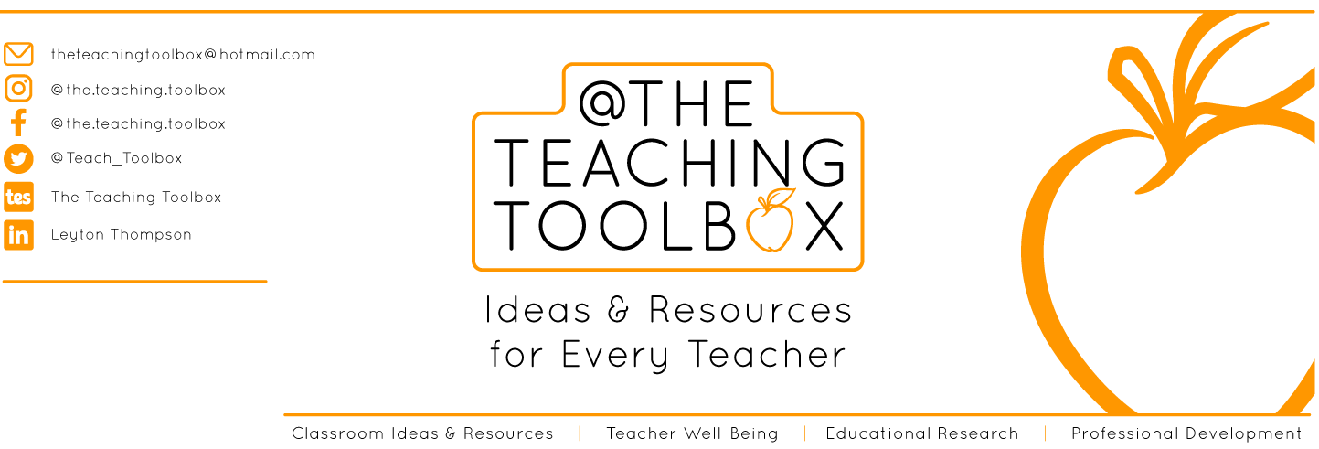
THANK YOU
Dear teacher, thank you for choosing this resource from The Teaching Toolbox. I really hope it can help to support you in making your lessons more engaging, effective and fun as well as providing some relief from the work-related pressure!
TERMS OF USE
This product is a digital download from my TES store and can only be used for the personal use of the teacher, his or her classroom and students. Please, respect the time and energy I have invested in preparing my products. ALL my resources are FREE so please encourage colleagues or friends to download for themselves from my store to support me in being able to continue producing FREE resources!

Slide 2
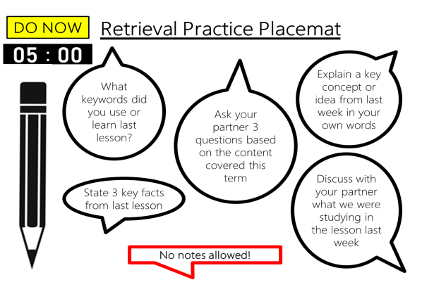
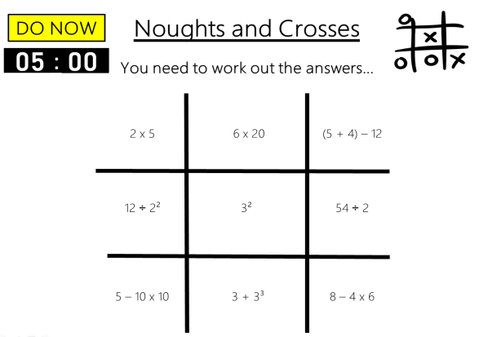
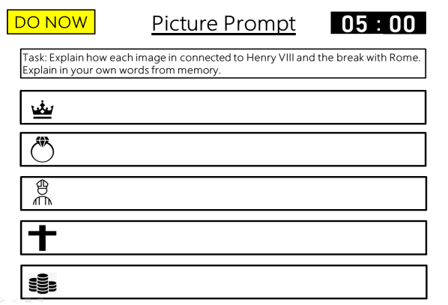
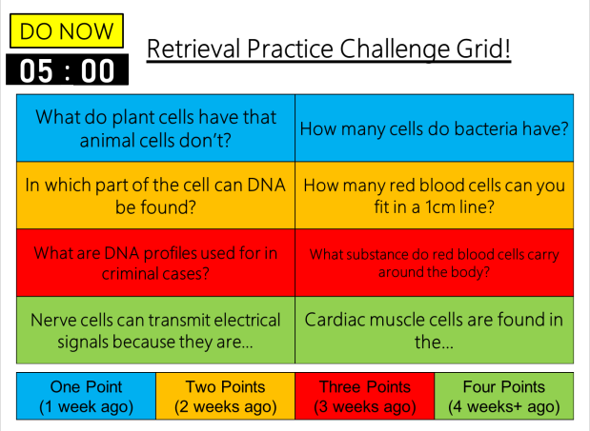
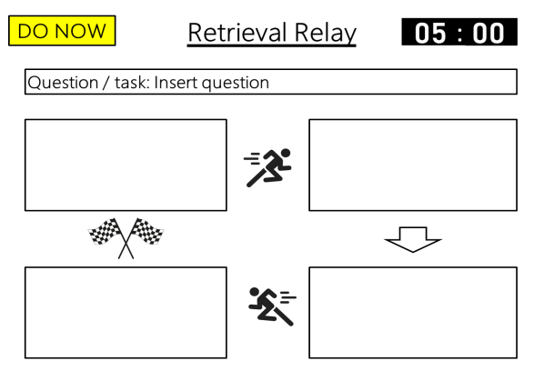
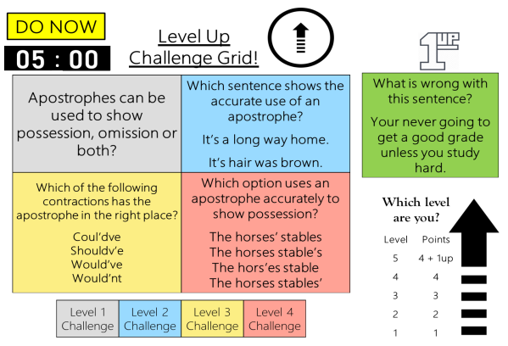
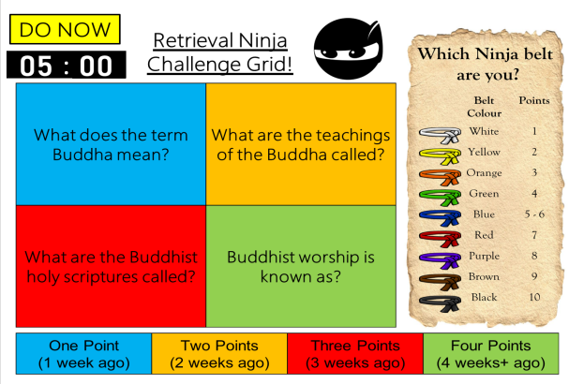
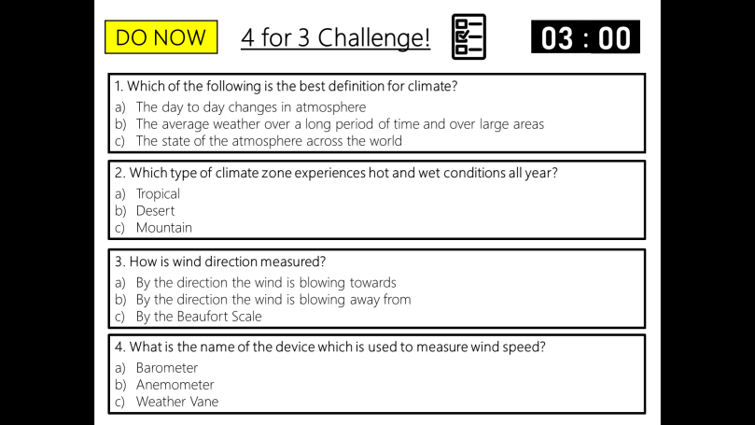
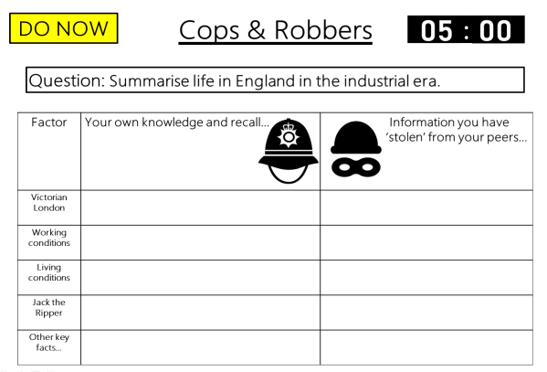
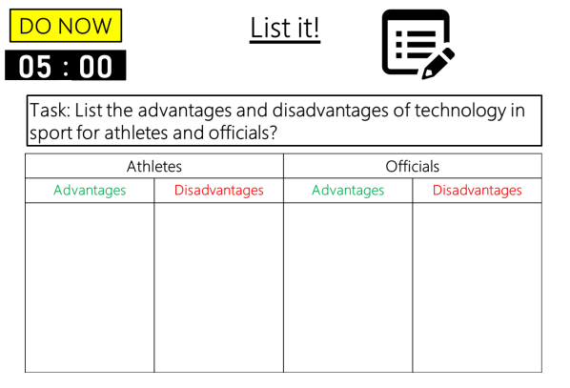

DO NOW
Retrieval Practice
Ninja Challenge Grid
Editable template slides, Exemplar slides & Timers – all ready to go!

Slide 3



Example
DO NOW
Retrieval Ninja
Challenge Grid!
Which Ninja belt
are you?
00
01
02
03
04
05
:
00
01
02
03
04
05
06
07
08
09
10
11
12
13
14
15
16
17
18
19
20
21
22
23
24
25
26
27
28
29
30
31
32
33
34
35
36
37
38
39
40
41
42
43
44
45
46
47
48
49
50
51
52
53
54
55
56
57
58
59
00
01
02
03
04
05
06
07
08
09
10
11
12
13
14
15
16
17
18
19
20
21
22
23
24
25
26
27
28
29
30
31
32
33
34
35
36
37
38
39
40
41
42
43
44
45
46
47
48
49
50
51
52
53
54
55
56
57
58
59
00
01
02
03
04
05
06
07
08
09
10
11
12
13
14
15
16
17
18
19
20
21
22
23
24
25
26
27
28
29
30
31
32
33
34
35
36
37
38
39
40
41
42
43
44
45
46
47
48
49
50
51
52
53
54
55
56
57
58
59
00
01
02
03
04
05
06
07
08
09
10
11
12
13
14
15
16
17
18
19
20
21
22
23
24
25
26
27
28
29
30
31
32
33
34
35
36
37
38
39
40
41
42
43
44
45
46
47
48
49
50
51
52
53
54
55
56
57
58
59
00
01
02
03
04
05
06
07
08
09
10
11
12
13
14
15
16
17
18
19
20
21
22
23
24
25
26
27
28
29
30
31
32
33
34
35
36
37
38
39
40
41
42
43
44
45
46
47
48
49
50
51
52
53
54
55
56
57
58
59
00
What does the term Buddha mean? | What are the teachings of the Buddha called?
What are the Buddhist holy scriptures called? | Buddhist worship is known as?
Belt Colour | Points
White | 1
Yellow | 2
Orange | 3
Green | 4
Blue | 5 - 6
Red | 7
Purple | 8
Brown | 9
Black | 10
One Point (1 week ago) | Two Points (2 weeks ago) | Three Points (3 weeks ago) | Four Points (4 weeks+ ago)
Notes:
A challenge grid is simply a grid with a range of questions for students to generate an answer to (the amount of boxes with questions can vary, you can decide – I have included templates for 4, 8, 12, 16 and 20 questions.
The aim of the challenge grid is to provide different questions that vary in the level of difficulty they pose from content taught. This resource works well if you have a mixed ability class as there are questions that everyone should be able to access. The challenge is focused on subject content, not the activity itself, and only requires a very brief explanation in regards to instruction. Each question will be worth a certain number of points.
Depending on the length or type of answers you could provide answers on the next slide or a separate sheet for students to self-check and correct. Alternatively, you could discuss the answers as a class depending on how much time you wish to dedicate to this activity.
Depending on the number of questions you choose, allow enough time accordingly. Students are to answer as many questions as they can from memory and without notes – they can select the question that they answer.
Within Retrieval Ninja students score points per correct answer given depending on how long ago that specific bit of content was taught (ie. 1 point 1 week ago, 2 points 2 weeks ago, 3 points 3 weeks ago, 4 points 4+ weeks ago).
Retrieval Ninja refers to the number of points students achieve in the activity and indicates which Ninja belt they have achieved – the motivation is to try and achieve a higher colour belt next time – students can keep a record of the coloured belts achieved - This enables them to be in competition with themselves and to maintain motivation.

Slide 4
Example
DO NOW
Retrieval Ninja
Challenge Grid!
Which Ninja belt
are you?
Answers
What does the term Buddha mean? | What are the teachings of the Buddha called?
What are the Buddhist holy scriptures called? | Buddhist worship is known as?
Belt Colour | Points
White | 1
Yellow | 2
Orange | 3
Green | 4
Blue | 5 - 6
Red | 7
Purple | 8
Brown | 9
Black | 10
Enlightened One
Dharma
Tripitaka
Puja
One Point (1 week ago) | Two Points (2 weeks ago) | Three Points (3 weeks ago) | Four Points (4 weeks+ ago)

Slide 5
Template
DO NOW
Retrieval Ninja
Challenge Grid!
Which Ninja belt
are you?
00
01
02
03
04
05
:
00
01
02
03
04
05
06
07
08
09
10
11
12
13
14
15
16
17
18
19
20
21
22
23
24
25
26
27
28
29
30
31
32
33
34
35
36
37
38
39
40
41
42
43
44
45
46
47
48
49
50
51
52
53
54
55
56
57
58
59
00
01
02
03
04
05
06
07
08
09
10
11
12
13
14
15
16
17
18
19
20
21
22
23
24
25
26
27
28
29
30
31
32
33
34
35
36
37
38
39
40
41
42
43
44
45
46
47
48
49
50
51
52
53
54
55
56
57
58
59
00
01
02
03
04
05
06
07
08
09
10
11
12
13
14
15
16
17
18
19
20
21
22
23
24
25
26
27
28
29
30
31
32
33
34
35
36
37
38
39
40
41
42
43
44
45
46
47
48
49
50
51
52
53
54
55
56
57
58
59
00
01
02
03
04
05
06
07
08
09
10
11
12
13
14
15
16
17
18
19
20
21
22
23
24
25
26
27
28
29
30
31
32
33
34
35
36
37
38
39
40
41
42
43
44
45
46
47
48
49
50
51
52
53
54
55
56
57
58
59
00
01
02
03
04
05
06
07
08
09
10
11
12
13
14
15
16
17
18
19
20
21
22
23
24
25
26
27
28
29
30
31
32
33
34
35
36
37
38
39
40
41
42
43
44
45
46
47
48
49
50
51
52
53
54
55
56
57
58
59
00
Insert challenge | Insert challenge
Insert challenge | Insert challenge
Belt Colour | Points
White | 1
Yellow | 2
Orange | 3
Green | 4
Blue | 5 - 6
Red | 7
Purple | 8
Brown | 9
Black | 10
One Point (1 week ago) | Two Points (2 weeks ago) | Three Points (3 weeks ago) | Four Points (4 weeks+ ago)
Notes:
Editable question slide template.
Editable answer slide template.
Set your own tasks.
Set your own time limit.
4, 8, 12, 16 and 20 question templates.

Slide 6
Template
DO NOW
Retrieval Ninja
Challenge Grid!
Which Ninja belt
are you?
Answers
Insert challenge | Insert challenge
Insert challenge | Insert challenge
Belt Colour | Points
White | 1
Yellow | 2
Orange | 3
Green | 4
Blue | 5 - 6
Red | 7
Purple | 8
Brown | 9
Black | 10
Insert answer
Insert answer
Insert answer
Insert answer
One Point (1 week ago) | Two Points (2 weeks ago) | Three Points (3 weeks ago) | Four Points (4 weeks+ ago)

Slide 7
Example
DO NOW
Retrieval Ninja
Challenge Grid!
Which Ninja belt
are you?
00
01
02
03
04
05
:
00
01
02
03
04
05
06
07
08
09
10
11
12
13
14
15
16
17
18
19
20
21
22
23
24
25
26
27
28
29
30
31
32
33
34
35
36
37
38
39
40
41
42
43
44
45
46
47
48
49
50
51
52
53
54
55
56
57
58
59
00
01
02
03
04
05
06
07
08
09
10
11
12
13
14
15
16
17
18
19
20
21
22
23
24
25
26
27
28
29
30
31
32
33
34
35
36
37
38
39
40
41
42
43
44
45
46
47
48
49
50
51
52
53
54
55
56
57
58
59
00
01
02
03
04
05
06
07
08
09
10
11
12
13
14
15
16
17
18
19
20
21
22
23
24
25
26
27
28
29
30
31
32
33
34
35
36
37
38
39
40
41
42
43
44
45
46
47
48
49
50
51
52
53
54
55
56
57
58
59
00
01
02
03
04
05
06
07
08
09
10
11
12
13
14
15
16
17
18
19
20
21
22
23
24
25
26
27
28
29
30
31
32
33
34
35
36
37
38
39
40
41
42
43
44
45
46
47
48
49
50
51
52
53
54
55
56
57
58
59
00
01
02
03
04
05
06
07
08
09
10
11
12
13
14
15
16
17
18
19
20
21
22
23
24
25
26
27
28
29
30
31
32
33
34
35
36
37
38
39
40
41
42
43
44
45
46
47
48
49
50
51
52
53
54
55
56
57
58
59
00
Belt Colour | Points
White | 1 – 2
Yellow | 3 – 5
Orange | 6 – 8
Green | 9 – 11
Blue | 12 – 14
Red | 15 – 17
Purple | 18
Brown | 19
Black | 20
What do plant cells have that animal cells don’t? | How many cells do bacteria have?
In which part of the cell can DNA be found? | How many red blood cells can you fit in a 1cm line?
What are DNA profiles used for in criminal cases? | What substance do red blood cells carry around the body?
Nerve cells can transmit electrical signals because they are… | Cardiac muscle cells are found in the…
One Point (1 week ago) | Two Points (2 weeks ago) | Three Points (3 weeks ago) | Four Points (4 weeks+ ago)

Slide 8
Example
DO NOW
Retrieval Ninja
Challenge Grid!
Which Ninja belt
are you?
Answers
Belt Colour | Points
White | 1 – 2
Yellow | 3 – 5
Orange | 6 – 8
Green | 9 – 11
Blue | 12 – 14
Red | 15 – 17
Purple | 18
Brown | 19
Black | 20
What do plant cells have that animal cells don’t? | How many cells do bacteria have?
In which part of the cell can DNA be found? | How many red blood cells can you fit in a 1cm line?
What are DNA profiles used for in criminal cases? | What substance do red blood cells carry around the body?
Nerve cells can transmit electrical signals because they are… | Cardiac muscle cells are found in the…
A cell wall
1
Nucleus
1,250
Identifying suspects
Oxygen
Long and thin
Heart
One Point (1 week ago) | Two Points (2 weeks ago) | Three Points (3 weeks ago) | Four Points (4 weeks+ ago)

Slide 9
Template
DO NOW
Retrieval Ninja
Challenge Grid!
Which Ninja belt
are you?
00
01
02
03
04
05
:
00
01
02
03
04
05
06
07
08
09
10
11
12
13
14
15
16
17
18
19
20
21
22
23
24
25
26
27
28
29
30
31
32
33
34
35
36
37
38
39
40
41
42
43
44
45
46
47
48
49
50
51
52
53
54
55
56
57
58
59
00
01
02
03
04
05
06
07
08
09
10
11
12
13
14
15
16
17
18
19
20
21
22
23
24
25
26
27
28
29
30
31
32
33
34
35
36
37
38
39
40
41
42
43
44
45
46
47
48
49
50
51
52
53
54
55
56
57
58
59
00
01
02
03
04
05
06
07
08
09
10
11
12
13
14
15
16
17
18
19
20
21
22
23
24
25
26
27
28
29
30
31
32
33
34
35
36
37
38
39
40
41
42
43
44
45
46
47
48
49
50
51
52
53
54
55
56
57
58
59
00
01
02
03
04
05
06
07
08
09
10
11
12
13
14
15
16
17
18
19
20
21
22
23
24
25
26
27
28
29
30
31
32
33
34
35
36
37
38
39
40
41
42
43
44
45
46
47
48
49
50
51
52
53
54
55
56
57
58
59
00
01
02
03
04
05
06
07
08
09
10
11
12
13
14
15
16
17
18
19
20
21
22
23
24
25
26
27
28
29
30
31
32
33
34
35
36
37
38
39
40
41
42
43
44
45
46
47
48
49
50
51
52
53
54
55
56
57
58
59
00
Belt Colour | Points
White | 1 – 2
Yellow | 3 – 5
Orange | 6 – 8
Green | 9 – 11
Blue | 12 – 14
Red | 15 – 17
Purple | 18
Brown | 19
Black | 20
Insert challenge | Insert challenge
Insert challenge | Insert challenge
Insert challenge | Insert challenge
Insert challenge | Insert challenge
One Point (1 week ago) | Two Points (2 weeks ago) | Three Points (3 weeks ago) | Four Points (4 weeks+ ago)
Notes:
Editable question slide template.
Editable answer slide template.
Set your own tasks.
Set your own time limit.
4, 8, 12, 16 and 20 question templates.

Slide 10
Template
DO NOW
Retrieval Ninja
Challenge Grid!
Which Ninja belt
are you?
Answers
Belt Colour | Points
White | 1 – 2
Yellow | 3 – 5
Orange | 6 – 8
Green | 9 – 11
Blue | 12 – 14
Red | 15 – 17
Purple | 18
Brown | 19
Black | 20
Insert challenge | Insert challenge
Insert challenge | Insert challenge
Insert challenge | Insert challenge
Insert challenge | Insert challenge
Insert answer
Insert answer
Insert answer
Insert answer
Insert answer
Insert answer
Insert answer
Insert answer
One Point (1 week ago) | Two Points (2 weeks ago) | Three Points (3 weeks ago) | Four Points (4 weeks+ ago)

Slide 11
Template
DO NOW
Retrieval Ninja
Challenge Grid!
Which Ninja belt
are you?
00
01
02
03
04
05
:
00
01
02
03
04
05
06
07
08
09
10
11
12
13
14
15
16
17
18
19
20
21
22
23
24
25
26
27
28
29
30
31
32
33
34
35
36
37
38
39
40
41
42
43
44
45
46
47
48
49
50
51
52
53
54
55
56
57
58
59
00
01
02
03
04
05
06
07
08
09
10
11
12
13
14
15
16
17
18
19
20
21
22
23
24
25
26
27
28
29
30
31
32
33
34
35
36
37
38
39
40
41
42
43
44
45
46
47
48
49
50
51
52
53
54
55
56
57
58
59
00
01
02
03
04
05
06
07
08
09
10
11
12
13
14
15
16
17
18
19
20
21
22
23
24
25
26
27
28
29
30
31
32
33
34
35
36
37
38
39
40
41
42
43
44
45
46
47
48
49
50
51
52
53
54
55
56
57
58
59
00
01
02
03
04
05
06
07
08
09
10
11
12
13
14
15
16
17
18
19
20
21
22
23
24
25
26
27
28
29
30
31
32
33
34
35
36
37
38
39
40
41
42
43
44
45
46
47
48
49
50
51
52
53
54
55
56
57
58
59
00
01
02
03
04
05
06
07
08
09
10
11
12
13
14
15
16
17
18
19
20
21
22
23
24
25
26
27
28
29
30
31
32
33
34
35
36
37
38
39
40
41
42
43
44
45
46
47
48
49
50
51
52
53
54
55
56
57
58
59
00
Belt Colour | Points
White | 1 – 5
Yellow | 6 – 10
Orange | 11 – 14
Green | 15 – 18
Blue | 19 – 22
Red | 23 – 25
Purple | 26 - 28
Brown | 29
Black | 30
Insert challenge | Insert challenge | Insert challenge
Insert challenge | Insert challenge | Insert challenge
Insert challenge | Insert challenge | Insert challenge
Insert challenge | Insert challenge | Insert challenge
One Point (1 week ago) | Two Points (2 weeks ago) | Three Points (3 weeks ago) | Four Points (4 weeks+ ago)
Notes:
Editable question slide template.
Editable answer slide template.
Set your own tasks.
Set your own time limit.
4, 8, 12, 16 and 20 question templates.

Slide 12
Template
DO NOW
Retrieval Ninja
Challenge Grid!
Which Ninja belt
are you?
Answers
Belt Colour | Points
White | 1 – 5
Yellow | 6 – 10
Orange | 11 – 14
Green | 15 – 18
Blue | 19 – 22
Red | 23 – 25
Purple | 26 - 28
Brown | 29
Black | 30
Insert challenge | Insert challenge | Insert challenge
Insert challenge | Insert challenge | Insert challenge
Insert challenge | Insert challenge | Insert challenge
Insert challenge | Insert challenge | Insert challenge
Insert
answer
Insert
answer
Insert
answer
Insert
answer
Insert
answer
Insert
answer
Insert
answer
Insert
answer
Insert
answer
Insert
answer
Insert
answer
Insert
answer
One Point (1 week ago) | Two Points (2 weeks ago) | Three Points (3 weeks ago) | Four Points (4 weeks+ ago)

Slide 13
Template
DO NOW
Retrieval Ninja
Challenge Grid!
Which Ninja belt
are you?
00
01
02
03
04
05
:
00
01
02
03
04
05
06
07
08
09
10
11
12
13
14
15
16
17
18
19
20
21
22
23
24
25
26
27
28
29
30
31
32
33
34
35
36
37
38
39
40
41
42
43
44
45
46
47
48
49
50
51
52
53
54
55
56
57
58
59
00
01
02
03
04
05
06
07
08
09
10
11
12
13
14
15
16
17
18
19
20
21
22
23
24
25
26
27
28
29
30
31
32
33
34
35
36
37
38
39
40
41
42
43
44
45
46
47
48
49
50
51
52
53
54
55
56
57
58
59
00
01
02
03
04
05
06
07
08
09
10
11
12
13
14
15
16
17
18
19
20
21
22
23
24
25
26
27
28
29
30
31
32
33
34
35
36
37
38
39
40
41
42
43
44
45
46
47
48
49
50
51
52
53
54
55
56
57
58
59
00
01
02
03
04
05
06
07
08
09
10
11
12
13
14
15
16
17
18
19
20
21
22
23
24
25
26
27
28
29
30
31
32
33
34
35
36
37
38
39
40
41
42
43
44
45
46
47
48
49
50
51
52
53
54
55
56
57
58
59
00
01
02
03
04
05
06
07
08
09
10
11
12
13
14
15
16
17
18
19
20
21
22
23
24
25
26
27
28
29
30
31
32
33
34
35
36
37
38
39
40
41
42
43
44
45
46
47
48
49
50
51
52
53
54
55
56
57
58
59
00
Belt Colour | Points
White | 1 – 6
Yellow | 7 – 12
Orange | 13 – 18
Green | 19 – 24
Blue | 25 – 30
Red | 31 – 36
Purple | 37 - 38
Brown | 39
Black | 40
Insert challenge | Insert challenge | Insert challenge | Insert challenge
Insert challenge | Insert challenge | Insert challenge | Insert challenge
Insert challenge | Insert challenge | Insert challenge | Insert challenge
Insert challenge | Insert challenge | Insert challenge | Insert challenge
One Point (1 week ago) | Two Points (2 weeks ago) | Three Points (3 weeks ago) | Four Points (4 weeks+ ago)
Notes:
Editable question slide template.
Editable answer slide template.
Set your own tasks.
Set your own time limit.
4, 8, 12, 16 and 20 question templates.

Slide 14
Template
DO NOW
Retrieval Ninja
Challenge Grid!
Which Ninja belt
are you?
Answers
Belt Colour | Points
White | 1 – 6
Yellow | 7 – 12
Orange | 13 – 18
Green | 19 – 24
Blue | 25 – 30
Red | 31 – 36
Purple | 37 – 38
Brown | 39
Black | 40
Insert challenge | Insert challenge | Insert challenge | Insert challenge
Insert challenge | Insert challenge | Insert challenge | Insert challenge
Insert challenge | Insert challenge | Insert challenge | Insert challenge
Insert challenge | Insert challenge | Insert challenge | Insert challenge
Insert answer
Insert answer
Insert answer
Insert answer
Insert answer
Insert answer
Insert answer
Insert answer
Insert answer
Insert answer
Insert answer
Insert answer
Insert answer
Insert answer
Insert answer
Insert answer
One Point (1 week ago) | Two Points (2 weeks ago) | Three Points (3 weeks ago) | Four Points (4 weeks+ ago)

Slide 15
Template
DO NOW
Retrieval Ninja
Challenge Grid!
Which Ninja belt
are you?
00
01
02
03
04
05
:
00
01
02
03
04
05
06
07
08
09
10
11
12
13
14
15
16
17
18
19
20
21
22
23
24
25
26
27
28
29
30
31
32
33
34
35
36
37
38
39
40
41
42
43
44
45
46
47
48
49
50
51
52
53
54
55
56
57
58
59
00
01
02
03
04
05
06
07
08
09
10
11
12
13
14
15
16
17
18
19
20
21
22
23
24
25
26
27
28
29
30
31
32
33
34
35
36
37
38
39
40
41
42
43
44
45
46
47
48
49
50
51
52
53
54
55
56
57
58
59
00
01
02
03
04
05
06
07
08
09
10
11
12
13
14
15
16
17
18
19
20
21
22
23
24
25
26
27
28
29
30
31
32
33
34
35
36
37
38
39
40
41
42
43
44
45
46
47
48
49
50
51
52
53
54
55
56
57
58
59
00
01
02
03
04
05
06
07
08
09
10
11
12
13
14
15
16
17
18
19
20
21
22
23
24
25
26
27
28
29
30
31
32
33
34
35
36
37
38
39
40
41
42
43
44
45
46
47
48
49
50
51
52
53
54
55
56
57
58
59
00
01
02
03
04
05
06
07
08
09
10
11
12
13
14
15
16
17
18
19
20
21
22
23
24
25
26
27
28
29
30
31
32
33
34
35
36
37
38
39
40
41
42
43
44
45
46
47
48
49
50
51
52
53
54
55
56
57
58
59
00
Insert challenge | Insert challenge | Insert challenge | Insert challenge | Insert challenge
Insert challenge | Insert challenge | Insert challenge | Insert challenge | Insert challenge
Insert challenge | Insert challenge | Insert challenge | Insert challenge | Insert challenge
Insert challenge | Insert challenge | Insert challenge | Insert challenge | Insert challenge
Belt Colour | Points
White | 1 – 7
Yellow | 8 – 14
Orange | 15 – 21
Green | 22 – 28
Blue | 29 – 35
Red | 36 – 42
Purple | 43 – 48
Brown | 49
Black | 50
One Point (1 week ago) | Two Points (2 weeks ago) | Three Points (3 weeks ago) | Four Points (4 weeks+ ago)
Notes:
Editable question slide template.
Editable answer slide template.
Set your own tasks.
Set your own time limit.
4, 8, 12, 16 and 20 question templates.

Slide 16
Template
DO NOW
Retrieval Ninja
Challenge Grid!
Which Ninja belt
are you?
Answers
Insert challenge | Insert challenge | Insert challenge | Insert challenge | Insert challenge
Insert challenge | Insert challenge | Insert challenge | Insert challenge | Insert challenge
Insert challenge | Insert challenge | Insert challenge | Insert challenge | Insert challenge
Insert challenge | Insert challenge | Insert challenge | Insert challenge | Insert challenge
Belt Colour | Points
White | 1 – 7
Yellow | 8 – 14
Orange | 15 – 21
Green | 22 – 28
Blue | 29 – 35
Red | 36 – 42
Purple | 43 – 48
Brown | 49
Black | 50
Insert answer
Insert answer
Insert answer
Insert answer
Insert answer
Insert answer
Insert answer
Insert answer
Insert answer
Insert answer
Insert answer
Insert answer
Insert answer
Insert answer
Insert answer
Insert answer
Insert answer
Insert answer
Insert answer
Insert answer
One Point (1 week ago) | Two Points (2 weeks ago) | Three Points (3 weeks ago) | Four Points (4 weeks+ ago)

