Slide 1

THANK YOU
Dear teacher, thank you for choosing this resource from The Teaching Toolbox. I really hope it can help to support you in making your lessons more engaging, effective and fun as well as providing some relief from the work-related pressure!
TERMS OF USE
This product is a digital download from my TES store and can only be used for the personal use of the teacher, his or her classroom and students. Please, respect the time and energy I have invested in preparing my products. ALL my resources are FREE so please encourage colleagues or friends to download for themselves from my store to support me in being able to continue producing FREE resources!

Slide 2
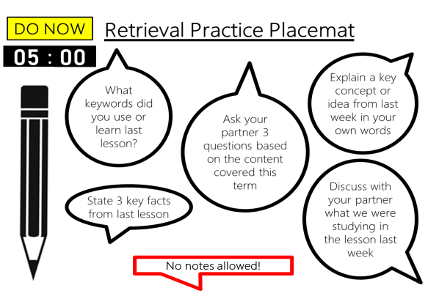
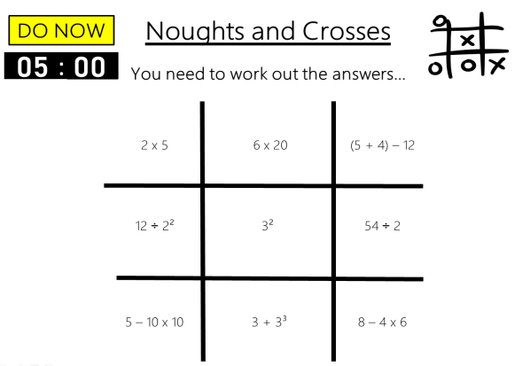
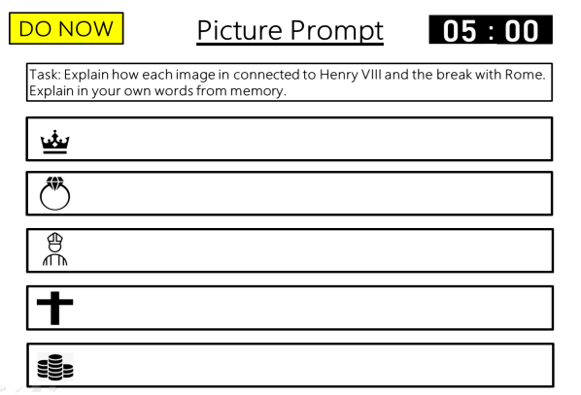
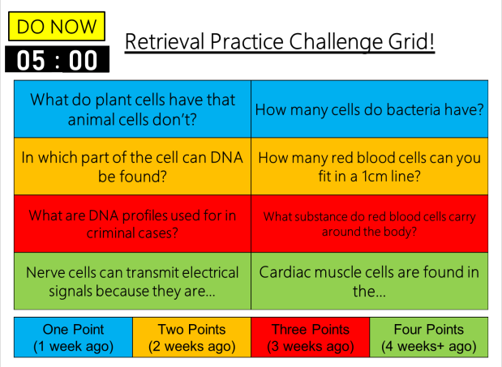
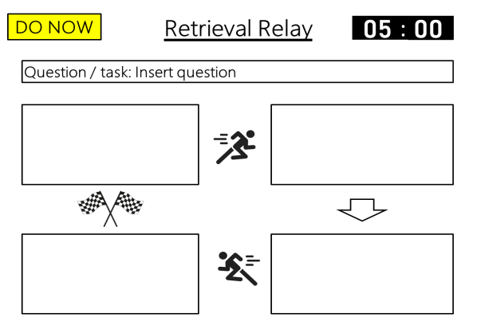
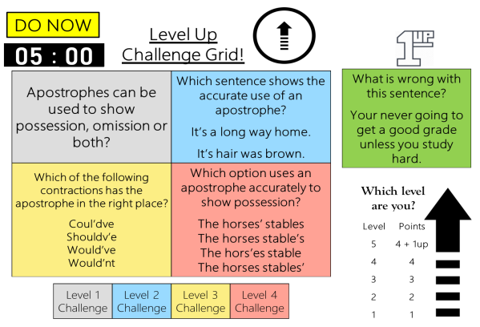
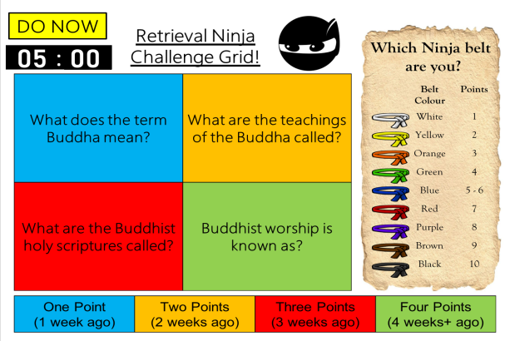
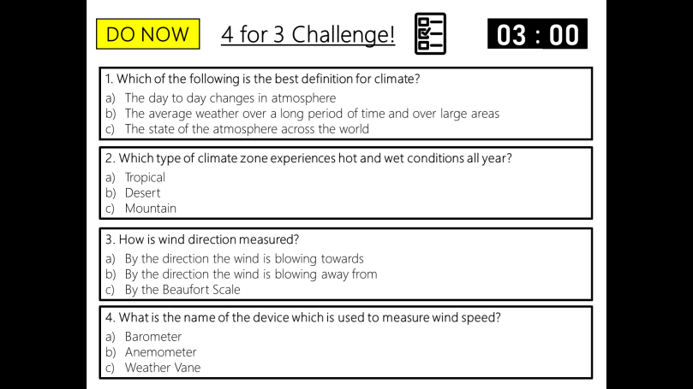
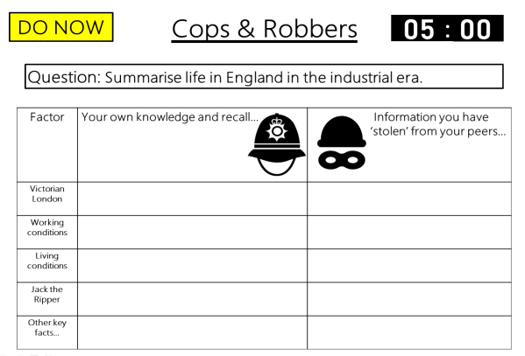
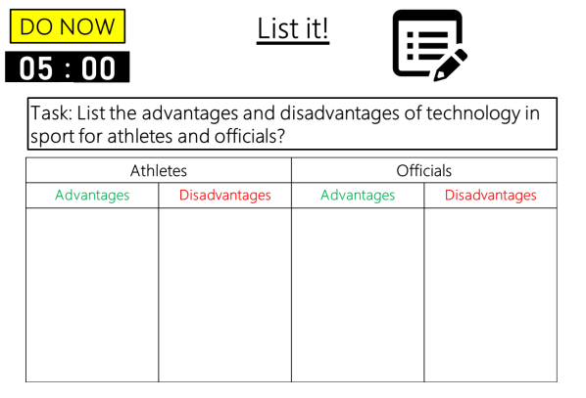

DO NOW
Retrieval Practice
Level Up Challenge Grid
Editable template slides, Exemplar slides & Timers – all ready to go!

Slide 3



Example
DO NOW
Level Up
Challenge Grid!
00
01
02
03
04
05
:
00
01
02
03
04
05
06
07
08
09
10
11
12
13
14
15
16
17
18
19
20
21
22
23
24
25
26
27
28
29
30
31
32
33
34
35
36
37
38
39
40
41
42
43
44
45
46
47
48
49
50
51
52
53
54
55
56
57
58
59
00
01
02
03
04
05
06
07
08
09
10
11
12
13
14
15
16
17
18
19
20
21
22
23
24
25
26
27
28
29
30
31
32
33
34
35
36
37
38
39
40
41
42
43
44
45
46
47
48
49
50
51
52
53
54
55
56
57
58
59
00
01
02
03
04
05
06
07
08
09
10
11
12
13
14
15
16
17
18
19
20
21
22
23
24
25
26
27
28
29
30
31
32
33
34
35
36
37
38
39
40
41
42
43
44
45
46
47
48
49
50
51
52
53
54
55
56
57
58
59
00
01
02
03
04
05
06
07
08
09
10
11
12
13
14
15
16
17
18
19
20
21
22
23
24
25
26
27
28
29
30
31
32
33
34
35
36
37
38
39
40
41
42
43
44
45
46
47
48
49
50
51
52
53
54
55
56
57
58
59
00
01
02
03
04
05
06
07
08
09
10
11
12
13
14
15
16
17
18
19
20
21
22
23
24
25
26
27
28
29
30
31
32
33
34
35
36
37
38
39
40
41
42
43
44
45
46
47
48
49
50
51
52
53
54
55
56
57
58
59
00
Apostrophes can be used to show possession, omission or both? | Which sentence shows the accurate use of an apostrophe? It’s a long way home. It’s hair was brown.
Which of the following contractions has the apostrophe in the right place? Coul’dve Shouldv’e Would’ve Would’nt | Which option uses an apostrophe accurately to show possession? The horses’ stables The horses stable’s The hors’es stable The horses stables’
What is wrong with this sentence? Your never going to get a good grade unless you study hard.
Which level
are you?
Level | Points
5 | 4 + 1up
4 | 4
3 | 3
2 | 2
1 | 1
Level 1 Challenge | Level 2 Challenge | Level 3 Challenge | Level 4 Challenge
Notes:
A variation of the Retrieval Challenge Grid. A challenge grid is simply a grid with a range of questions for students to generate an answer to (the amount of boxes with questions can vary, you can decide – I have included templates for 4 & 8 questions.
The aim of the challenge grid is to provide different questions that vary in the level of difficulty they pose from content taught. This resource works well if you have a mixed ability class as there are questions that everyone should be able to access. The challenge is focused on subject content, not the activity itself, and only requires a brief a very brief explanation in regards to instruction.
Depending on the length or type of answers you could provide answers on the next slide for students to self-check and correct. Alternatively, you could discuss the answers as a class depending on how much time you wish to dedicate to this activity.
Depending on the number of questions you choose, allow enough time accordingly. Students are to answer as many questions as they can from memory and without notes.
Level Up Challenge Grid – students score 1 point per correct answer given. The number of points achieved = a given level. If they get the 1up bonus question correct they automatically move up a level.
Students can start on whichever question they want, once they have completed all the questions they can they can then move on to the 1up question.

Slide 4
Example
DO NOW
Level Up
Challenge Grid!
Answers
Apostrophes can be used to show possession, omission or both? | Which sentence shows the accurate use of an apostrophe? It’s a long way home. It’s hair was brown.
Which of the following contractions has the apostrophe in the right place? Coul’dve Shouldv’e Would’ve Would’nt | Which option uses an apostrophe accurately to show possession? The horses’ stables The horses stable’s The hors’es stable The horses stables’
What is wrong with this sentence? Your never going to get a good grade unless you study hard.
Both possession and omission
It’s a long way home
Your should be You’re
Which level
are you?
Level | Points
5 | 4 + 1up
4 | 4
3 | 3
2 | 2
1 | 1
Would’ve
The horses’ stables
Level 1 Challenge | Level 2 Challenge | Level 3 Challenge | Level 4 Challenge

Slide 5
Template
DO NOW
Level Up
Challenge Grid!
00
01
02
03
04
05
:
00
01
02
03
04
05
06
07
08
09
10
11
12
13
14
15
16
17
18
19
20
21
22
23
24
25
26
27
28
29
30
31
32
33
34
35
36
37
38
39
40
41
42
43
44
45
46
47
48
49
50
51
52
53
54
55
56
57
58
59
00
01
02
03
04
05
06
07
08
09
10
11
12
13
14
15
16
17
18
19
20
21
22
23
24
25
26
27
28
29
30
31
32
33
34
35
36
37
38
39
40
41
42
43
44
45
46
47
48
49
50
51
52
53
54
55
56
57
58
59
00
01
02
03
04
05
06
07
08
09
10
11
12
13
14
15
16
17
18
19
20
21
22
23
24
25
26
27
28
29
30
31
32
33
34
35
36
37
38
39
40
41
42
43
44
45
46
47
48
49
50
51
52
53
54
55
56
57
58
59
00
01
02
03
04
05
06
07
08
09
10
11
12
13
14
15
16
17
18
19
20
21
22
23
24
25
26
27
28
29
30
31
32
33
34
35
36
37
38
39
40
41
42
43
44
45
46
47
48
49
50
51
52
53
54
55
56
57
58
59
00
01
02
03
04
05
06
07
08
09
10
11
12
13
14
15
16
17
18
19
20
21
22
23
24
25
26
27
28
29
30
31
32
33
34
35
36
37
38
39
40
41
42
43
44
45
46
47
48
49
50
51
52
53
54
55
56
57
58
59
00
Insert challenge | Insert challenge
Insert challenge | Insert challenge
Insert challenge
Which level
are you?
Level | Points
5 | 4 + 1up
4 | 4
3 | 3
2 | 2
1 | 1
Level 1 Challenge | Level 2 Challenge | Level 3 Challenge | Level 4 Challenge
Notes:
Editable question slide template.
Editable answer slide template.
Set your own tasks.
Set your own time limit.
4 & 8 question templates.

Slide 6
Template
DO NOW
Level Up
Challenge Grid!
Answers
Insert challenge | Insert challenge
Insert challenge | Insert challenge
Insert challenge
Insert answer
Insert answer
Insert answer
Which level
are you?
Level | Points
5 | 4 + 1up
4 | 4
3 | 3
2 | 2
1 | 1
Insert answer
Insert answer
Level 1 Challenge | Level 2 Challenge | Level 3 Challenge | Level 4 Challenge

Slide 7
Template
DO NOW
Level Up
Challenge Grid!
00
01
02
03
04
05
:
00
01
02
03
04
05
06
07
08
09
10
11
12
13
14
15
16
17
18
19
20
21
22
23
24
25
26
27
28
29
30
31
32
33
34
35
36
37
38
39
40
41
42
43
44
45
46
47
48
49
50
51
52
53
54
55
56
57
58
59
00
01
02
03
04
05
06
07
08
09
10
11
12
13
14
15
16
17
18
19
20
21
22
23
24
25
26
27
28
29
30
31
32
33
34
35
36
37
38
39
40
41
42
43
44
45
46
47
48
49
50
51
52
53
54
55
56
57
58
59
00
01
02
03
04
05
06
07
08
09
10
11
12
13
14
15
16
17
18
19
20
21
22
23
24
25
26
27
28
29
30
31
32
33
34
35
36
37
38
39
40
41
42
43
44
45
46
47
48
49
50
51
52
53
54
55
56
57
58
59
00
01
02
03
04
05
06
07
08
09
10
11
12
13
14
15
16
17
18
19
20
21
22
23
24
25
26
27
28
29
30
31
32
33
34
35
36
37
38
39
40
41
42
43
44
45
46
47
48
49
50
51
52
53
54
55
56
57
58
59
00
01
02
03
04
05
06
07
08
09
10
11
12
13
14
15
16
17
18
19
20
21
22
23
24
25
26
27
28
29
30
31
32
33
34
35
36
37
38
39
40
41
42
43
44
45
46
47
48
49
50
51
52
53
54
55
56
57
58
59
00
Insert challenge | Insert challenge | Insert challenge | Insert challenge
Insert challenge | Insert challenge | Insert challenge | Insert challenge
Insert challenge
Which level
are you?
Level | Points
5 | 8 + 1up
4 | 8
3 | 6
2 | 4
1 | 2
Level 1 Challenge | Level 2 Challenge | Level 3 Challenge | Level 4 Challenge
Notes:
Editable question slide template.
Editable answer slide template.
Set your own tasks.
Set your own time limit.
4 & 8 question templates.

Slide 8
Template
DO NOW
Level Up
Challenge Grid!
Answers
Insert challenge | Insert challenge | Insert challenge | Insert challenge
Insert challenge | Insert challenge | Insert challenge | Insert challenge
Insert challenge
Insert answer
Insert answer
Insert answer
Insert answer
Insert answer
Which level
are you?
Level | Points
5 | 8 + 1up
4 | 8
3 | 6
2 | 4
1 | 2
Insert answer
Insert answer
Insert answer
Insert answer
Level 1 Challenge | Level 2 Challenge | Level 3 Challenge | Level 4 Challenge

