Slide 1

THANK YOU
Dear teacher, thank you for choosing this resource from The Teaching Toolbox. I really hope it can help to support you in making your lessons more engaging, effective and fun as well as providing some relief from the work-related pressure!
TERMS OF USE
This product is a digital download from my TES store and can only be used for the personal use of the teacher, his or her classroom and students. Please, respect the time and energy I have invested in preparing my products. ALL my resources are FREE so please encourage colleagues or friends to download for themselves from my store to support me in being able to continue producing FREE resources!

Slide 2
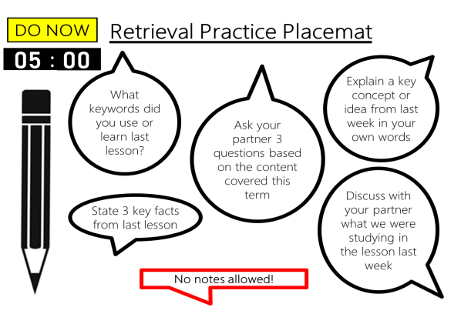
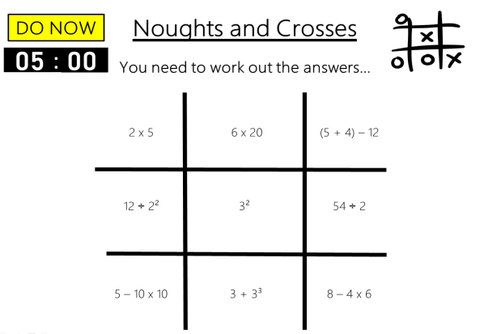
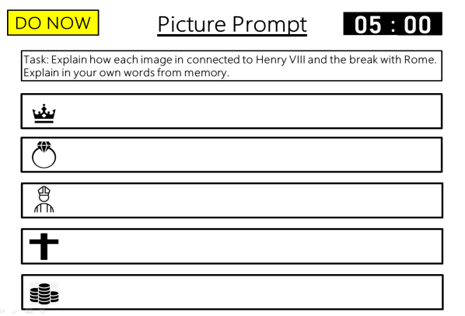
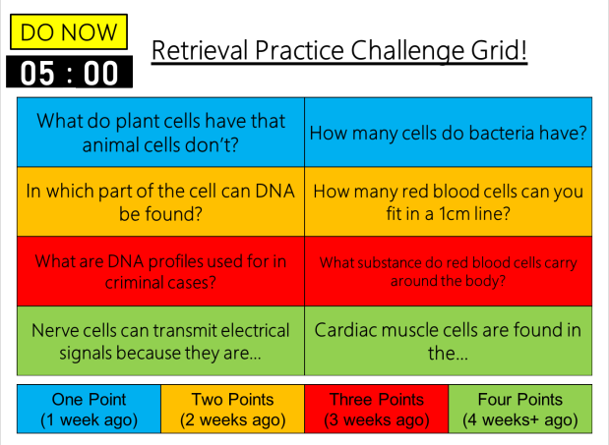
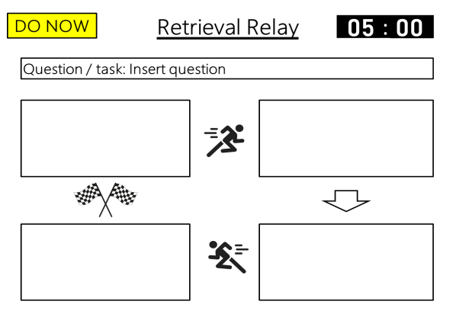
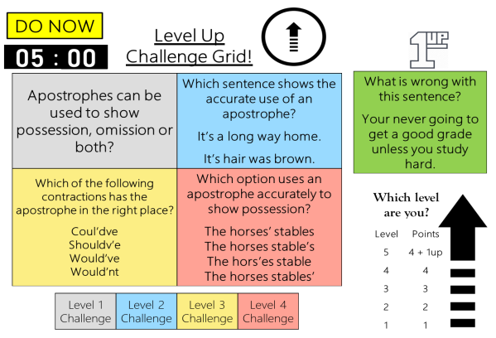
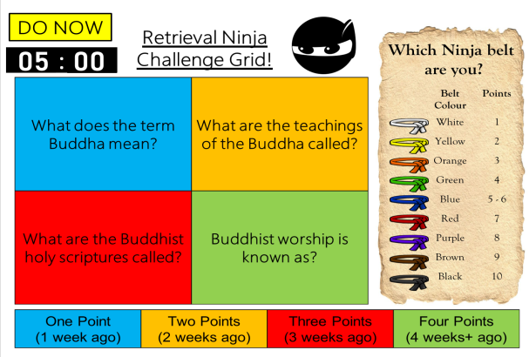
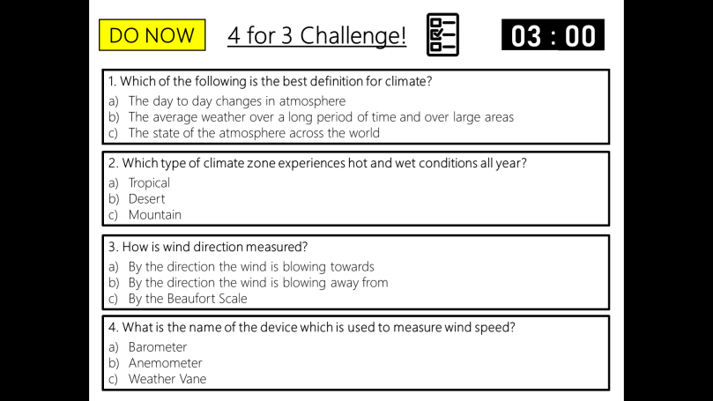
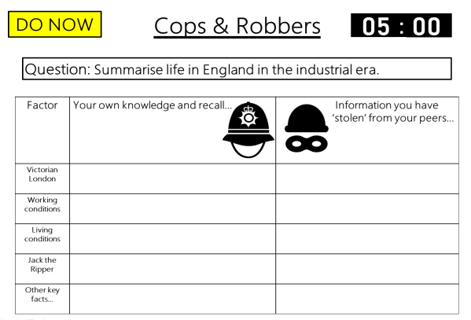
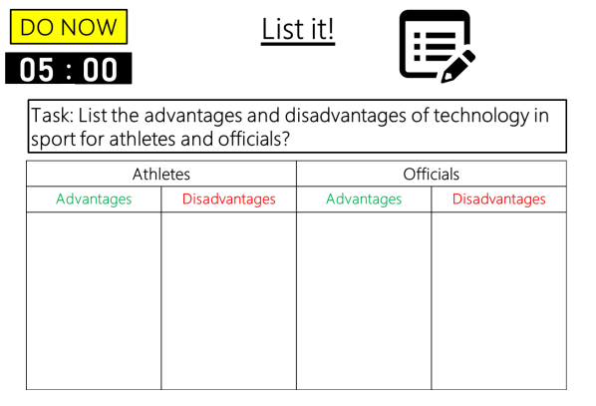

DO NOW
Retrieval Practice
Brain Dump
Editable template slides, Exemplar slides & Timers – all ready to go!

Slide 3

Example
DO NOW
Retrieval Practice Brain Dump
00
01
02
03
04
05
:
00
01
02
03
04
05
06
07
08
09
10
11
12
13
14
15
16
17
18
19
20
21
22
23
24
25
26
27
28
29
30
31
32
33
34
35
36
37
38
39
40
41
42
43
44
45
46
47
48
49
50
51
52
53
54
55
56
57
58
59
00
01
02
03
04
05
06
07
08
09
10
11
12
13
14
15
16
17
18
19
20
21
22
23
24
25
26
27
28
29
30
31
32
33
34
35
36
37
38
39
40
41
42
43
44
45
46
47
48
49
50
51
52
53
54
55
56
57
58
59
00
01
02
03
04
05
06
07
08
09
10
11
12
13
14
15
16
17
18
19
20
21
22
23
24
25
26
27
28
29
30
31
32
33
34
35
36
37
38
39
40
41
42
43
44
45
46
47
48
49
50
51
52
53
54
55
56
57
58
59
00
01
02
03
04
05
06
07
08
09
10
11
12
13
14
15
16
17
18
19
20
21
22
23
24
25
26
27
28
29
30
31
32
33
34
35
36
37
38
39
40
41
42
43
44
45
46
47
48
49
50
51
52
53
54
55
56
57
58
59
00
01
02
03
04
05
06
07
08
09
10
11
12
13
14
15
16
17
18
19
20
21
22
23
24
25
26
27
28
29
30
31
32
33
34
35
36
37
38
39
40
41
42
43
44
45
46
47
48
49
50
51
52
53
54
55
56
57
58
59
00
Task: Write down as much as you can recall about algorithms.
No notes allowed!
Notes:
Brain dumps are simply a knowledge recall task.
A ‘Brian Dump’ simply refers to dumping as much information from the brain about a specific topic or unit from long-term memory – without the use of notes onto a piece of paper.
This is a classic example of Low effort, high impact task for students to complete.
The teacher will give students a set amount of time to recall as much as they can from memory about a specific event, individual, concept, theory and so on.

Slide 4
Example
DO NOW
Retrieval Practice Brain Dump
Answers
Task: Write down as much as you can recall about algorithms.
Insert possible answers

Slide 5
Template
DO NOW
Retrieval Practice Brain Dump
00
01
02
03
04
05
:
00
01
02
03
04
05
06
07
08
09
10
11
12
13
14
15
16
17
18
19
20
21
22
23
24
25
26
27
28
29
30
31
32
33
34
35
36
37
38
39
40
41
42
43
44
45
46
47
48
49
50
51
52
53
54
55
56
57
58
59
00
01
02
03
04
05
06
07
08
09
10
11
12
13
14
15
16
17
18
19
20
21
22
23
24
25
26
27
28
29
30
31
32
33
34
35
36
37
38
39
40
41
42
43
44
45
46
47
48
49
50
51
52
53
54
55
56
57
58
59
00
01
02
03
04
05
06
07
08
09
10
11
12
13
14
15
16
17
18
19
20
21
22
23
24
25
26
27
28
29
30
31
32
33
34
35
36
37
38
39
40
41
42
43
44
45
46
47
48
49
50
51
52
53
54
55
56
57
58
59
00
01
02
03
04
05
06
07
08
09
10
11
12
13
14
15
16
17
18
19
20
21
22
23
24
25
26
27
28
29
30
31
32
33
34
35
36
37
38
39
40
41
42
43
44
45
46
47
48
49
50
51
52
53
54
55
56
57
58
59
00
01
02
03
04
05
06
07
08
09
10
11
12
13
14
15
16
17
18
19
20
21
22
23
24
25
26
27
28
29
30
31
32
33
34
35
36
37
38
39
40
41
42
43
44
45
46
47
48
49
50
51
52
53
54
55
56
57
58
59
00
Task: Insert task.
No notes allowed!
Notes:
Editable task slide template.
Answer slide template.
Set your own tasks.
Set your own time limit.

Slide 6
Template
DO NOW
Retrieval Practice Brain Dump
Answers
Task: Write down as much as you can about… Insert task
Insert possible answers

