Slide 1
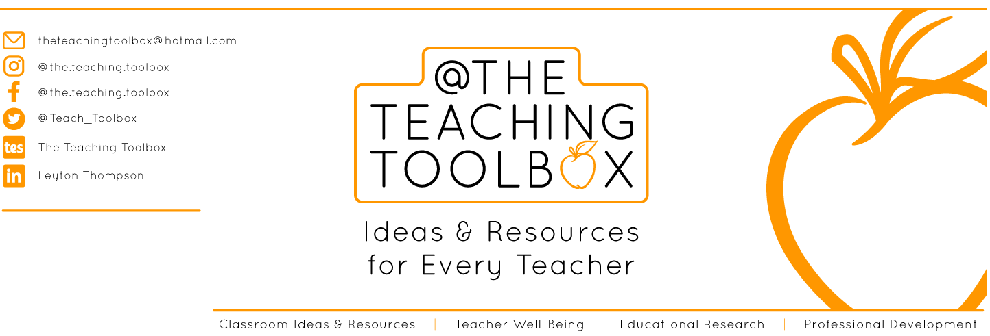
THANK YOU
Dear teacher, thank you for choosing this resource from The Teaching Toolbox. I really hope it can help to support you in making your lessons more engaging, effective and fun as well as providing some relief from the work-related pressure!
TERMS OF USE
This product is a digital download from my TES store and can only be used for the personal use of the teacher, his or her classroom and students. Please, respect the time and energy I have invested in preparing my products. ALL my resources are FREE so please encourage colleagues or friends to download for themselves from my store to support me in being able to continue producing FREE resources!

Slide 2
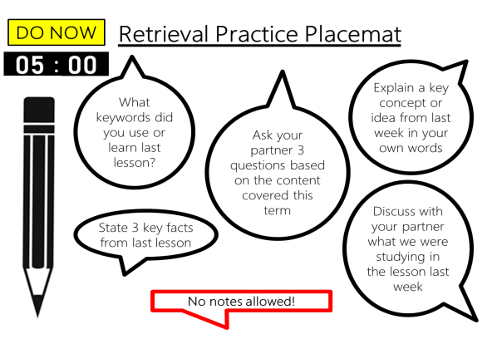
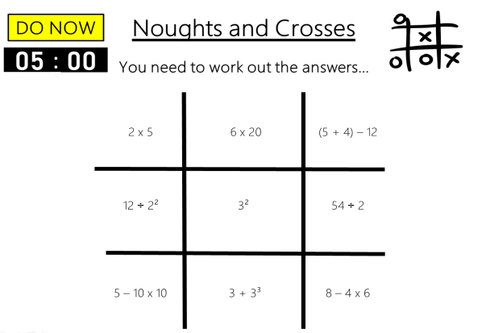
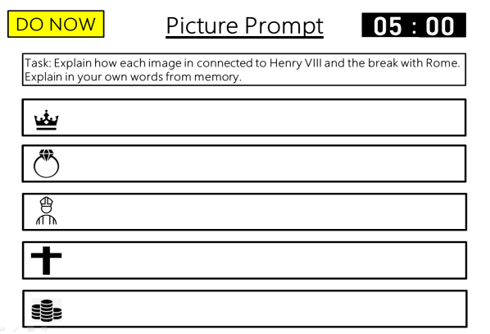
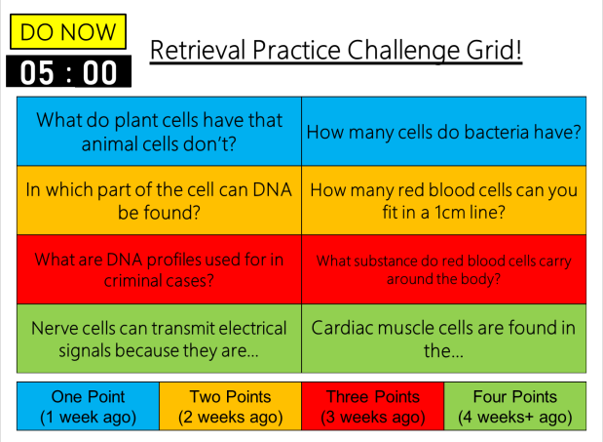
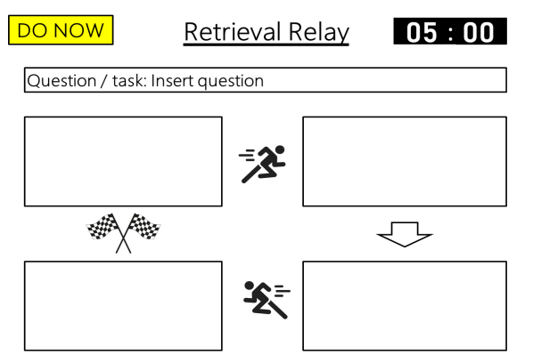
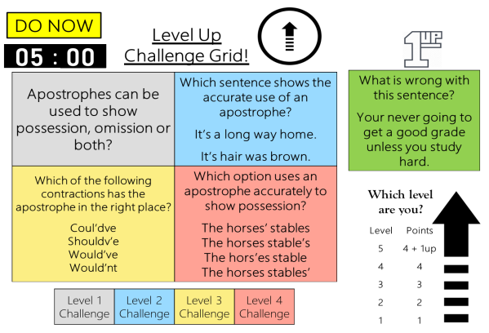
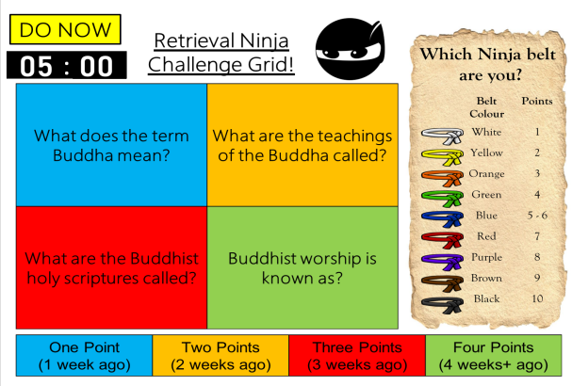
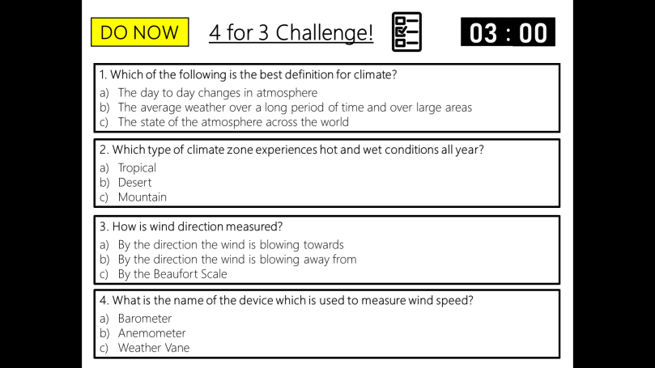
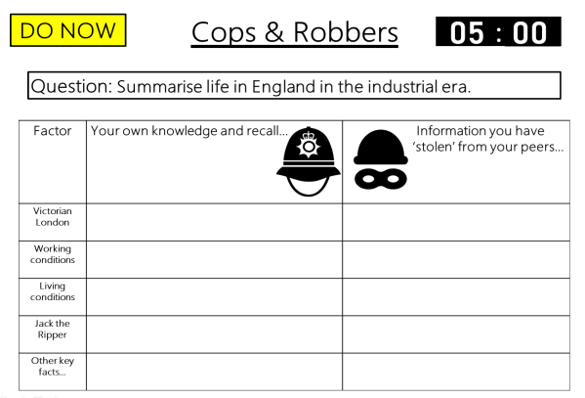
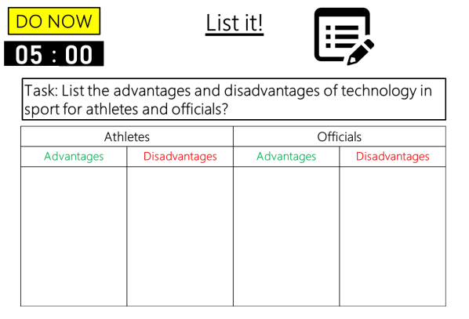

DO NOW
Retrieval Practice
4 for 3 Keyword Challenge
Editable template slides, Exemplar slides & Timers – all ready to go!

Slide 3

Example
4 for 3
Keyword Challenge!
00
01
02
03
:
00
01
02
03
04
05
06
07
08
09
10
11
12
13
14
15
16
17
18
19
20
21
22
23
24
25
26
27
28
29
30
31
32
33
34
35
36
37
38
39
40
41
42
43
44
45
46
47
48
49
50
51
52
53
54
55
56
57
58
59
00
01
02
03
04
05
06
07
08
09
10
11
12
13
14
15
16
17
18
19
20
21
22
23
24
25
26
27
28
29
30
31
32
33
34
35
36
37
38
39
40
41
42
43
44
45
46
47
48
49
50
51
52
53
54
55
56
57
58
59
00
01
02
03
04
05
06
07
08
09
10
11
12
13
14
15
16
17
18
19
20
21
22
23
24
25
26
27
28
29
30
31
32
33
34
35
36
37
38
39
40
41
42
43
44
45
46
47
48
49
50
51
52
53
54
55
56
57
58
59
DO NOW
00
1. A style or type of music. What am I?
2. A sequence of notes that make a tune. What am I?
3. A section of a song which is a bit different to the rest. It often appears before the final chorus. What am I?
4. A short repeated and catchy musical idea. This can be a melody, bass line or a chord progression. What am I?
Notes:
4 for 3 keyword challenge is similar to the multiple choice 4 for 3 challenge.
In this activity students must read the definition of a keyword and identify what the key word is.
This activity can also be done in reverse, where you give the students the keyword and they have to write the definition accurately.

Slide 4
Example
4 for 3
Keyword Challenge!
DO NOW
Answers
1. A style or type of music. What am I?
Genre
2. A sequence of notes that make a tune. What am I?
Melody
3. A section of a song which is a bit different to the rest. It often appears before the final chorus. What am I?
Bridge
4. A short repeated and catchy musical idea. This can be a melody, bass line or a chord progression. What am I?
Riff

Slide 5
Example
4 for 3
Keyword Challenge!
00
01
02
03
:
00
01
02
03
04
05
06
07
08
09
10
11
12
13
14
15
16
17
18
19
20
21
22
23
24
25
26
27
28
29
30
31
32
33
34
35
36
37
38
39
40
41
42
43
44
45
46
47
48
49
50
51
52
53
54
55
56
57
58
59
00
01
02
03
04
05
06
07
08
09
10
11
12
13
14
15
16
17
18
19
20
21
22
23
24
25
26
27
28
29
30
31
32
33
34
35
36
37
38
39
40
41
42
43
44
45
46
47
48
49
50
51
52
53
54
55
56
57
58
59
00
01
02
03
04
05
06
07
08
09
10
11
12
13
14
15
16
17
18
19
20
21
22
23
24
25
26
27
28
29
30
31
32
33
34
35
36
37
38
39
40
41
42
43
44
45
46
47
48
49
50
51
52
53
54
55
56
57
58
59
DO NOW
00
1. All body systems working well, free from illness and injury. Ability to carry out every day tasks. What am I?
2. Provision of funds or other forms of support to an individual or event in return for some commercial return. What am I?
3. Cognitive relaxation techniques involving control of mental thoughts and imaging positive outcomes. What am I?
4. Aggressive act which involves physical contact with others, eg. A punch. What am I?

Slide 6
Example
4 for 3
Keyword Challenge!
DO NOW
Answers
1. All body systems working well, free from illness and injury. Ability to carry out every day tasks. What am I?
Physical Health & Well-being
2. Provision of funds or other forms of support to an individual or event in return for some commercial return. What am I?
Sponsorship
3. Cognitive relaxation techniques involving control of mental thoughts and imaging positive outcomes. What am I?
Mental rehearsal / Visualisation / Imagery
4. Aggressive act which involves physical contact with others, eg. A punch. What am I?
Direct aggression

Slide 7
Template
4 for 3
Keyword Challenge!
00
01
02
03
:
00
01
02
03
04
05
06
07
08
09
10
11
12
13
14
15
16
17
18
19
20
21
22
23
24
25
26
27
28
29
30
31
32
33
34
35
36
37
38
39
40
41
42
43
44
45
46
47
48
49
50
51
52
53
54
55
56
57
58
59
00
01
02
03
04
05
06
07
08
09
10
11
12
13
14
15
16
17
18
19
20
21
22
23
24
25
26
27
28
29
30
31
32
33
34
35
36
37
38
39
40
41
42
43
44
45
46
47
48
49
50
51
52
53
54
55
56
57
58
59
00
01
02
03
04
05
06
07
08
09
10
11
12
13
14
15
16
17
18
19
20
21
22
23
24
25
26
27
28
29
30
31
32
33
34
35
36
37
38
39
40
41
42
43
44
45
46
47
48
49
50
51
52
53
54
55
56
57
58
59
DO NOW
00
1. Insert definition. What am I?
2. Insert definition. What am I?
3. Insert definition. What am I?
4. Insert definition. What am I?
Notes:
Editable task slide template.
Answer slide template.
Set your own tasks.
Set your own time limit.

Slide 8
Template
4 for 3
Keyword Challenge!
DO NOW
Answers
1. Insert definition. What am I?
Insert keyword
2. Insert definition. What am I?
Insert keyword
3. Insert definition. What am I?
Insert keyword
4. Insert definition. What am I?
Insert keyword

Slide 9
Template
4 for 3
Keyword Challenge!
00
01
02
03
:
00
01
02
03
04
05
06
07
08
09
10
11
12
13
14
15
16
17
18
19
20
21
22
23
24
25
26
27
28
29
30
31
32
33
34
35
36
37
38
39
40
41
42
43
44
45
46
47
48
49
50
51
52
53
54
55
56
57
58
59
00
01
02
03
04
05
06
07
08
09
10
11
12
13
14
15
16
17
18
19
20
21
22
23
24
25
26
27
28
29
30
31
32
33
34
35
36
37
38
39
40
41
42
43
44
45
46
47
48
49
50
51
52
53
54
55
56
57
58
59
00
01
02
03
04
05
06
07
08
09
10
11
12
13
14
15
16
17
18
19
20
21
22
23
24
25
26
27
28
29
30
31
32
33
34
35
36
37
38
39
40
41
42
43
44
45
46
47
48
49
50
51
52
53
54
55
56
57
58
59
DO NOW
00
1. Insert Keyword. What is the definition?
2. Insert Keyword. What is the definition?
3. Insert Keyword. What is the definition?
4. Insert Keyword. What is the definition?
Notes:
Editable task slide template.
Answer slide template.
Set your own tasks.
Set your own time limit.

Slide 10
Template
4 for 3
Keyword Challenge!
DO NOW
Answers
1. Insert Keyword. What is the definition?
Insert definition
2. Insert Keyword. What is the definition?
Insert definition
3. Insert Keyword. What is the definition?
Insert definition
4. Insert Keyword. What is the definition?
Insert definition

