Slide 1

Trinity High School
Qualifications Information Event
September 2025

Slide 2

Tonight’s Event
Welcome
Mr Marshall
Key Information for Parents and Carers
SQA 2025/26
SCQF
UCAS and School Leavers (Ms Thomson)

Slide 3




To achieve excellence together and ensure all young people sustain a positive destination which maximises their potential.

Slide 4
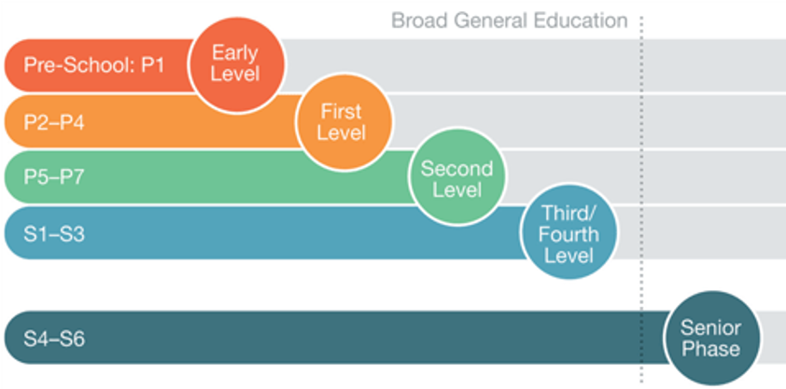
Scottish Education Structure

Slide 5



Being a Senior At
Trinity High School
Senior Phase – S4, S5 and S6
Different from the Broad General Education (BGE)
Increased expectation and pressure
Being a role model – uniform, conduct
Developing skills and preparing for the next step
Vital to take opportunities – S6 Leadership and representing views
"Paying it forward"

Slide 6
As a minimum....
Full school uniform at all times – role model to juniors
Working to full potential, attending all classes
Submitting all required home learning and coursework
Excellent timekeeping and attendance

Slide 7
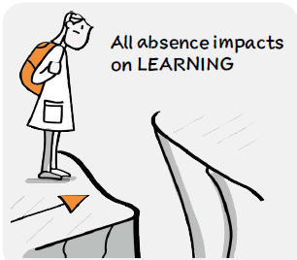
Promoting Good Attendance
Promoting Good Attendance
Every Moment Matters – Know Your Score
An average school year comprises 190 days, therefore…..
92% Attendance
Means your child will have missed 15 days or 3 weeks of school
88% Attendance
Means your child will have missed 23 days or 4.5 weeks of school
84% Attendance
Means your child will have missed 30 days or 6 weeks of school
Good attendance gives every young person the opportunity to:
Learn new things
Engage in physical exercise
Increase their achievement
Build their confidence
Develop & practise new skills
Improve self-esteem
Make friends and feel included
Take responsibility for learning
Develop skills for work
Prepare for the world of work
Increase their attainment
Engage in digital learning

Slide 8
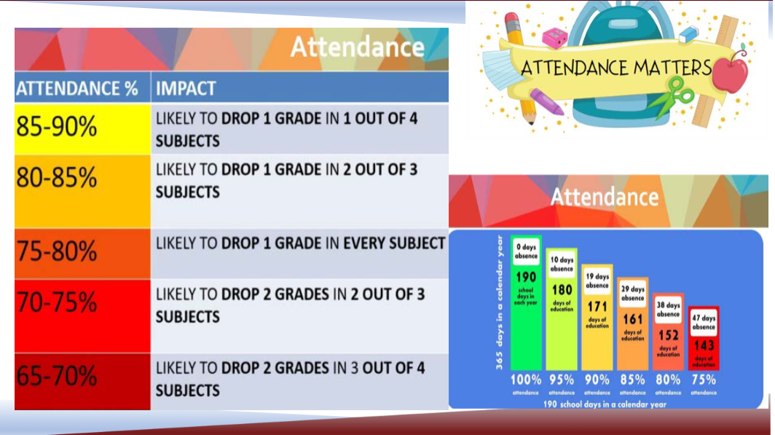

Slide 9

Here's a breakdown of the timeline:
Autumn
2025:
Qualifications Scotland is expected to become operational.
2026:
Rebalancing assessment in existing national qualifications will take place.
2028:
The start of new qualification development at the subject level is scheduled.
The main qualifications awarding body in Scottish schools
Responsible for setting content and mode of assessment for qualifications
Qualifications Scotland now operational – SQA will be replaced but not during this academic session

Slide 10
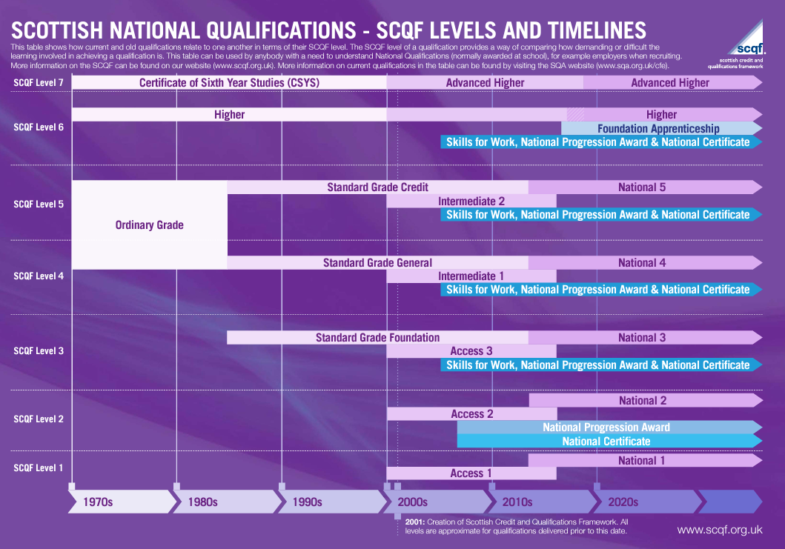
National qualifications
Exam DIET only exists at
National 5,
Higher and
Advanced Higher Level

Slide 11

SQA 2025/26
National Qualifications
What are National Qualifications?
National Qualifications are one of the most important types of qualification in Scotland, and almost everyone leaving school or college today has one or more National Qualification.
They are mainly taken by learners in the senior phase of secondary school (S4 to S6) and learners in colleges.
They cover a range of subjects and are designed to develop the skills and knowledge needed to succeed beyond the classroom; whether progressing to other SQA qualifications, training, employment or university.

Slide 12

How are National Courses Assessed?
National 2, National 3 and National 4
In National 2, National 3 and National 4 courses, learners complete unit assessments throughout the year. Most National 4 courses also include an end-of-year assessment called an Added Value Unit.
These assessments are marked internally by the teacher. National 2, National 3 and National 4 courses are assessed as ‘pass’ or ‘fail’ and are quality assured by SQA.
Internal assessment is more suitable for courses at National 4 level and will help to build learners' confidence in preparation for National 5 exams.

Slide 13

National 5, Higher and
Advanced Higher
In National 5, Higher and Advanced Higher courses, learners complete a course assessment towards the end of the course. This will usually involve one or more of the following:
Exam
Coursework (such as an assignment, project or portfolio)
Performance
Practical activity
Exams and coursework are submitted to SQA for marking. Depending on the subject, performances and practical activities will be marked through one of the following approaches:
The teacher will mark the assessment and it will be quality assured by SQA.
The assessment will be marked by a visiting examiner appointed by SQA.
The assessment will be marked in collaboration between the teacher, lecturer or training practitioner and a visiting examiner appointed by SQA.
National 5, Higher and Advanced Higher courses are graded A to D or
‘No Award’.

Slide 14
Is a grade D worth more than a National 4?
Yes. National 5 Courses
(which are graded A – D)
are worth 24 Scottish Credit and Qualifications Framework (SCQF) credit points at SCQF level 5.
National 4 Courses
(which are not graded)
are worth 24 SCQF points at SCQF level 4 and have a lower level of demand and challenge compared with National 5 courses.

Slide 15

What does a ‘No Award’ mean?
For National 5, Higher and Advanced Higher courses, a ‘No Award’ result means the candidate has not passed the course assessment and therefore has not been awarded the course.
Candidates must score at least 40% in the course assessment to be awarded the course. Those who score less than 40% will receive a ‘No Award’ result.
Is there a fallback position for National Courses?
No, there is no automatic fallback, or other compensatory arrangement at any level. For example, if you fail a National 5 course, you will not automatically receive a National 4 award.

Slide 16

What support is available for learners with support needs?
SQA can allow assessment arrangements to be made for learners in their exams and assessments.
For example, a learner who experiences difficulties with handwriting can use a laptop to write up their work.
SQA allow many kinds of assessment support, such as using sign language, digital readers, human scribes or prompters, or allowing extra time to complete assessments.
SQA can also provide adapted question papers, including Braille question papers, digital question papers, large print question papers and question papers that printed on coloured paper.
SQA will then work with schools to find the most suitable arrangement for the learner to complete their assessments.
Ms Waddel is our PT Inclusive Support and can be contacted if you have questions regarding AA.

Slide 17
Do all learners sit ‘Prelims’ or
‘Exam Practice’?
Individual schools will decide whether to hold prelims/exam practice. Prelims are not part of the formal assessment process for National Qualifications and are not a requirement.
SQA does not produce or mark prelim papers. Prelim papers are set and marked by the school.
Prelims often support next steps for learners or determine if the course level is too challenging.

Slide 18

Senior Phase Timeline
Such a quick year!
SQA Exam diet is due to start on Wednesday 22nd April and finish Monday 1st June. Teaching prior to that will end on Thursday 2nd April.
Really about 6 months of teaching time – NOT a year!
August – October 9 weeks
October – Christmas 9 weeks
January – Easter 12 weeks
The intensity of the year can cause stress - don't waste time now – make sure you are meeting all your deadlines while the pace in just getting going.
https://www.mysqa.org.uk/cs8/content/secure/my_homepage.jsp

Slide 19
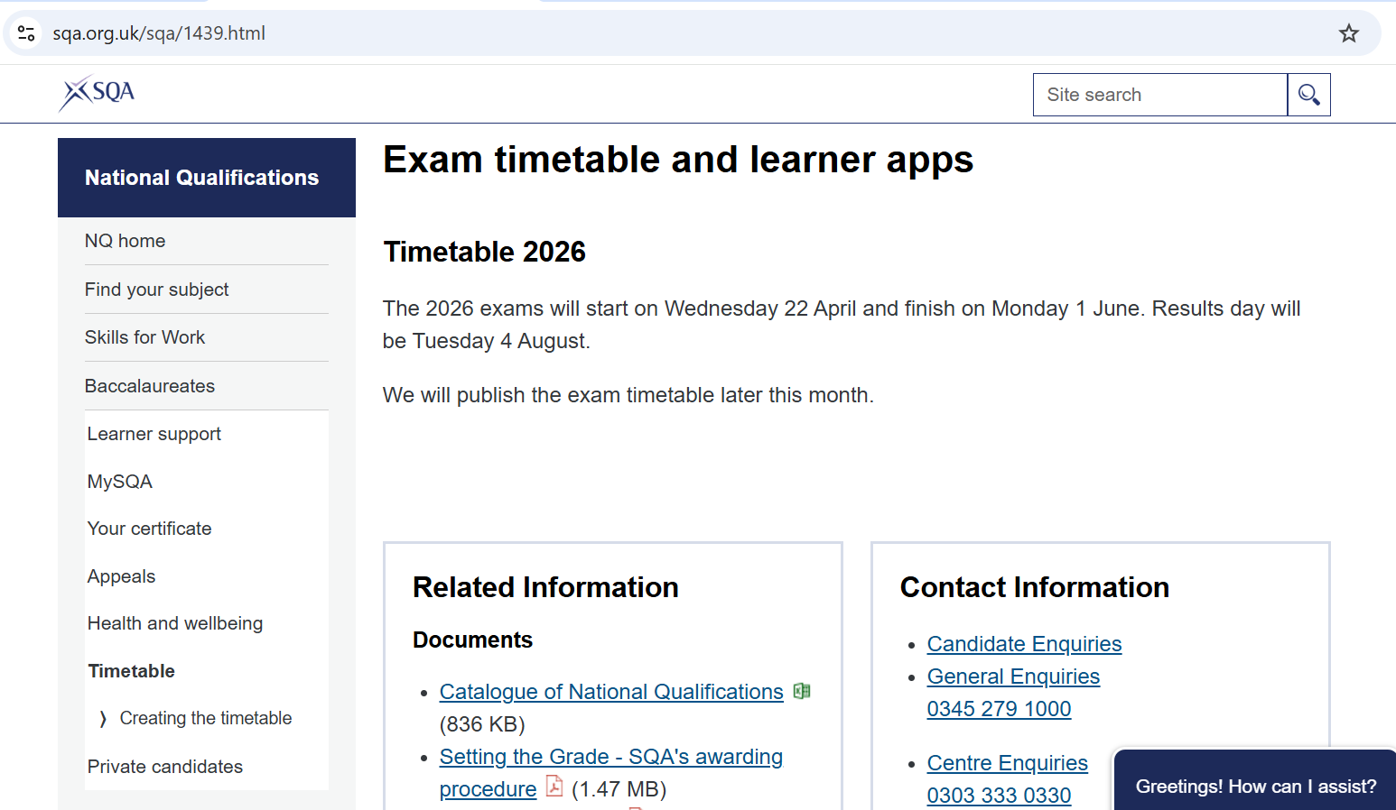
www.mysqa.org.uk

Slide 20

MySQA
SQA’s My Study Plan app will automatically create your own personalised study plan based on your exam times, their importance and when you want to study.
Once the study plan is generated you can view and edit it to customise it further to meet your needs. You can then share your plan as a printable calendar or list.
You can track study progress using the study timer and get optional reminders on the days you plan to study.

Slide 21

Study Planning
Planning ahead is extremely important.
We recommend that pupils create and follow a study timetable to cover all the necessary work in a sensible and manageable way.

Slide 22
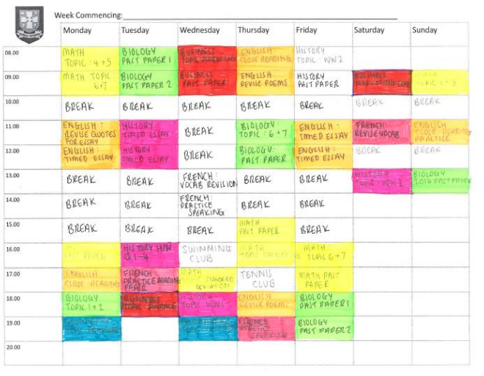

Study Timetables

Slide 23
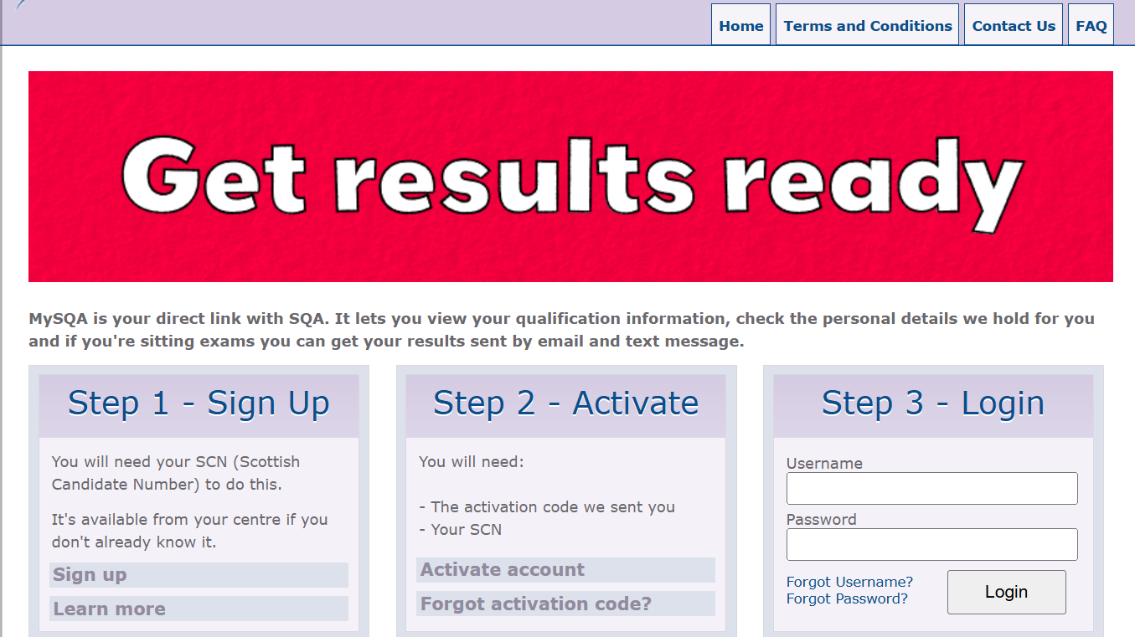
www.mysqa.org.uk

Slide 24

Study CAFE
Pupil study café beginning Tuesday 30th September in the Assembly Hall
Until 5pm

Slide 25


Slide 26

SCQF
https://www.youtube.com/watch?v=6aKZS7T3dUk

Slide 27
What does SCQF level mean?
SCQF stands for Scottish Credit and Qualifications Framework. The SCQF shows how all qualifications in Scotland, such as those awarded by SQA and universities, compare with each other. There's more information on the SCQF website www.sqa.org.uk/scqf.
The level of the qualification shows how demanding it is. There are 12 SCQF levels, with level 1 being the least demanding (the introductory level of qualification) and level 12 the most demanding (for example, PhDs).
SCQF level 7 is the starting point of the higher education levels on the framework.

Slide 28
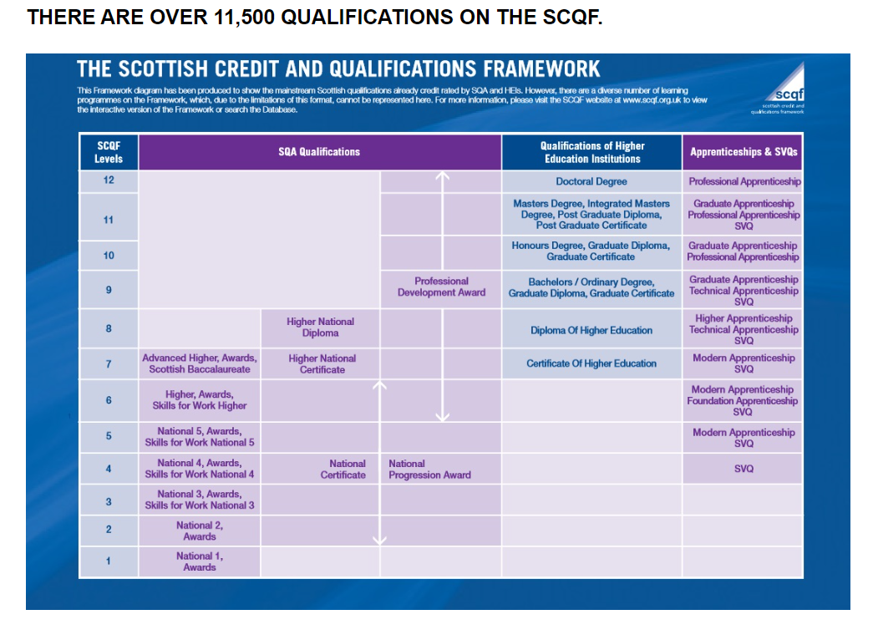

Slide 29
How do SCQF Credit points work and are they the same as UCAS points?
SCQF credit points are based on the amount of time the average learner would take to complete the qualification. As well as including the time spent learning in school, college, university or training, it also includes self-directed learning — study at home or the library.
One SCQF credit point represents a notional 10 hours of learning. So, for example, if you achieve a Higher course (SCQF level 6) with 24 SCQF credits, you will have done about 240 hours of learning.
SCQF credit points do not relate to UCAS tariff points. UCAS tariff points are designed solely for deciding how useful a qualification is for progression into higher education. They take account of the type of qualification and the grade achieved.
By contrast, SCQF credit points measure how much learning needs to be done at a certain level to achieve a qualification, regardless of the grade achieved.

Slide 30
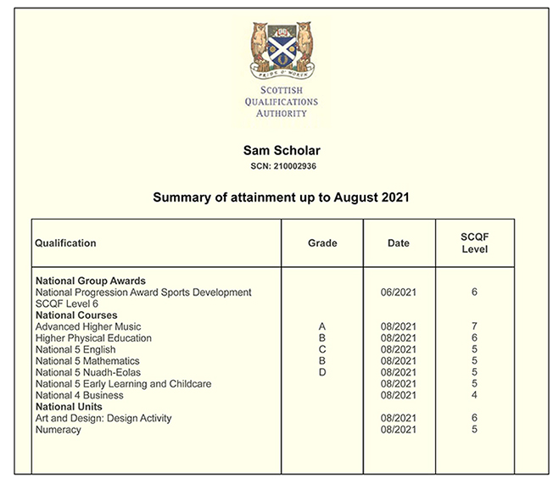
SQA Certificate
Grade Achieved
Subjects
Studied
Date Qualification Achieved
SCQF Level of the Qualification

Slide 32

UCAS and Trinity High School
This Photo by Unknown Author is licensed under CC BY-SA

Slide 33

Information Evening
2025_26

Slide 34
Choosing the Right Path
Each young person is unique and the right pathway post is highly individual:
Employment
College – January and August start courses
Apprenticeships
  Modern Apprentice – opportunity to work in a paid job whilst undertaking workplace training in order to gain new and enhanced skills and recognized qualifications.
  Graduate Apprenticeships – provides an alternative pathway to degree-level study for individuals who want to go straight into employment. Sectors include ICT and Digital, Cyber Security, Data, Civil Engineering, Engineering, Construction and Business (up to Masters level).
University

Slide 35
University Places
In recent years, places at university have become more competitive.
There are several reasons for this including funding cuts and an increase in adult applicants and foreign students (who pay higher fees than the Scottish Government do for Scottish students).

Slide 36
Consequences of more competition
S5 attainment is often not enough. Universities increasingly want to see progress in S6:
  S6 students should be following a curriculum of 4 subjects in addition to attending PE, RE and SE.
  S6 – Volunteering and Leadership
  Pursuing work experience
The key is for students to develop and broaden their skills!
  Personal statements are becoming more and more important for many courses, particularly ‘person-centred’ courses such as Nursing and Teaching, as well as highly competitive courses such as Law and Engineering

Slide 37
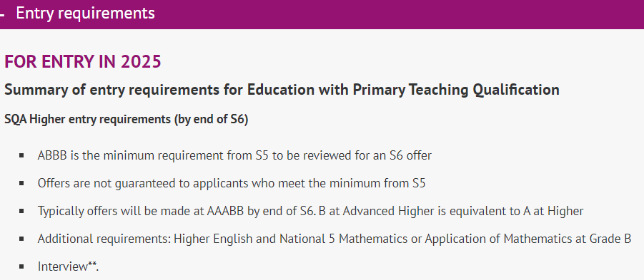

Slide 38
Minimum entry requirements
“Minimum entry requirements” are offered to applicants who may have faced barriers to entry to higher education.
These include:
SIMD 1-4 postcode
Care experience
Young Carer

Slide 39
Choosing a course
Focus on your strengths
Does the course inspire you – try to go to a lecture during a university open day!
Length of course
Which faculty
  Arts / Social Science / Science / Finance / Business / Languages / Engineering /Computing

Slide 40

Choosing a University
Course content – may vary depending on the university
Stay at home/move out
Support available
Job prospects
Facilities
High performance sporting opportunities

Slide 41
What young people need to do…
Research the careers they are likely to be qualified for
Research whether the career/profession suits their interests/personality
Talk to professionals and look for work experience
Consider ‘graduate schemes’ – many companies offer these schemes for graduates with any/multiple different degrees
Attend open days
Check individual university websites

Slide 42
For those applying to start in September 2026
Attend all SE classes
Check the S6 Teams page regularly
Key dates for all applicants:
Fri 19th Sept (tomorrow) – Register with UCAS, link to school, add basic details and grades achieved so far
Fri 10th Oct – Share personal statement with pastoral care teacher and add course choices to UCAS
During the fortnight following Oct break – Meet with pastoral care teacher to discuss application
Fri 21st Nov – Deadline for application to be submitted on UCAS (pastoral teachers then check applications and add their reference)

Slide 43
School Reference
Pastoral staff are required to provide and honest and accurate reference to UCAS
Universities are of the view that a strong performance throughout S6 is a reliable indicator of future success
Estimated grades
  Based on evidence
  1st Tracking report – 7th Nov
All references undergo a quality assurance process

Slide 44
For those applying for Medicine, Dentistry, Vet Med, Oxbridge or Conservatoires
The deadlines for application to these courses are earlier
Music courses at Conservatoires close on 2nd October and all other courses listed above close on 15th October
Young people applying to these courses will already have spoken with their pastoral teacher to discuss earlier deadlines

Slide 45
For those applying for Medicine, Dentistry, Vet Med, Oxbridge or Conservatoires
Key dates for these applicants:
Fri 19th Sept (tomorrow) – Register with UCAS, link to school, add all details of education, employment etc., make course choices, share personal statement with pastoral teacher
w/b 22nd Sept – Meet with pastoral care teacher to discuss and submit application

Slide 46
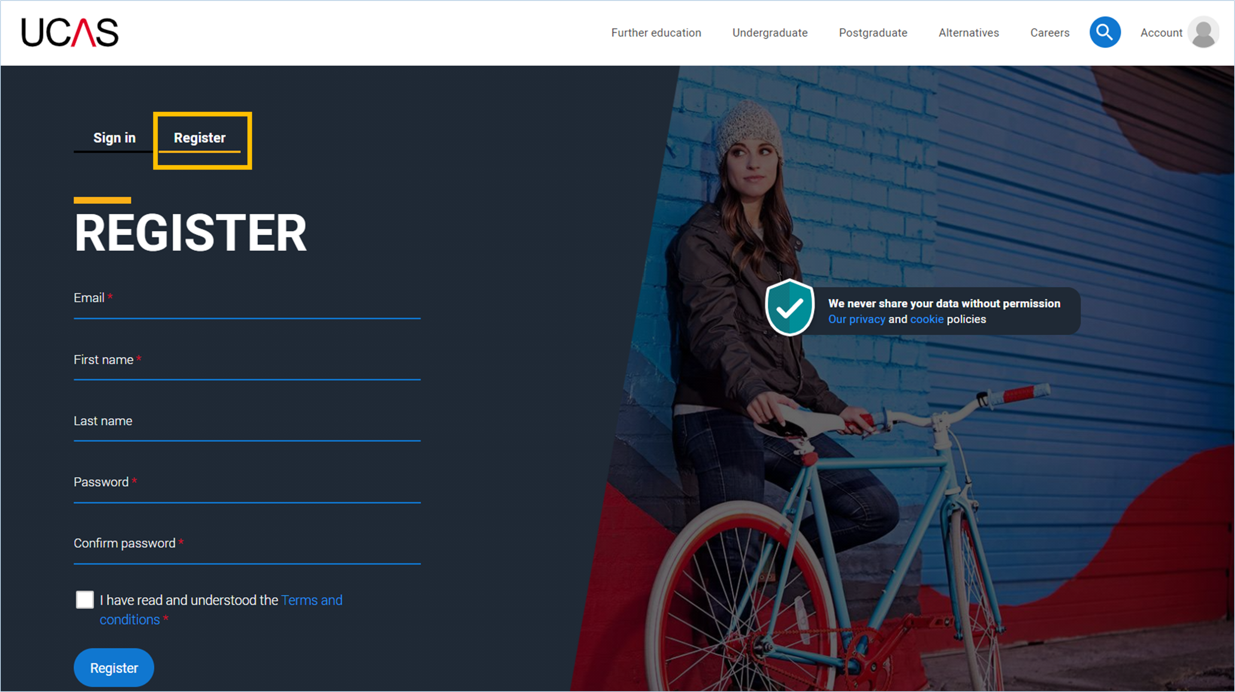
Using the UCAS site
Detailed instructions, including screenshots from UCAS website, can be found on the S6 Teams page.
There are also sample paragraphs to support you to write your personal statement.

Slide 47
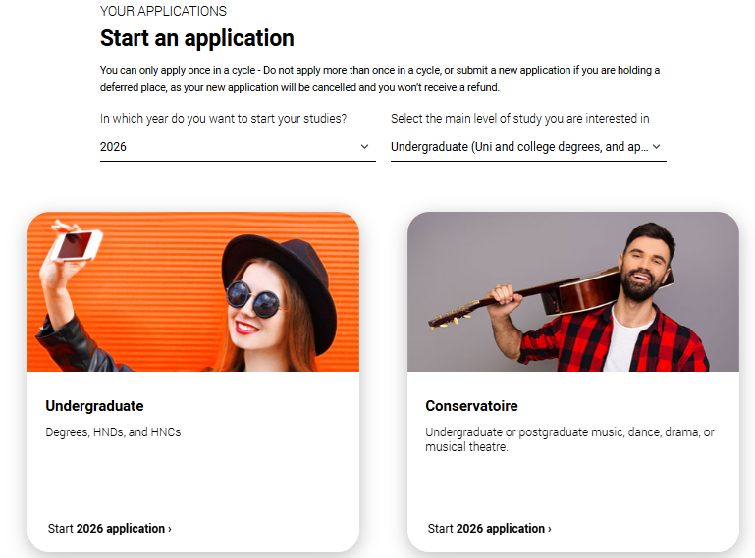
Starting your application
Choose the year you want to start your studies, level of study (it's Undergraduate if you are still at school/college) and type of application you wish to make.
Make sure you choose 2026 if you want to start next year, including if you want to defer entry.
Public

Slide 48
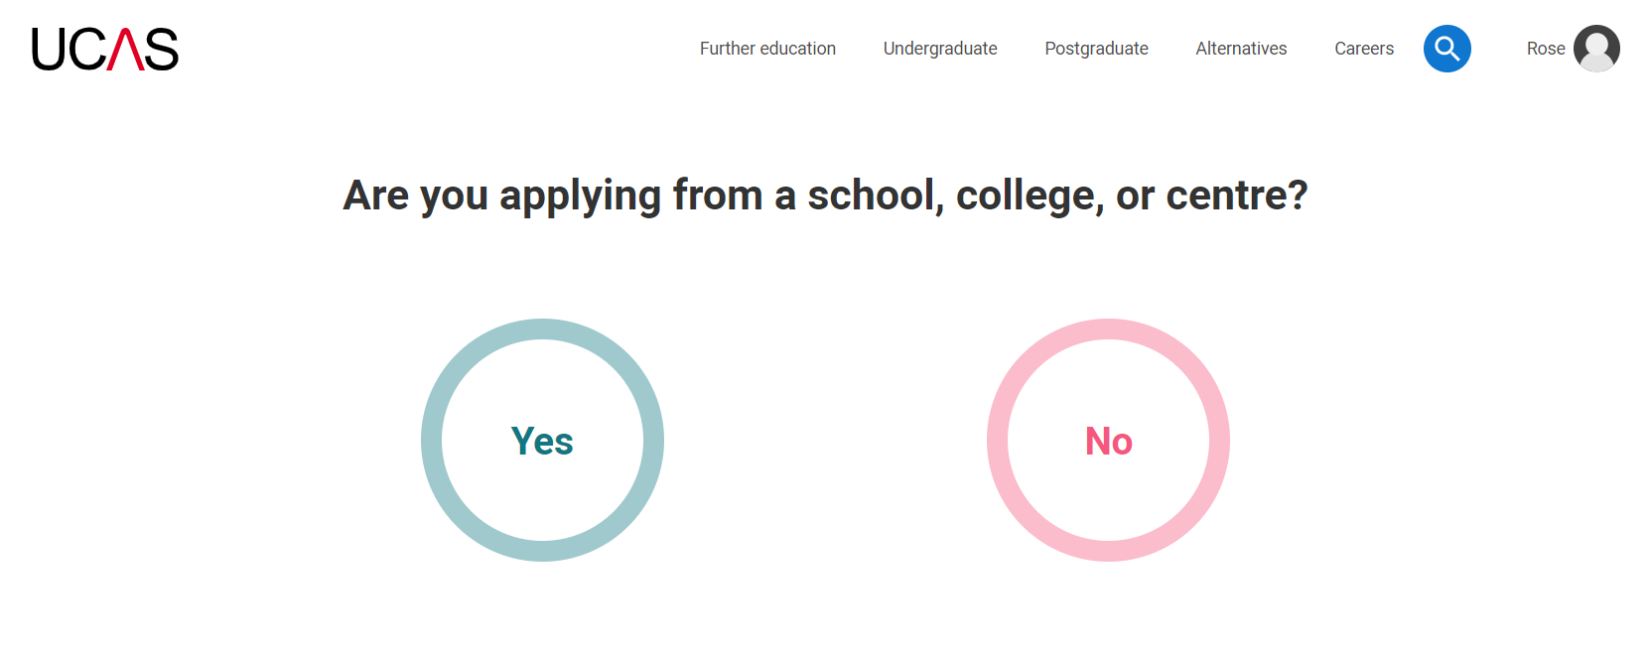
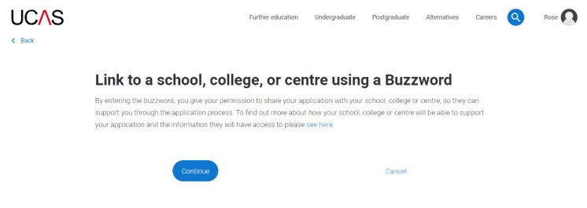
Linking to your school, college or centre
To link to Trinity High School, pupils should select ‘yes’ and the input the buzzword:
THSREN2026
Public

Slide 49
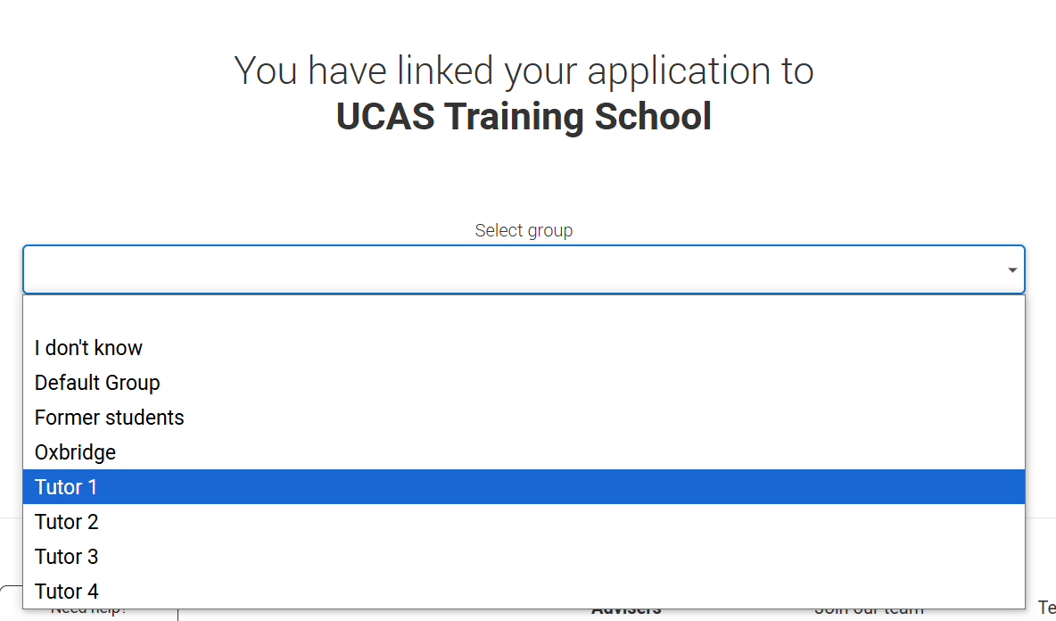
Linking to your school, college or centre
Once your application has been linked, you can then select a group.
You should select your pastoral teacher.
Public

Slide 50
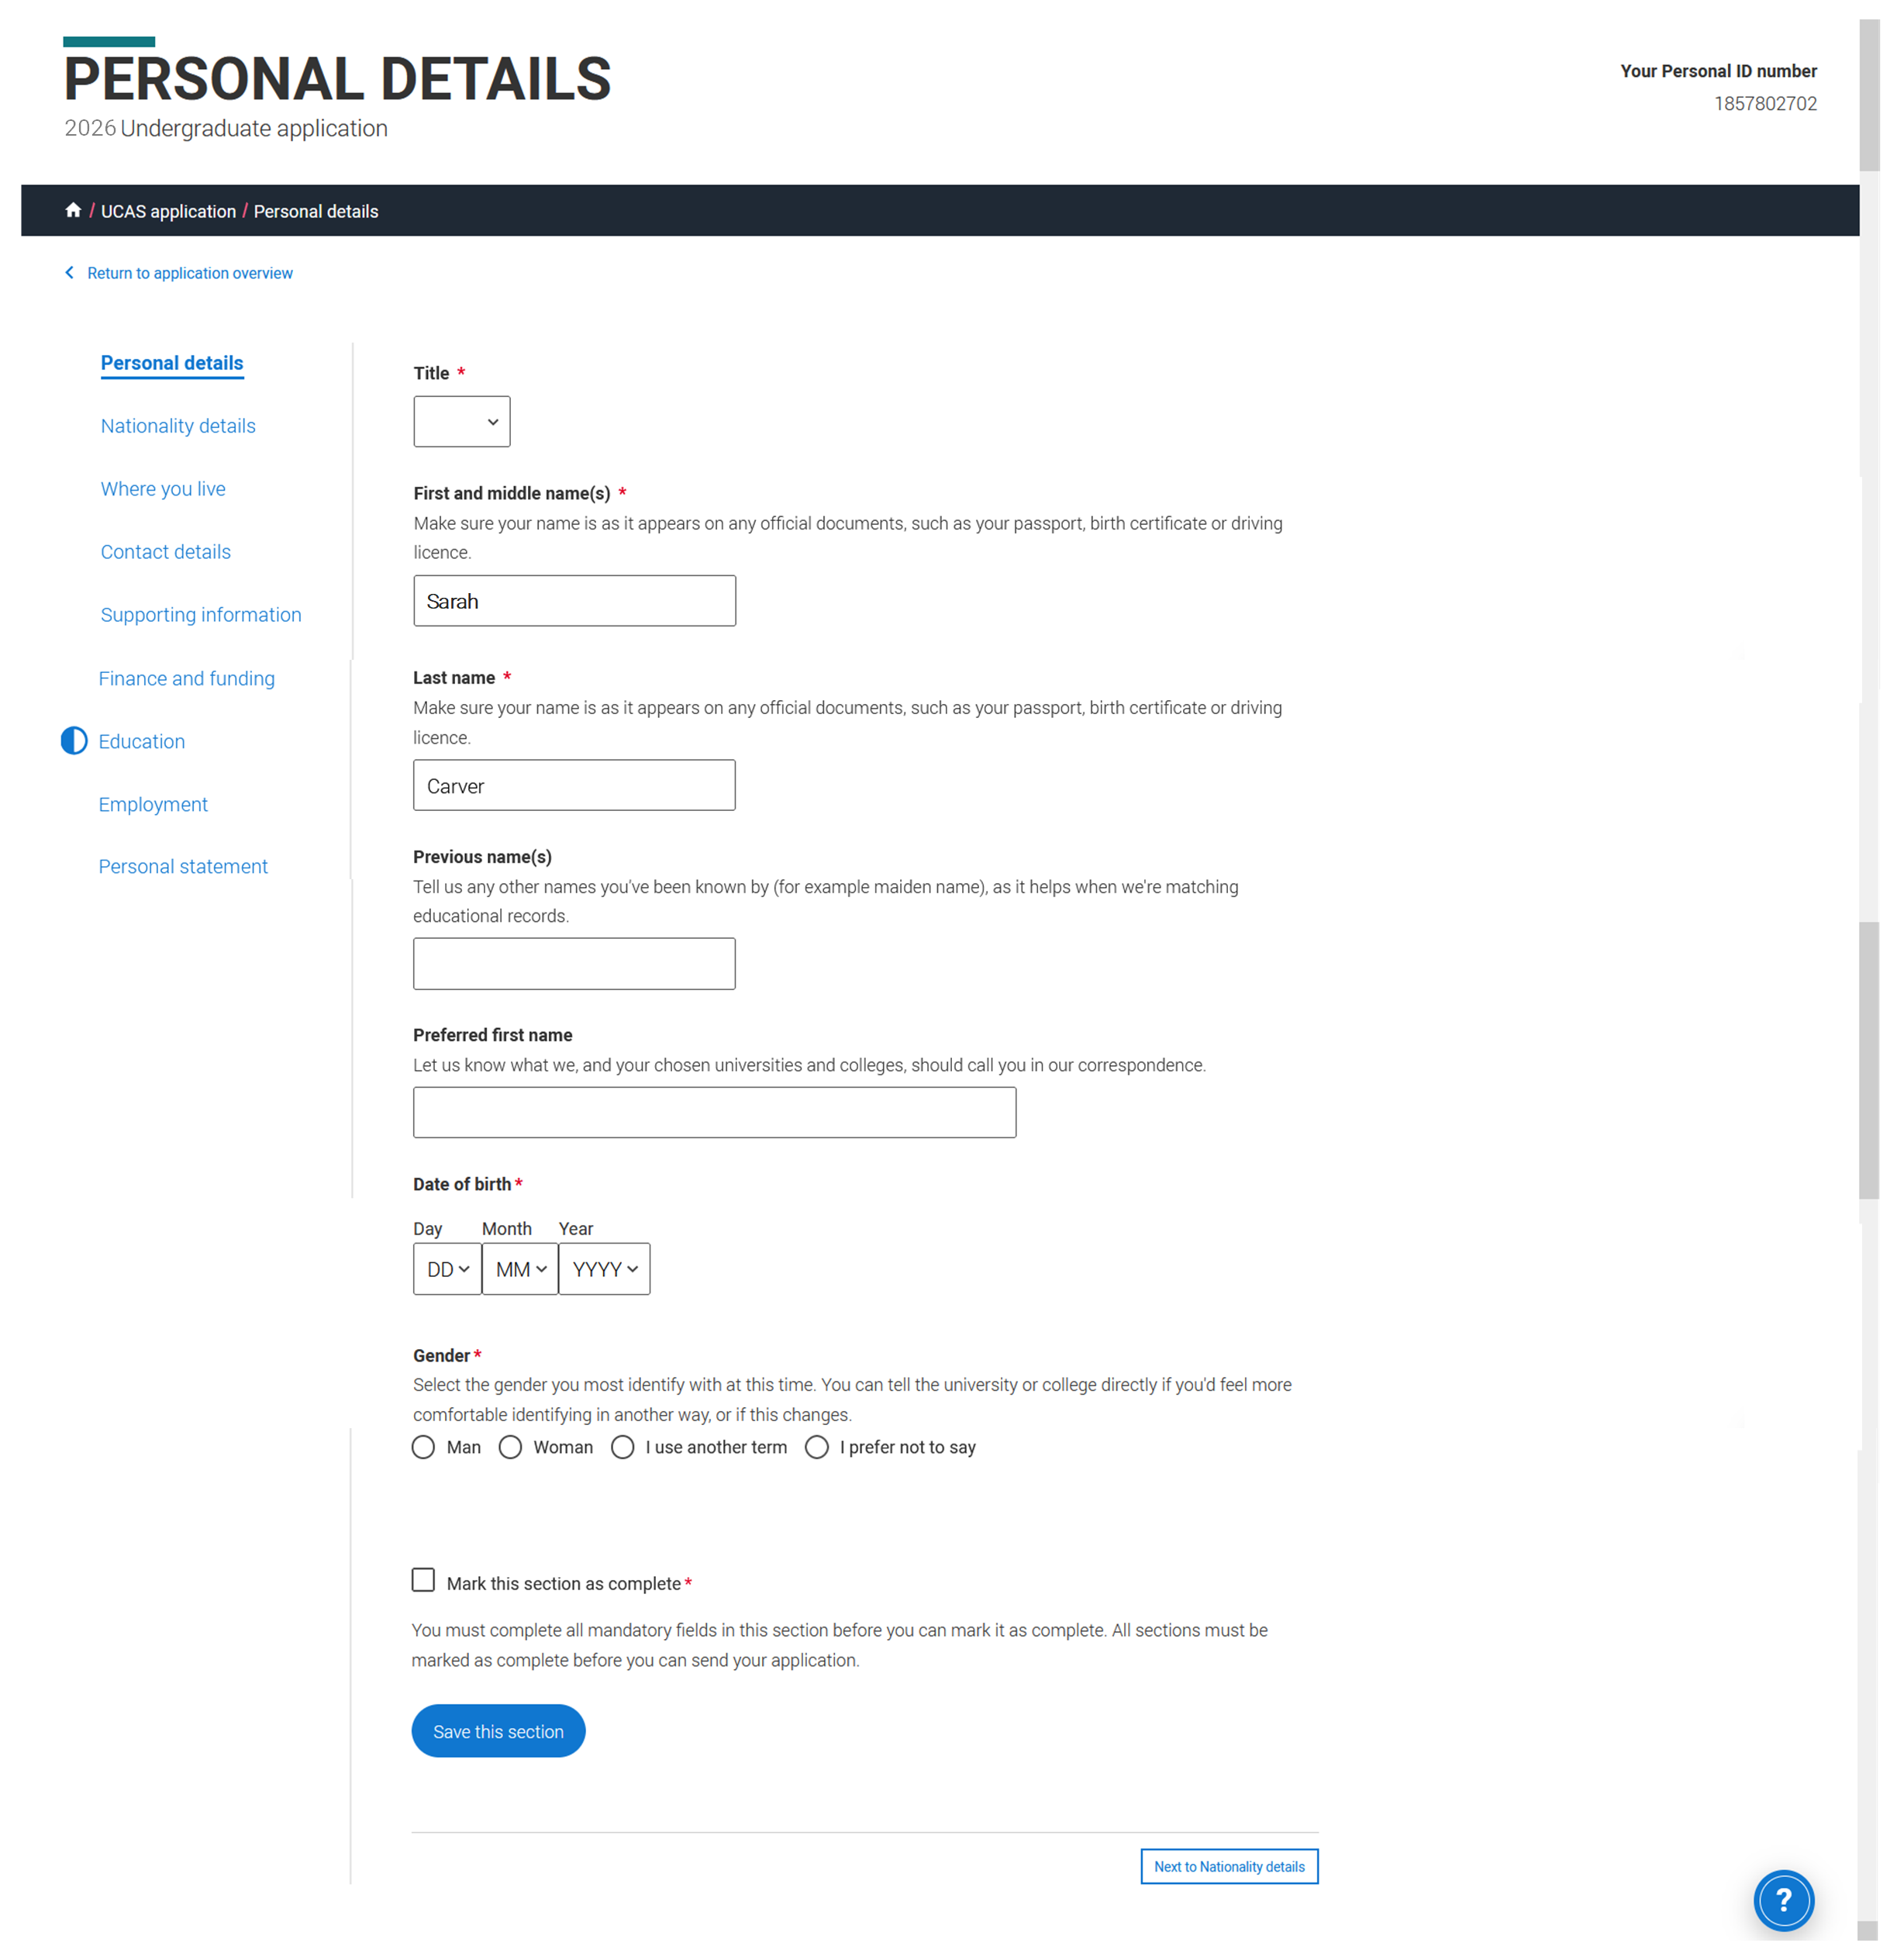
Personal details
Your name should already show, but you'll need to add your title and complete the other mandatory fields (marked with a *).
Please be careful to capitalise proper nouns throughout the application process:
-Your own name
-Street name
-Postcode
-School subject names (e.g. Higher Modern Studies)
Public

Slide 51
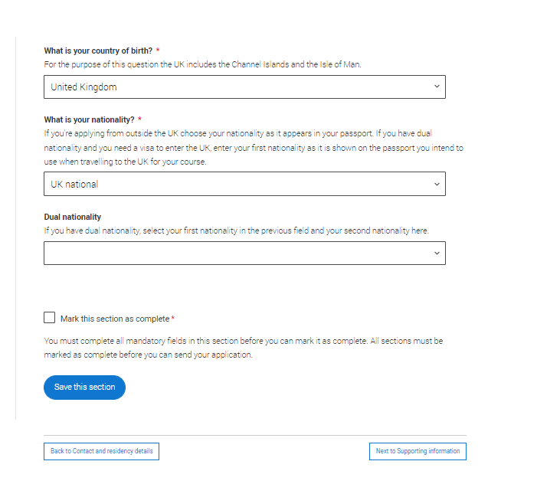
Nationality details
Your nationality is associated with the country that would issue you a passport for international travel. If you don't have a passport, it is usually the country in which you were born.
This is not your ethnicity. Ethnicity refers to your cultural identity and ancestry.
Additional questions may appear based on the information you provide.
If you have lived in Scotland for less than 3 years, see your pastoral teacher to discuss. It is likely that you will not be entitled to have your tuition fees paid for by the Scottish Government.
Public
Notes:
Some courses are only available to students with UK nationality. The information you provide will:
determine your eligibility,
determine the fees you need to pay,
help the university or college to assist you with the visa application process, if required.
If any of this information changes after you have applied, contact your chosen universities and colleges immediately.

Slide 52
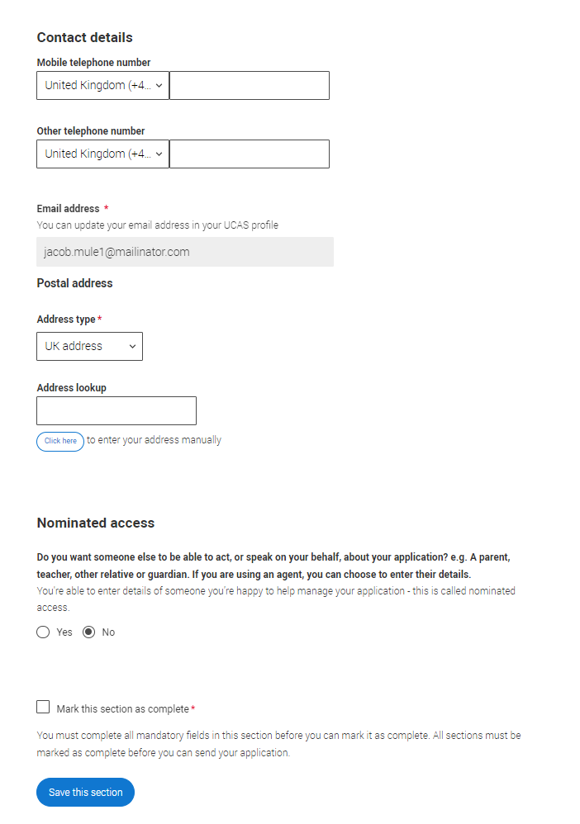
Contact Details
Your email will be used by both UCAS and your university and college choices.
Use your personal email address.
If there is any reason you may not be able to respond to university offers yourself, you will be given the option to nominate a parent/carer to be able to act on your behalf.
Public

Slide 53
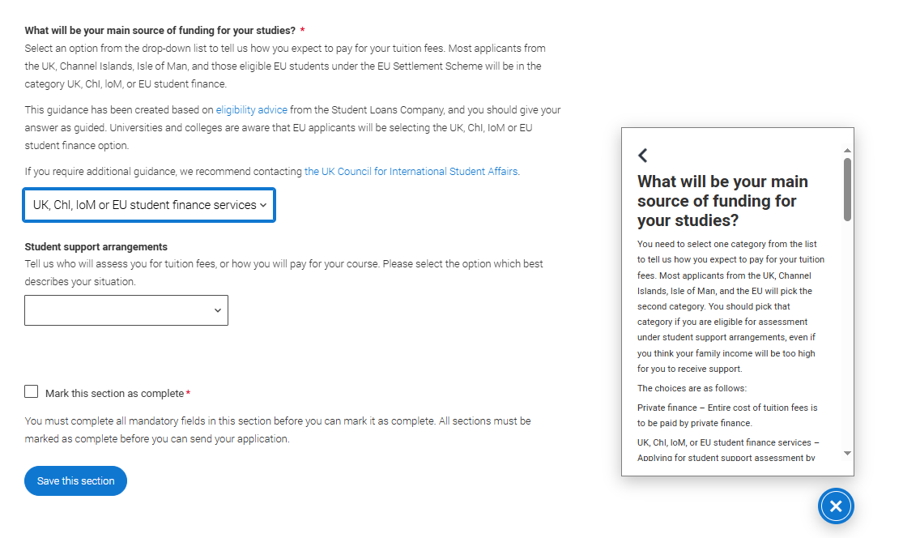
Finance and funding
You will only be asked further questions in finance and funding if you select UK, ChI, IoM or EU Student Finance Services.
You should then select SAAS (Student Awards Agency Scotland).
The Scottish Government will only pay your fees if you apply for SAAS (even if you choose not to also apply for a student loan or bursary).
Public

Slide 54
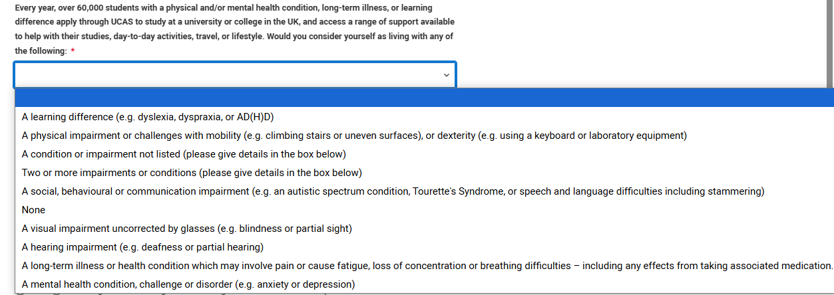
More about you
You can share any individual needs or circumstances, such as a disability or health condition.
Sharing this information helps the university connect you to the right support – they may send you more information or contact you to discuss what would help you succeed.
If you don't have any conditions to report, you select "No disability" to mark the section as complete.
Public

Slide 55
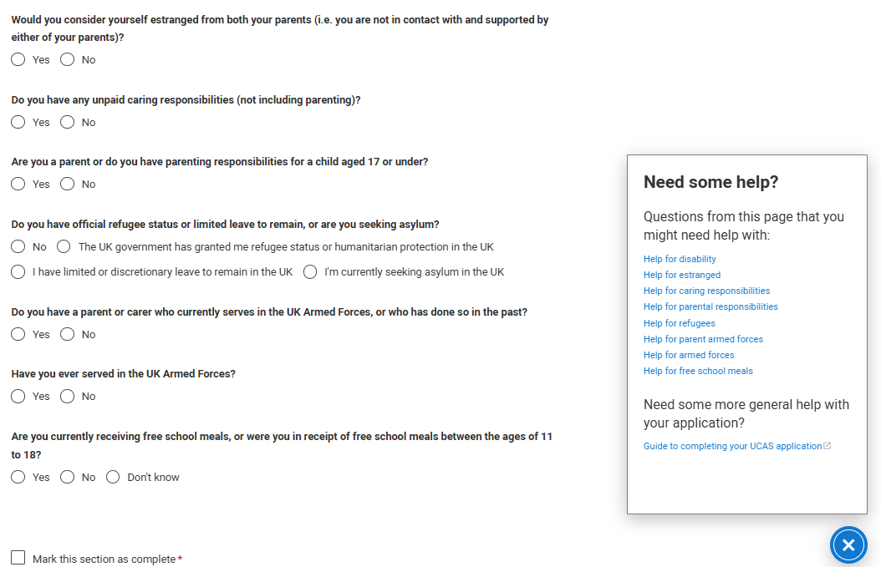
More about you
You might feel uncertain about sharing personal circumstances, be reassured it’s never used to decide whether to offer you a place, but it might be used to make you an offer that looks at your achievements in context.
These questions are intended to connect you to the right support for your needs.
Public

Slide 56
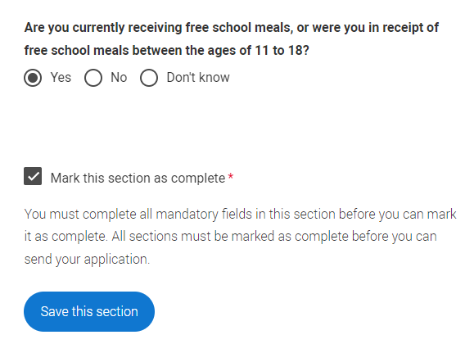
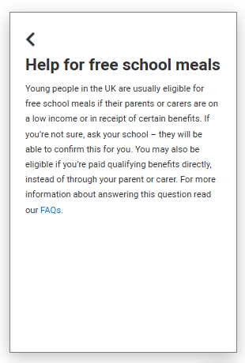
More about you
UCAS Free Schools Meal Application Fee Waiver
You must answer, ‘Yes’ to this question in ‘More about you’ to identify you are eligible for the free school meals application fee waiver.
If you are not entitled to Free School Meals, you will be asked to pay £28.95 by card when you come to submit your application to the school.
Public

Slide 57
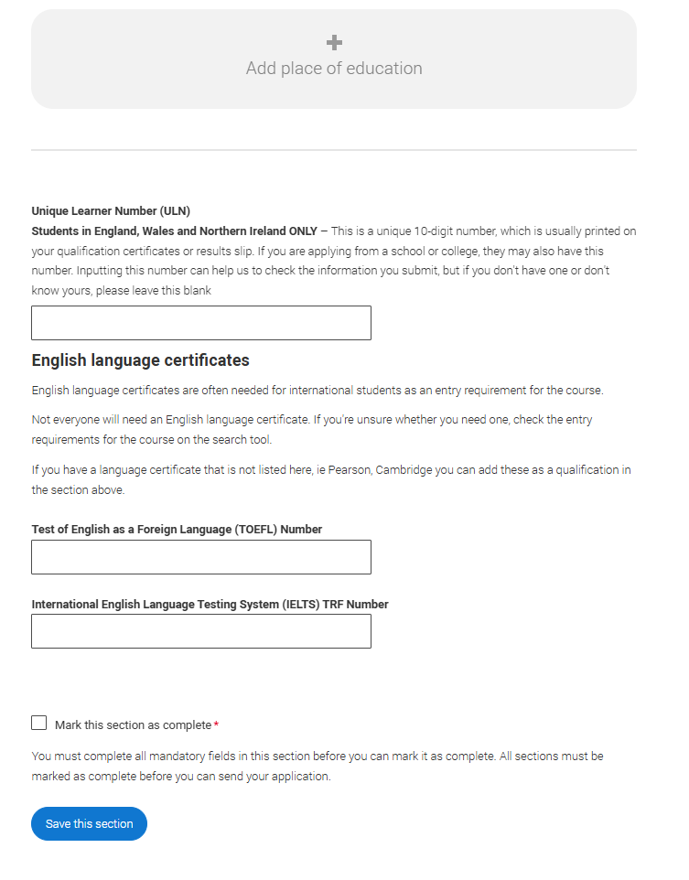
Education
You must enter all your qualifications from secondary education onwards – whether you have the result or you’re still awaiting exams and results.
For qualifications you are sitting this year, select ‘pending’.
When you add your ‘place of education’, you’ll be asked for a ‘Unique Learner Number’ – This is not required for Scottish students.
Public

Slide 58
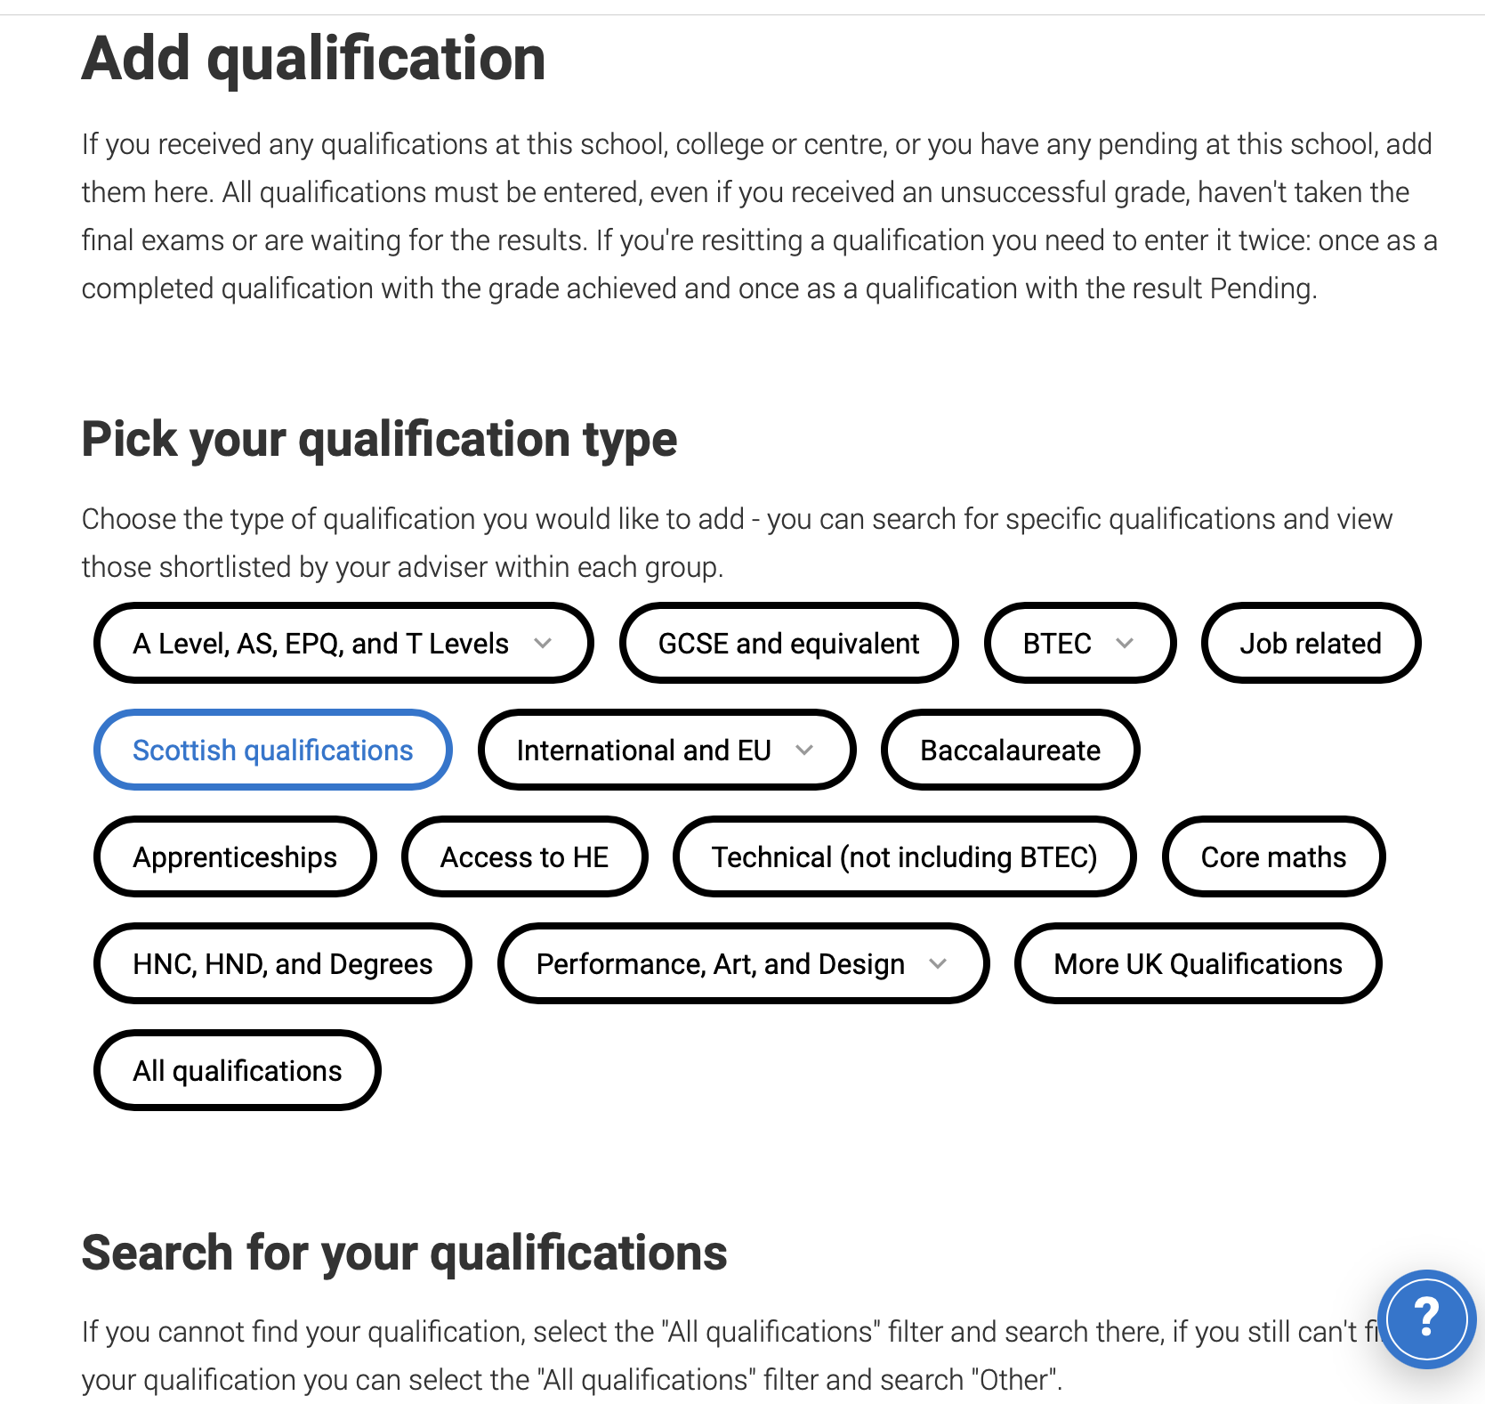
Education
For some courses, you will notice that there are different course code options.
Select the code beginning with ‘C’.
E.g. Higher English – C824; Higher Geography – C833
Public

Slide 59
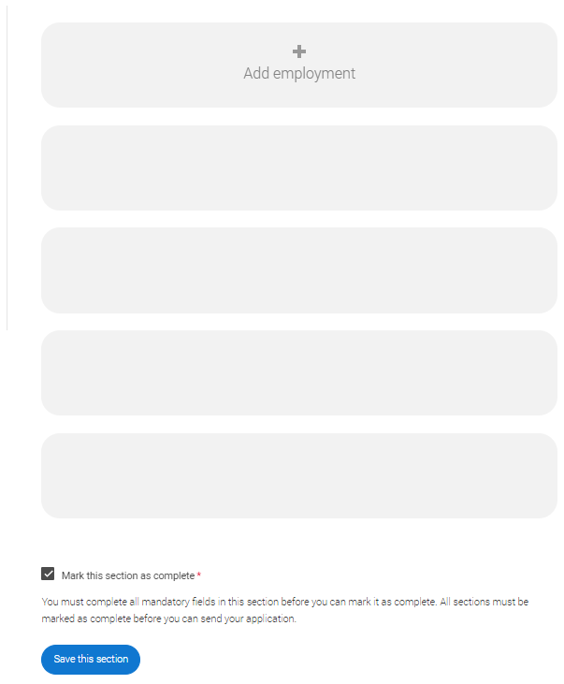
Employment
Include details of any paid employment relevant to the courses or subjects you're applying for.
Any unpaid or voluntary work relevant to the courses or subjects you're applying for shouldn’t be included in this section – you may wish mention that in your personal statement.
If you don’t have any paid work experience, leave this section blank, and mark it as complete.
Public
Notes:
.

Slide 60
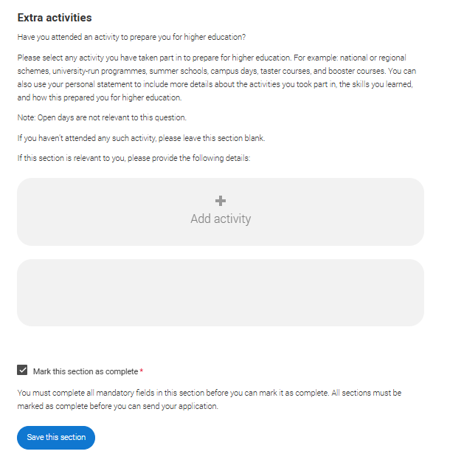
Extra activities
Please add any activity you have taken part in to prepare for higher education.
These include national or regional schemes, university-run programmes, summer schools, taster courses, and booster courses.
Open days are not relevant to this question.
If you haven’t attended any such activity, please leave this section blank and mark it as complete
Public

Slide 61
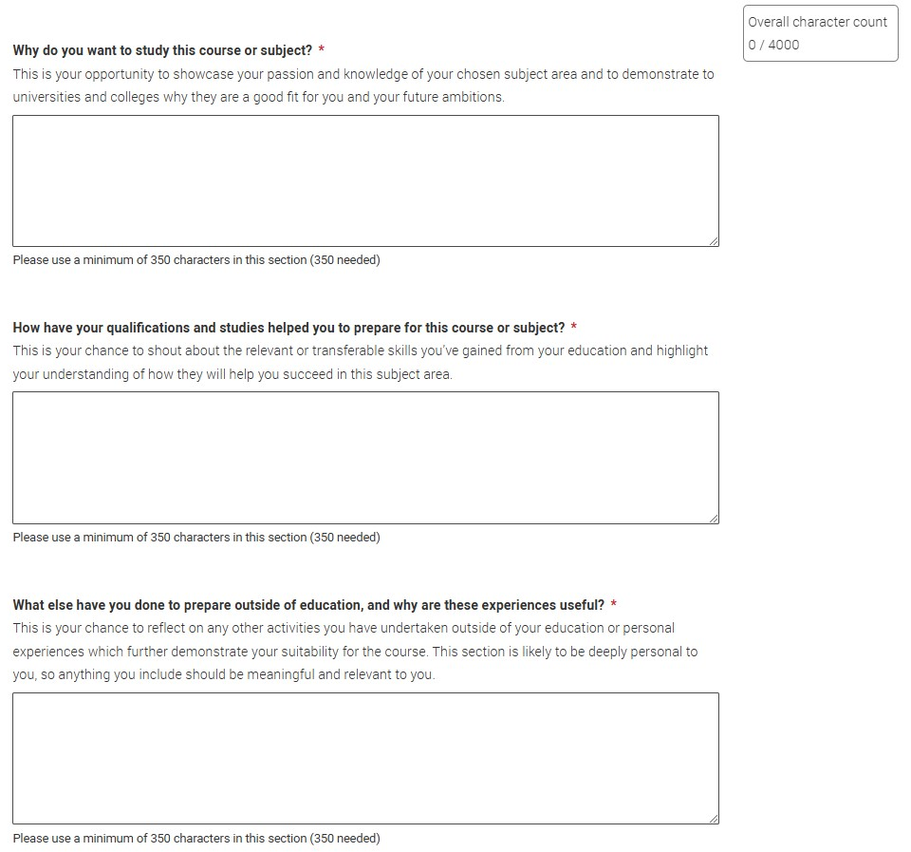
Personal statement
You can save and edit this as many times as you need to.
However, this should be shared with your pastoral teacher by Fri 10th October as a word document.
This allows us to add comments and suggestions.
Public

Slide 62




What are the questions?
“
“
“
Why do you
want to study this course or subject?
How have your qualifications and studies helped you to prepare for this course or subject?
What else have you done to prepare outside of education, and why are these experiences useful?
“
“
“

Slide 63
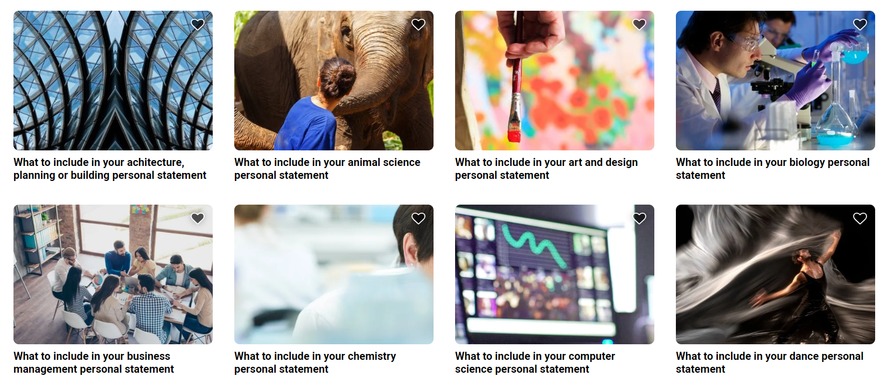
Personal statement guides
All illustrations designed by Storyset on Freepik.com

Slide 64

Q1: Why do you want to study this course or subject?
You’ll want to show evidence of passion, curiosity and interest, this might include:
Motivations for studying this course(s):
Knowledge of this subject area and interests:
Future plans; demonstrate why this course/subject
is a good fit:
Have you been inspired
by a key role model or moment in your life?
Is it a subject you love and want to pursue further?
What is your drive?
How has your path led
you to this course or subject area?
Is there a particular subject area you’ve researched?
Something you can’t wait to learn more about?
What about a book or subject expert doing great things that’s sparked your interest?
Do you already have a particular profession in mind?
How might you use your studies to launch your career?
What’s important to you and your future, and how might
the knowledge gained from
this course(s) help you
achieve this?
Remember these are just some examples, you don’t need to include it all.
The key is to research the course(s) to find out what might be most relevant.

Slide 65
Example: Law
I first gained an insight into the nuanced and ever-changing nature of law when studying drug laws in Scotland and was particularly struck by the way in which legislation evolves in response to the challenges faced by society.
Example: Sports Science
Studying Sports Science is the ideal course to prepare me for a career as a strength and conditioning coach for Olympic athletes. Studying Sports Science will provide me with a deep understanding of human physiology and biomechanics, allowing me to apply scientific principles to elite training environments.

Slide 66

Q2: How have your qualifications and studies helped
you to prepare for this course or subject?
Focus on what’s most recent and relevant to your subject or course(s), examples could include:
How your studies or training relate to chosen course(s) or subject area:
What relevant or transferable skills have you got that make you a great candidate:
Any relevant educational achievements
Are there a couple of subjects that helped you develop a core set of relevant skills required for your chosen course(s).
Maybe a particular module or project helped you understand where your interests and strengths lie.
Universities and colleges will
see your grades on your application - don’t waste space talking about these.
Focus on your other accomplishments like a competition, holding a position
of responsibility or
representing the
school/college.
This could be your current or previous studies.
This could be from any form of formal education – think school, college, training, or short online courses.
Focus on the skills you have developed through your studies and how this has prepared your for studying your chosen course.

Slide 67
Example: Biomedical Science
I have outstanding scientific knowledge, analytical skills and time management skills, as demonstrated by my success in Higher Biology and Chemistry. I am also adept at applying and transferring the knowledge I have acquired from one area of study to another. For example, studying molecular structures allowed me to better understand gene expression. Furthermore, the excellent scores I achieved for both my Biology and Chemistry assignments highlight my ability to plan, carry out and evaluate an experiment safely and effectively.

Slide 68

Q3: What else have you done to prepare outside of
education, and why are these experiences useful?
Examples should be reflective and demonstrate further suitability for your subject or course(s), this could include:
Work experience, employment, or volunteering
Personal life
experiences or responsibilities
Hobbies and any extracurricular or outreach activities:
Achievements
outside of school
or college
In-person or virtual
work experience.
Paid for work or volunteering.
The key thing is reflection on the experiences and
the skills gained relevant to your chosen course(s).
Is there a situation
you’ve personally overcome that has influenced your decision?
Are there personal experiences that have helped you develop essential qualities for
the course?
Think sports, reading, community work,
summer schools.
Any activities outside
of core studies that
help further showcase
why you’d make a
great student.
This could be a position
of responsibility for
local clubs or groups, competitions, or qualifications you’ve attained outside of
the classroom.
Focus on the skills you have developed through these activities. Try to ensure roughly 70% of your personal statement focuses on academics and relevant work experience and around 30% on hobbies and non-related employment.

Slide 69
Example: Generic
As the captain of my basketball team, I have developed a range of skills that extend beyond the court and into my academic development. Being the captain has required me to communicate effectively, motivate others and foster a sense of unity among the team. The role has also strengthened my ability to make strategic decisions and remain resilient in challenging situations, qualities that are vital both in sport and study.
Example: Maths
Working at Next has developed skills directly transferable to studying Maths. In a fast-paced retail environment, I regularly use problem solving and logical thinking to help manage stock, organise displays and respond efficiently to customer needs. Teamwork with colleagues and clear communication with customers have further enhanced my interpersonal skills. These experiences have prepared me to thrive both academically and socially in a university setting.

Slide 70
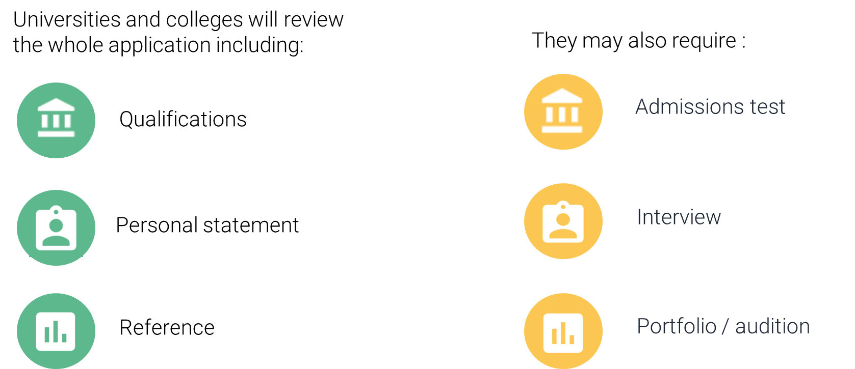
Decisions
Public

Slide 71
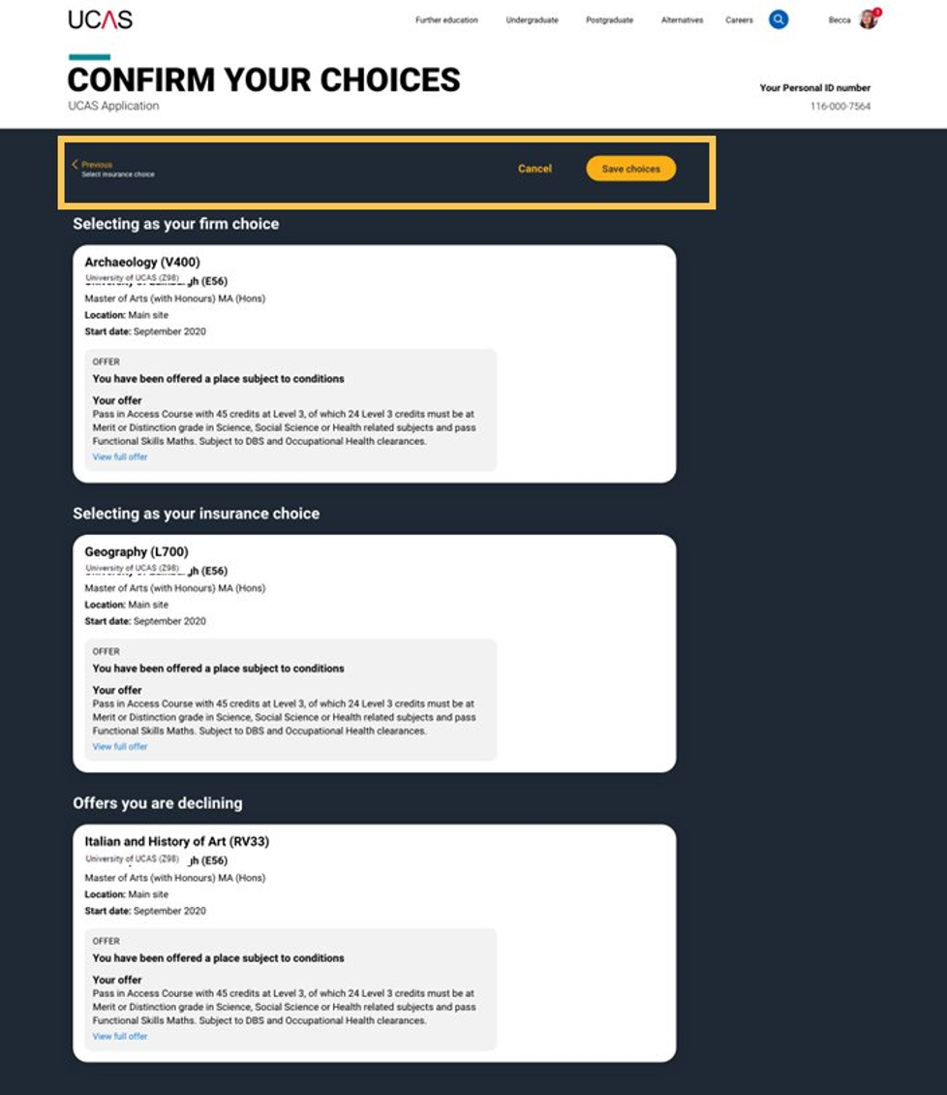
Replies to offers
Once you've made your decisions, choose a 'firm' and 'insurance' choice.
Decline any remaining offers.
If you receive your last decision on or before 31 March 2026, your reply date is 6 May 2026
If you receive your last decision on or before 13 May 2026, your reply date is 3 June 2026
If you receive your last decision on or before 15 July 2026, your reply date is 22 July 2026
Public

Slide 72

Other options
Extra (26 Feb – 1 Jul)
If you have used all five choices and had no offers, you can still find a place using Extra.
Clearing (2 Jul – Oct)
Clearing is for students in various situations, whether you've exceeded expectations, changed your mind, or don’t have a place.
Public

Slide 73
Applying for SAAS
Apply to SAAS for your first choice of course. If you do not get on that course, or if you change your mind, contact SAAS to change your application to another course or cancel your application.
The deadline to apply for student finance for academic year 2025 to 2026 is 31 March 2026.
You need to apply for SAAS so the government pay your tuition fees.

Slide 74
Living cost support
Household Income | Young Student Bursary (Grant) | Loan (Max) | Total Support
£0 – £20,999 | £2,000 | £9,400 | £11,400
£21,000 – £23,999 | £1,125 | £9,400 | £10,525
£24,000 – £33,999 | £500 | £9,400 | £9,900
£34,000+ | £0 | £9,400 | £9,400
Bursaries do not need to be repaid.
You will have student loan repayments deducted from your wage when you start earning once you earn over £32,745 per year.

Slide 75
Information Evening
Any questions?

