Slide 1
Trinity High School Qualifications Information Event
September 2023

Slide 2
Tonight’s Event
Welcome introduction from Mr Marshall, Head Teacher
SQA 2023 Update
Key Information for Parents and Carers
SCQF
Tigers (Foundation Apprenticeships)
West College Scotland

Slide 3
SQA 2023 – National Qualifications
What are National Qualifications?
National Qualifications are one of the most important types of qualification in Scotland, and almost everyone leaving school or college today has one or more National Qualification. They are mainly taken by learners in the senior phase of secondary school (S4 to S6) and learners in colleges.
They cover a range of subjects and are designed to develop the skills and knowledge needed to succeed beyond the classroom; whether progressing to other SQA qualifications, training, employment or university.

Slide 4
How are National Courses Assessed?
National 2, National 3 and National 4
In National 2, National 3 and National 4 courses, learners complete unit assessments throughout the year. National 4 courses also include an end-of-year assessment called an Added Value Unit.
These assessments are marked internally by the teacher, lecturer or training practitioner. National 2, National 3 and National 4 courses are assessed as ‘pass’ or ‘fail’ and are quality assured by SQA.
National 4 courses have been designed to provide flexibility in timetabling and assessment. Internal assessment is more suitable for courses at National 4 level and will help to build learners' confidence in preparation for National 5.
Learners complete a National 4 Added Value Unit assessment instead of an exam, and the Added Value Unit assessment allows them to demonstrate the knowledge and skills they have developed throughout the course.

Slide 5
National 5, Higher and Advanced Higher
National 5, Higher and Advanced Higher
In National 5, Higher and Advanced Higher courses, learners complete a course assessment towards the end of the course. This will usually involve one or more of the following:
Exam
Coursework (such as an assignment, project or portfolio)
Performance
Practical activity
Exams and coursework are submitted to SQA for marking. Depending on the subject, performances and practical activities will be marked through one of the following approaches:
The teacher will mark the assessment and it will be quality assured by SQA.
The assessment will be marked by a visiting examiner appointed by SQA.
The assessment will be marked in collaboration between the teacher, lecturer or training practitioner and a visiting examiner appointed by SQA.
National 5, Higher and Advanced Higher courses are graded A to D or ‘No Award’.

Slide 6
Is a grade D worth more than a National 4?
Yes. National 5 Courses (which are graded A – D) are worth 24 Scottish Credit and Qualifications Framework (SCQF) credit points at SCQF level 5.
National 4 Courses (which are not graded) are worth 24 SCQF points at SCQF level 4 and have a lower level of demand and challenge compared with National 5 courses.

Slide 7
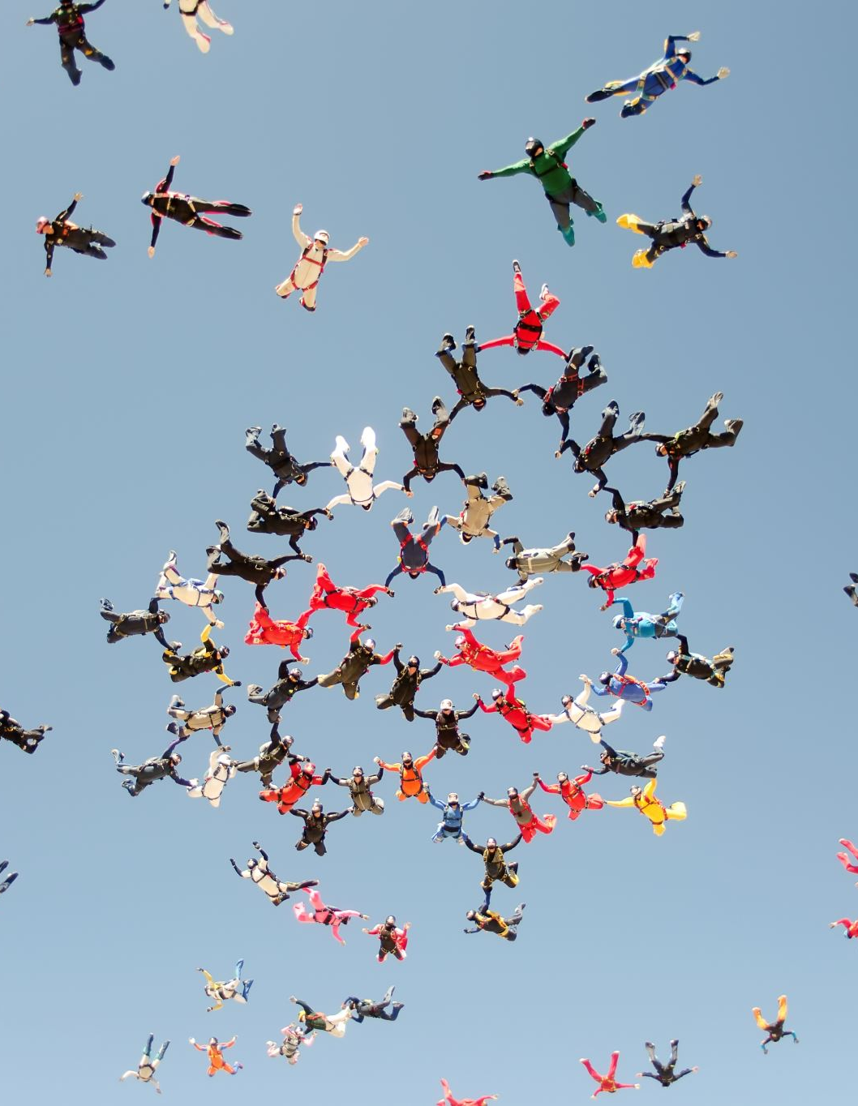
What does a ‘No Award’ mean?
For National 5, Higher and Advanced Higher courses, a ‘No Award’ result means the candidate has not passed the course assessment and therefore has not been awarded the course.
Candidates must score at least 40% in the course assessment to be awarded the course. Those who score less than 40% will receive a ‘No Award’ result.
Is there a fallback position for National Courses?
No, there is no automatic fallback, or other compensatory arrangement at any level. For example, if you fail a National 5 course, you will not automatically receive a National 4 award.

Slide 8
What support is available for learners with support needs?
SQA can allow assessment arrangements to be made for learners in their exams and assessments. For example, a learner who experiences difficulties with handwriting can use a laptop to write up their work. We allow many kinds of assessment support, such as using sign language, human readers, scribes or prompters, or allowing extra time to complete assessments. We can also provide adapted question papers, including Braille question papers, digital question papers, large print question papers and question papers that printed on coloured paper.
Schools, colleges and training providers are responsible for making an ‘assessment arrangements’ request to SQA on behalf of the learner. We will then work with them to find the most suitable arrangement for the learner to complete their assessments. In most cases, the school, college or training provider has already identified the learner's needs and is providing support for them during their studies.

Slide 9
Do all learners sit ‘Prelims’?
Individual schools, colleges and training providers will decide whether to hold prelims. Prelims are not part of the formal assessment process for National Qualifications and are not a requirement.
SQA does not produce or mark prelim papers. Prelim papers are set and marked by the school, college or training provider.

Slide 10
SCQF

Slide 11
What is the SCQF and what does it do?
SCQF stands for Scottish Credit and Qualifications Framework. The SCQF shows how all qualifications in Scotland, such as those awarded by SQA and universities, compare with each other. There's more information on the SCQF website www.sqa.org.uk/scqf.
It supports progression or movement between different qualifications — for example:
how Highers (SCQF level 6) help prepare learners for HNC/HND (SCQF level 7/8) or university degree courses (beginning at SCQF level 7 and awarding at SCQF levels 9 or 10)
how learners who have achieved an HND (SCQF level 8) can often get direct entry into the third year (SCQF level 9) of a related undergraduate degree course in some universities

Slide 12
What does SCQF level mean?
The level of the qualification shows how demanding it is. There are 12 SCQF levels, with level 1 being the least demanding (the introductory level of qualification) and level 12 the most demanding (for example, PhDs).
SCQF level 7 is the starting point of the higher education levels on the framework.

Slide 13
How do SCQF Credit points work and are they the same as UCAS points?
SCQF credit points are based on the amount of time the average learner would take to complete the qualification. As well as including the time spent learning in school, college, university or training, it also includes self-directed learning — study at home or the library.
One SCQF credit point represents a notional 10 hours of learning. So, for example, if you achieve a Higher course (SCQF level 6) with 24 SCQF credits, you will have done about 240 hours of learning.
SCQF credit points do not relate to UCAS tariff points. UCAS tariff points are designed solely for deciding how useful a qualification is for progression into higher education. They take account of the type of qualification and the grade achieved.
By contrast, SCQF credit points measure how much learning needs to be done at a certain level to achieve a qualification, regardless of the grade achieved.

Slide 14
Are qualifications that have the same level, equal?
No. The SCQF level shows that qualifications at the same level involve the same complexity of learning, but each qualification may differ in terms of the subject, purpose and size.
For example; qualifications on the same level may have a different number of credit points, which will show that more time is needed to achieve the qualification. For example, an Advanced Higher is at SCQF level 7 and has 32 credit points, while a Higher National Certificate is also at SCQF level 7and has 96 credit points.
Not only are the qualifications different sizes, but they are also different types and serve different purposes.

Slide 15
Tigers
Foundation Apprenticeships

Slide 16
West College Scotland Vocational Courses

