Slide 1
You will have the opportunity to choose RMPS for your Nat 5 and Higher

Slide 2
RMPS stands for…
Religious
Moral
Philosophical
Studies
Which means…

Slide 3
You will be studying One World Religion
Religious

Slide 4
What is God like?
What is the golden rule?
How, where and why do religious people worship?
Why do humans act in a particular way?
What was Jesus like? Did he exist?
What happens after we die?

Slide 5
You will be studying Medicine and the human body
Moral

Slide 6
You will be studying Medicine and the Human body
Moral
End of life care
Organ Donation
Assisted dying
Giving consent
Voluntary and non voluntary Euthanasia
Living donors
In vitro Fertilisation (IVF)
Use of embryos in research

Slide 7
Does God really exist or not?
You will be studying One Philosophical Question
Philosophical

Slide 8
What are the origins of the universe?
You will be studying One Philosophical Question
Philosophical
How does religion explain the origins of the universe and of life?
How does science explain the origins of the universe and of life?
What evidence does religion use to support these explanations?
Can religious and scientific views on origins be compatible?
What are the strengths and weaknesses of evidence/explanations?
Was the universe and life created?

Slide 9
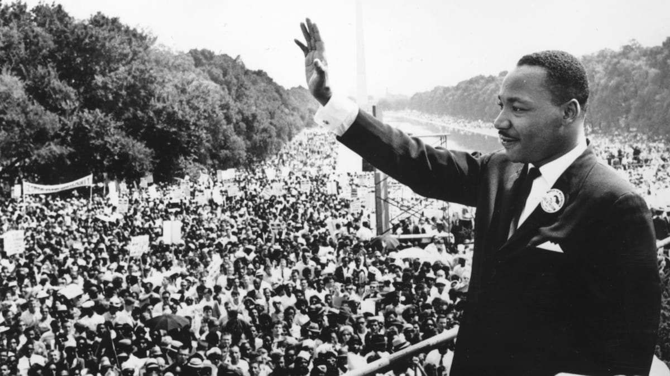
Here are some examples of RMPS graduates
Matt Groening – Creator of The Simpsons and Futurama
Martin Luther King – Human Rights Activist

Slide 10
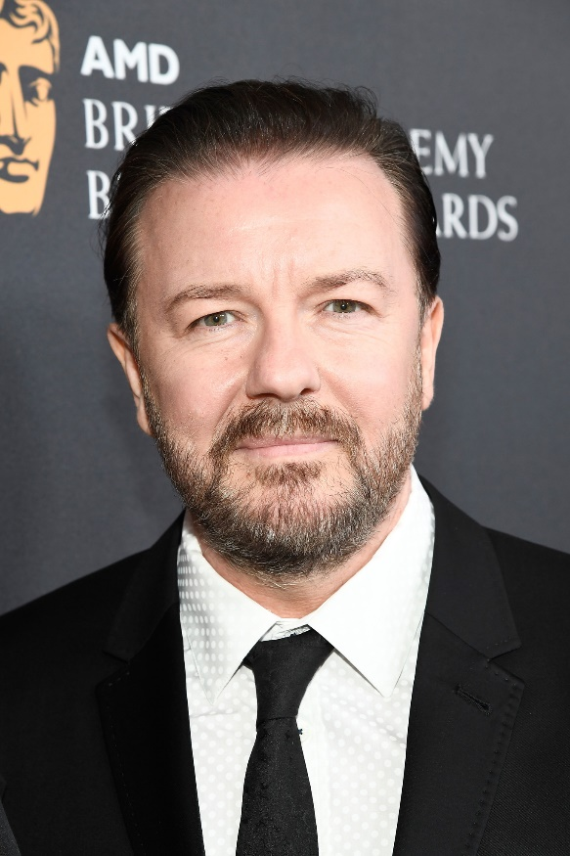
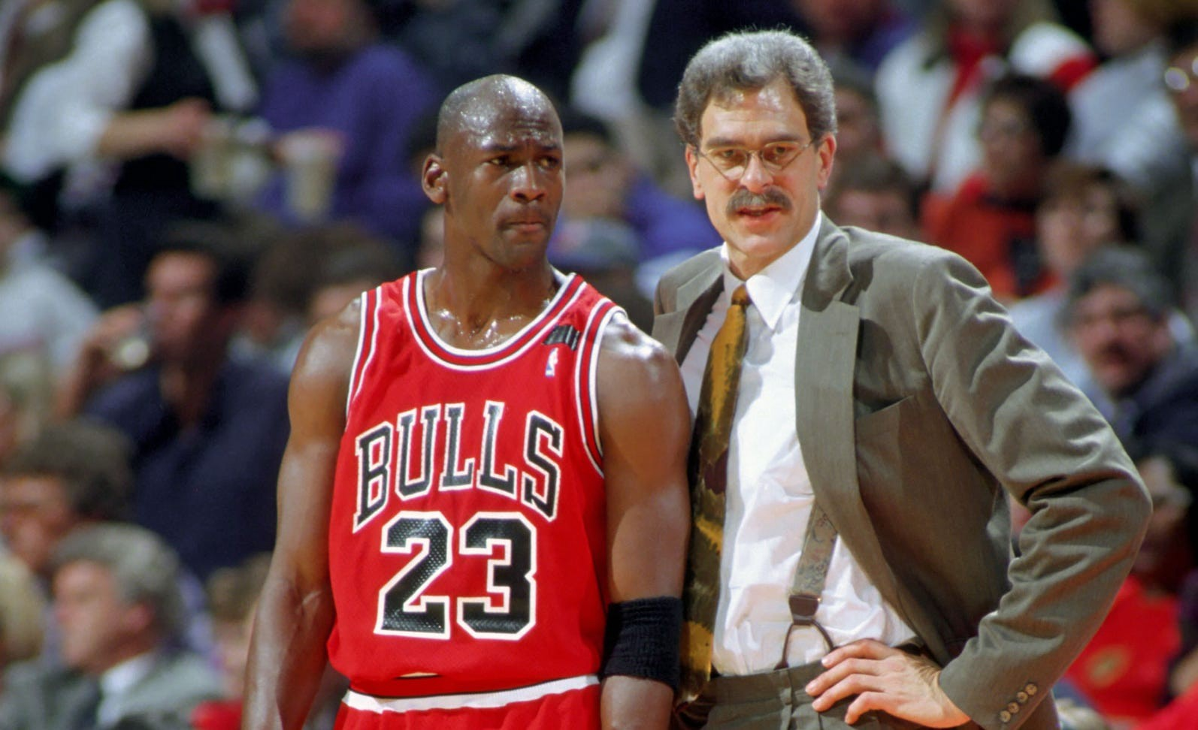
Here are some examples of RMPS graduates
Ricky Gervais – Comedian, Actor, Producer
Phil Jackson – Basketball Coach

