Slide 1
You will have the opportunity to choose RMPS for your Nat 4 and Nat 5

Slide 2
RMPS stands for…
Religious
Moral
Philosophical
Studies
Which means…

Slide 3
You will be studying One World Religion
Religious

Slide 4
What is God like?
What is the golden rule?
How, where and why do religious people worship?
Why do humans act in a particular way?
What was Jesus like? Did he exist?
What happens after we die?

Slide 5
You will be studying Human Relationships
Moral

Slide 6
You will be studying Human Relationships
Moral
Equality and exploitation
Consideration of gender roles
Sexual relationships
How religion is presented in the media
Marriage, civil partnerships and divorce

Slide 7
Does God really exist or not?
You will be studying One Philosophical Question
Philosophical

Slide 8
Does God really exist or not?
You will be studying One Philosophical Question
Philosophical
How do you create a successful argument?
Can religion and science be compatible?
Does God exist?
How was the universe created?
Where does our knowledge come from?
What makes an argument good or bad?

Slide 9
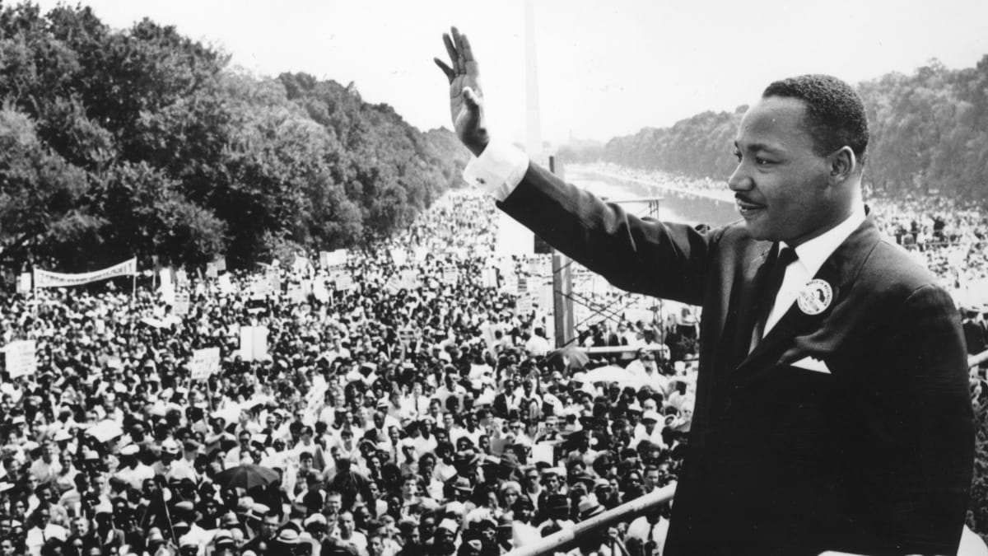
Here are some examples of RMPS graduates
Matt Groening – Creator of The Simpsons and Futurama
Martin Luther King – Human Rights Activist

Slide 10
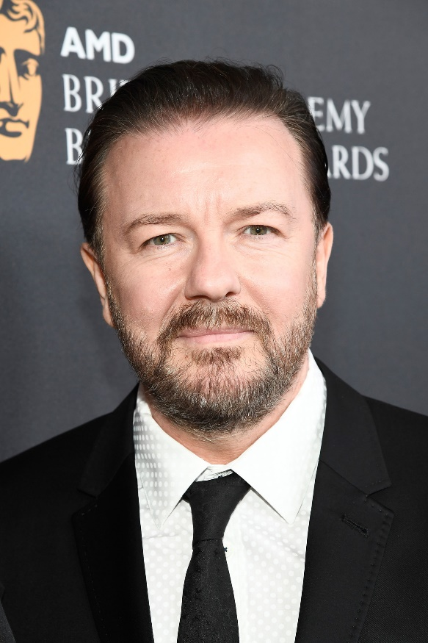
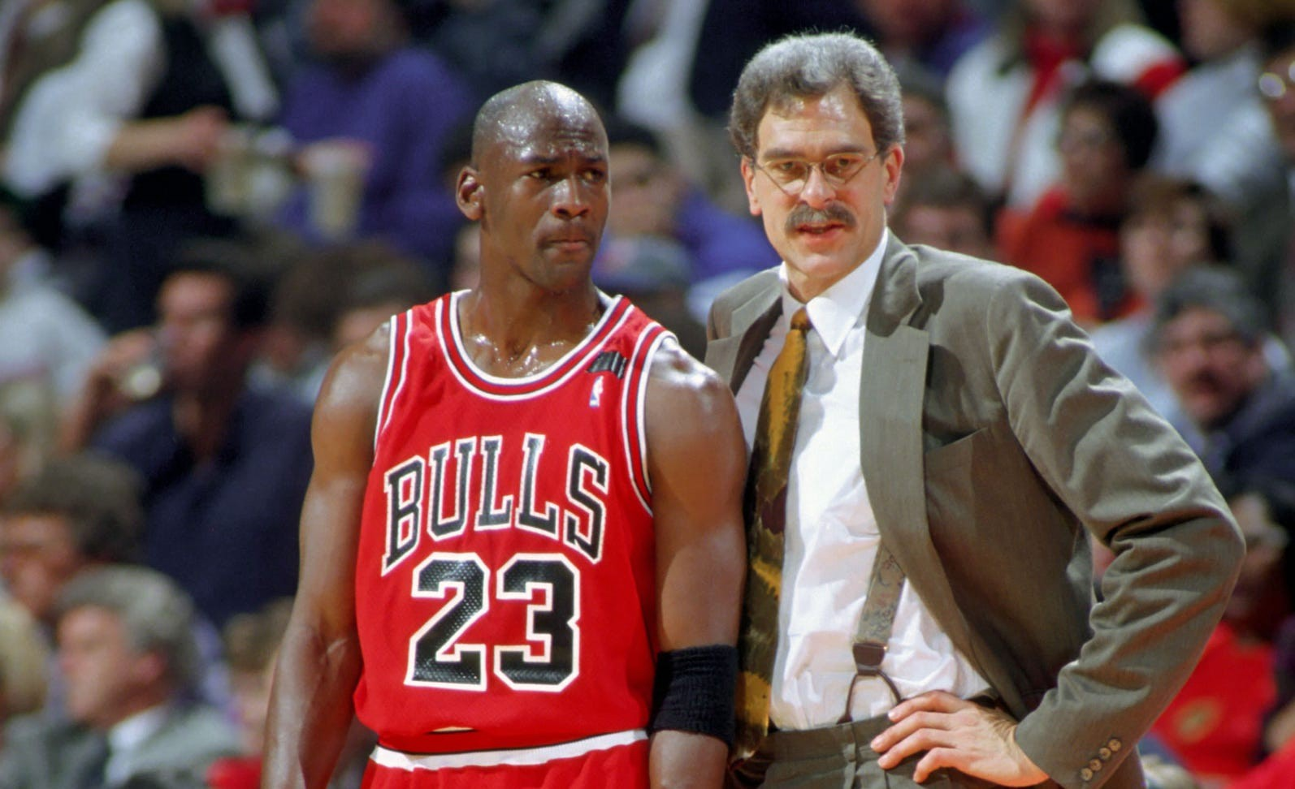
Here are some examples of RMPS graduates
Ricky Gervais – Comedian, Actor, Producer
Phil Jackson – Basketball Coach

