Slide 1
For your S1 Religious Education class…We are going on an Adventure!

Slide 2
Here are some of the Highlights of our Journey:

Slide 3
Here are some of the key skills which pupils will develop during their Religious Education course.

Slide 4
RE focuses on these three aspects of the human experience:
Religious
Moral
Philosophical

Slide 5
Pupils will be studying World Religions
Religious

Slide 6
Pupils will be studying Human Relationships
Moral

Slide 7
Does God really exist or not?
Pupils will be studying Philosophical Questions
Philosophical

Slide 8
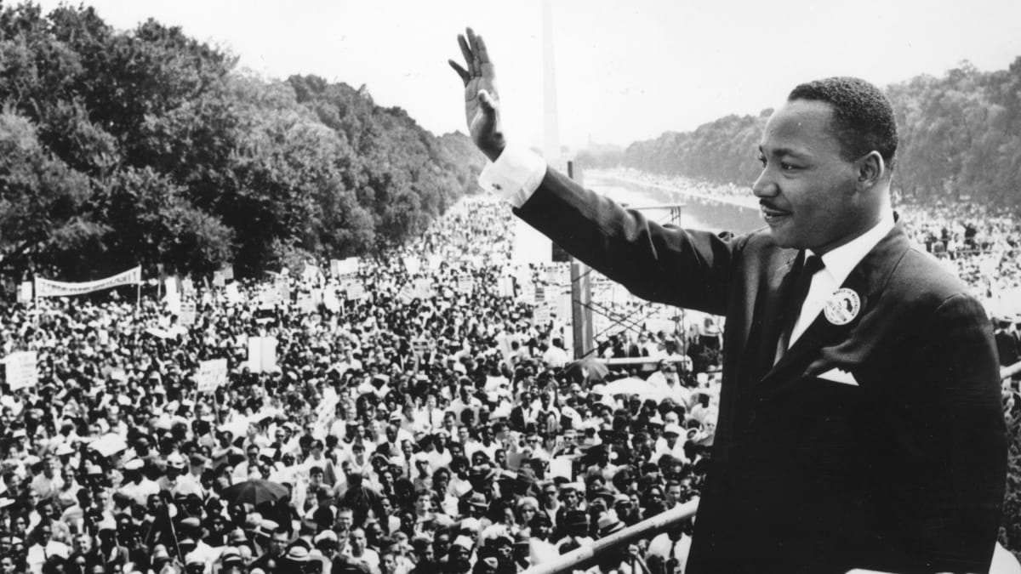
Here are some examples of RE graduates
Matt Groening – Creator of The Simpsons and Futurama
Martin Luther King – Human Rights Activist

Slide 9
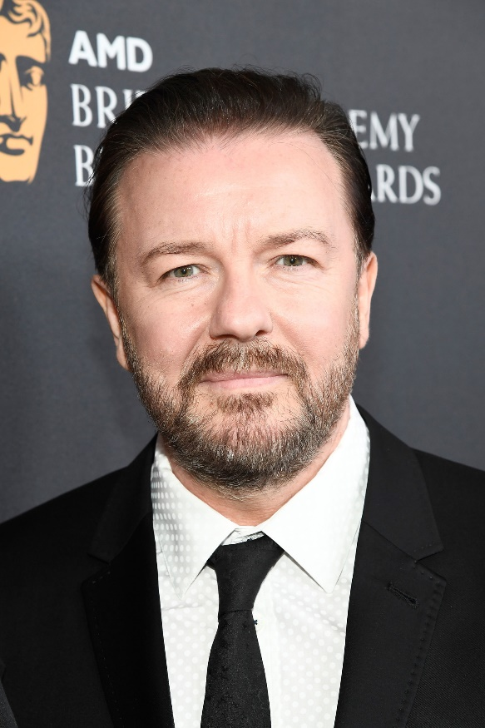
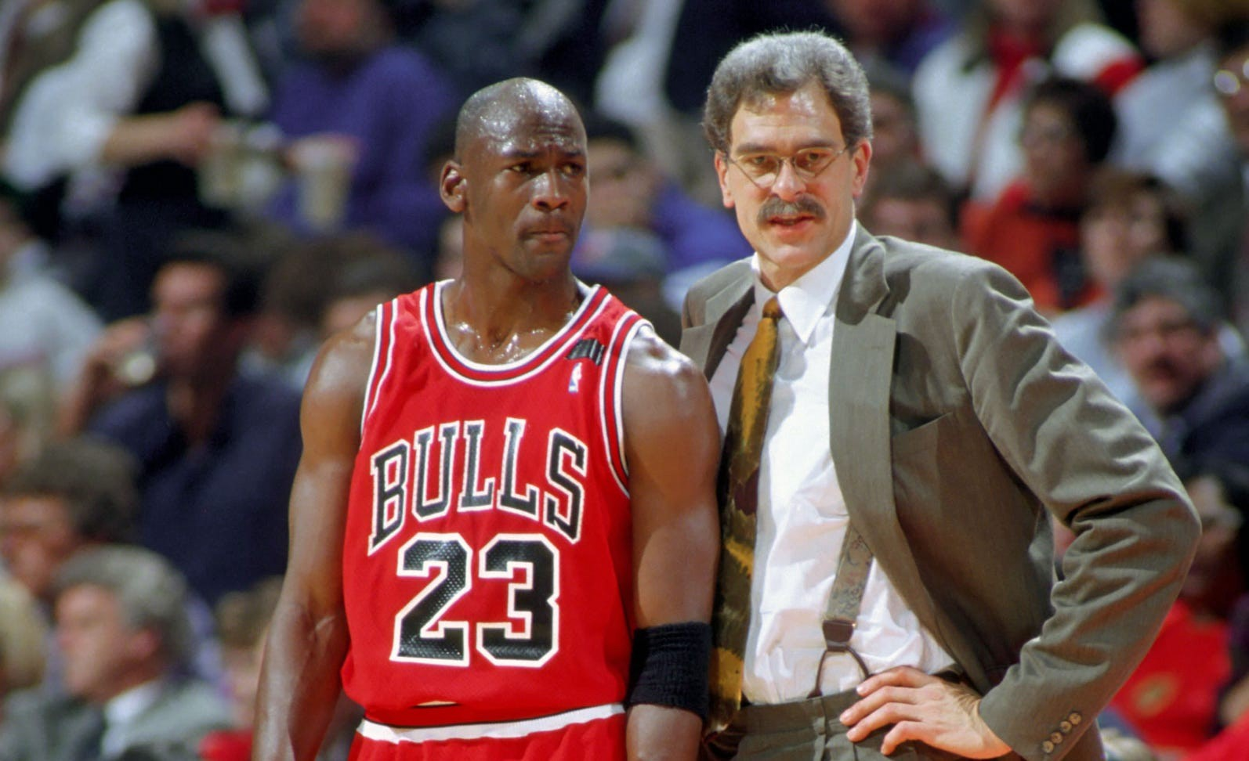
Here are some examples of RE graduates
Ricky Gervais – Comedian, Actor, Producer
Phil Jackson – Basketball Coach

Slide 10
But there will also be a lot more to discover in our RE course, which is deeply rooted in our Core Values…

Slide 11
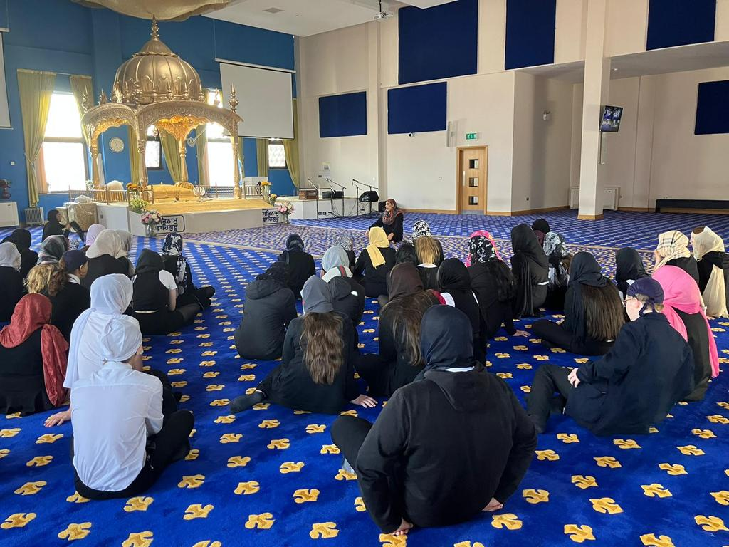
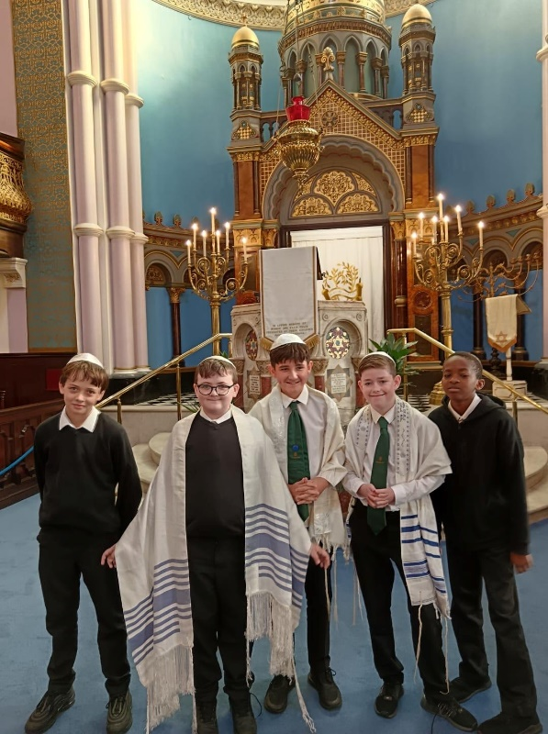
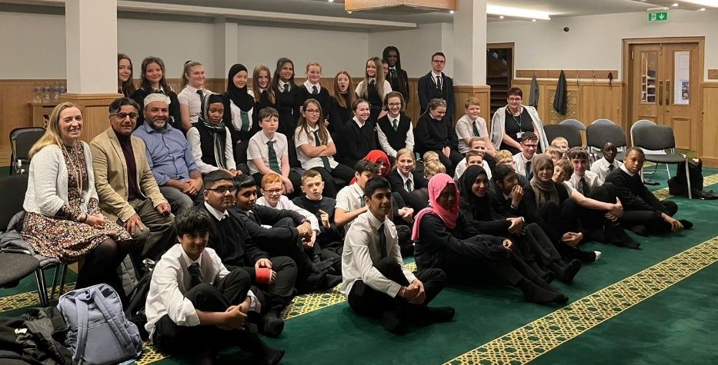
THS Core Value: Respect
Respect means showing regard for the feelings, wishes and rights of others.
In RE we experience Respect by learning about different World Religions and visiting their places of worship.

Slide 12
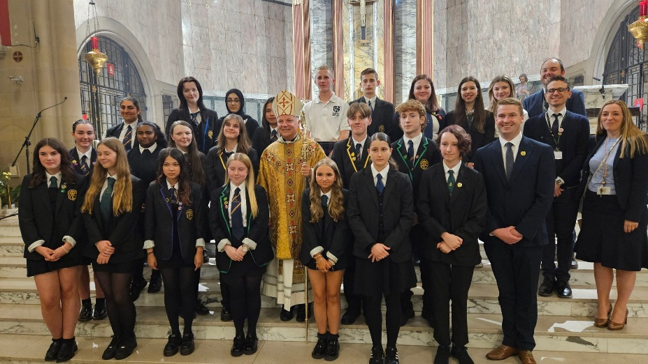
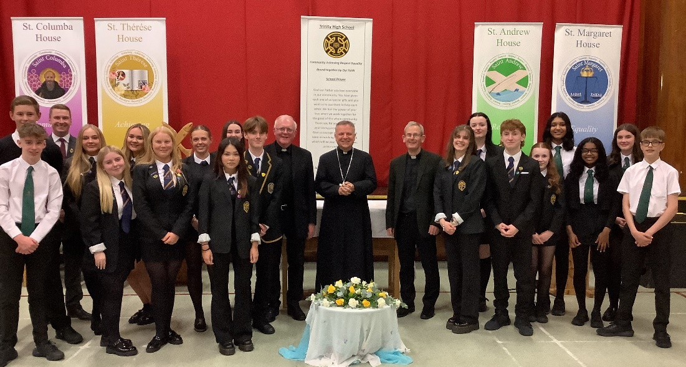
THS Core Value: Community
Community means a group of people who work closely together with shared interests.
In RE we experience the value of Community by being involved whole school and diocesan initiatives. By working together with other people, we discover we are part of larger community.

Slide 13
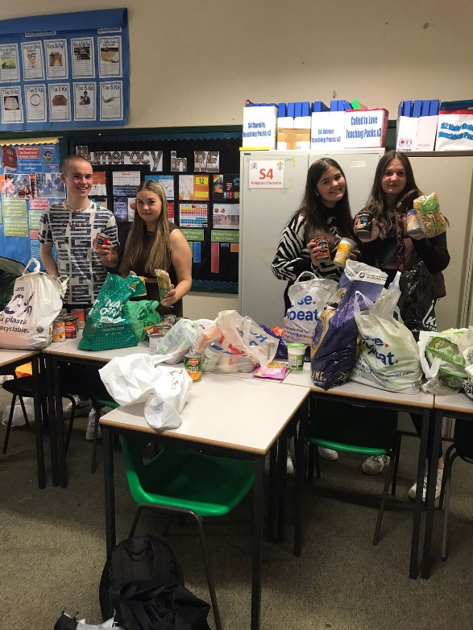
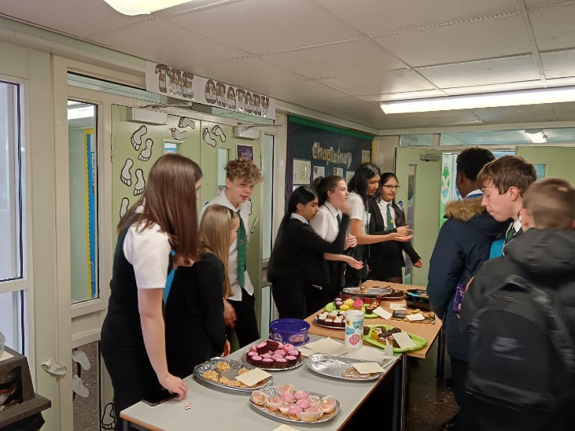
THS Core Value: Equality
Equality means making sure everyone is treated fairly and given the same opportunities, with dignity and respect.
In RE we demonstrate Equality by treating each other in a fair way and by helping others through our charity work.

Slide 14
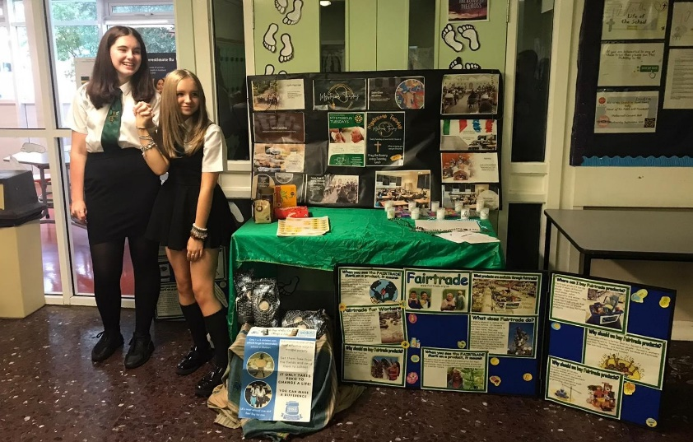
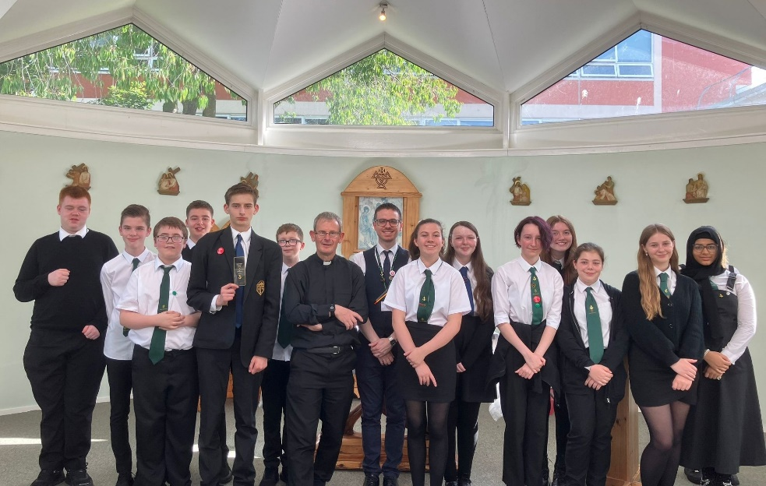
THS Core Value: Achieving
Achieving means doing your best and reaching your goals.
In RE we Achieve by taking part in extra-curricular clubs. In these clubs we work together to make a difference to the local and global community.

Slide 15
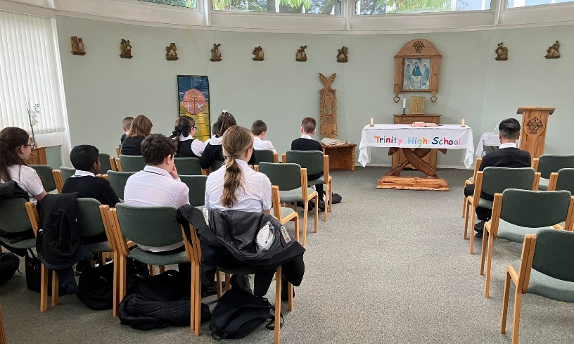
Our Faith Life
In THS Faith underpins all our Core Values
Mysterious Tuesday Club
Fairtrade Club
Oratory Visits
Mass

Slide 16
In our special journey we will discover this,
and so much more besides…
… And we will have some unique companions to guide us along the way:

Slide 17
You will understand how RE can make you more aware your rights as a child.
In RE you will understand the importance of respecting other people and of preventing violence in all cases.
In RE you will learn how to make a difference in the world and how to change it for the better (particularly in regard to safeguarding all creatures of God)

Slide 18
See you all very soon in the RE Department!
Mrs McKillop and I are looking forward to embarking on this journey together and to visiting some amazing places…

