Slide 1
LOVE & LEARN
CONNECTIONS BUILD BRAINS
EARLY YEARS LOCAL LEARNING COMMUNITY 2018
Notes:
1
1

Slide 2
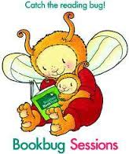
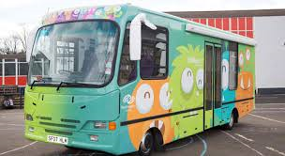
Early Years Local Learning Community
in association with
SKOOBMOBILE
Notes:
2
2

Slide 3
Background Information
About three years ago we formed our Early Years Local Learning Community with local schools and nurseries. The idea of the community is to share good practice and also to work together to improve the outcomes for our children. This is now our third joint project that we have worked on together. The last two have been very successful.

Slide 4
Love & Learn Challenge
*The challenge will run for 5 weeks. *Each week there will be a focus on a different area of the Five to Thrive building blocks. *Families will be issued with a sheet with 4/5 challenges and are asked to complete at least one over the week. *Children will then be encouraged to talk about this in nursery and bring in photographs/drawings. (Photographs can also be sent in through the Class Dojo)

Slide 5
Love & Learn Challenge
*Once a child has completed a challenge they will receive a stamp on their record card. *The children will receive an extra stamp for any other challenges completed that week. *The challenges are designed to give parents ideas on how they can help their child’s development at home. *If you feel you are already doing all of the challenges then perhaps you could write down in the space on the sheet a suggestion for a new activity. We would love to hear your ideas.

Slide 6
Why Five to Thrive?
FIVE to THRIVE
The Five to Thrive approach, developed by Kate Cairns, is a flexible programme that offers learning for practitioners and parents. It is designed to enhance awareness of the central ingredients for healthy brain development in babies and children, with five key activities – Respond, Cuddle, Relax, Play, Talk – described as the ‘building blocks for a healthy brain’.
RESPOND: When we respond, we are emotionally available to our children. When we set aside time from mobile phones, household chores, television etc., we can tune into our child and support them to regulate their emotions.
CUDDLE: When we spend time together and create opportunities to be physically close it helps us to connect emotionally with our child.
RELAX: When we relax together this models for our child the ability to self- regulate in times of stress.
PLAY: When we play with our child we create shared enjoyment and memories. We can use our child's interests to invite interaction and shared attention.
TALK: When we talk with our child we help them to understand their world. When we spend time talking, listening and creating narratives we support them to become lifelong learners.
initiative
per that has beenis
Notes:
6
6

Slide 7
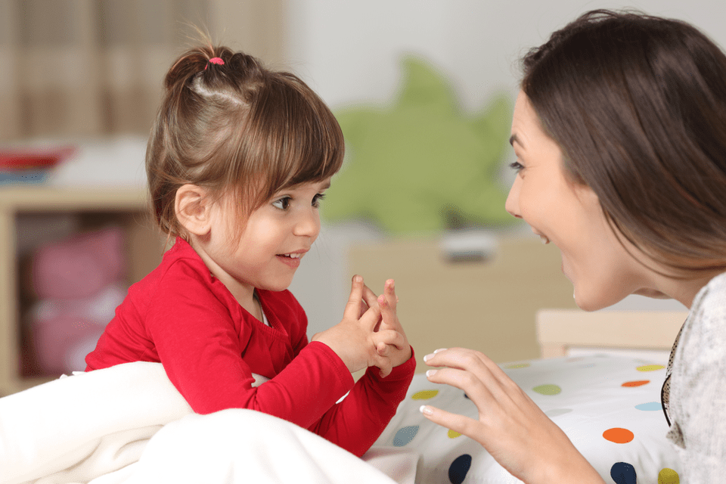
RESPOND
Notes:
7
7

Slide 8
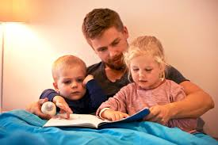
CUDDLE
Notes:
8
8

Slide 9
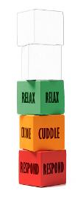
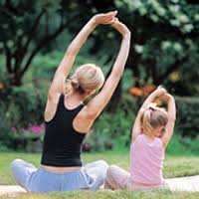
RELAX
Notes:
9
9

Slide 10
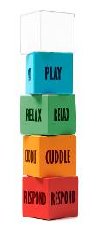
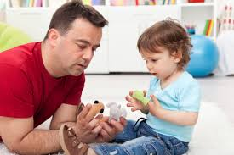
PLAY
Notes:
10
10

Slide 11
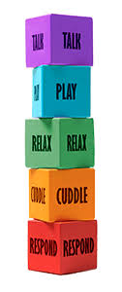
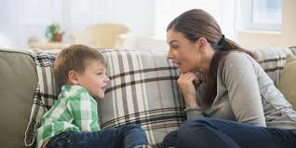
TALK
Notes:
11
11

Slide 12
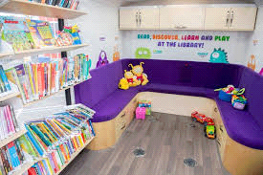
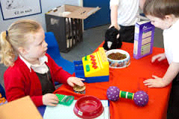
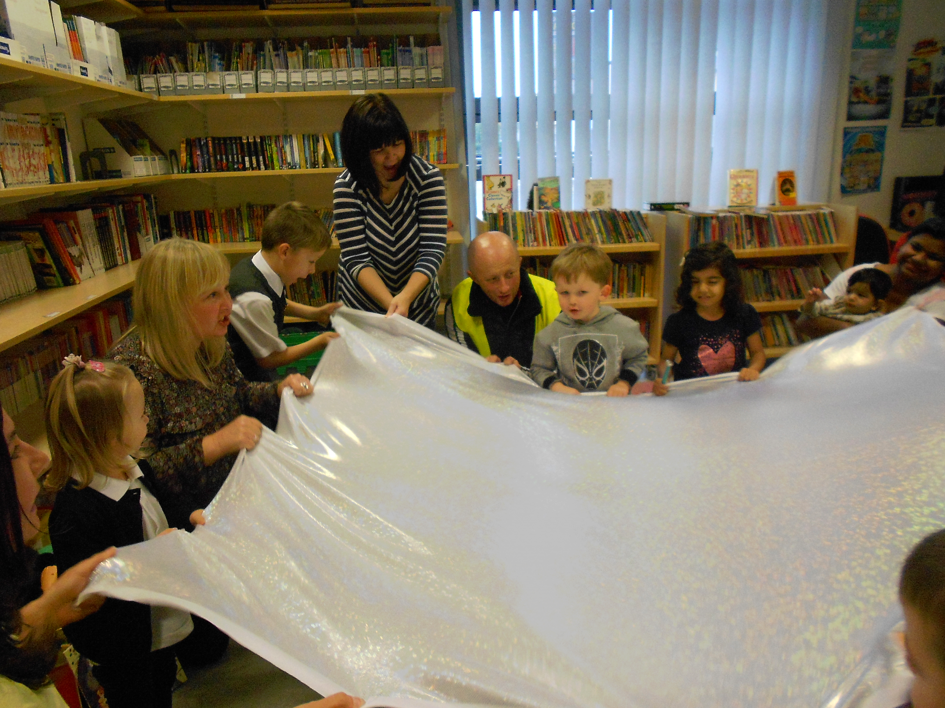
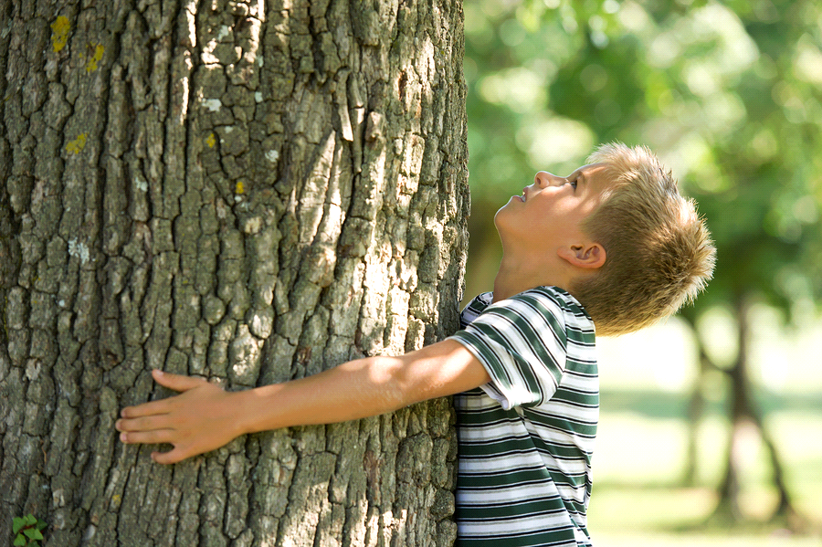
Experiences on offer
17/01/2018
Notes:
12

Slide 13
Experiences on offer
*The Skoobmobile will visit weekly and all children will have the opportunity to visit at least once. *The children will learn songs relating to the five building blocks of Five to Thrive. *The song words will be put on the Class Dojo and on the website. If you are unsure Google should help! *To celebrate the challenge we will have a large celebration with all the other establishments in Paisley Town Hall on the 9th March (there will be a morning and afternoon session, details to follow).

Slide 14
17/01/2018
Notes:
14

