Slide 1
Practical Maths Ideas for Parents
St James Primary (Renfrew)

Slide 2
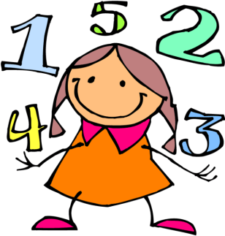
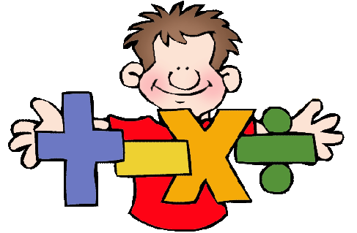
Early Level

Slide 3
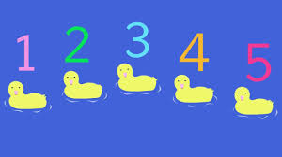
Number and Number Processes
Numbers are everywhere in the environment, point them out to your child wherever possible:
Number songs – 1,2,3,4,5 once I caught a fish alive
5 little ducks went swimming one day, 10 green bottles
Give your child opportunities to count a range of objects – coins, pasta shapes, buttons
Try counting things you can’t touch – lights, window panes
Play games that involve counting e.g. snakes and ladders, dice games, games that involve counting objects.

Slide 4
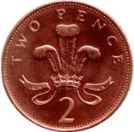
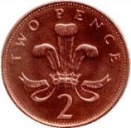
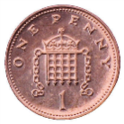
Money
Set up a shop using items from around the house. Pupils could label their toys and then pay for them using real coins.
When shopping look at price labels and talk about them.
Demonstrate different ways to make amounts e.g.
is the same as

Slide 5
Measurement and Estimation
Your child will be measuring and estimating in non standard unite e.g. hand span, cubes for length, a cup for volume.
How many cups will it take to fill this pot?
How many giant steps/ baby steps will it take to get to the bottom of the garden?
Which item is the heaviest/ lightest, longest/ shortest?
Estimate how many grapes are in the bowl. Now can you count them?

Slide 6
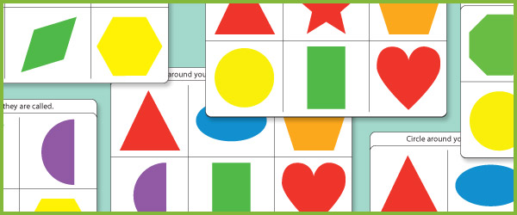
Shape, Position and Movement
Play a blindfold game/ hide and seek/ treasure bag game when you hold a shape behind your back and describe it.
2D shapes – square, rectangle, triangle, circle (describe number of sides and corners)
3D objects – cube, cuboid, cone, cylinder and sphere (describe faces -flat, curved, number and what shapes it is made up from.

Slide 7
Shape, Position and Movement
Encourage your child to describe the position of objects, ‘it’s behind the chair’ … ‘It’s next to the chair’
Can they give and follow directions to get to an object ‘Go forward’ … ‘step to the right’

Slide 8
First Level

Slide 9
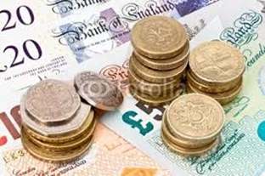
Money
At this stage of the mathematics programme your child will be working with the following notes and coins 1p, 2p, 5p, 10p, 20p, 50p, £1, £2, £5
Go shopping with your child to buy two or three items. Ask them to work out the total amount spent and how much change you will get.
Give them an amount e.g. 54p. Can they give change from £1, £5, £10.
Can they give as many ways as possible to make 72p.

Slide 10
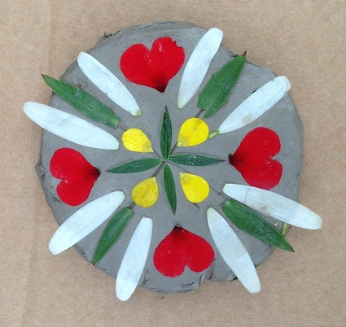
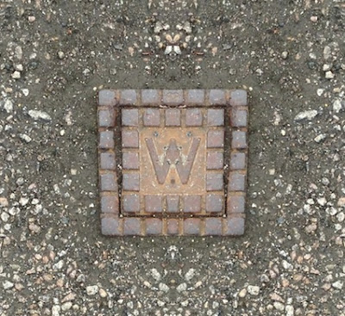
Properties of 2D shapes
Look for 2D shapes within tiling patter
Go on a right angle hunt
Notice symmetry in nature

Slide 11
Real Life Problems
Practise measuring the lengths or heights of objects (in metres or cm). Help your child to use different rulers and tape measures correctly. Encourage them to estimate before measuring.
Let your child help with cooking at home. Help them to measure ingredients accurately using weighing scales or measuring jugs. Talk about what each division on the scale stands for.
Choose some food items out of the cupboard. Try to put the objects in order of weight, by feel alone. Check by looking at the amounts on the packets.

Slide 12
Time
I can tell the time using 12 hour clocks, realising there is a link with 24 hour notation, explain how it impacts on my daily routine and ensure that I am organised and ready for events throughout my day.
Practise telling the time with your child. Use both digital and analogue clocks.
Be aware and teach the various ways we speak of time. Analogue – half past three, digital – three thirty.
When you are out and about ask pupils to read clocks that they see in supermarkets, banks and train station. Can they give the equivalent digital time? Ask your child to be a ‘timekeeper’ (e.g. tell me when it is half past four because then we are going swimming).

Slide 13
Second Level

Slide 14
Number and number processes
In this part of the mathematics programme, your child will be:
Counting, reading, writing and ordering whole numbers up to 100 000.
Reading and writing numbers up to one million
Extending work on fractions to include twentieths, fiftieths, and hundredths.
Calculating equal fractions and decimals.
Recording money and measurement to 2 decimal places. e.g. 105p =£1.05
152cm = 1.52m

Slide 15
Money
At this stage of the mathematics programme your child will be working with the following notes and coins in a variety of calculations –
1p, 2p, 5p, 10p, 20p, 50p, £1, £2, £5, £10, £20
With your child, use different combinations of coins and notes to make totals of up to £20
Use catalogues to ‘spend’ money up to £100
Give them the budget for buying the family lunch or a take away meal. Can they calculate the total cost. Think of the different combinations of notes and coins to pay the bill, receive change.

Slide 16
Number, Money and Measurement
Ask your child to write you a cheque for the week’s lottery win.
Share the lottery winnings between the family. E.g. 1/4, ½, 1/3.
Look for sale prices in shops, magazines and newspapers. Work out the prices for 50% off, 25% off.
Measure the family’s heights in centimetres and change to decimals.

Slide 17
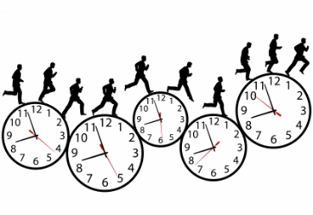
Time
In this part of the mathematics programme your child will be:
Using and comparing 24 and 12 hour clock time
Reading 24 hour timetables
Calculating lengths of time in hours and minute, mentally if possible
Using a stopwatch to time activities in seconds
Calculating speeds in practical activities.
Activities
Can your child use 24 hour times to set the video to record TV programmes?
Look at bus or train timetables with your child. Ask them to work out the length of different journeys.
Ask your child to set a digital alarm clock to wake the family in the morning.
Work out the length of film and TV programmes.

Slide 18
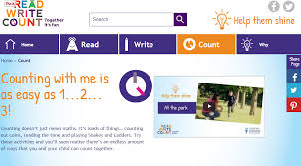
Useful Websites
Curriculinks
Read Write Count

