Slide 1
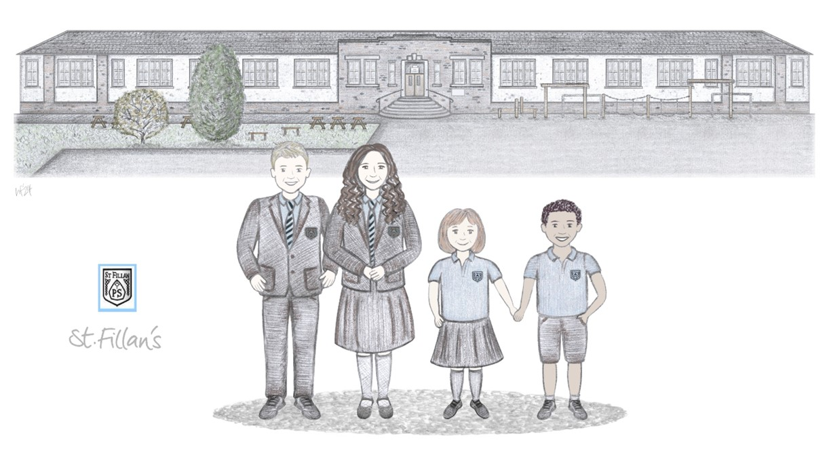
St. Fillan’s Primary
Meet The Teacher
Session 2026 -2027
Notes:
Welcome and introductions

Slide 2
Teachers – About Us
Mrs Nicola McNeil
Mrs Joanne McKay and Mrs Cat McAlaney are our Non-class contact teachers and will teach the children on a Tuesday afternoon and Thursday morning. They will cover Outdoor Learning/STEM and Digital skills.

Slide 3
Communication
How and when to contact me: - School office, drop off/ pick up, Seesaw
Information and updates: Seesaw, Sway digital newsletters

Slide 4
Class Charter
Positive behaviour approach- In St Fillan’s children are given house points for displaying the values of our class charter. These points are counted each week and the winning house receives an extra play. At the end of the year the winning house is awarded the house cup.
Rewards & celebrations: We love to celebrate our pupils’ achievements both in and out of school via our wider achievement wall. Please encourage your child to share their achievements with us.
In school achievements are celebrated at assembly via our Head Teacher Awards and Everyday Hero Awards.

Slide 5
Outdoor Learning
Our Outdoor Learning days are Monday and Tuesday
On these days we will require waterproof jacket and shoes (welly boots are perfect). A wooly hat and gloves for colder days and a sun hat and suncream for the sunny days.
Skill Development
Through outdoor learning we will be developing our metaskills.
Our metaskills focus fall into the categories of Self management, Social Intelligence and Innovation
Through these metaskills we will become more independent (getting ourselves ready for the outdoors), express our needs verbally and ask “why” or” how” when exploring the world around us.

Slide 6
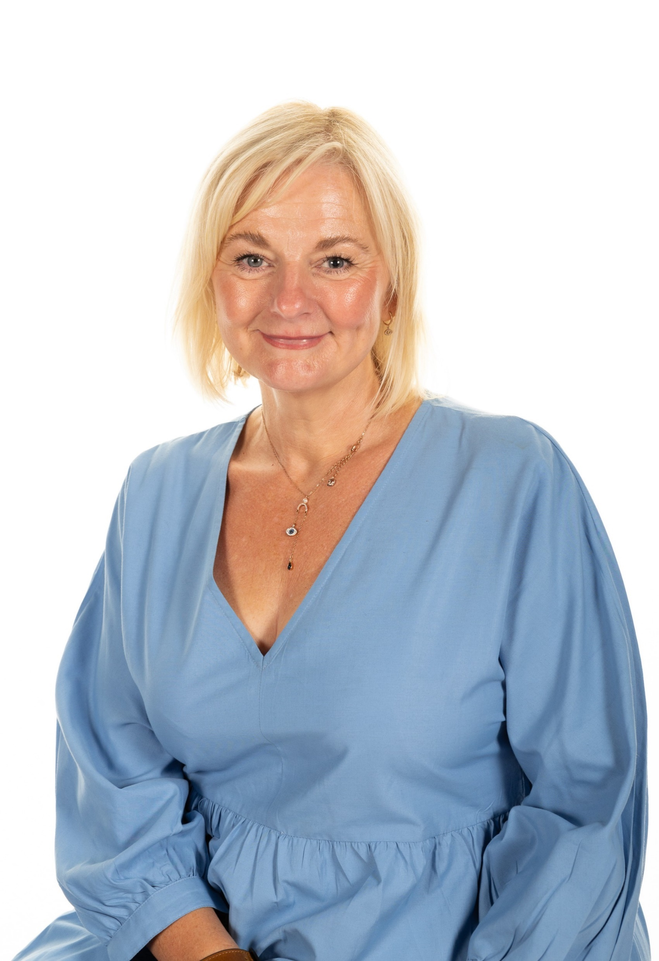
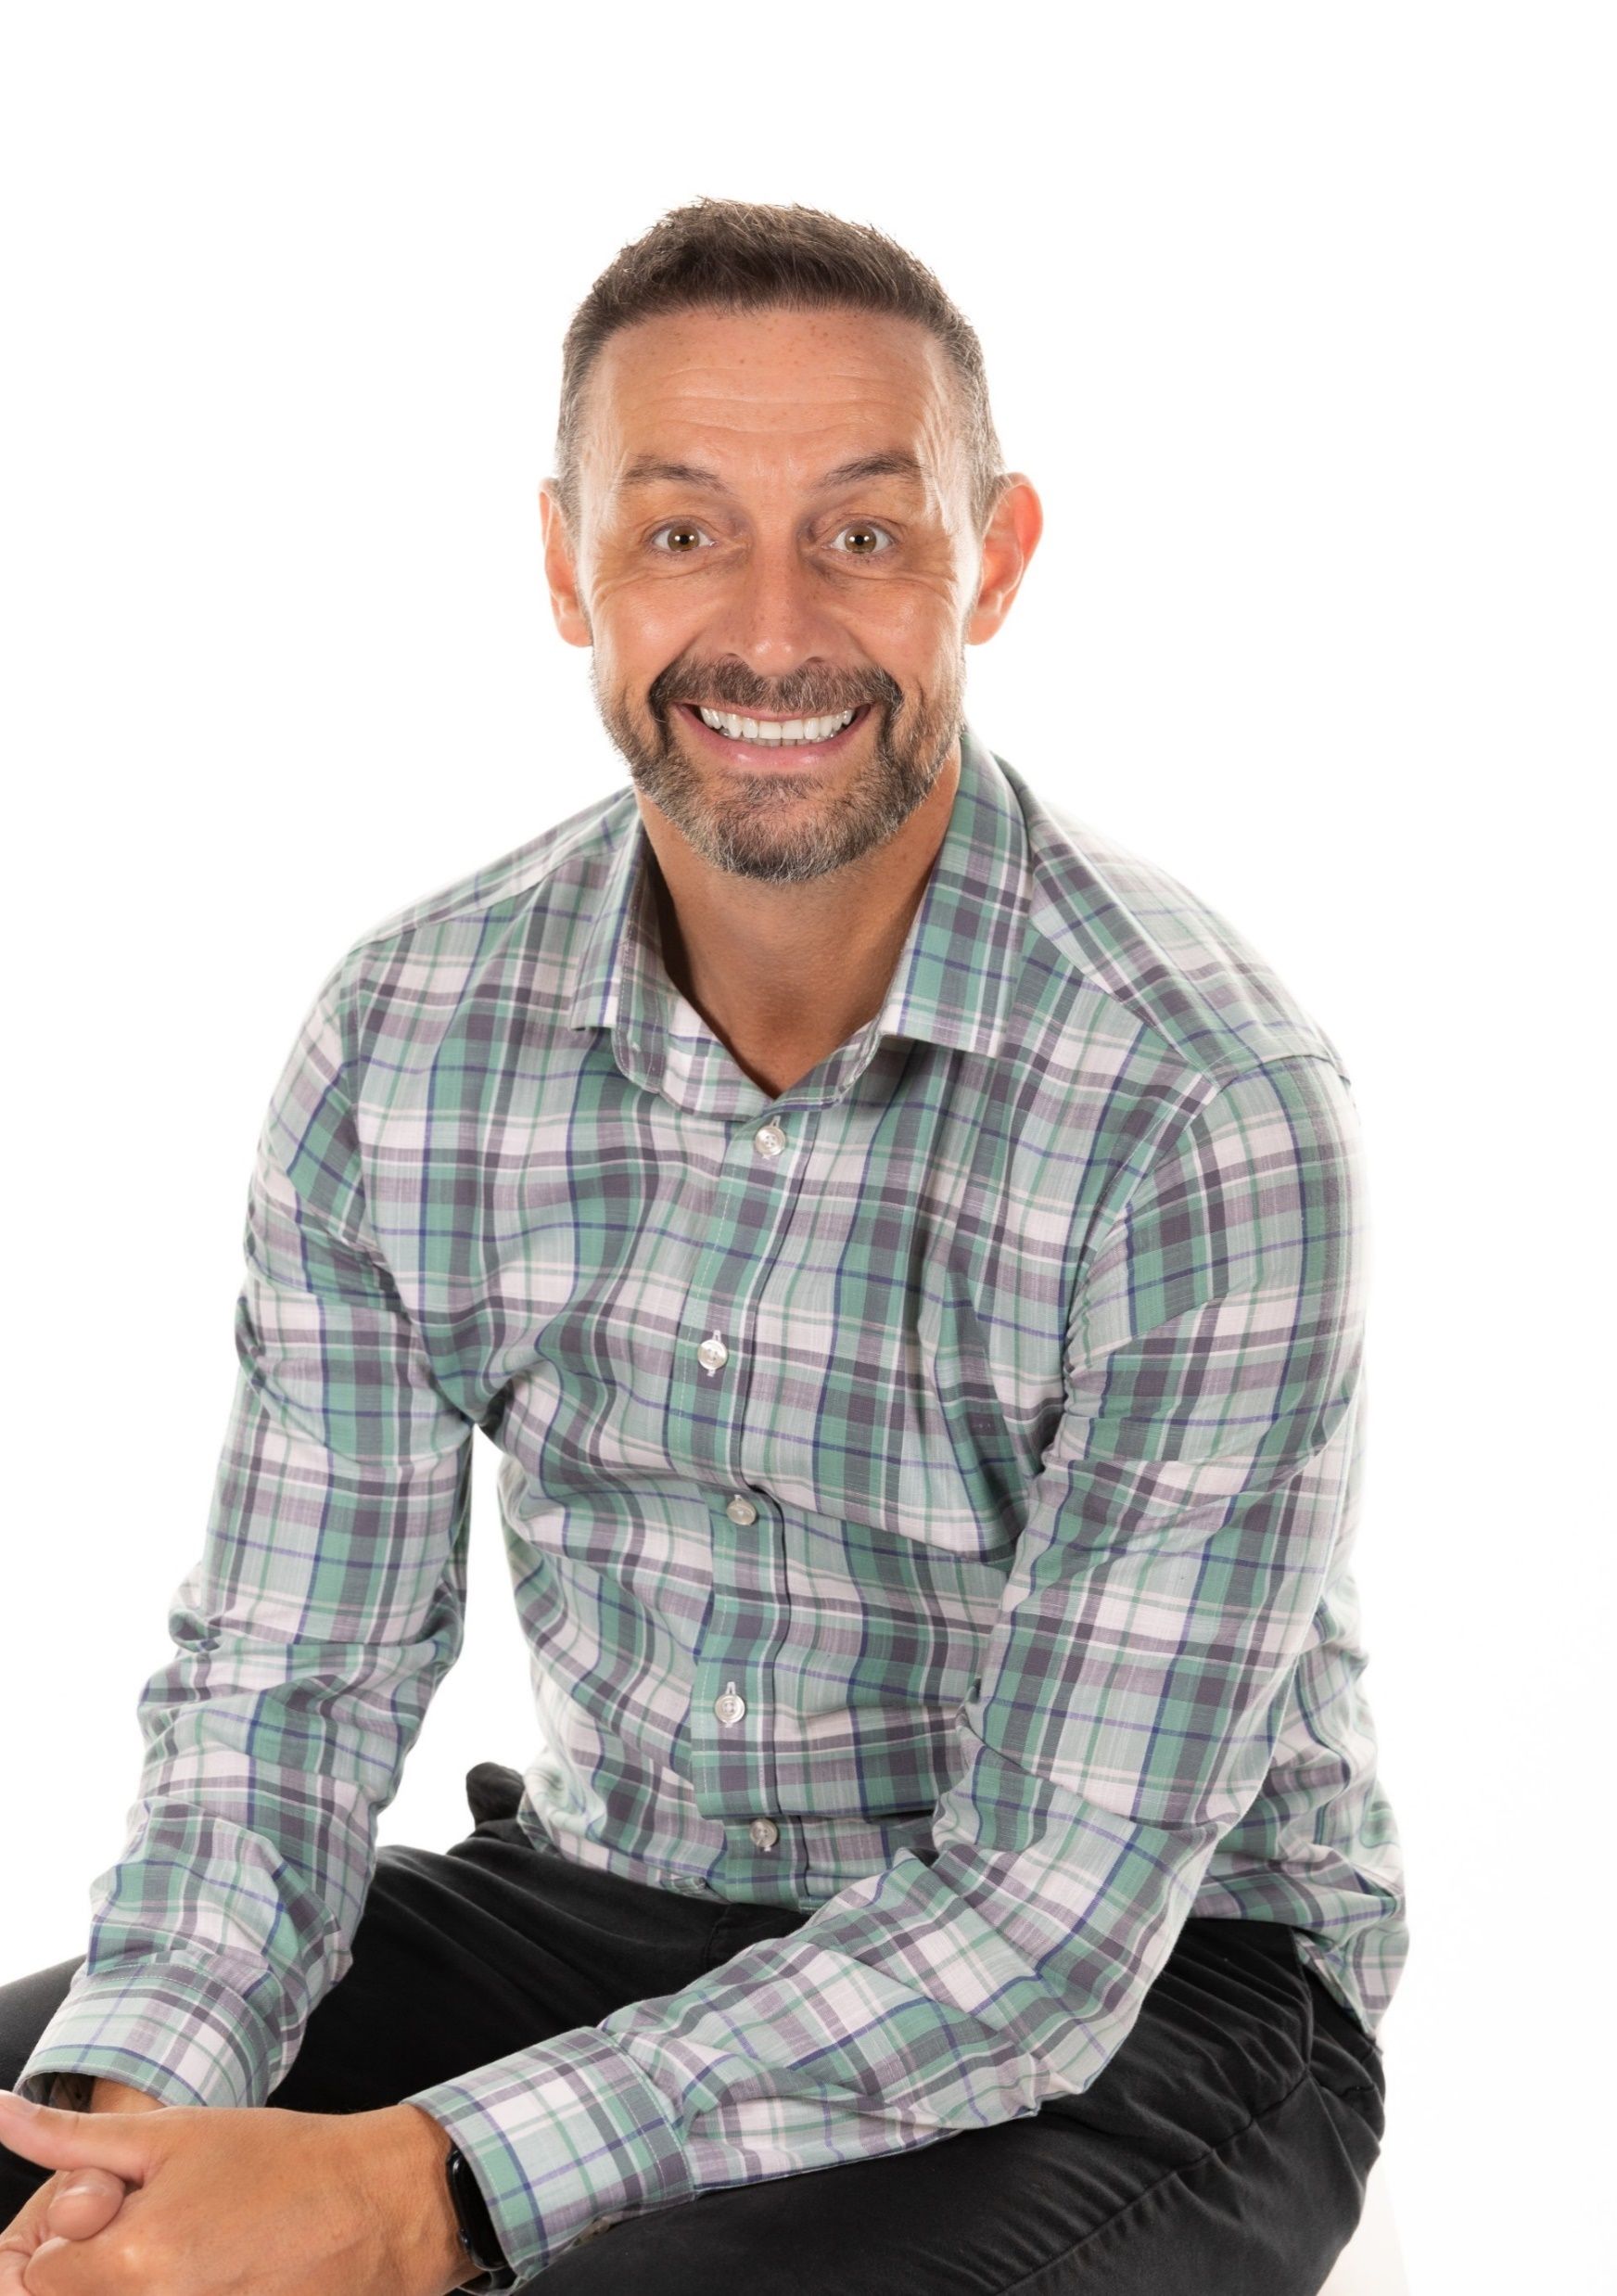
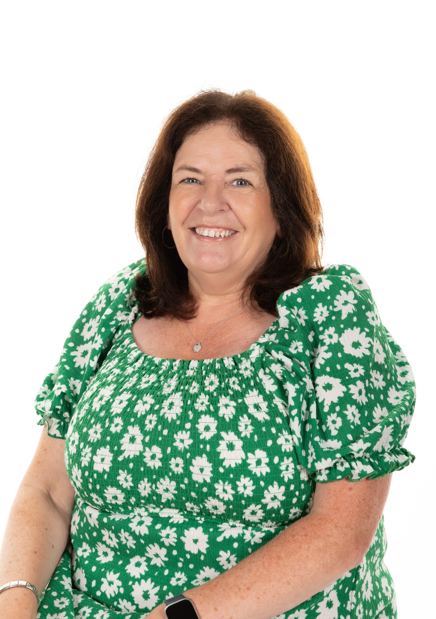
Other Staff Who Are Working With Your Child
Mrs Bruce ASNA
Mr Fabiani ASNA
Mrs Kelly
Classroom Assistant

Slide 7
Topics We Will Be Covering Until Christmas
Term 1 August-October
Places we could go -Through this learning context we will learn about our local area and another area or place of interest. The aim of this topic is to help us to understand where we live and develop our sense of belonging. While also researching and exploring somewhere we already have an interest in and finding out more about this place.

Slide 8
Important Class Information
PE days
Our PE days are Tuesdays and Thursdays.
Children can come to school in their tracksuits on these days.
Homework
Homework will always be set on a Monday and due on the Friday (Thursday if Friday is a holiday.)
Children will have their spelling words with two short spelling activities.
For maths they will have a worksheet that will be linked to what they have already learned in class. This is giving the children a chance to consolidate their learning.
A reading book will be given home, and I ask if the children can bring this to school each day.

Slide 9
How You Can Help at Home
Encourage reading for pleasure with physical books and the Reading Eggs Online library
Relate and encourage learning to real life e.g. encourage children to use their maths skills when shopping
Support homework routines and deadlines
Talk about the importance of following the Class Charter and learning
Praise effort and perseverance
Complete Reading Eggs / Math seeds tasks; we receive weekly report on usage and achievement. The class are used to using this resource and should know what to play and where to find it on the resource

Slide 10
Reading Eggs and Maths Seeds
Let’s now look at the Reading Eggs and Math Seeds platform to know exactly what the class will be Let’s now look at the Reading Eggs and Math Seeds platform to know exactly what the class will be asked to complete and where to find it: https://readingeggs.co.uk/

Slide 11
SeeSaw
You should be logged in as a FAMILY member to see updates on the class feed AND your child should be logged in to be able to complete homework tasks.
QR codes have been sent home however let me know if you need another QR code.
If anyone is having trouble getting onto Seesaw then we can try and sort it today, if not we can organise support.

Slide 12
