Slide 1
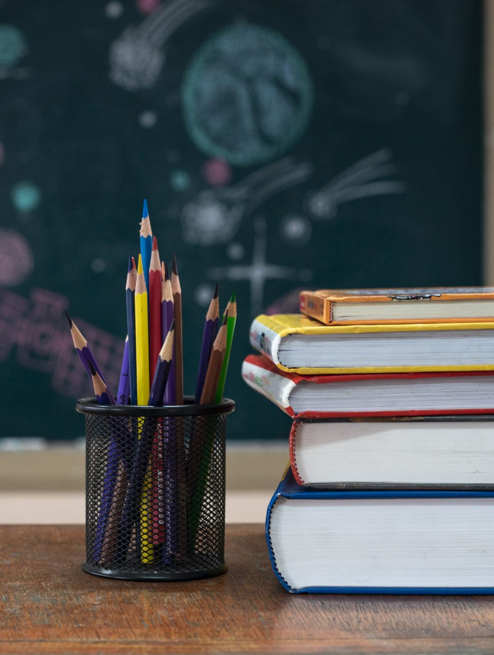
Meet the Teacher
Welcome to Primary 7
Class teacher: Laura Rennie
Questions can be asked at the end

Slide 2
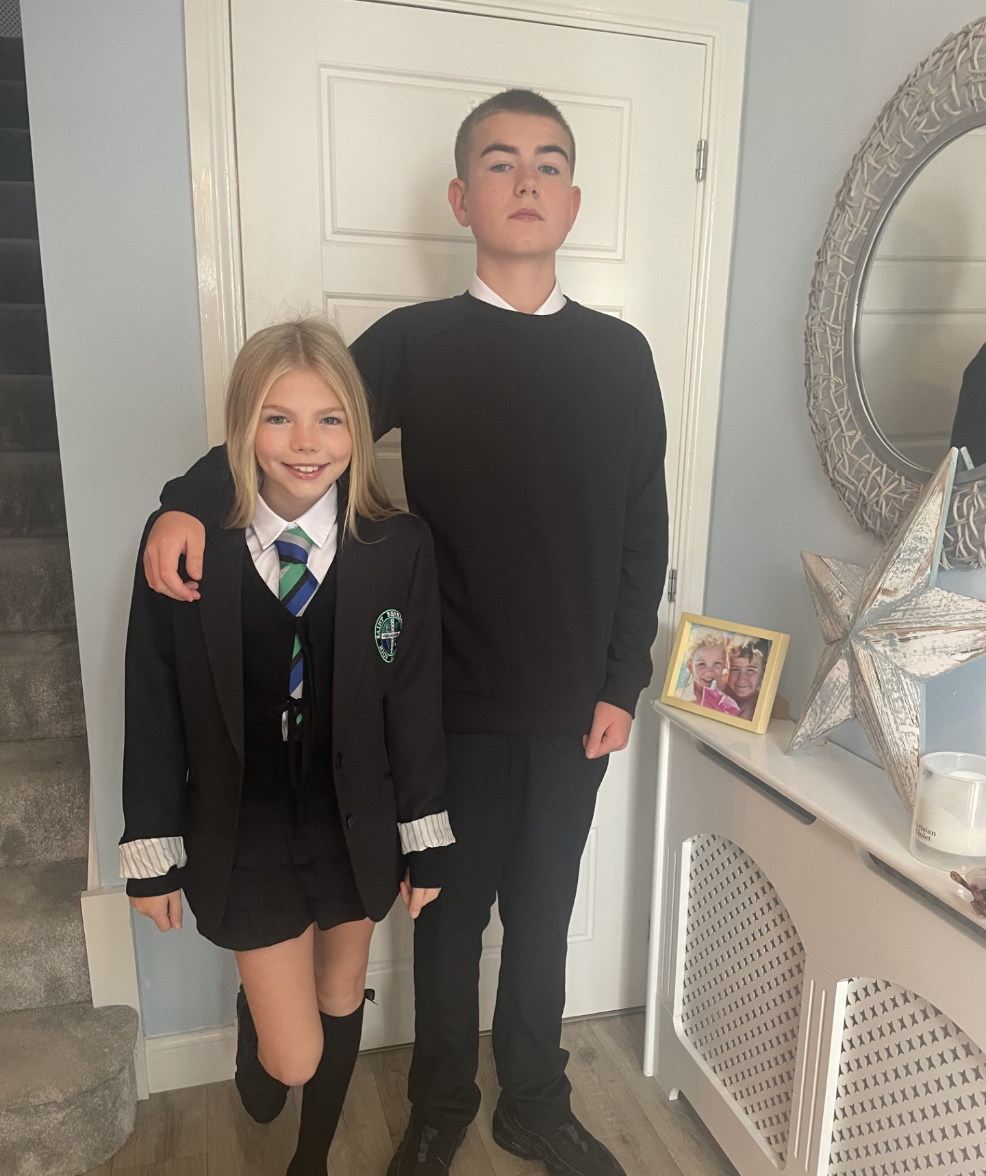
About Me

Slide 3
Communication
How and when to contact me:
Through Seesaw for minor questions or information
Via the office for bigger issues or things that may need more discussion
Information and updates: Seesaw, Sway digital newsletters

Slide 4
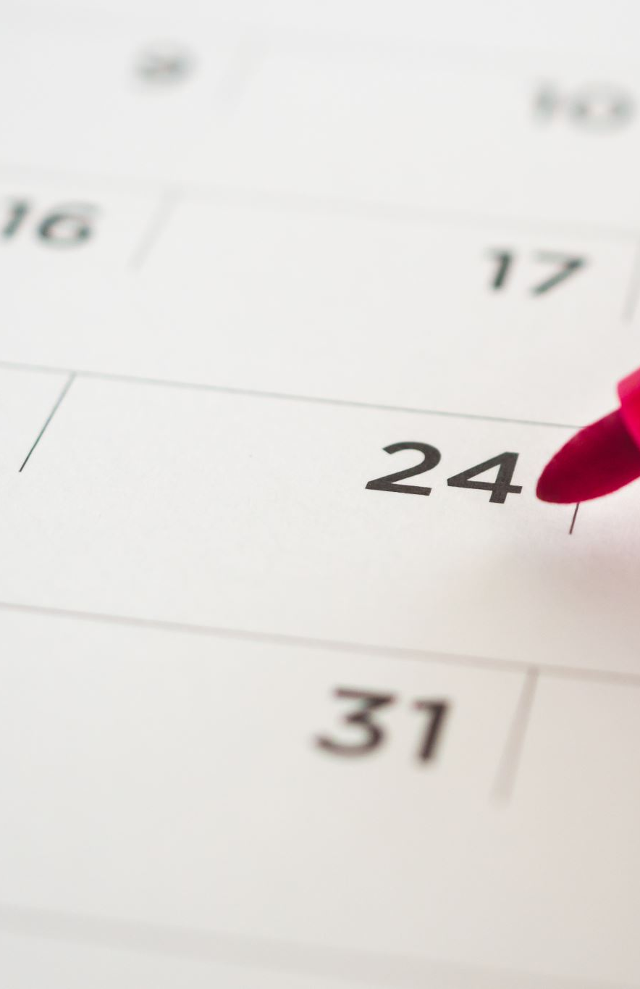
Important class Information
PE days: Monday and Friday
Homework given out on a Monday and returned on a Friday.

Slide 5
Class routines & Class Charter
• Let’s look at our class charter
• Positive behaviour approach
• Rewards & celebrations

Slide 6
Homework
Homework will be posted to Seesaw
Frequency and expectations:
Types: reading, spelling, maths, IDL tasks
Some written tasks will be expected to be completed: Spelling, some maths tasks. These can be completed in the homework jotter and returned on a Friday to be corrected.
Some digital tasks will be expected to be completed: Reading Eggs, Maths Seeds, Maths tasks and IDL related tasks.
You will receive a QR Code to log into Reading Eggs/Math Seeds. Stuck inside homework jotter
Reading Eggs & Math Seeds can be played on an I phone, laptop, Chromebook or an I pad.

Slide 7
How You Can Help at Home
Encourage reading for pleasure with physical books and the Reading Eggs Online library
Relate and encourage learning to real life e.g. encourage children to use their maths skills when shopping
Support homework routines and deadlines
Talk about the importance of following the Class Charter and learning
Praise effort and perseverance
Complete Reading Eggs / Math seeds tasks; we receive weekly report on usage and achievement. The class are used to using this resource and should know what to play and where to find it on the resource

Slide 8
Reading eggs & Math Seeds
Let’s now look at the Reading Eggs and Math Seeds platform to know exactly what the class will be asked to complete and where to find it: https://readingeggs.co.uk/
In summary the Homework tasks will be usually be:
Reading Eggs book/quiz once it is finished. This will be set by the teacher and appear in the LIBRARY area.
Occasionally a Reading Eggs OR Reading Express ‘My Lessons’ Comprehension task. We will be doing these in school.
Math Seeds ‘Lessons’. (Complete one)
Please let me know at the end if you do not have a device they can use at home for online homework tasks

Slide 9
SEEsaw
You should be logged in as a FAMILY member to see updates on the class feed AND your child should be logged in to be able to complete homework tasks.
QR codes have been sent home however let me know if you need another QR code.
If anyone is having trouble getting onto Seesaw then we can try and sort it today, if not we can organise support.

Slide 10
