Slide 1
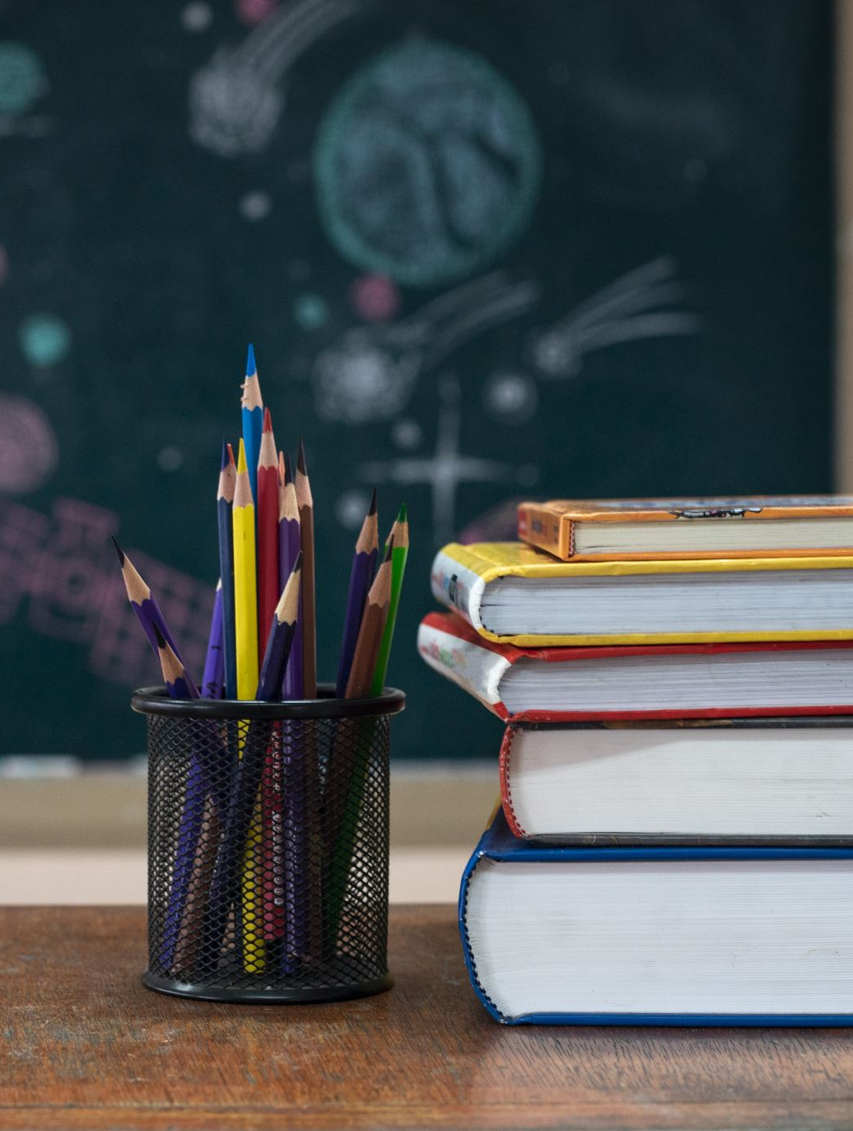
Meet the Teacher
Welcome to Primary 1
Class teachers: Mrs Kaney & Mrs Sim
Questions can be asked at the end

Slide 2
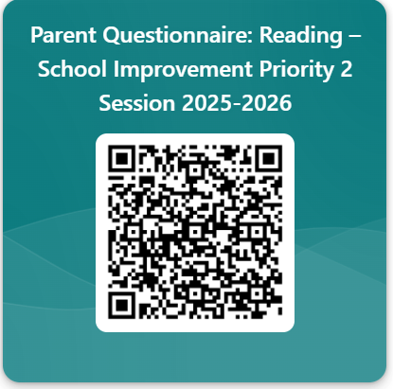

Slide 3
Communication
How and when to contact us:
You can call the school office, send a private message on Seesaw or a note in the diary, or feel free to catch us for a chat at the end of the day.
We will always aim to get back to you as soon as we can.
Information and updates:
Seesaw, Sway digital newsletters or homework diary

Slide 4
Important class Information
PE days
Our PE days are Tuesdays and Thursdays.
Children can come to school in their tracksuits on these days.
Homework
Homework will always be set on a Monday and due on the Friday (Thursday if Friday is a holiday.)
Children will have their sound and word tubs to practise every evening, and a reading book will be introduced when appropriate. They will also have a worksheet to reinforce phonics or number work.
As the year progresses, online homework will also be set on Reading Eggs or Math Seeds. Your child will be familiar with these platforms by this time, and we will give you an overview of this today.

Slide 5
Reading eggs & Math Seeds
Let’s now look at the Reading Eggs and Math Seeds platform to know exactly what the class will be asked to complete and where to find it: https://readingeggs.co.uk/
In summary the homework tasks will be usually be:
Reading Eggs lessons
Fast Phonics
Maths Seeds lessons
Please let me know at the end if you do not have a device they can use at home for online homework tasks

Slide 6
How You Can You Help at Home
Encourage reading for pleasure
Read aloud to your child
Frequent use of word and sound tubs
Frequent opportunity to read aloud to a parent, reading books are perfect for this.
Count together
Play car games such as I spy, I went to the shop or sing number songs together.

Slide 7
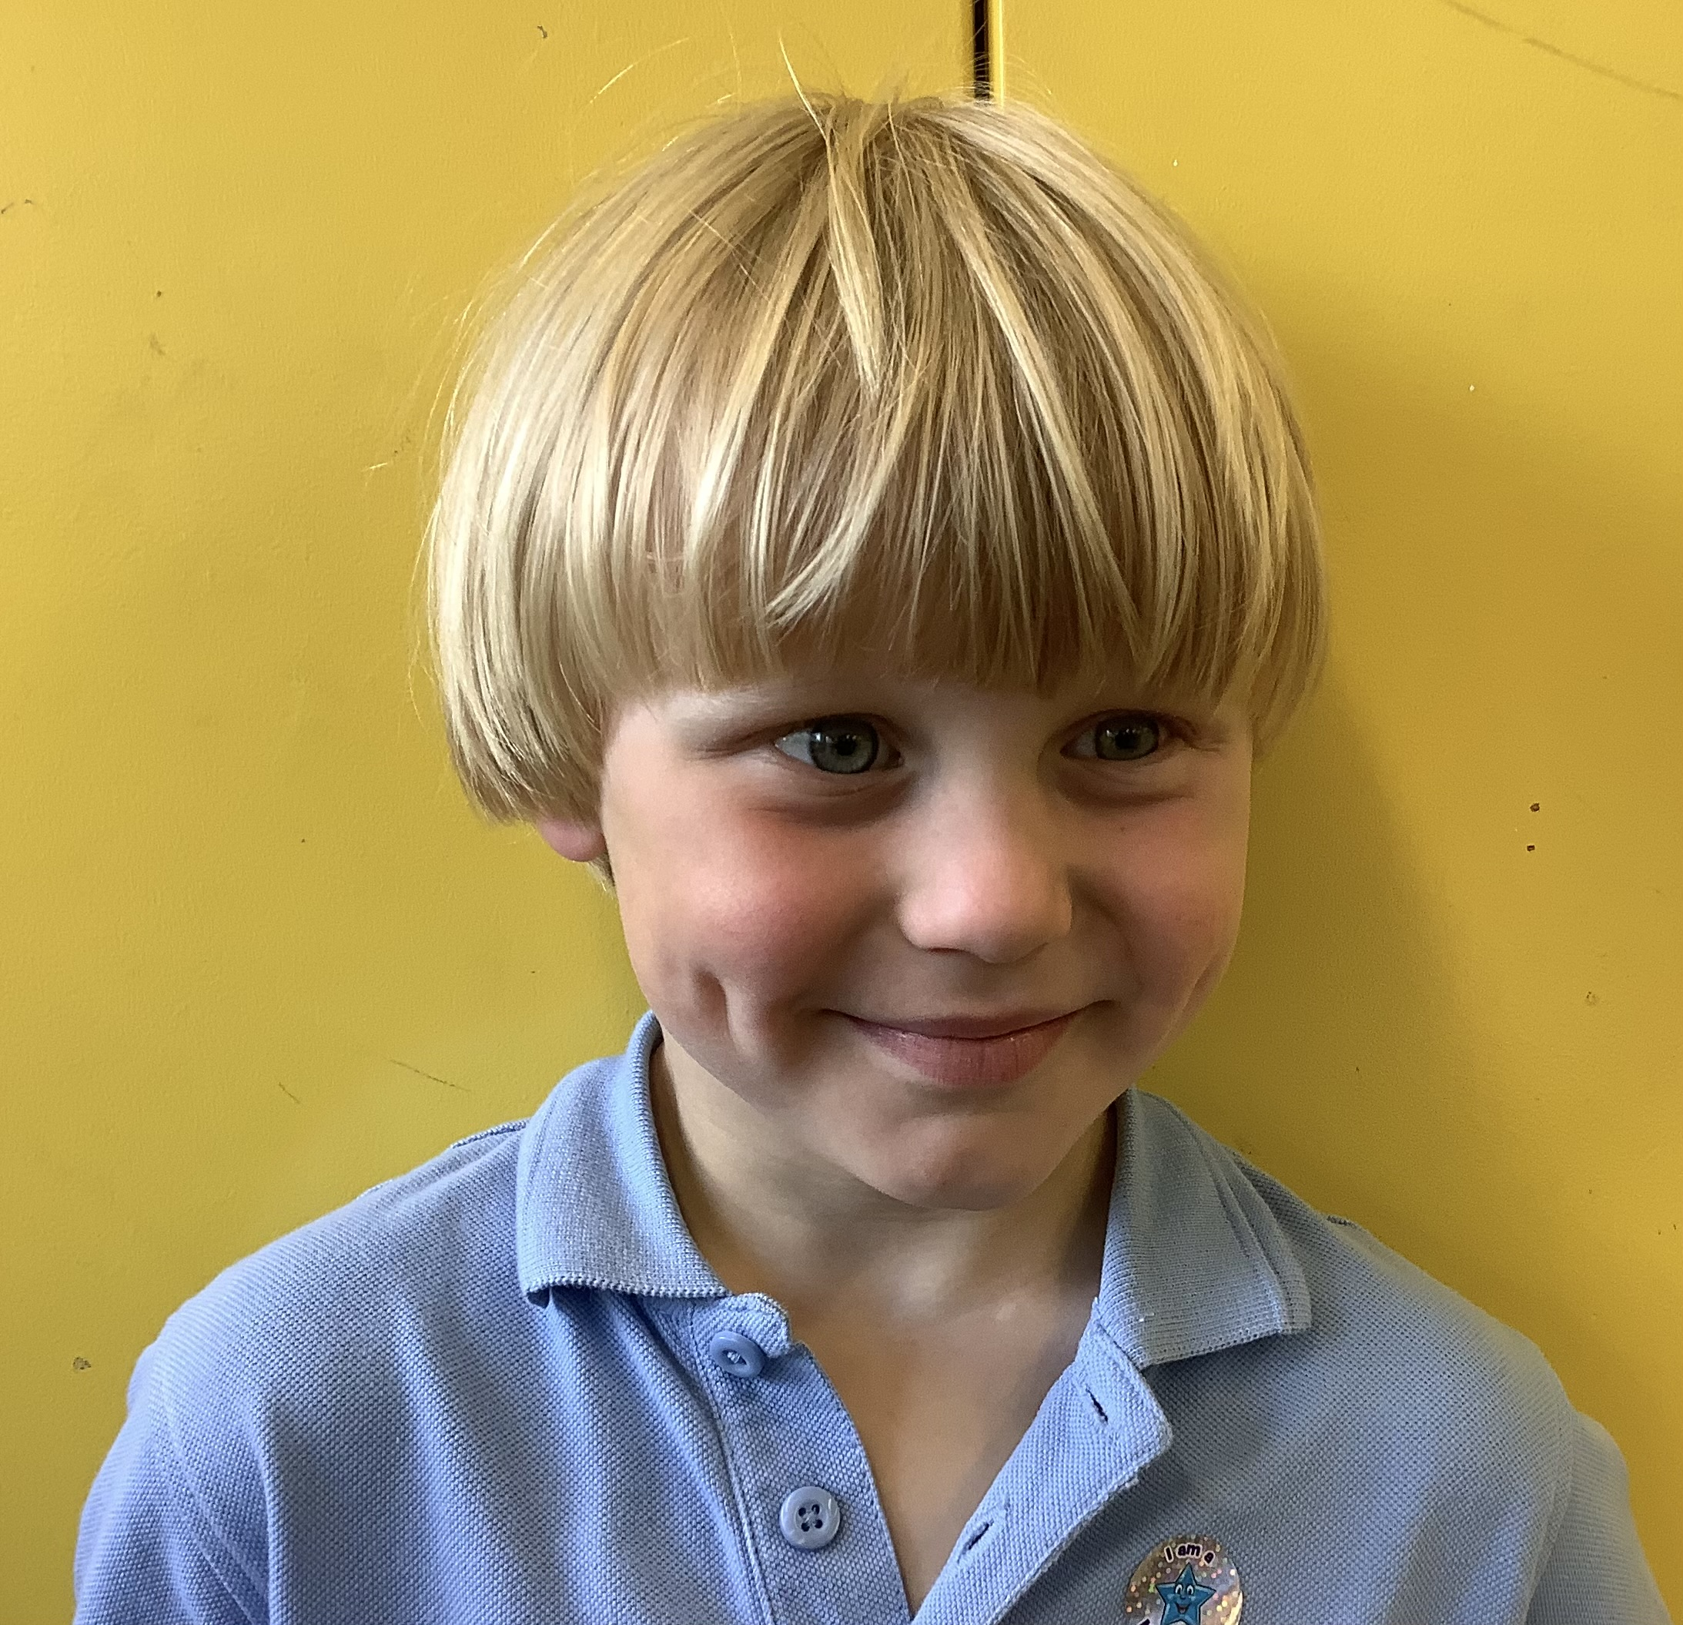
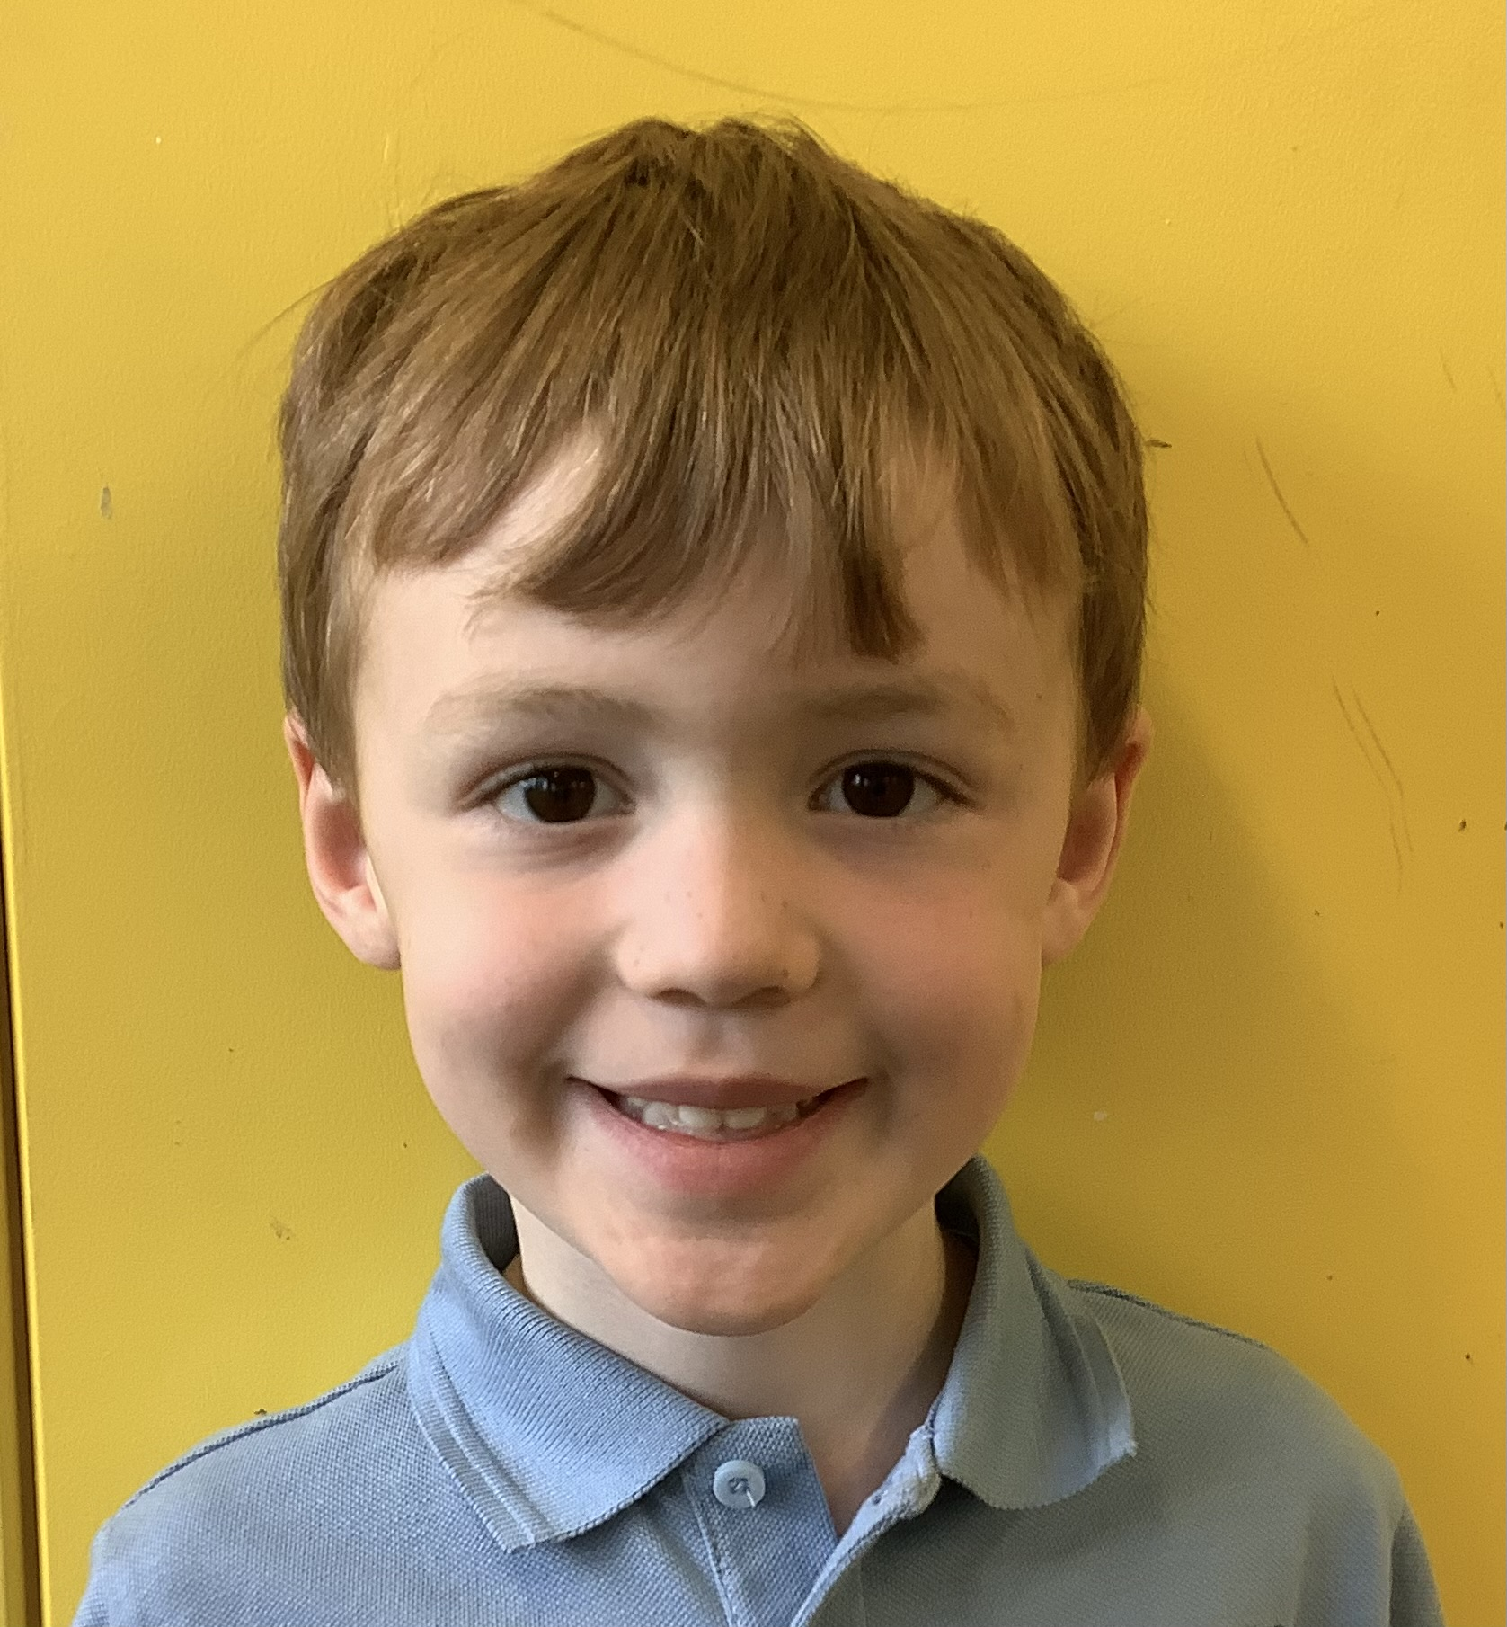
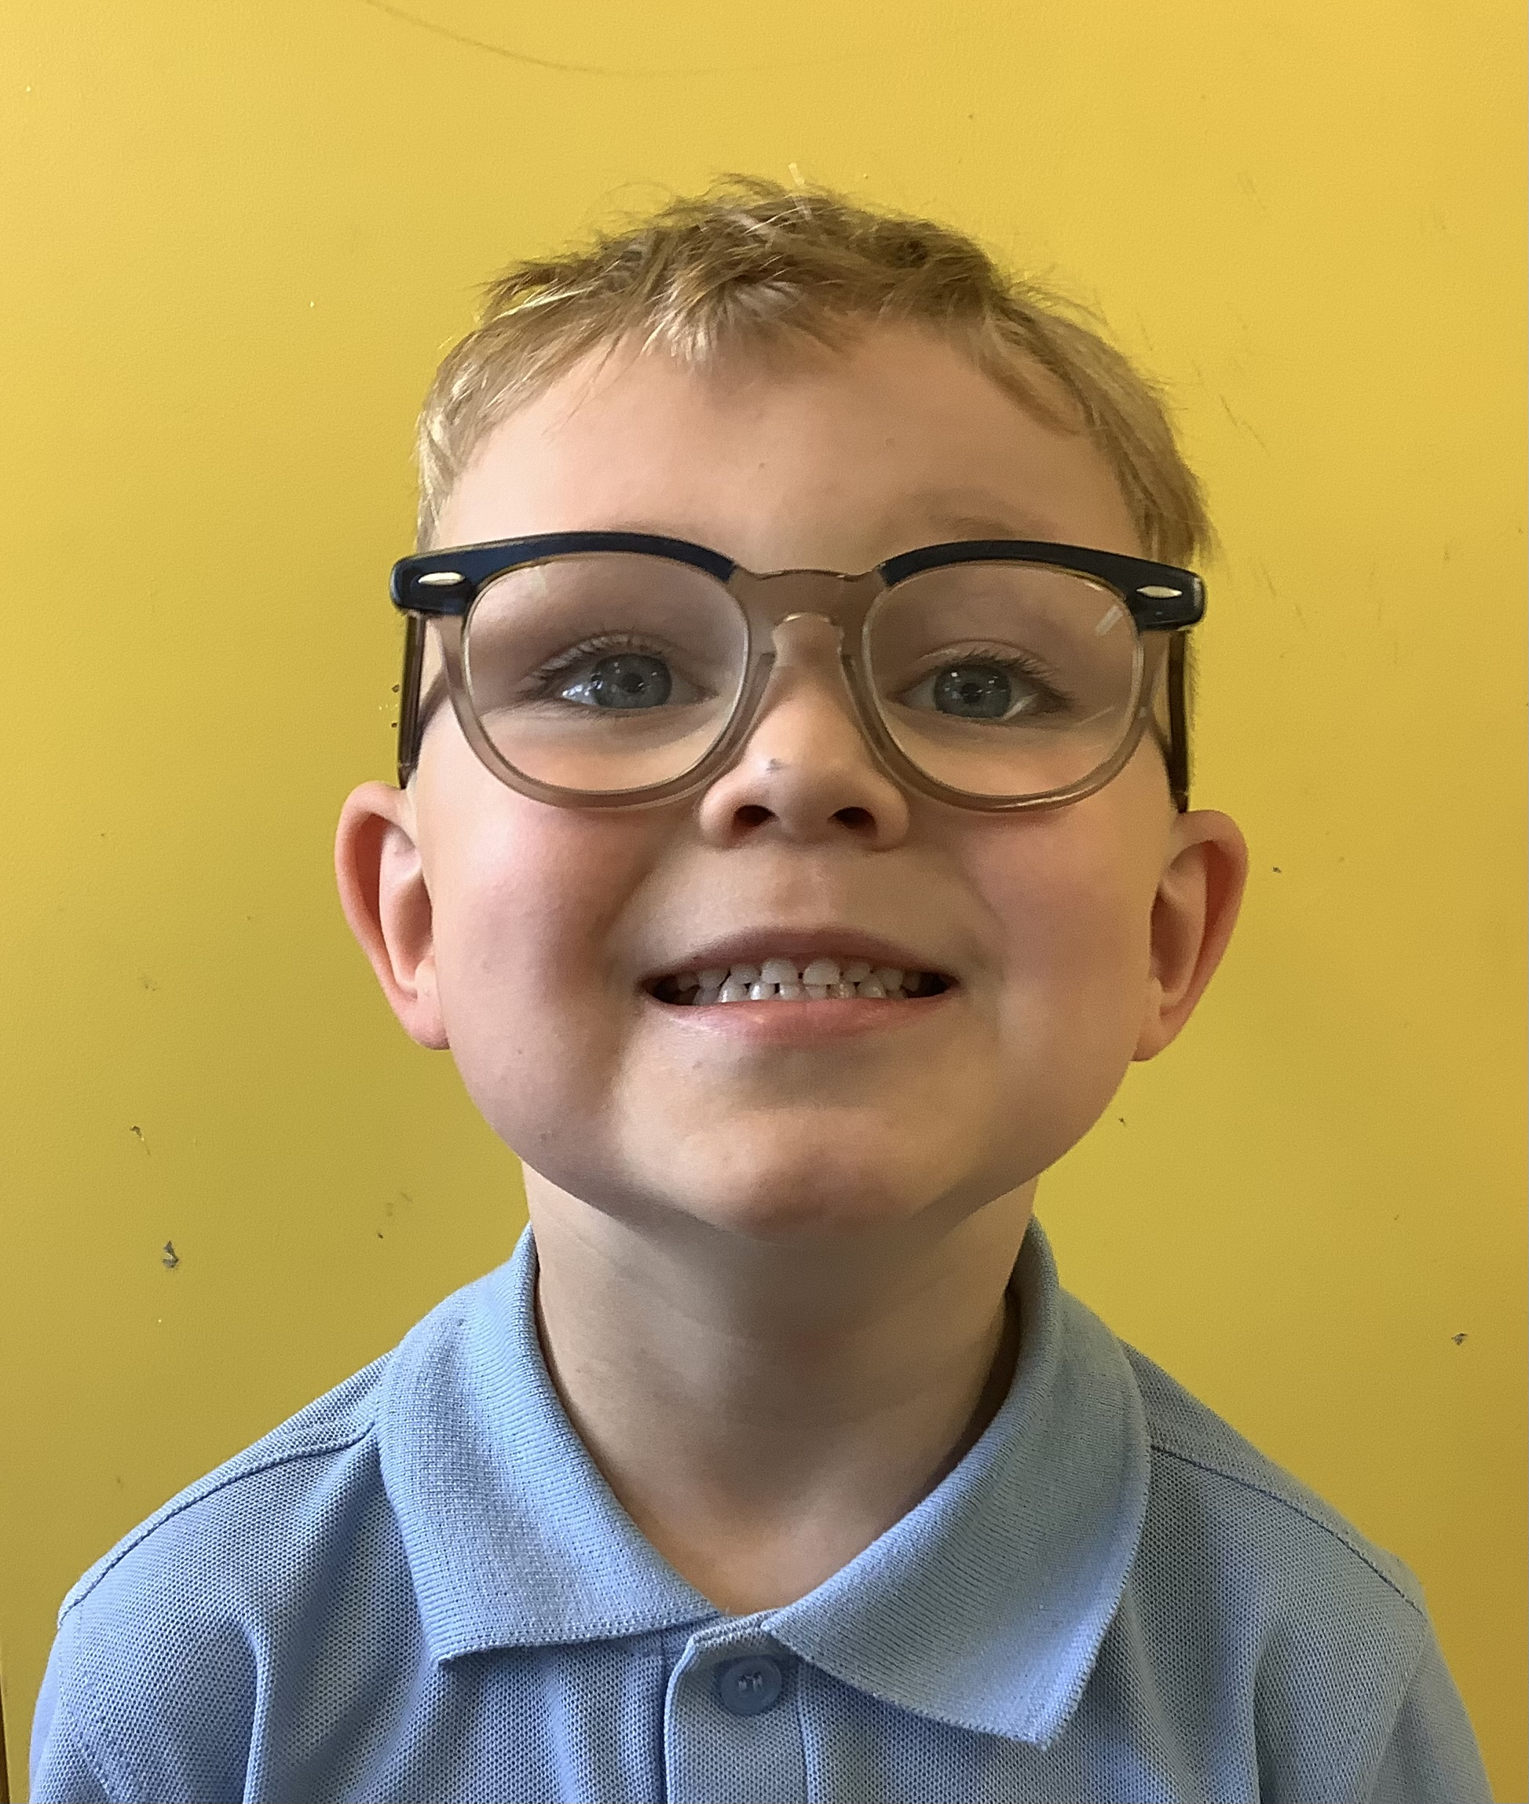
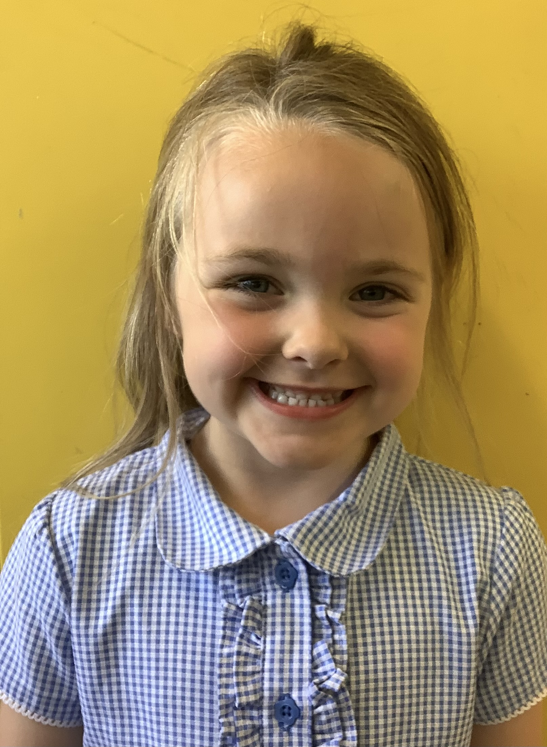
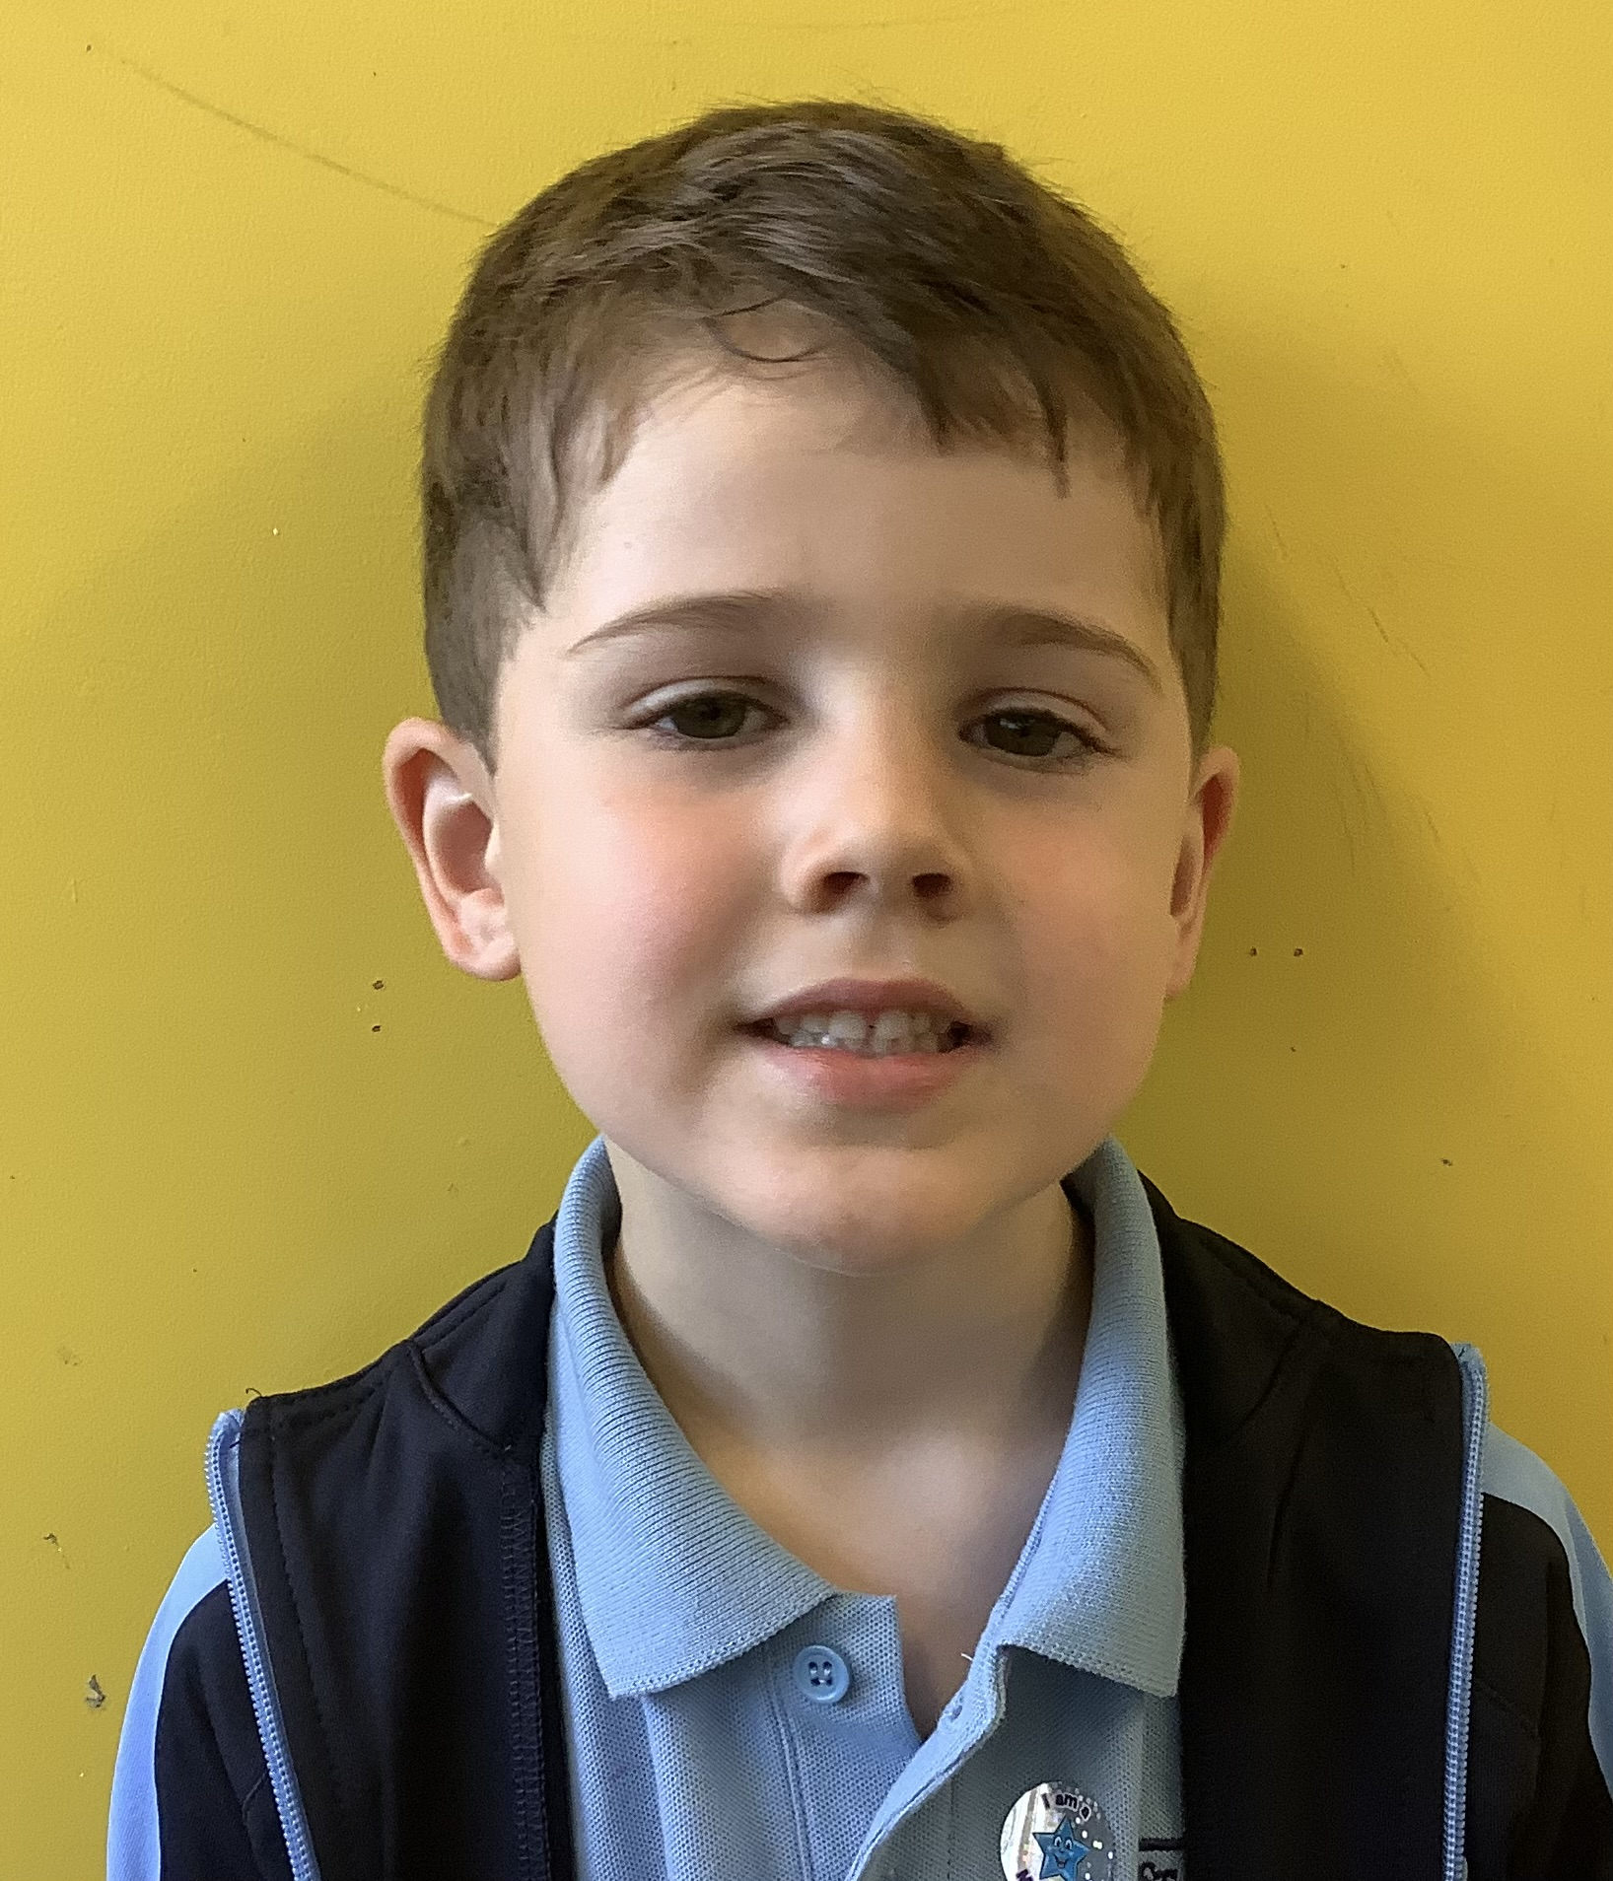
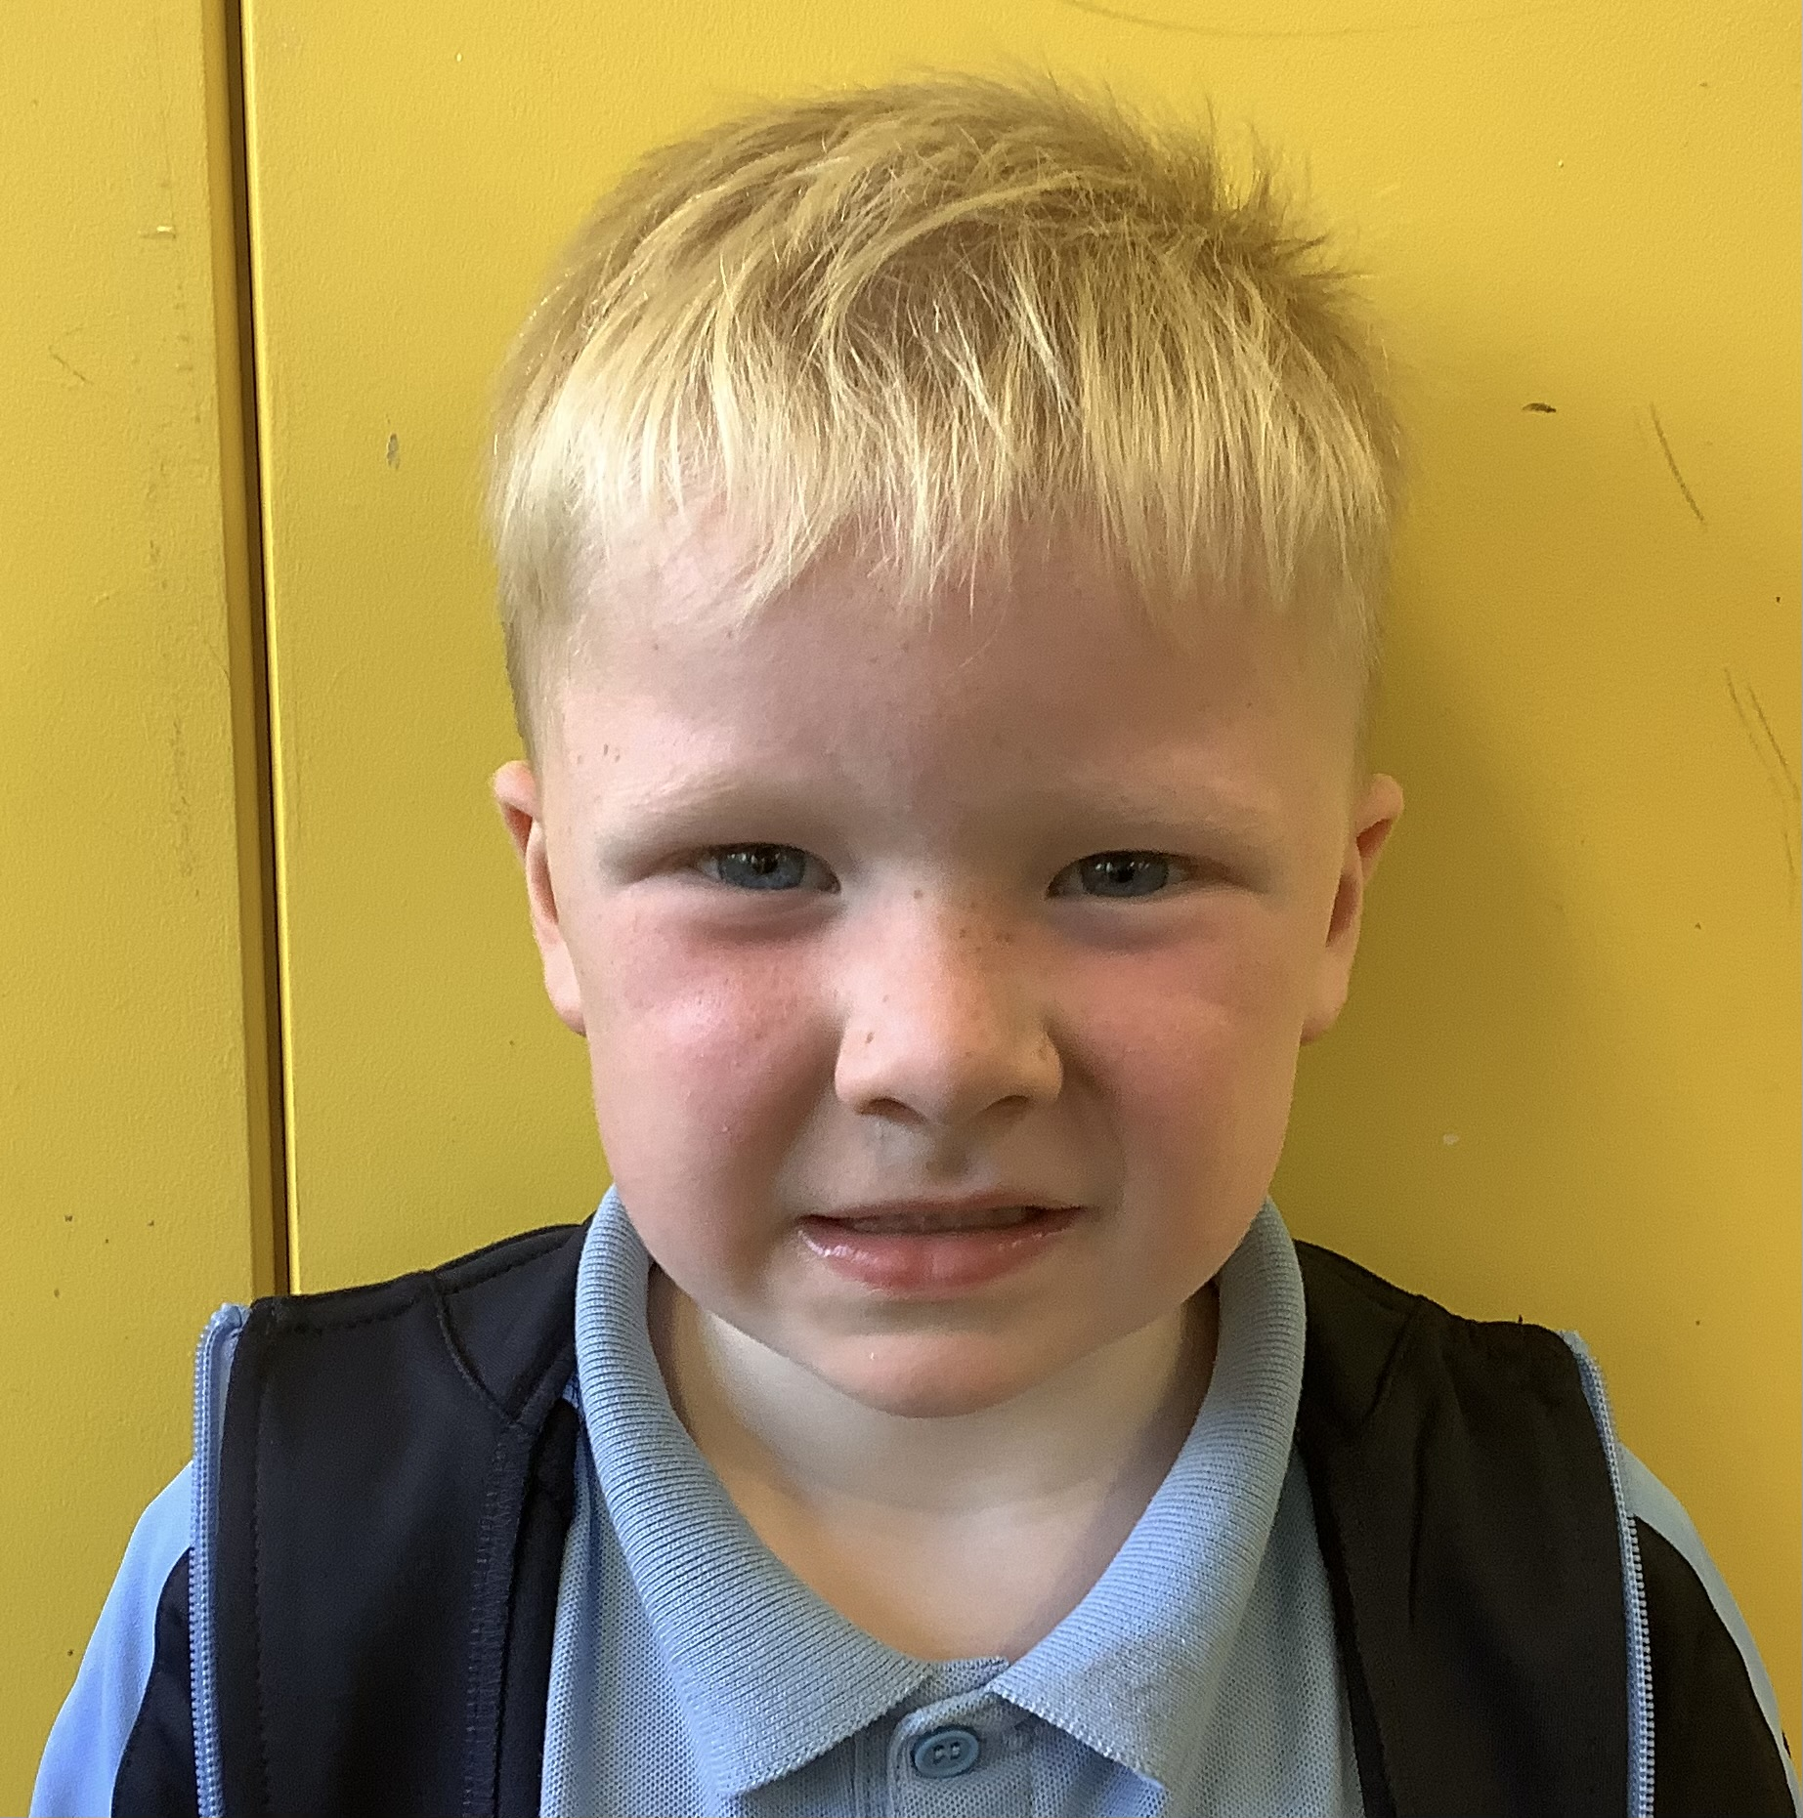
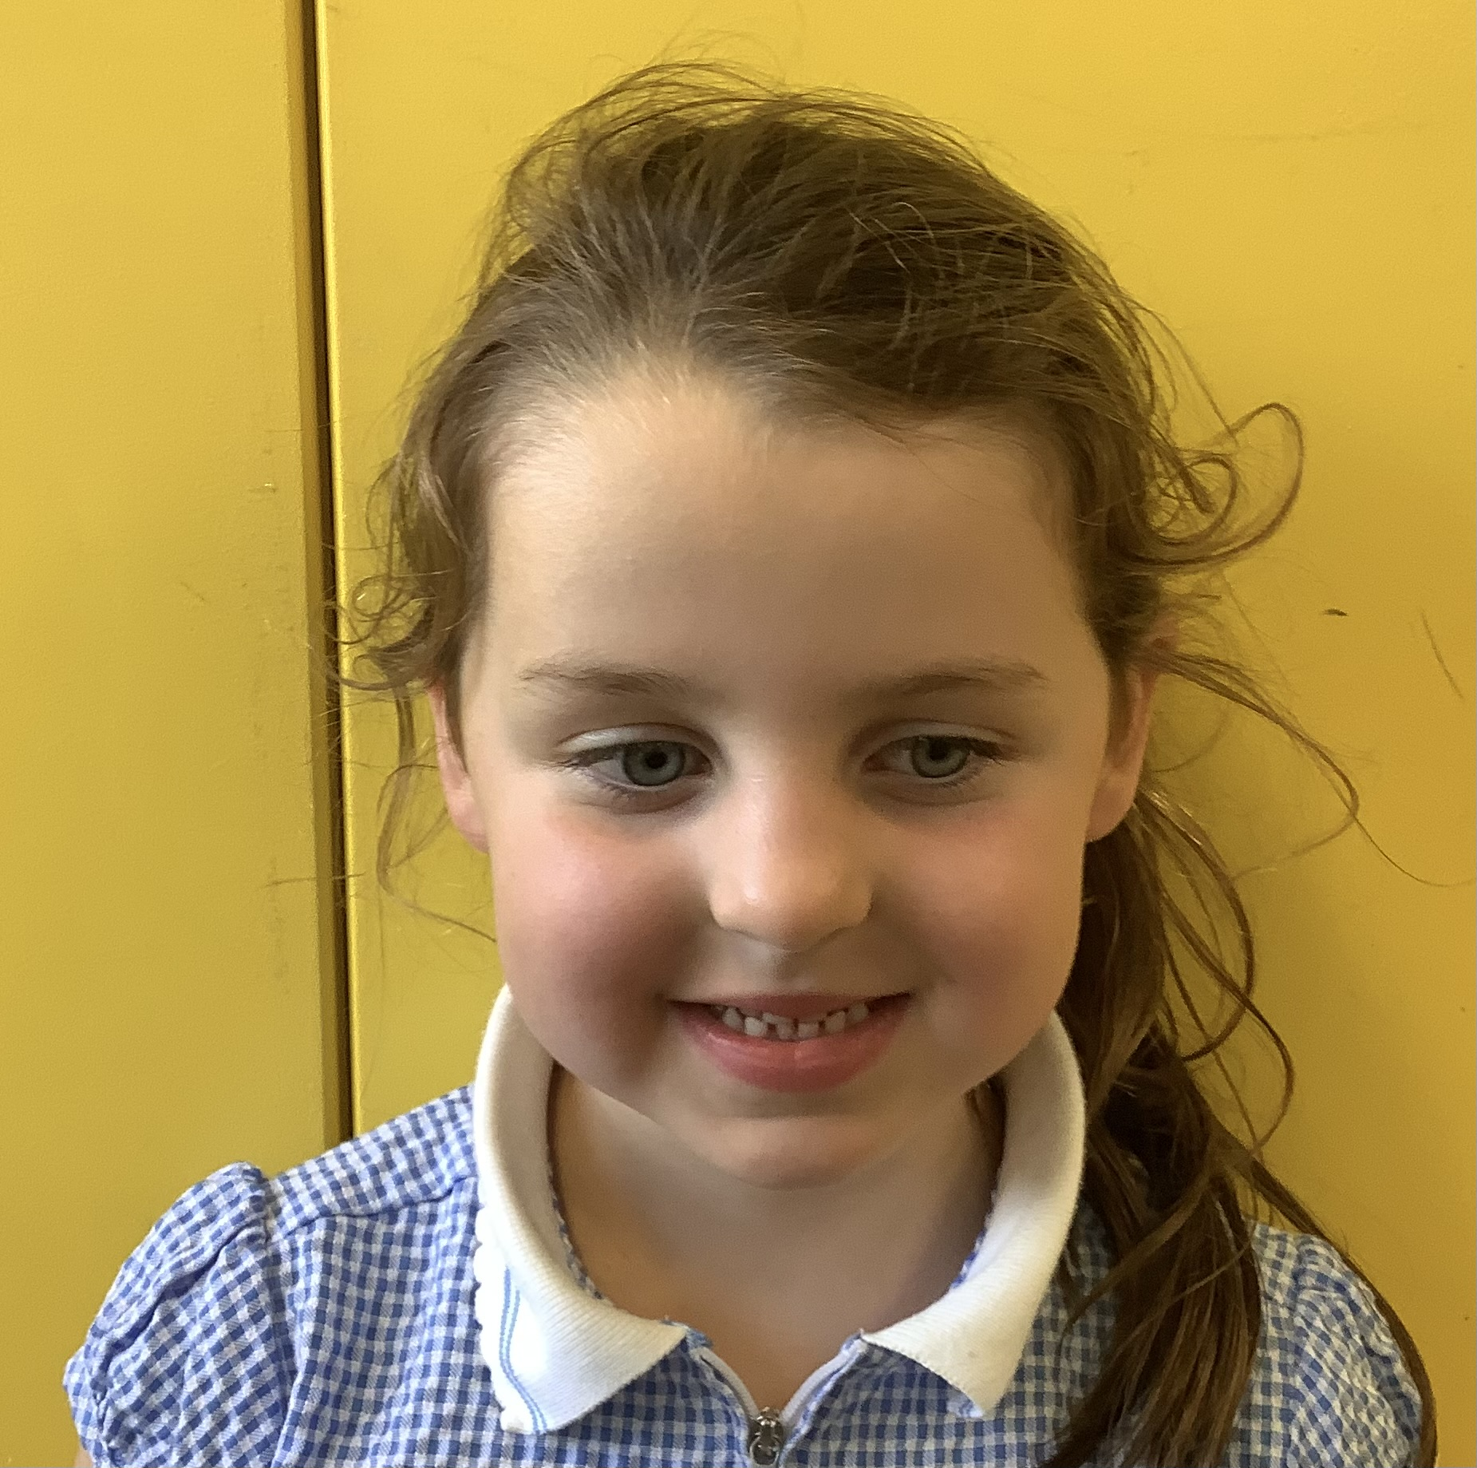
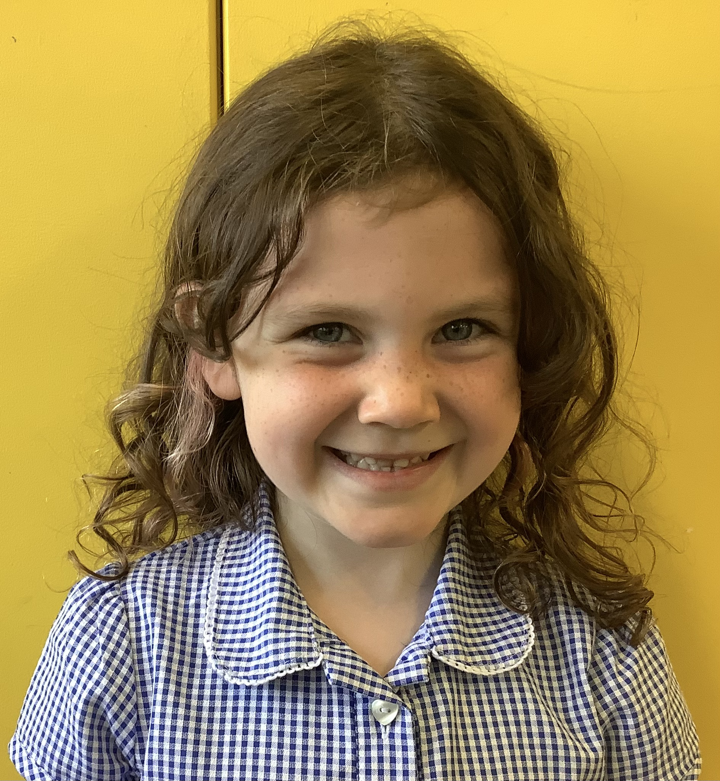
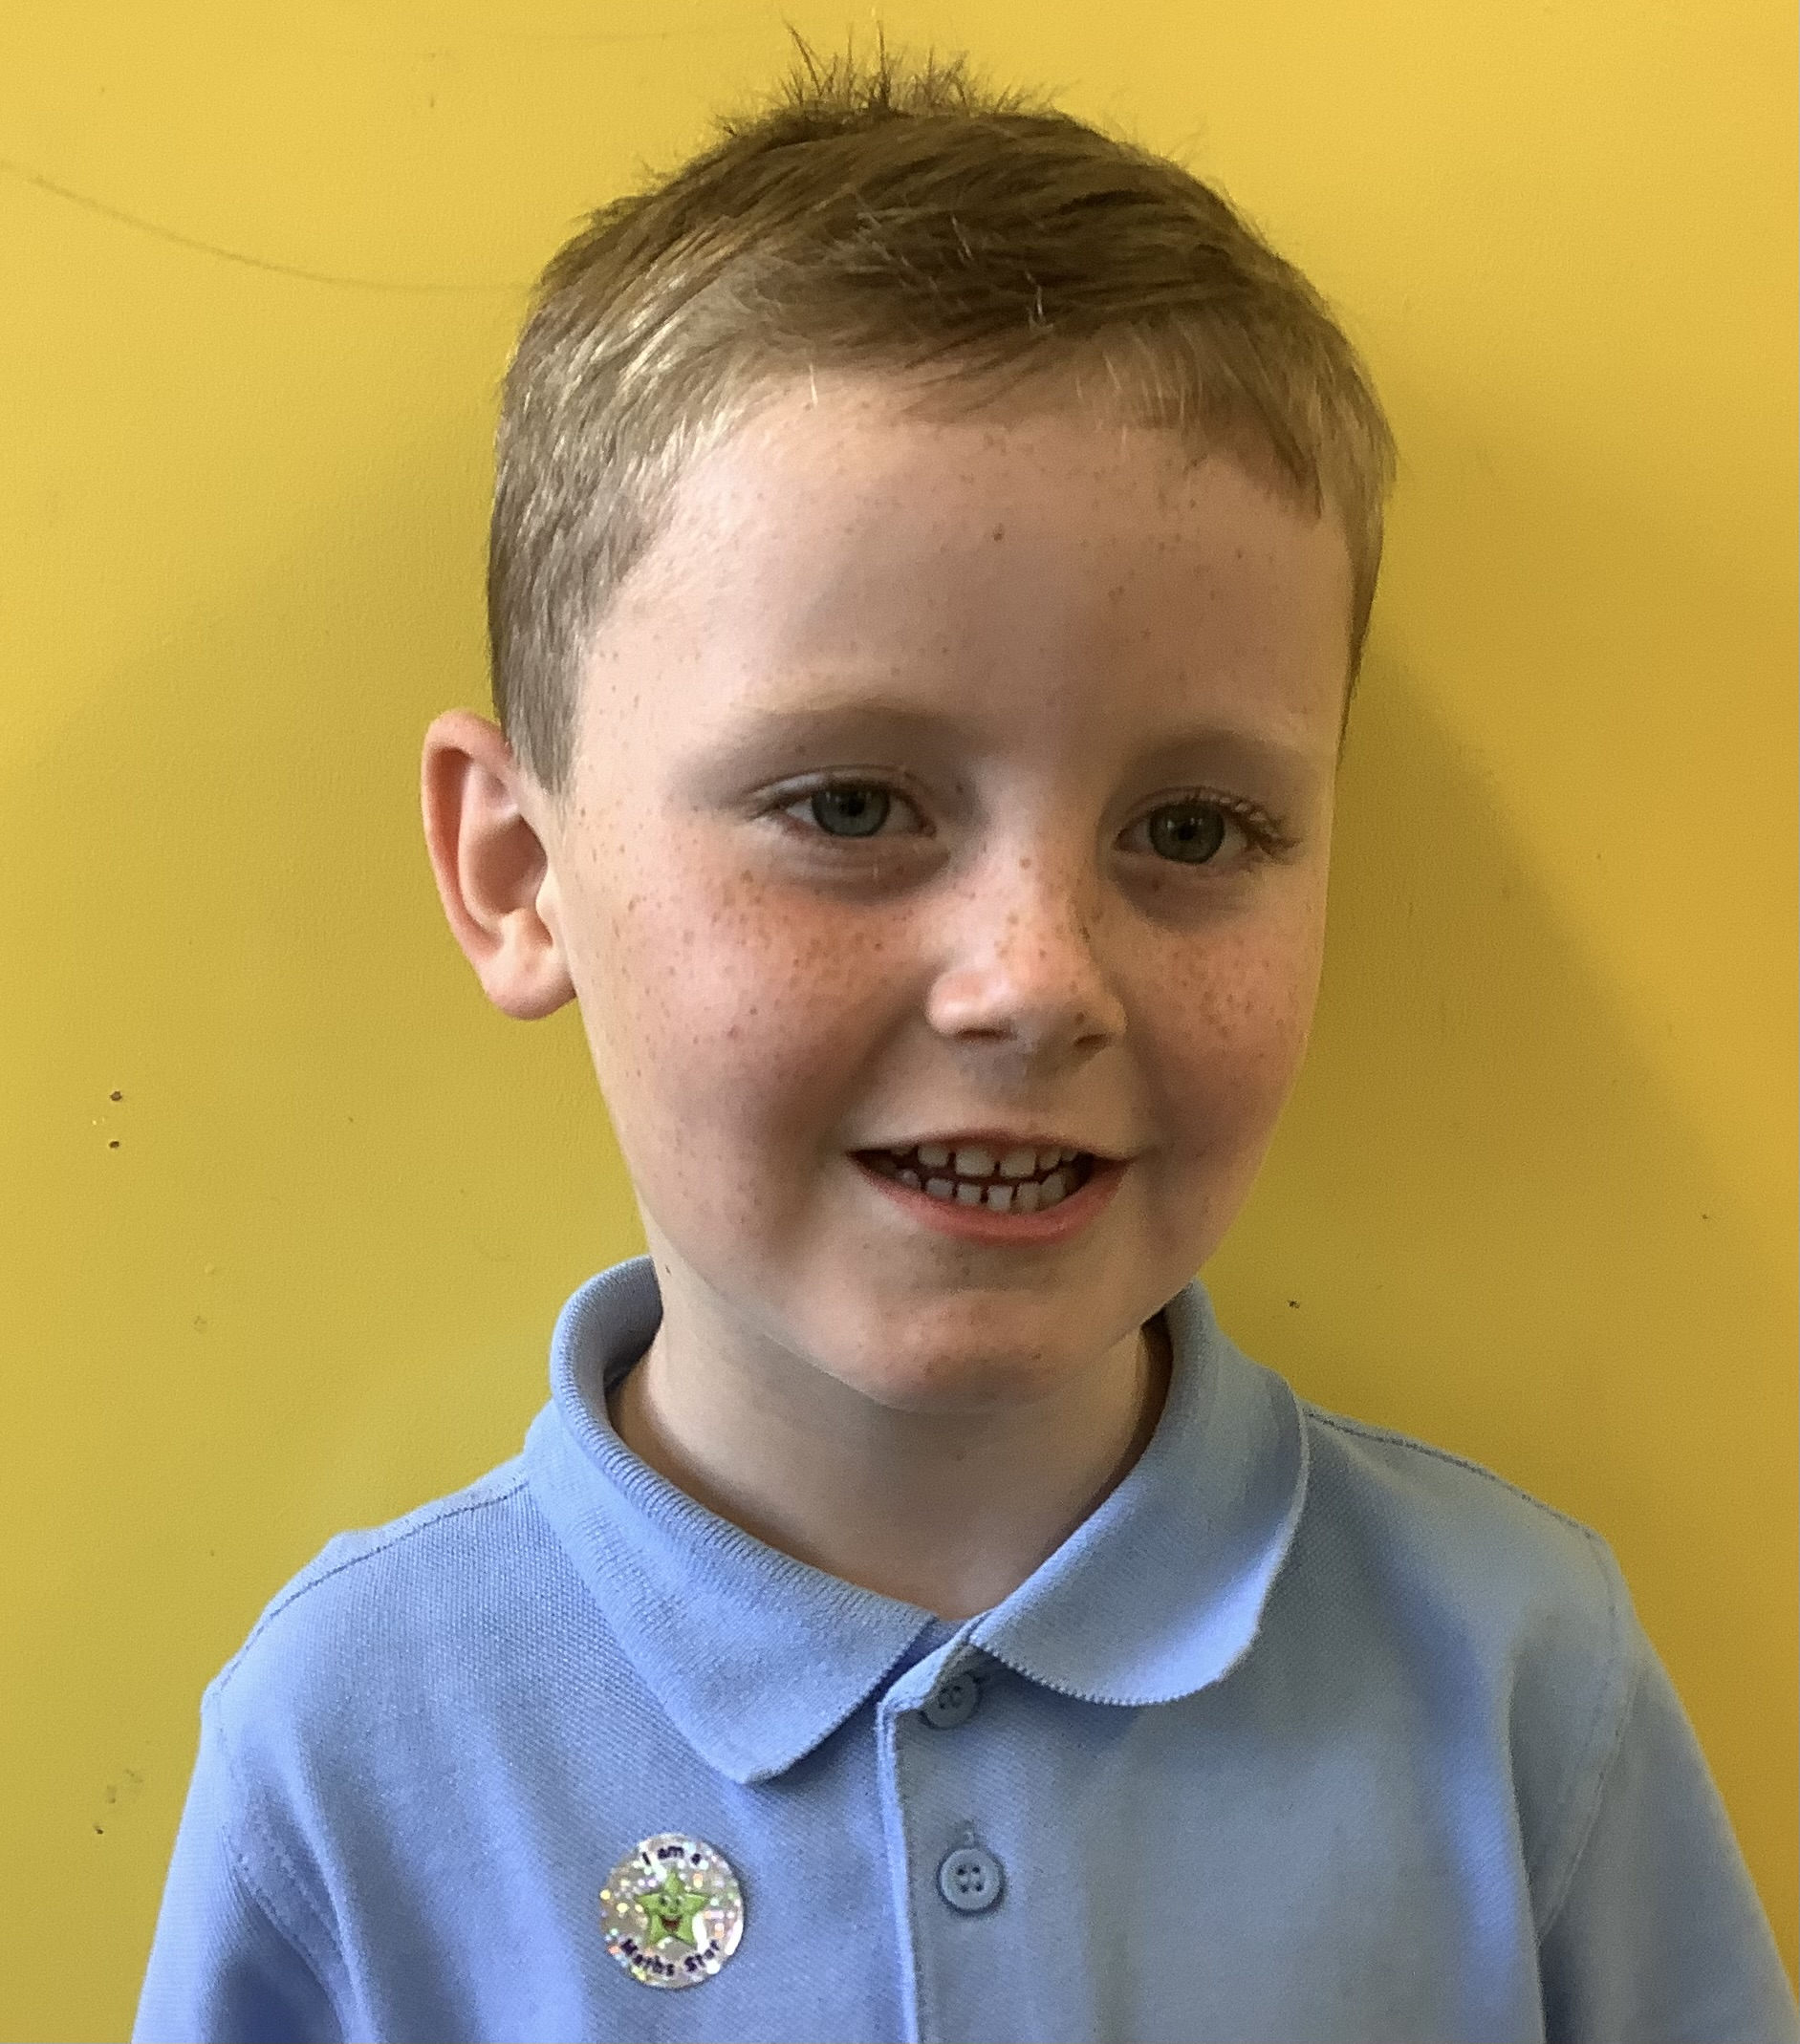
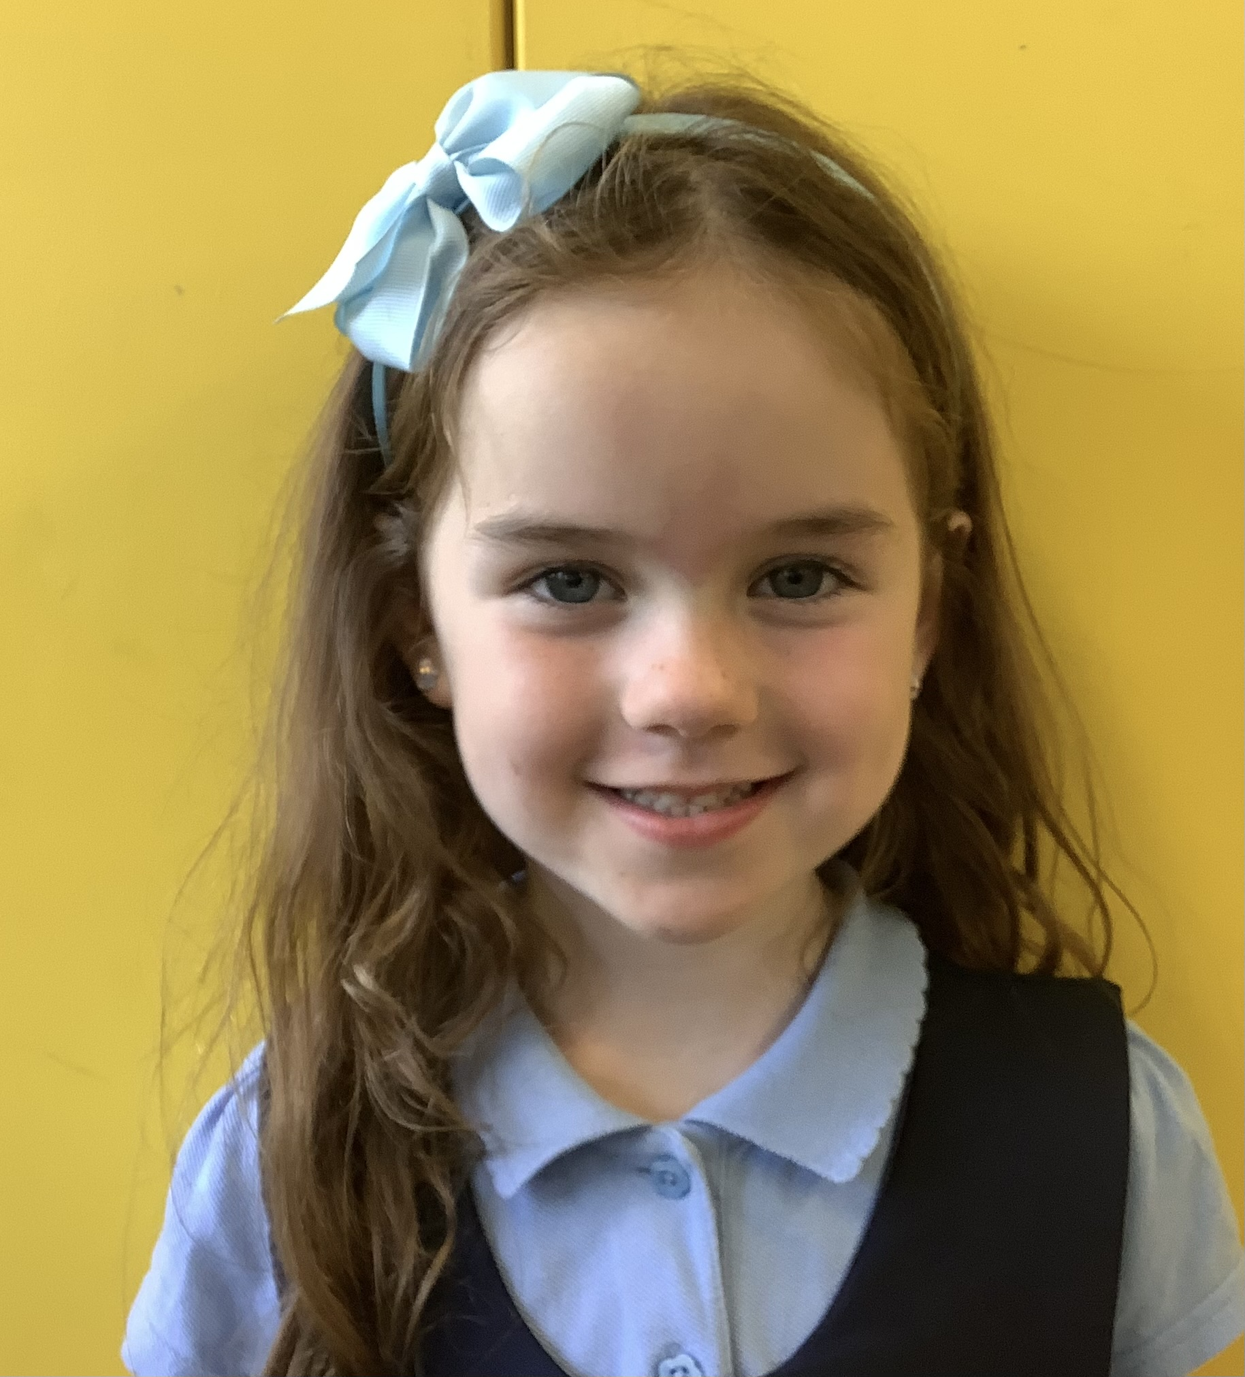
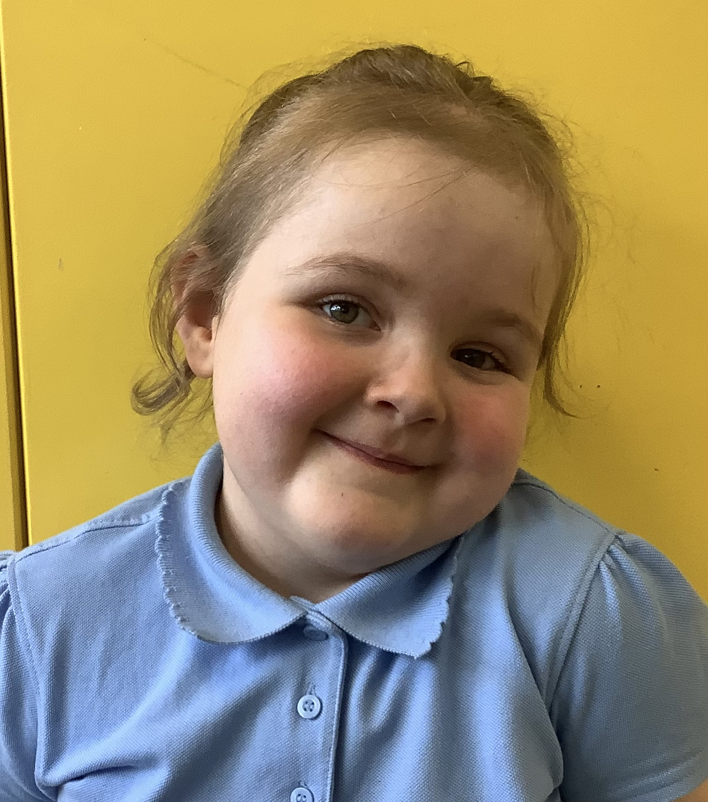
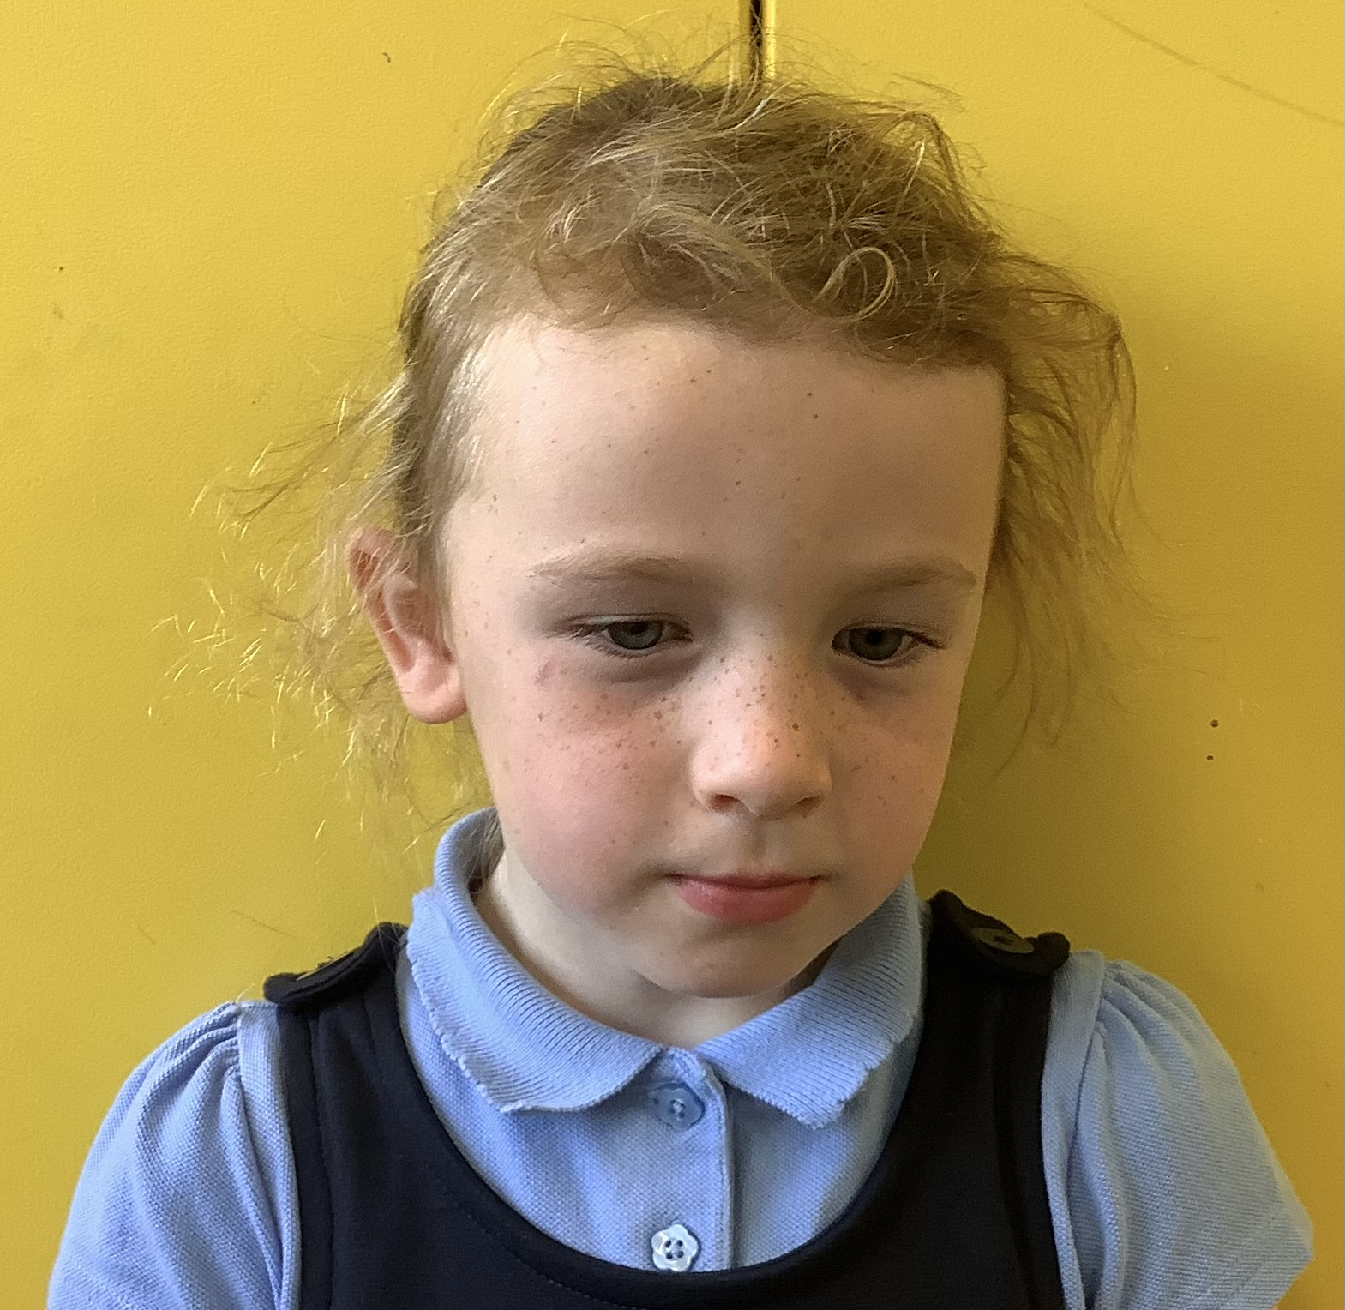
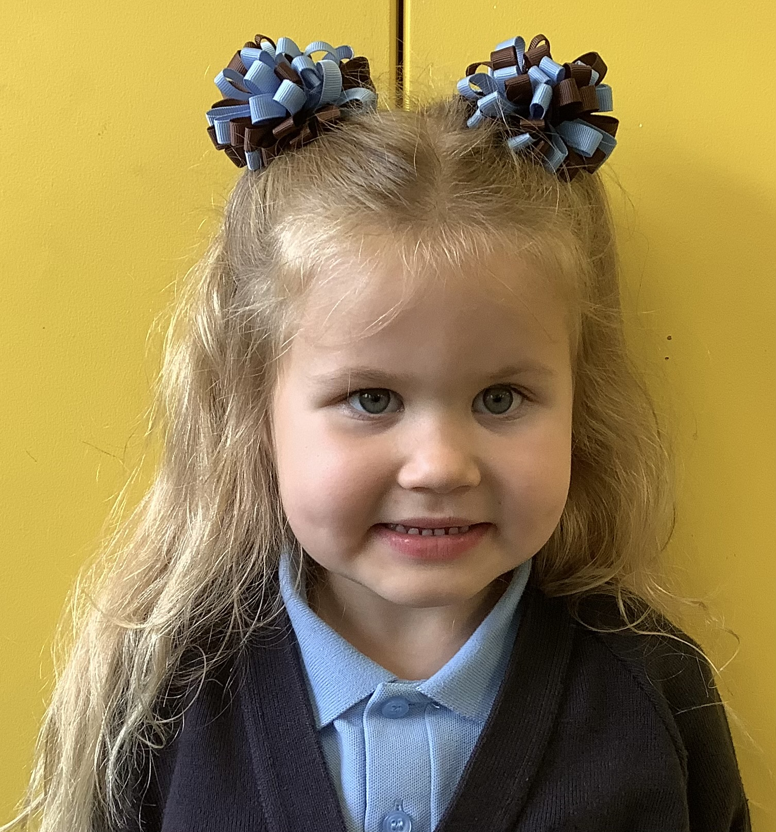
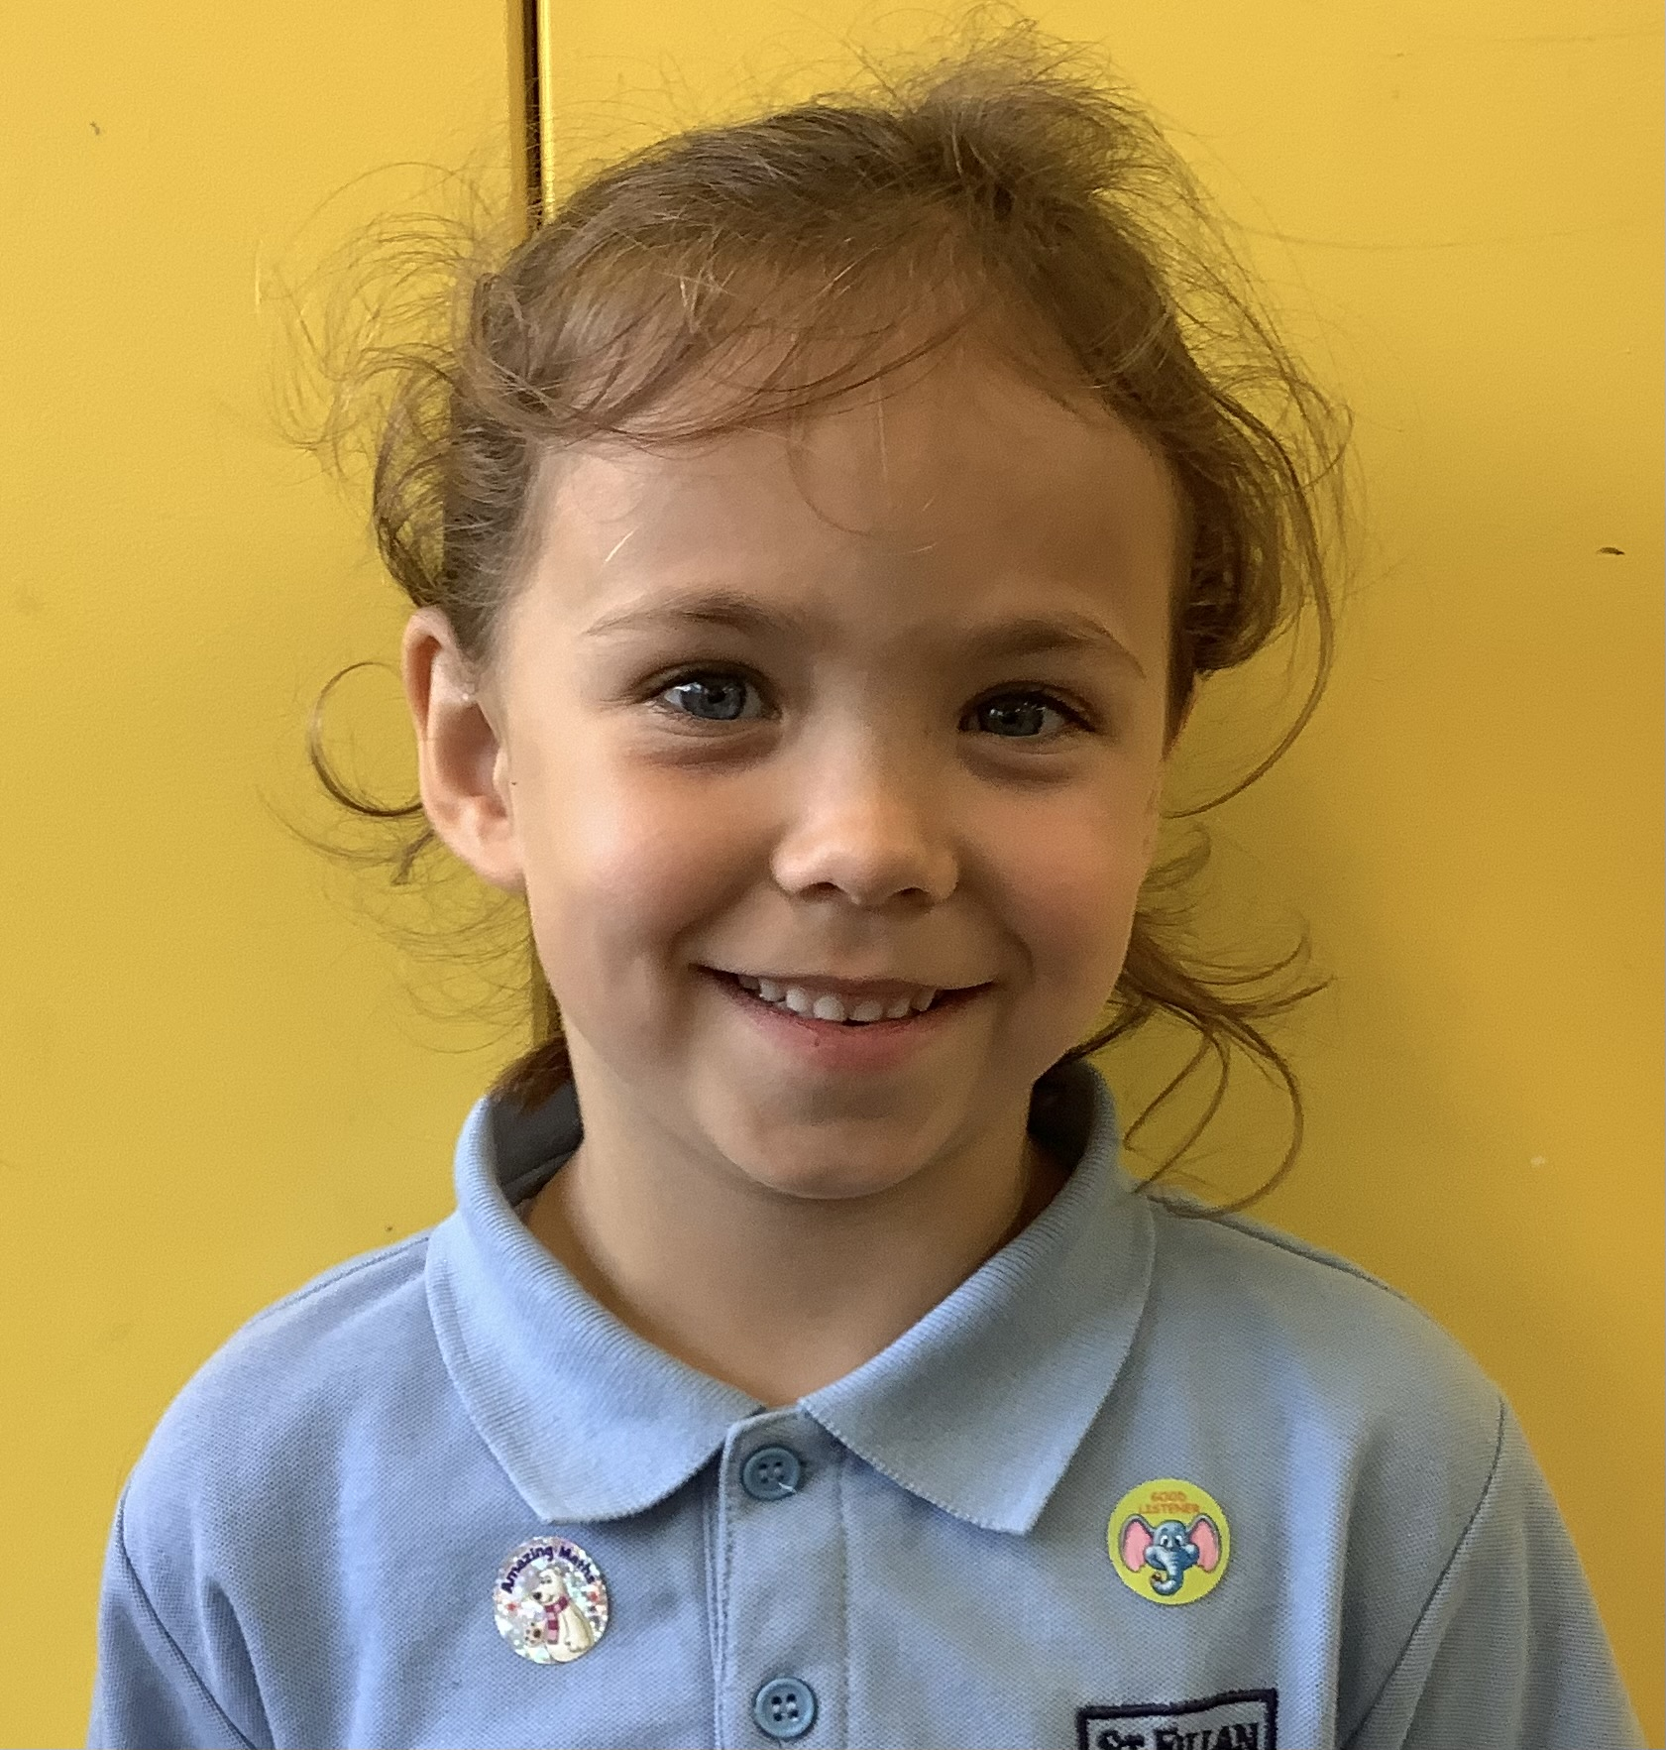
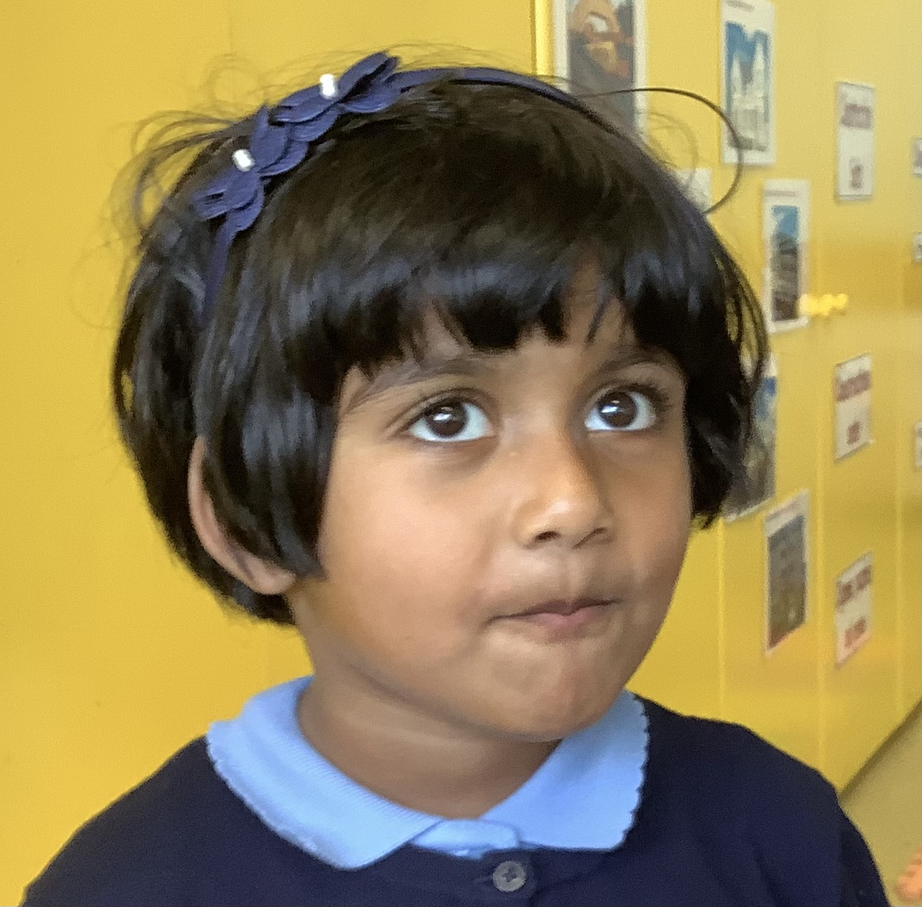
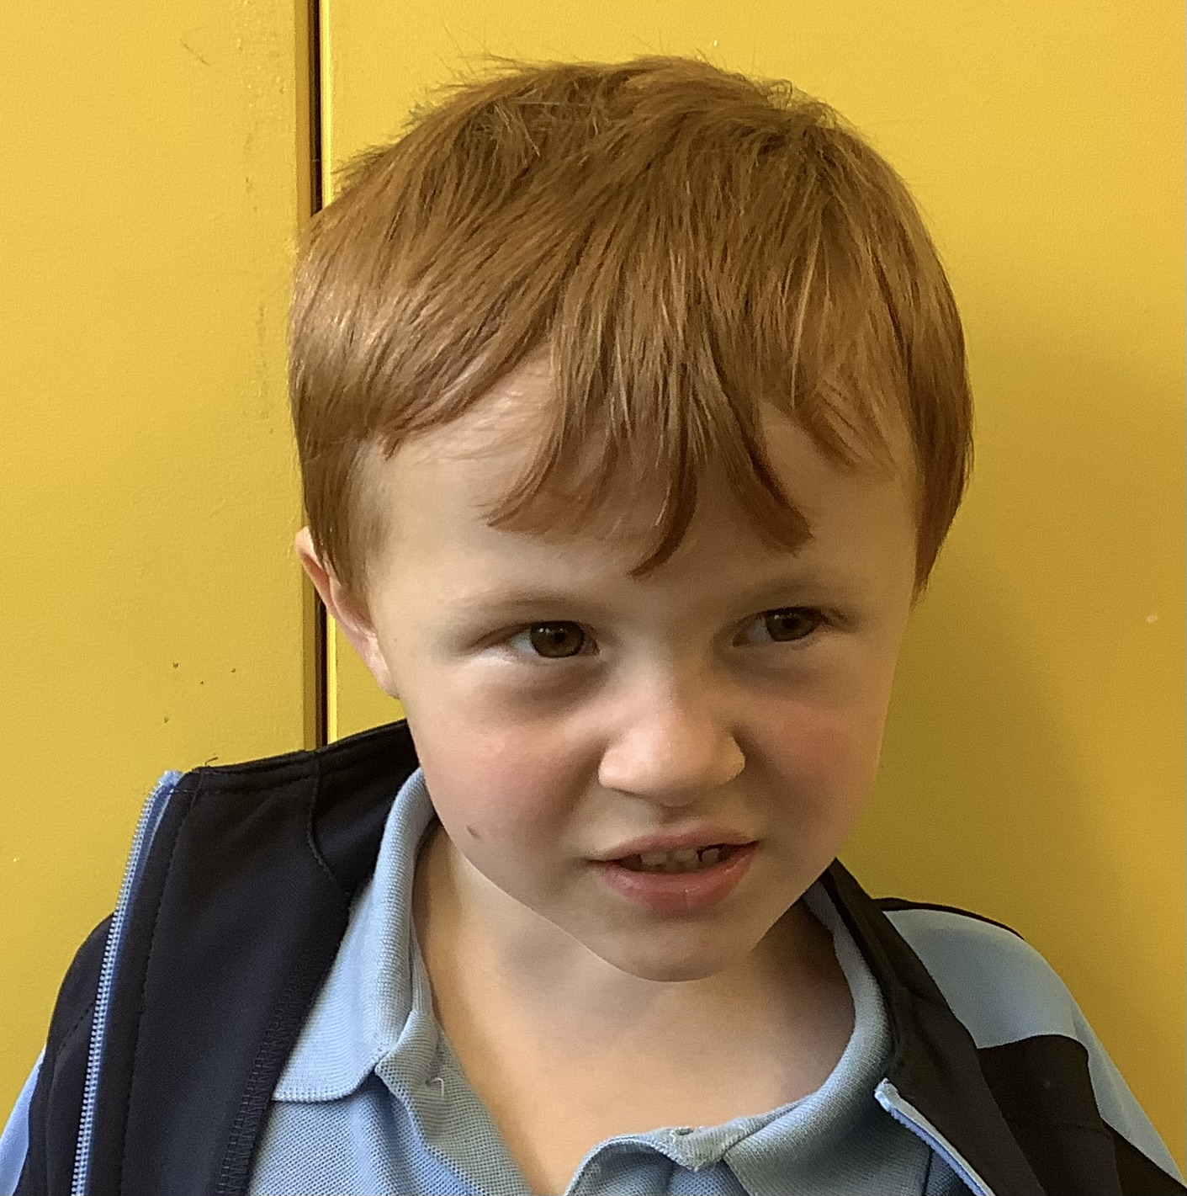
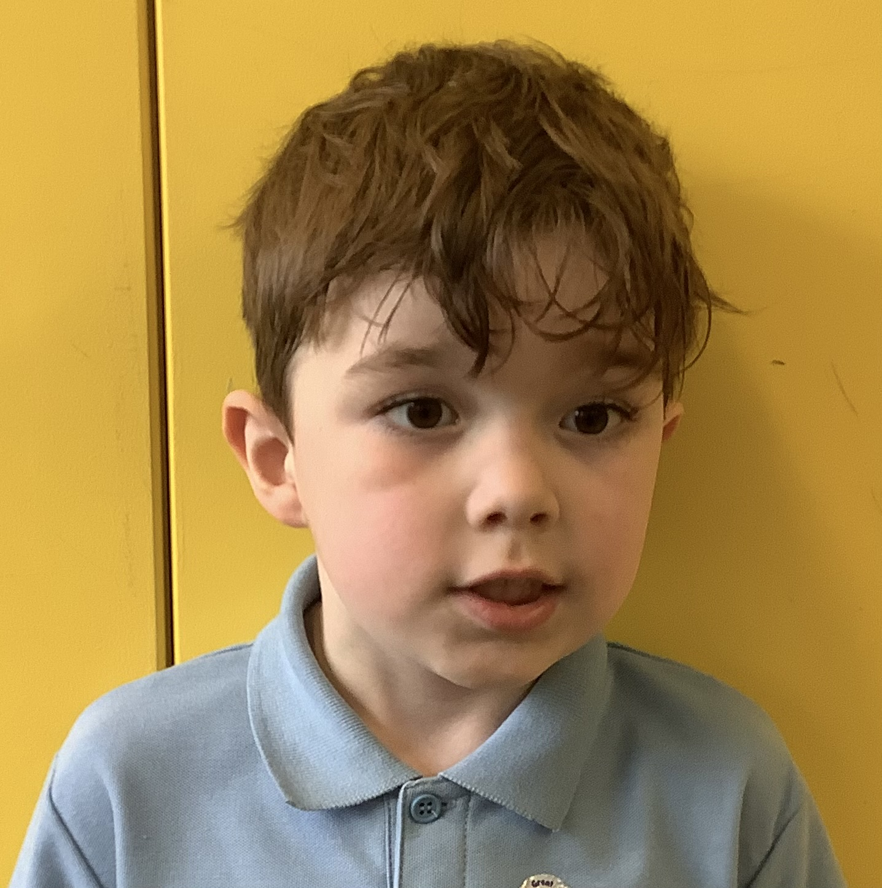
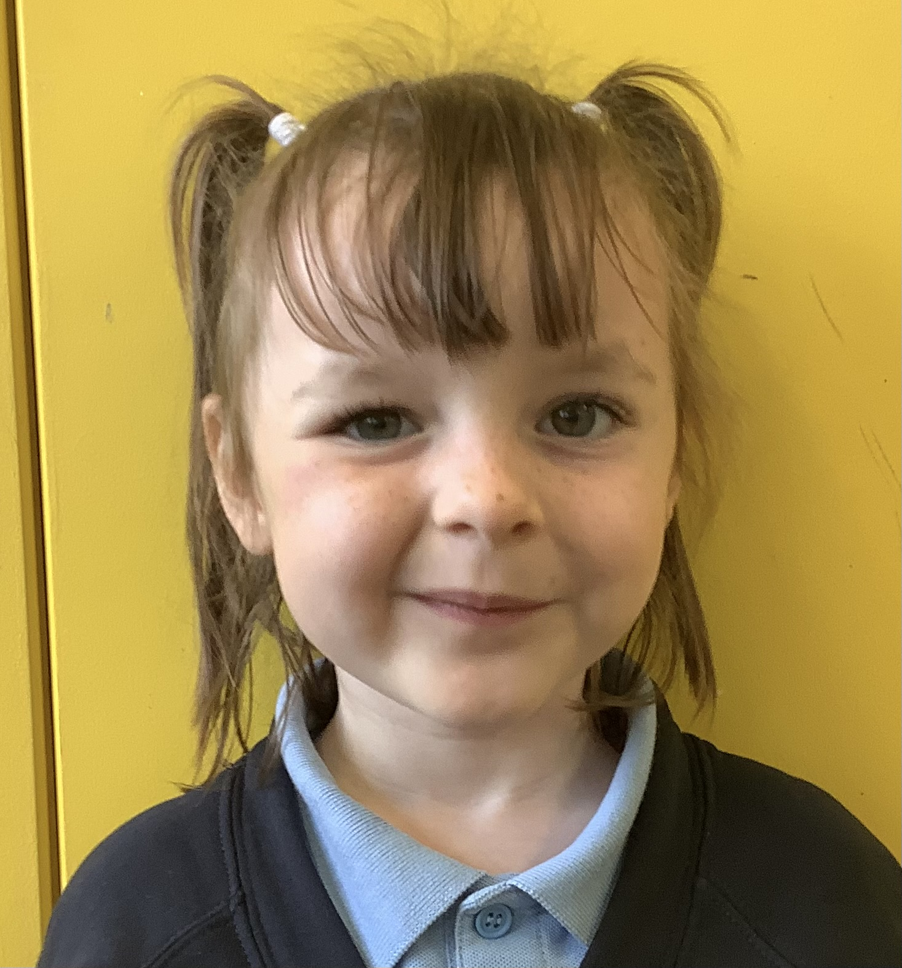
Class Charter & CELEBRATING SUCCESS

Slide 8
Class Charter & CELEBRATING SUCCESS
Positive behaviour approach- In St Fillan’s children are given house points for displaying the values of our class charter. These points are counted each week and the winning house receives an extra play. At the end of the year the winning house is awarded the house cup.
Rewards & celebrations: We love to celebrate our pupils’ achievements both in and out of school via our wider achievement wall. Please encourage your child to share their achievements with us.
In school achievements are celebrated at assembly via our Head Teacher Awards and Everyday Hero Awards.

Slide 9
SEEsaw
You should be logged in as a FAMILY member to see updates on the class feed AND your child should be logged in to be able to complete homework tasks.
QR codes have been sent home however let me know if you need another QR code.
If anyone is having trouble getting onto Seesaw then we can try and sort it today, if not we can organise support.
Any questions?
Thank you for your support!
Looking forward to a great year ahead!
Table top activities have been set for you to enjoy with your child.

