Slide 1
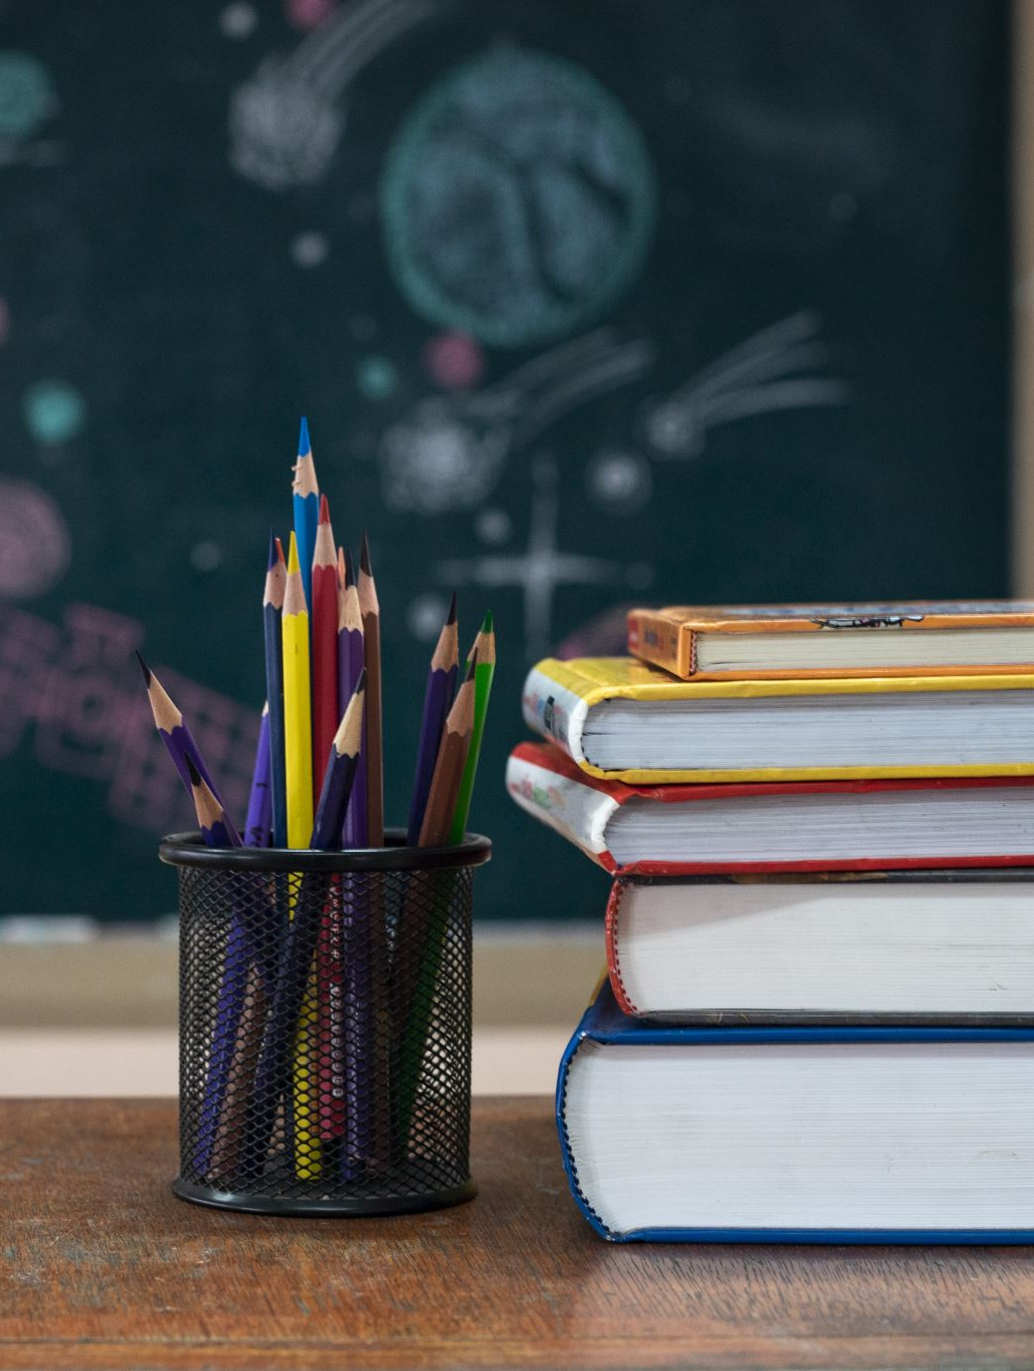
Meet the Teacher
Welcome to Primary 4
Class teacher(s):
Mrs Driver & Miss Duffy

Slide 2
About Me
As a teacher:
Mrs Driver – Monday, Tuesday
Miss Duffy – Wednesday- Friday

Slide 3
Communication
How and when to contact me:
School office, drop off/ pick up, Seesaw
Information and updates: Seesaw, Sway digital newsletters

Slide 4
Important class Information
PE days: Monday & Thursday
Class Topics :
UNCRC/ Class Charter- Health and Wellbeing
Rivers – Social studies, Literacy, Art
Numeracy
-Place Value, Length, Symmetry
Literacy
Talk for Writing- The Amazon River
Reading skills through class novel: The Thames and Tide Club: The Secret City

Slide 5
Class routines & Class Charter
• Let’s look at our class charter: Created using UNCRC, school vision, value and aims
• Rewards & celebrations: Wider achievement, Chance box, Table Points, House Points, Golden Ticket Tea Party, Weekly/ Termly Awards

Slide 6
Homework
Homework will be posted to Seesaw
Frequency and expectations: Posted Monday and returned by Friday
Types: Numeracy, Weekly spelling sound, Research, Learning Logs
Some written tasks will be expected to be completed: Spelling, some maths tasks. A picture of these can be taken and uploaded to the homework post on Seesaw and checked by the teacher.
Some digital tasks will be expected to be completed: Reading Eggs, Maths Seeds and topic related tasks.
You will receive a QR Code to log into Reading Eggs/Math Seeds. Keep it safe!
Reading Eggs & Math Seeds can be played on an I phone, laptop, Chromebook or an I pad.

Slide 7
How You Can Help at Home
Encourage reading for pleasure with physical books and the Reading Eggs Online library
Relate and encourage learning to real life e.g. encourage children to use their maths skills when shopping
Support homework routines and deadlines if possible
Praise effort and perseverance
Complete Reading Eggs / Math seeds tasks; we receive weekly report on usage and achievement. The class are used to using this resource and should know what to play and where to find it on the resource

Slide 8
Reading eggs & Math Seeds
Let’s now look at the Reading Eggs and Math Seeds platform to know exactly what the class will be asked to complete and where to find it: https://readingeggs.co.uk/
In summary the Homework tasks will be usually be:
Reading Eggs book/quiz once it is finished. This will be set by the teacher and appear in the LIBRARY area.
Occasionally a Reading Eggs OR Reading Express ‘My Lessons’ Comprehension task. We will be doing these in school.
Math Seeds ‘Lessons.
Please let me know at the end if you do not have a device they can use at home for online homework tasks

Slide 9
SEEsaw
You should be logged in as a FAMILY member to see updates on the class feed AND your child should be logged in to be able to complete homework tasks.
QR codes have been sent home however let me know if you need another QR code.
If anyone is having trouble getting onto Seesaw then we can try and sort it today, if not we can organise support.
Any questions?
Thank you for your support!
Looking forward to a great year ahead!
You are free to go!

Slide 10
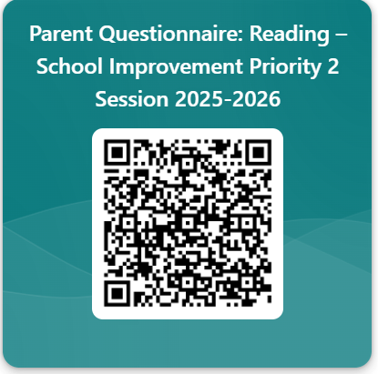
PARENT QUESTIONNAIRE:

