Slide 1
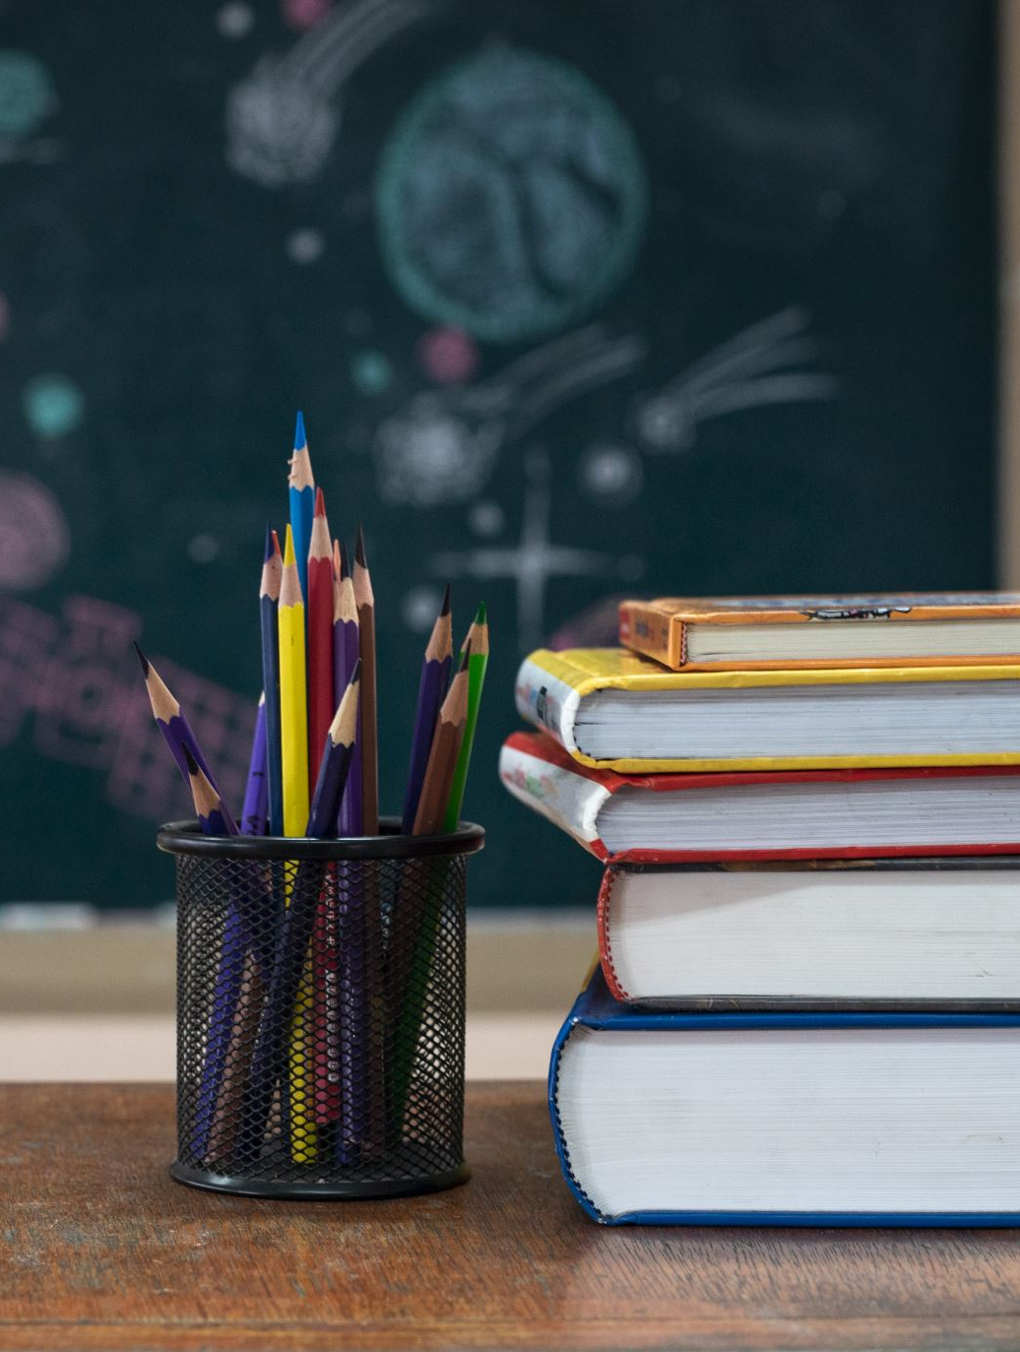
Meet the Teacher
Welcome to Primary 3
Class teacher(s):
Mrs Smith & Mrs McVicker
Questions can be asked at the end

Slide 2
Working patterns
Mrs Smith – Monday and Tuesday
Mrs McVicker – Wednesday, Thursday and Friday

Slide 3
Communication
How and when to contact us:
Seesaw message, after school in playground, email to the school office
Information and updates:
Seesaw, Sway digital newsletters

Slide 4
Important class Information
PE days:
Tuesday with Mrs Smith
Wednesday with Mrs McVicker
Class Topics :
UNCRC/ Class Charter- Health and Wellbeing
Flat Stanley – Social studies, Literacy, Art
Numeracy
-Place Value and Patterns
Literacy
Talk for Writing- Is Plastic Fantastic (description toolkit focus)

Slide 5
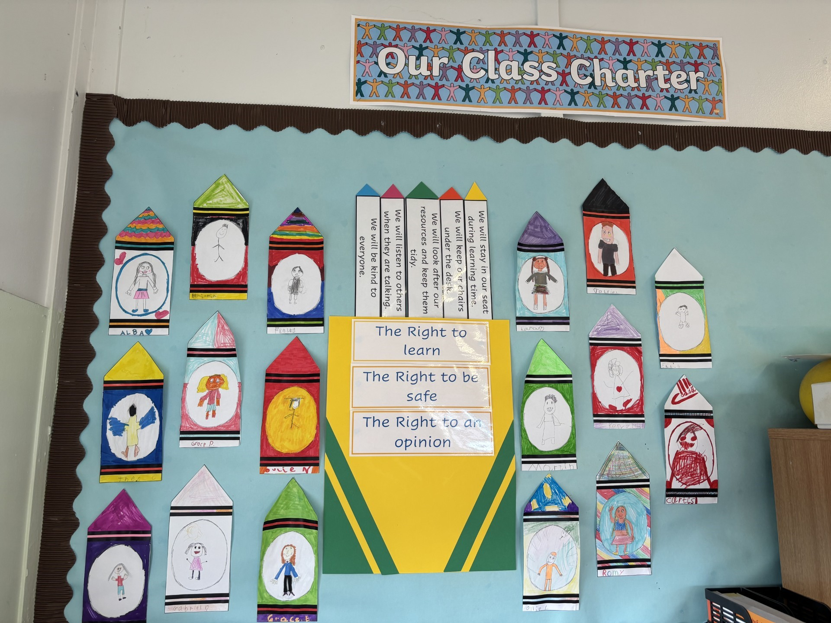
Class routines & Class Charter
• Let’s look at our class charter
• Rewards & celebrations
Group reward – pompoms. The winning group choose a prize each week.
House points throughout the school
Monthly and termly awards at Assemblies

Slide 6
Homework
Spelling homework will be ssued on a Monday. The words will be listed on SEESAW and children will copy their spelling words into their homework jotters.
Reading books will be issued on a Monday – Big Cat book will go home.
Maths homework will be posted to SEESAW and completed in a maths homework jotter.
Frequency and expectations: issued on a Monday and returned Friday or before
Types: Reading, Spelling, Maths and IDL tasks
Some digital tasks will be expected to be completed: Reading Eggs (occasionally), Maths Seeds, Maths games and IDL related tasks.
You will receive a QR Code for Reading Eggs/Math Seeds. Please keep it safe!
Reading Eggs & Math Seeds can be played on an I phone, laptop, Chromebook or an I pad.

Slide 7
How You Can Help at Home
Encourage reading for pleasure with physical books and the Reading Eggs Online library
Relate and encourage learning to real life e.g. encourage children to use their maths skills when shopping and telling the time on clocks at home
Support homework routines and deadlines
Talk about the importance of following the Class Charter during teaching and learning
Praise effort and perseverance
Complete Reading Eggs / Math seeds tasks; we receive weekly report on usage and achievement. The class are used to using this resource and should know what to play and where to find it on the resource.

Slide 8
Reading eggs & Math Seeds
Let’s now look at the Reading Eggs and Math Seeds platform to know exactly what the class will be asked to complete and where to find it: https://readingeggs.co.uk/
In summary the Homework tasks will be usually be:
Occasionally a Reading Eggs ‘My Lessons’ Comprehension task. We will be doing these in school.
Math Seeds ‘Lessons’. (Complete one lesson)
Please let me know at the end if you do not have a device they can use at home for online homework tasks.

Slide 9
SEEsaw
You should be logged in as a FAMILY member to see updates on the class feed AND your child should be logged in to be able to complete homework tasks.
QR codes have been sent home previously however let me know if you need another QR code.
If anyone is having trouble getting onto Seesaw then we can try and sort it today, if not we can organise support.
Any questions?
Thank you for your support!
Looking forward to a great year ahead!
You are free to go!

Slide 10
