Slide 1
P7 Parent/Carer Information Evening
Wednesday 11 June 2025

Slide 2
P7 Parent/Carer Information Evening
Agenda
Kevin Christie, Head Teacher: Welcome and Introduction
Rachael Malone, Transition Teacher: The Transition Process
Stephanie Nugent, PT Support for Learning: Support for Learning in Gryffe High School
Sara Dhesi, Depute Head Teacher S1 and S4: Key information
Josh Gallagher, PT Guidance: Pupil Support in Gryffe High School
Tour of the School: S4 Leadership Team

Slide 3
Mrs Malone
The Transition Process
P7 Parent/carer Information Evening

Slide 4
P7 / S1 Transition
Primary Visits / Lessons
Pupil Passport
Transition Meetings - P7 staff and Depute Head
S1 Spreadsheet
Gryffe staff
Attainment

Slide 5
Mrs Nugent
Support for Learning in Gryffe High School
P7 Parent/carer Information Evening

Slide 6
Support for Learning
Working closely with Transition Teacher- identify needs of pupils.
Information is shared with all staff, via our secure spreadsheet, which is updated regularly.
Plan and organise interventions- needs dependent

Slide 7

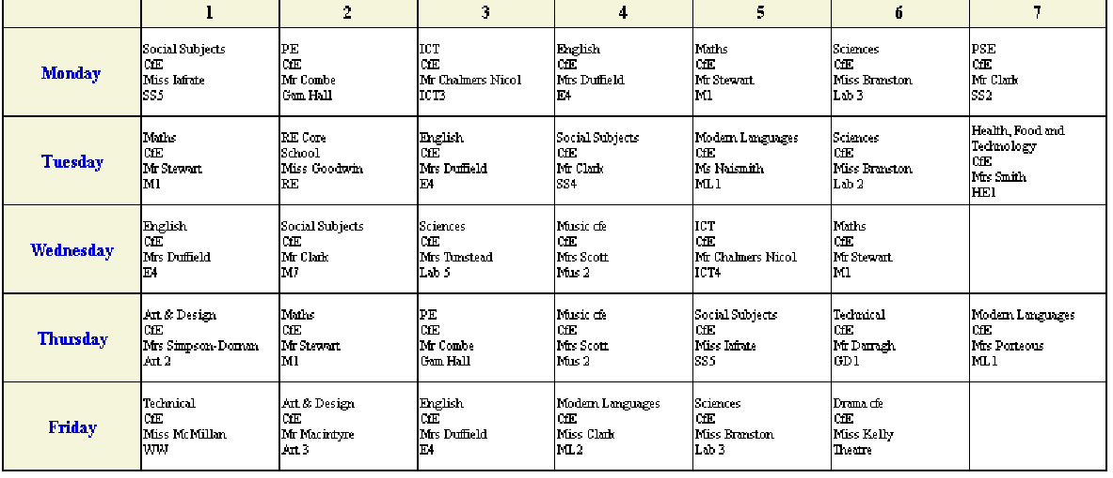

Support for Learning
Support for all

Slide 8
Ms Dhesi
DHT S1 & S4
Key Information
P7 Parent/Carer Information Evening

Slide 9
Transition Week
Positive first three days!
Getting to know each other, teachers and the school building.
Good balance of fun and introduction to learning.
Lots of questions!!

Slide 10
Questions…
House classes and practical classes?
Moving around the school – getting lost!
Being late for classes
Access to toilets / Social Area
What to bring?
Using the canteen
Leaving the school campus

Slide 11

P7 Parent/Carer Information Evening
Our expectations for school uniform are clear, consistent and fair. We know that uniform promotes equity for all our pupils and as of today, we expect all young people to wear full school uniform. It tells us that you are proud to be part of our school.

Slide 12
P7 Parent/carer Information Evening
Blazer: S1–S5 without braiding; S6 with red braiding
Black (or navy) trousers or skirt – no sports leggings
Black (or navy) plain jumper – no hoodies
White long or short-sleeved shirt, worn with a school tie
Plain black shoes or trainers – baseball/basketball boots/shoes with white trim are not permitted as part of the school uniform
Tie: School tie, worn neatly at the collar
PE Kit: Gryffe High School or plain white T-shirt or polo shirt with black shorts or tracksuit bottoms. Appropriate footwear must be worn.

Slide 13
P7 Parent/carer Information Evening
The School Day
Monday / Tuesday/ Thursday |  | Wednesday / Friday
8:50-9:40 | Period 1 | 8:50-9:40 | Period 1
9:40-10:30 | Period 2 | 9:40-10:30 | Period 2
10:30-10:45 | Interval | 10:30-10:45 | Interval
10:45-11:35 | Period 3 | 10:45-11:35 | Period 3
11:35-12:25 | Period 4 | 11:35-12:25 | Period 4
12:25-1:15 | Period 5 | 12:25-1:10 | Lunch
1:15-2:00 | Lunch | 1:10-2:00 | Period 5
2-2:50 | Period 6 | 2-2:50 | Period 6
2:50-3:40 | Period 7

Slide 14

Homework
Satchel One (formerly known as Show My Homework) is our Homework communication platform.
We use Satchel One to set, collect and provide feedback on homework.
Satchel One is also used to provide Parent/Carer updates.
Pupils can access this via their Glow accounts, and parent/carer logins will be provided in August.

Slide 15
Attendance
Unless your child is too unwell to come to school, or there is something exceptional happening at home, your child should be in school.
Please remember to contact the school office at the earliest opportunity to let us know that your child will not be in school.
Supporting your child with attendance:
Encourage your child to attend/stay in school if they are able.
If you are concerned about your child’s attendance, or worried there is something causing them to miss school, please speak to Ms Dhesi or Guidance, as soon as possible.

Slide 16
Attendance
Impact of low attendance:
If your child has 90% attendance, they will have the equivalent of:
1/2 a day off per week
19 days off per year
247 days off over their school career of 13 academic years - equivalent to over 1 year of lost education
95% attendance across a whole school session (August - June) means your child will have missed around 60 lessons
85% attendance will mean your child will have missed around 250 lessons

Slide 17
Attendance
If your child feels unwell during the school day, they should report to the school office.
We will try, wherever possible, to support your child back into class.
If your child feels that they cannot remain in school, a member of Senior Leadership (either a Year Head or the Head Teacher) will speak with them before the office make contact home.

Slide 18

P7 Parent/carer Information Evening
Gryffe High School is a mobile-free school!
All phones must be switched off and in schoolbags at all times during the school day. This applies as soon as pupils enter the school building in the morning.
At interval and lunch, pupils may use mobile phones in OUTDOOR areas only. Phones MUST be switched off and back in schoolbags before re-entering the building.
Earphones/headphones are not permitted in the school building and should be in your bag. Pupils requiring noise-cancelling headphones/earplugs are allowed to wear these inside the school building

Slide 19
Mrs Ward
Pupil Support in Gryffe High School
P7 Parent/carer Information Evening

Slide 20
Pupil Support Team
Guidance Team
First port of call – communication is key. Please pick up the phone/email – we will try to respond as soon as we can.
Burns Mr Clark
Fleming Ms Ward
Mackintosh Miss Hagan/Mr Gallacher
Wallace Miss Holmes & Mrs Scott
Pupil Support and Child Protection Coordinator: Ms Dhesi
Work in conjunction with our pupils, parents and external partners/services to support the
Health and Wellbeing of every pupil.
Wellbeing Indicators
Safe, Healthy, Achieving, Nurtured, Active, Respected, Responsible and Included – used to assess wellbeing and provide support where required to remove barriers and achieve full potential.
Gateway for further support:
Subjects/Curricular
Referrals to External Partners – Family Wellbeing/Exchange counselling/St Vincent's/Headstrong
Mental Health Signposting
Educational Psychologist
TAC (Team around Child) Meetings
Careers

Slide 21
Robin Livingston
Parent Council
P7 Parent/carer Information Evening

Slide 22
Fiona Clark
PTA
P7 Parent/carer Information Evening

Slide 23
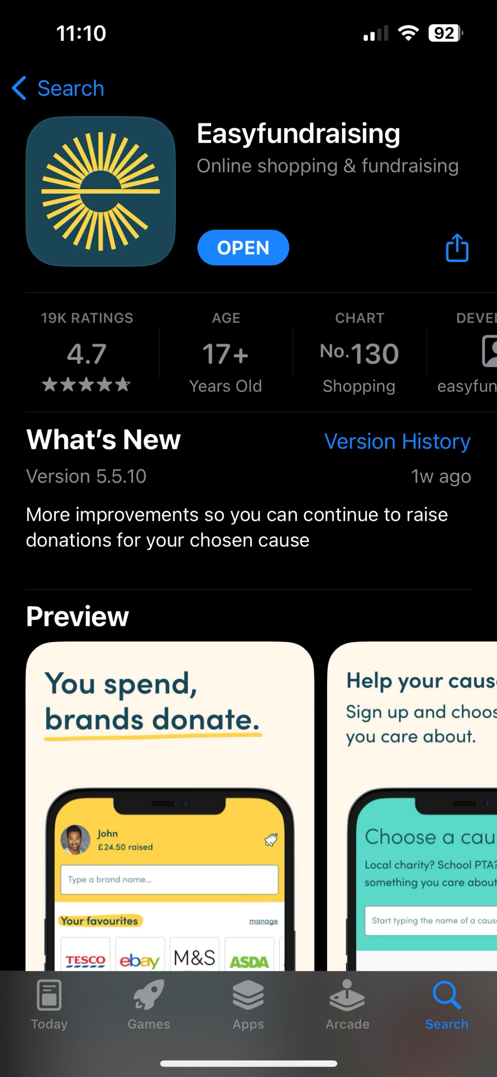
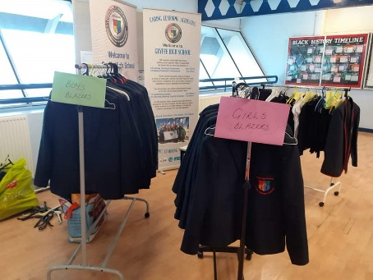
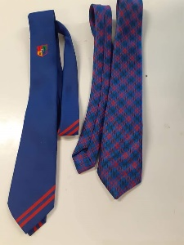
Gryffe High School PTA
Meetings take place 5/6 times per school year
Our objectives are to fundraise & connect with pupils/parents/carers
How you can help us!
Sign up to the following:
100 Club - £12 per year – Monthly draws – scan the QR Code!
Easyfundraising - Download the app, click Gryffe High School
PTA Committee – send us a message on the Facebook page!
Uniform Upcycling Shop : established July 2021
Have a browse tonight or pop back over the summer holidays

Slide 24
Where does the money go?
Bids from this year have still to be sorted through and agreed
Every penny raised goes back to the school to purchase additional support items needed
£2,000 - Grant from Virgin Money for digital inclusion that a parent applied for through their work
This recently bought several digital cameras for the photography department
Over past 5 years
PTA has funded
school requests
totalling around
£ 22,000

Slide 25
Current PTA Fundraising Events
Summer Concerts – June 2025
7 a-side football tournament – August 2025
Christmas Fayre – December 2025
Christmas Concerts – December 2025
More Event Details Coming Soon!!!!!
Check our social media for updates

