Slide 1

Welcome to Primary 2/1
Meet the Teacher Afternoon
30th August

Slide 2
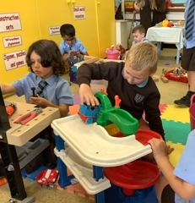
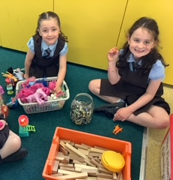
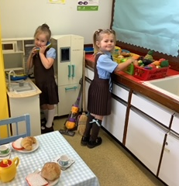
Making new friends…

Slide 3
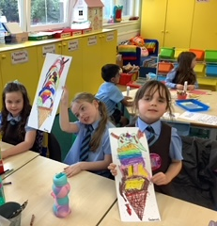
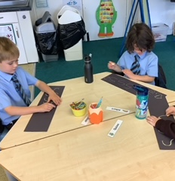
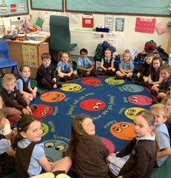
Learning together…

Slide 4
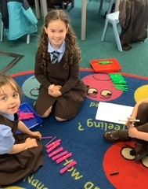
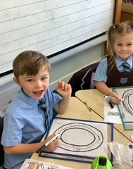
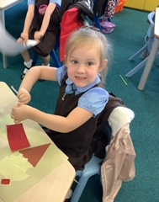
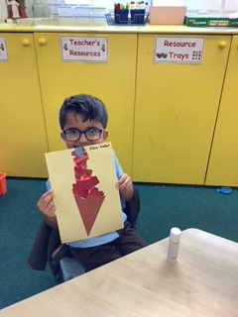
Doing our jobs…

Slide 5
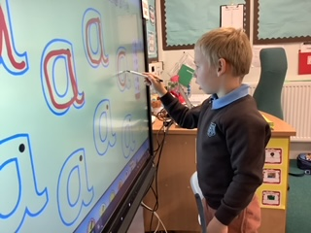
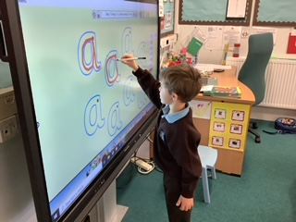
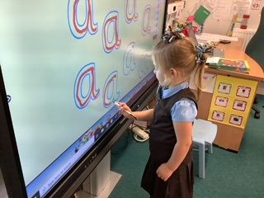
Using technology…

Slide 6

Our Shared Vision:
We hope that this year we will all work together to ensure that we meet our school vision. In learning, we are all growing and succeeding together.

Slide 7
To Support our School Vision,
our Shared Values are:
Faith, Trust, Team work, Respect,
Responsibility, Success
Learning about these values will help guide your child’s thinking and behaviour.

Slide 8
To help us achieve our school Vision and Values
Our School Aims are:
Be Brave
Unleash Creativity
Demonstrate Excellence
Show/Radiate Enthusiasm

Slide 9
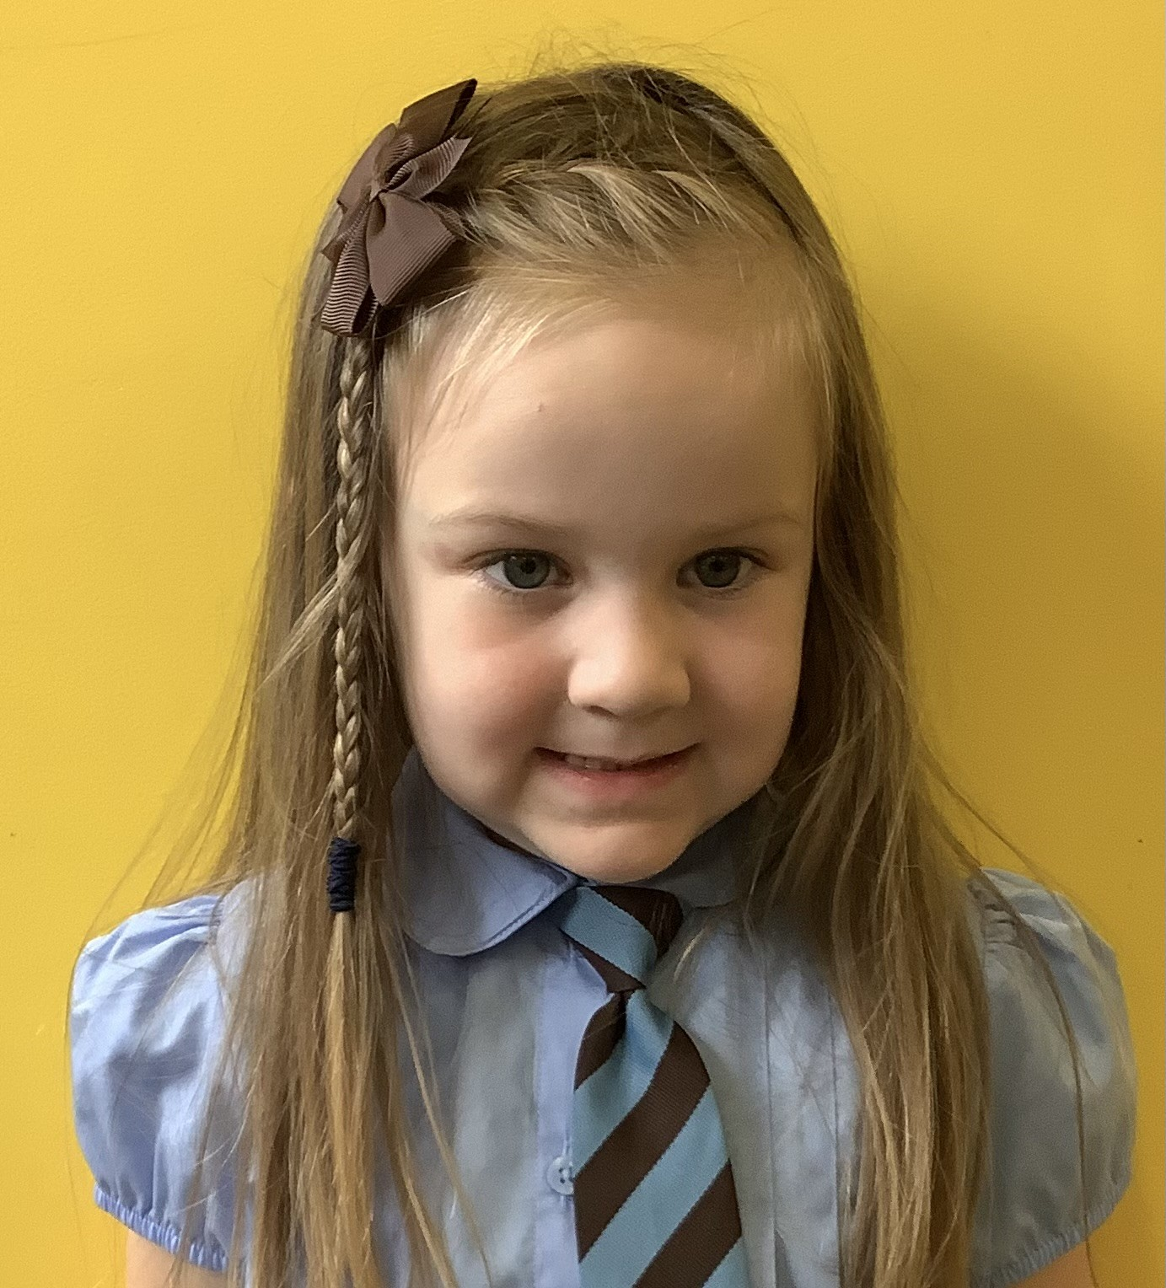
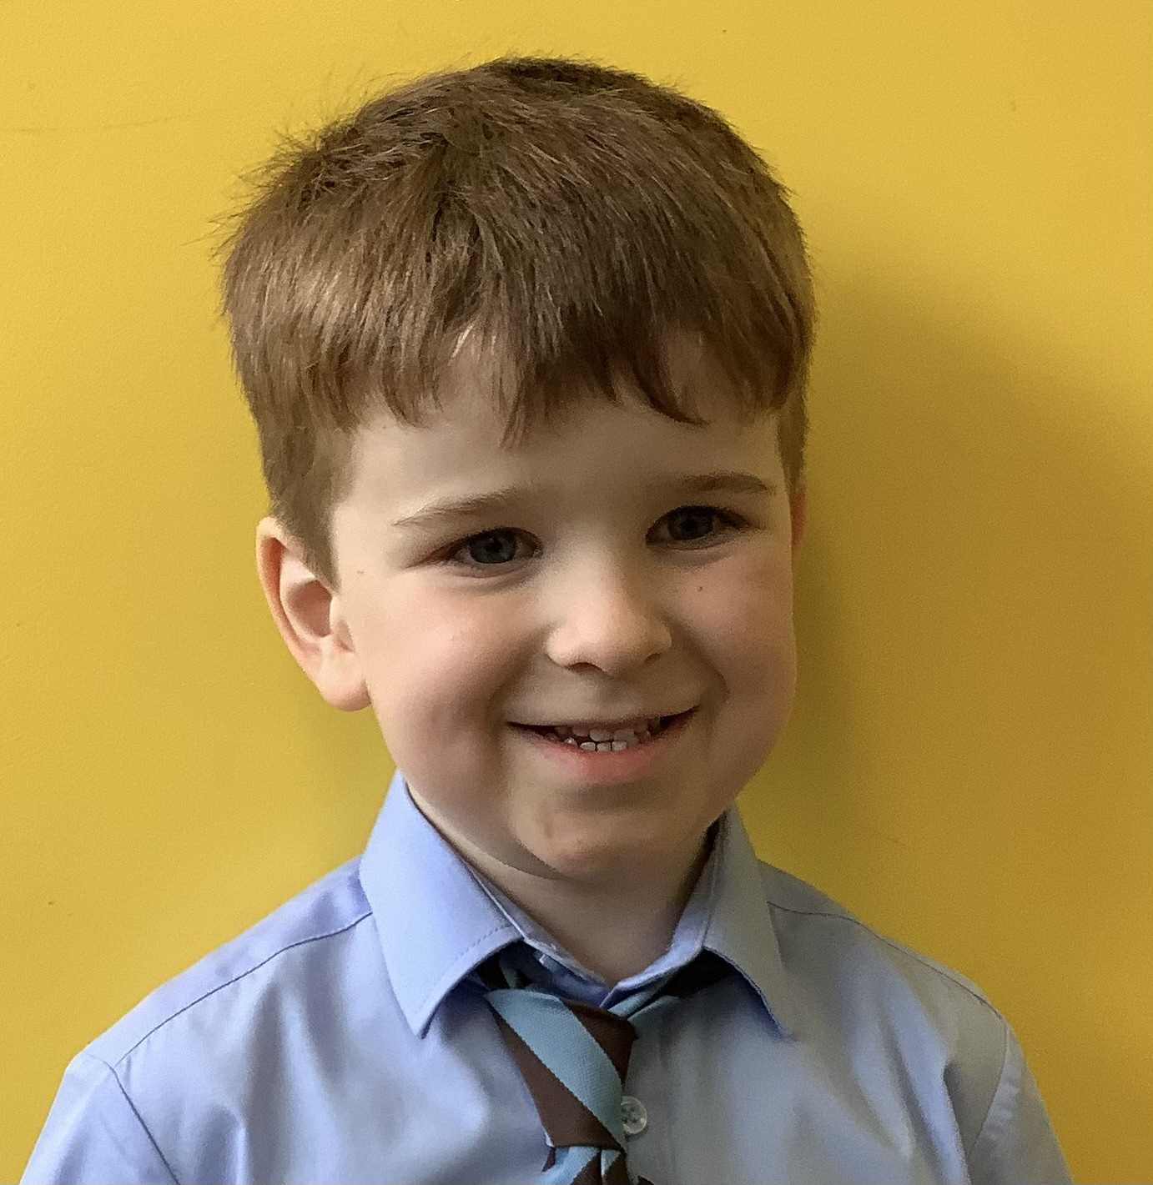
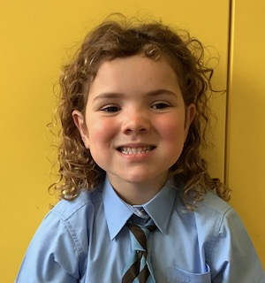
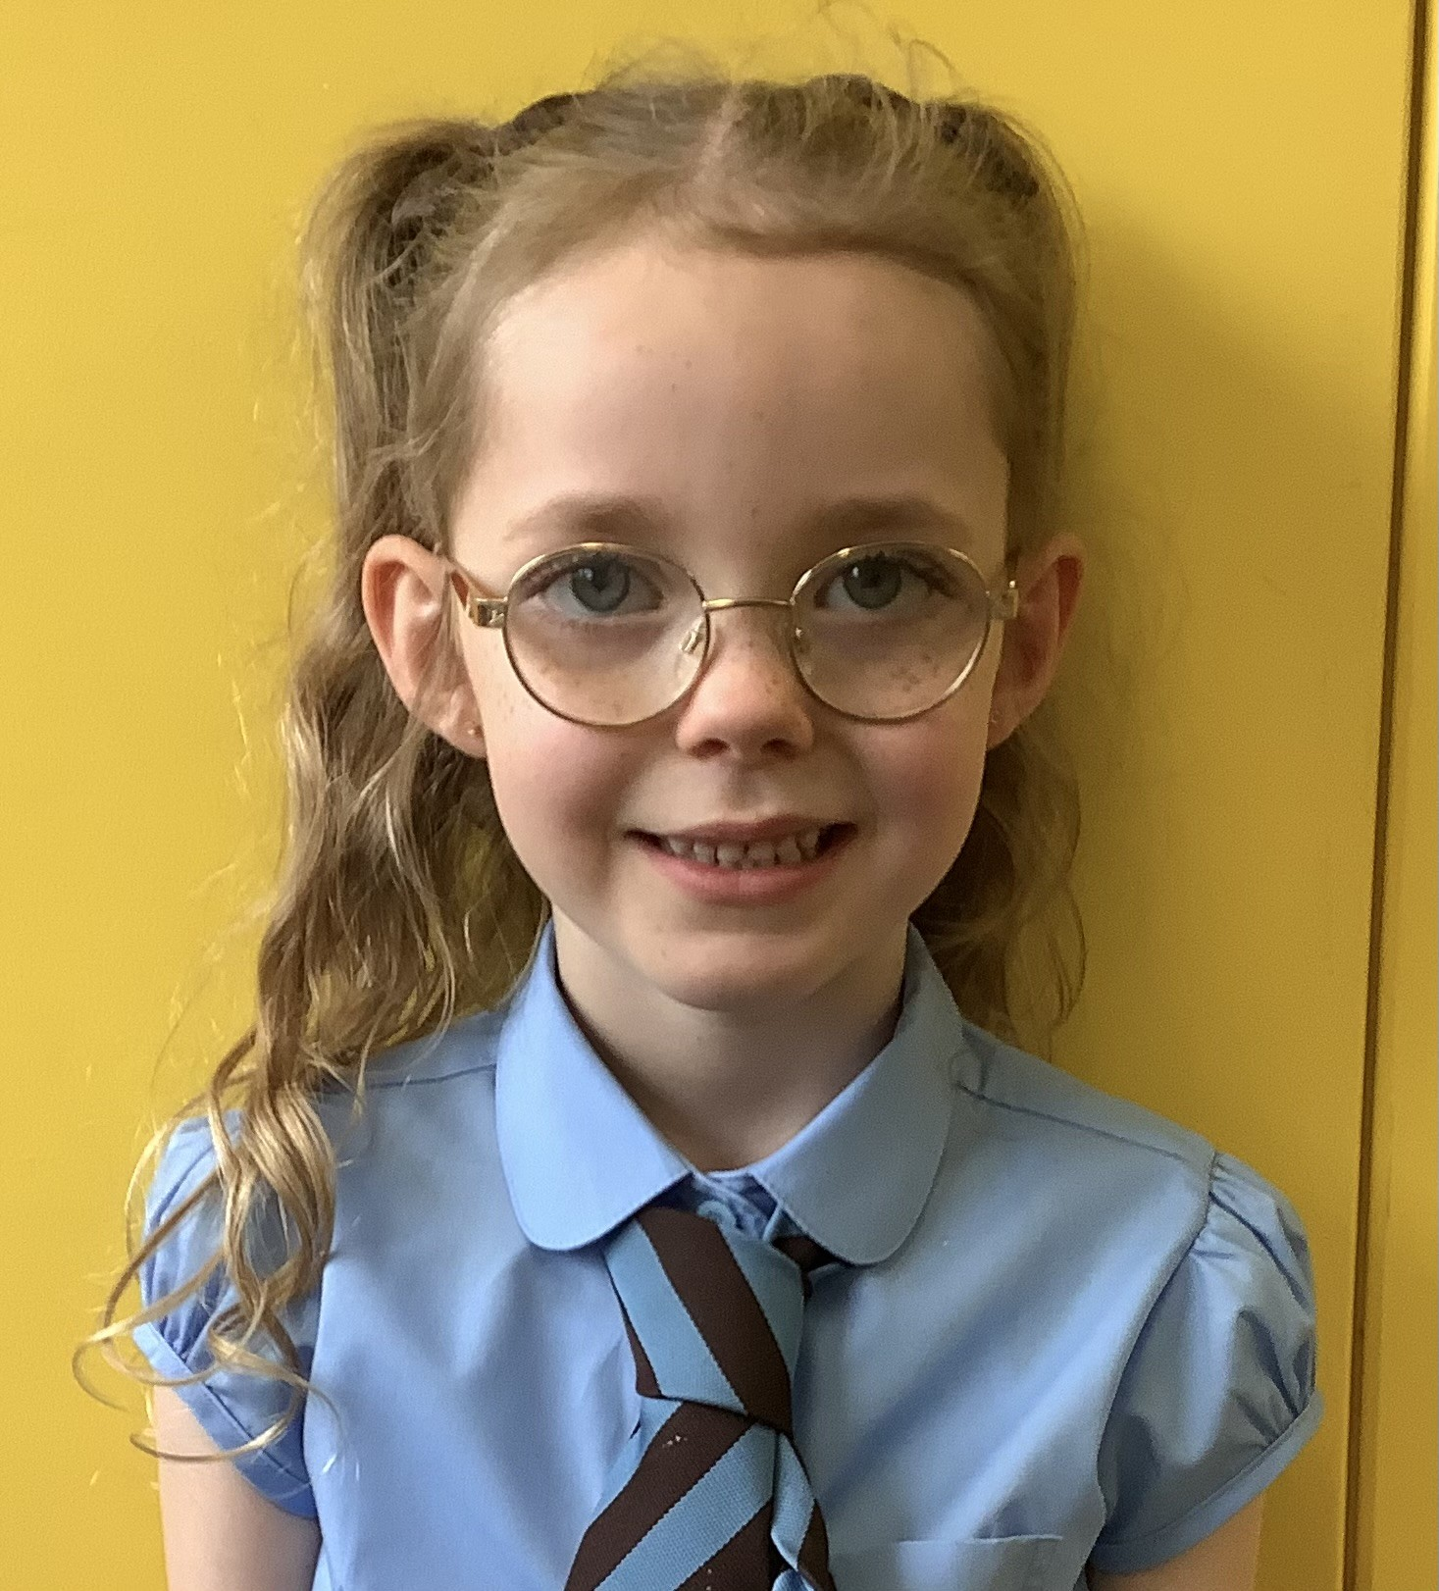
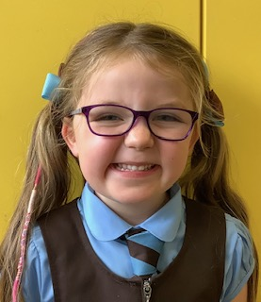
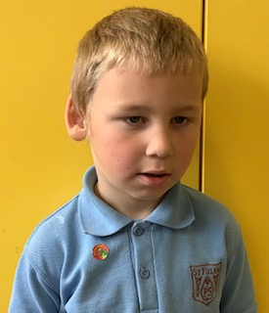
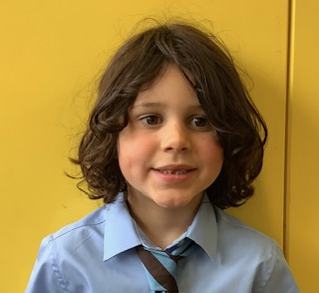
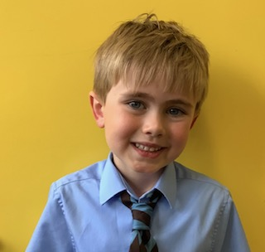
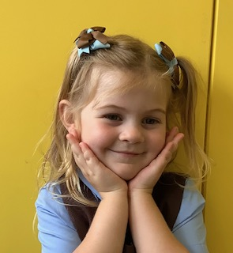
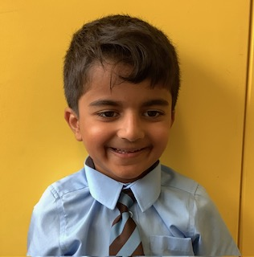
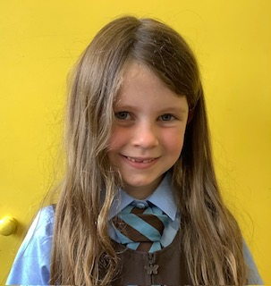
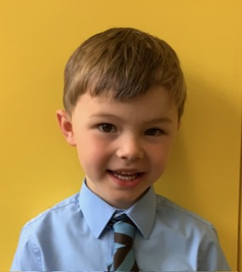
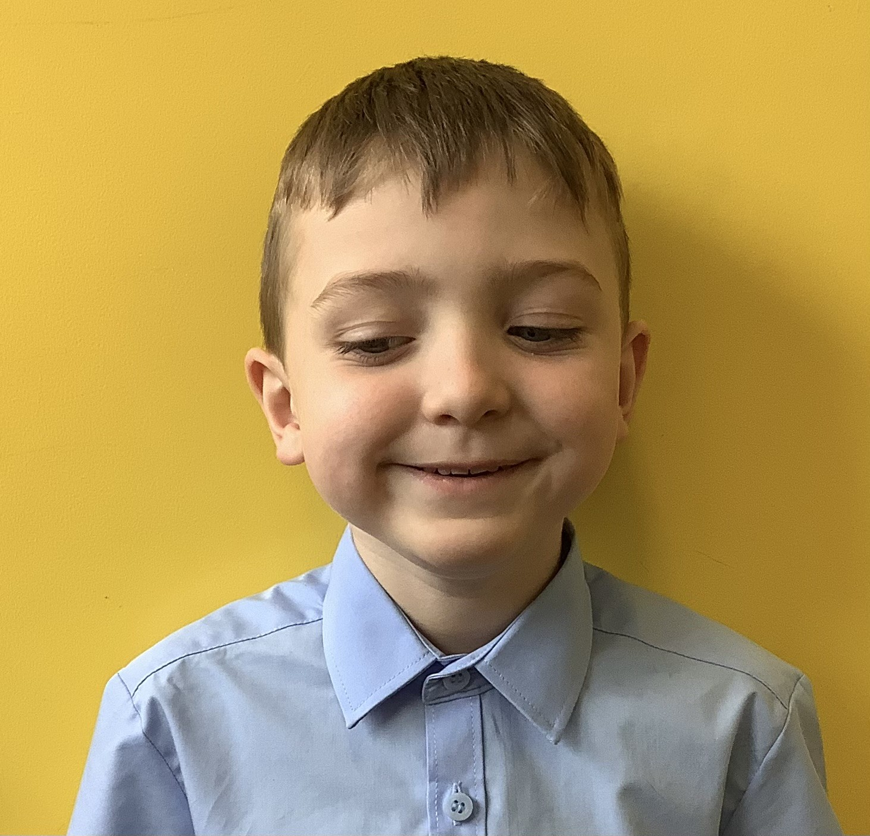
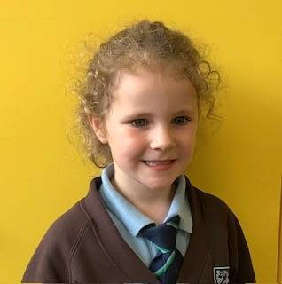
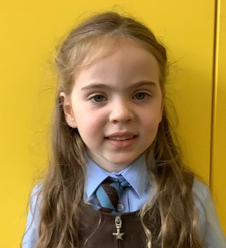
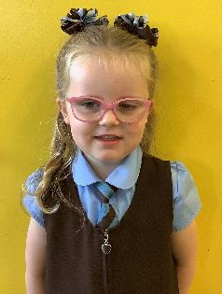
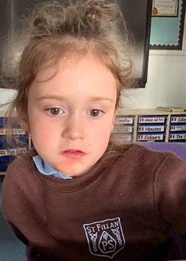
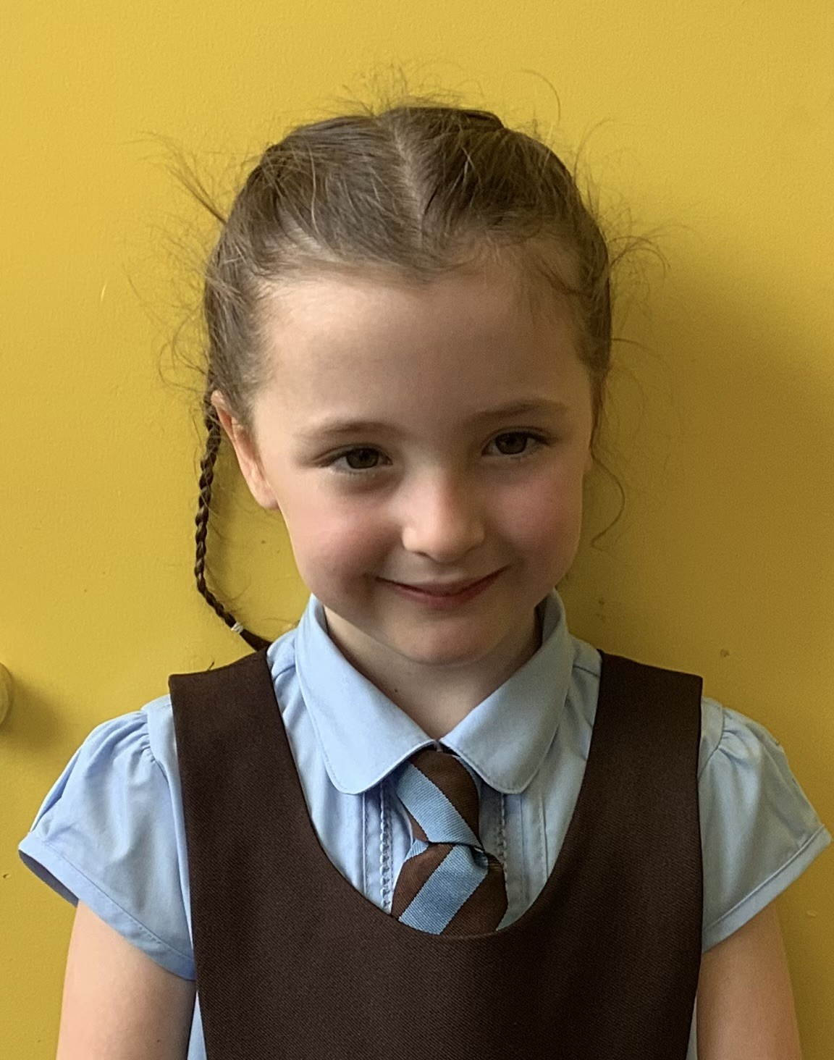
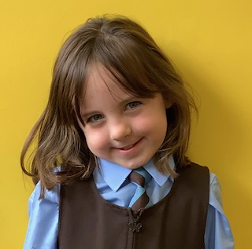
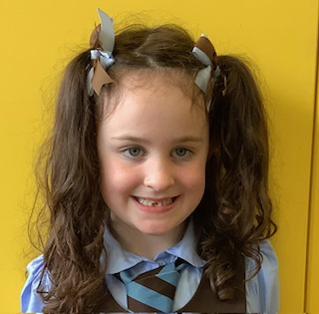
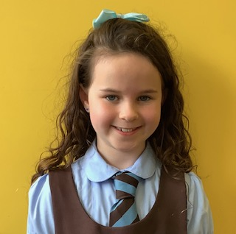
Our P2/1 Class…

Slide 10
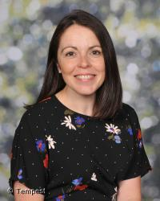
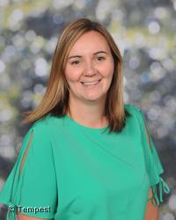
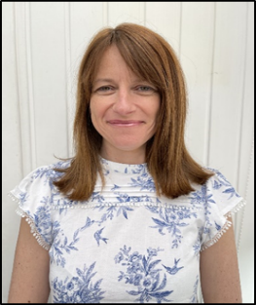
Primary 2/1 Class Teachers
Mrs Kaney – Monday to Wednesday
Mrs Sim – Thursday and Friday

Slide 11
Daily Routine for Primary 2/1
Line up in the playground
Put away own resources (jacket, bag, lunchbox, homework folder, etc)
Prayers/register/ lunch choices
Learning activities throughout the day will include:
Direct teaching time
Play
Independent activities
Paired tasks
Group learning activities
Focussed teaching time with small groups
Each day one child will be chosen as PATHS pupil of the day and will receive their compliments from us.

Slide 12

Primary 2/1 Homework –
in partnership with parents
A description of the weekly homework will be added to the Homework Diary each Monday.
The related resources will be sent home on a Monday, e.g. numeracy & maths worksheets and reading books (later in the term).
Primary 1 sounds and words will be added to their tubs throughout the week, so please bring tubs into school every day (as per letter sent home).
Reading books and cards and any worksheets given should be handed in on a Friday.

Slide 13



Primary 2/1 Interdisciplinary Learning Focus
TERM 1…
Primary 1 focus on making friends!
Primary 2 focus is ‘what makes me special?’

Slide 14

Primary 2/1 Reporting to Parents
Meet The Teacher
Formal Parent / Teacher Meeting – Using Seesaw posts to report progress.
Daily / Weekly Seesaw Posts
Unplanned daily / weekly conversations
Sharing the learning events
Nativity
Wall displays
Learning conversations

Slide 15



Primary 2/1 Reporting to Parents
We report on your child’s progress in a wide variety of formal and informal ways including:
Informal Reporting
Social Media
Sharing Our Learning events
Newsletters
Term in a Nutshell class newsletters
Please ensure you are registered on Parentpay

Slide 16

Time to explore our classroom!
Use our ‘classroom tour’ checklist to help your child show you around our classroom.
If you have time, you and your child can also do the ‘numeracy activities’ placed around the room’
Thank you for coming!

