Slide 1
Our Shared Vision: We hope that this year all of us will work together to ensure that we meet our school vision. In learning, we are all growing and succeeding together.

Slide 2
To Support Our School Vision
Our Shared Values Are: Faith, Trust, Team Work, Respect, Responsibility, Success
Learning about these values will help guide your child’s thinking and behaviour.

Slide 3
To help us achieve our
school Vision & Values
Our School Aims Are:
Be Brave
Unleash Creativity
Demonstrate Excellence
Show/Radiate Enthusiasm

Slide 4
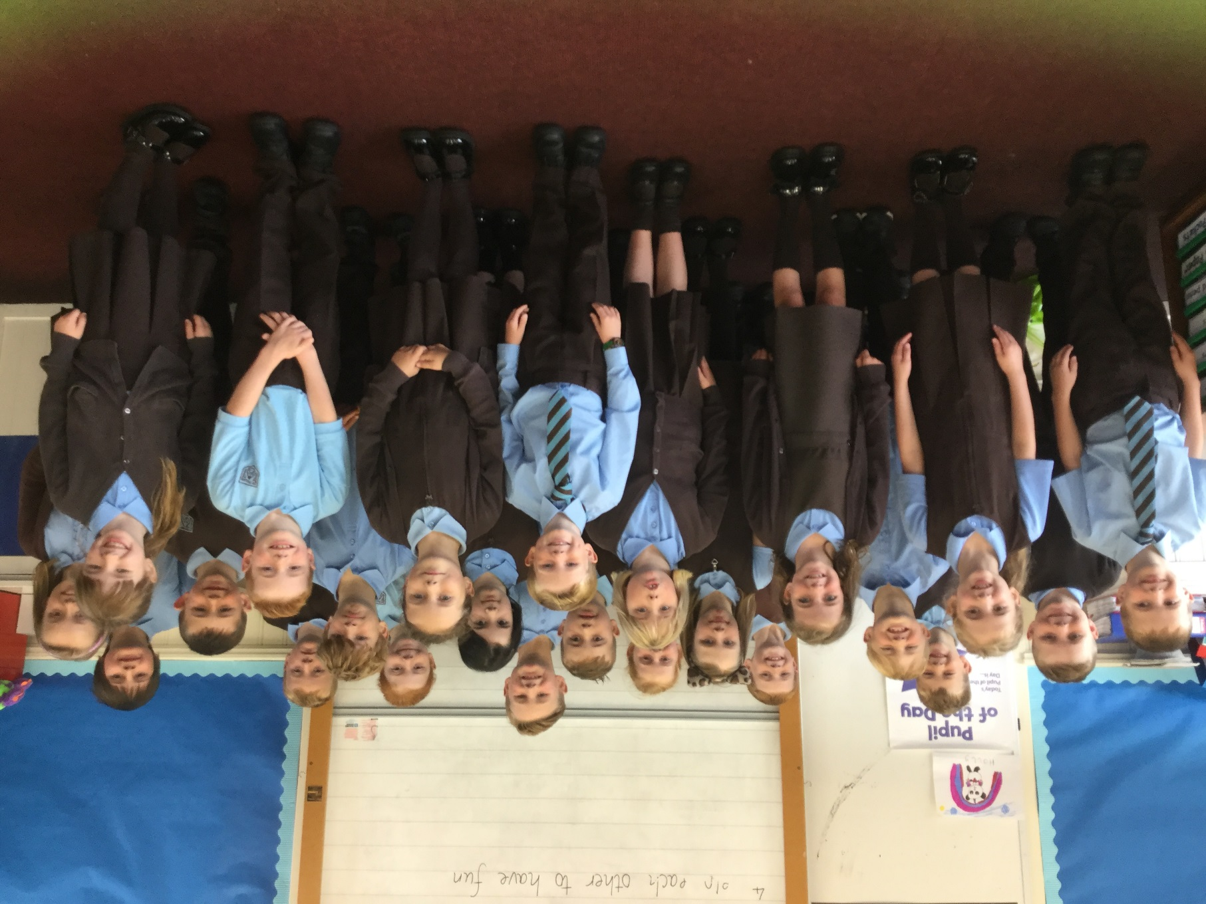
Welcome to Primary 4

Slide 5
Teacher Introduction
Julie Degnan

Slide 6
Classroom Procedures
Primary 4 Daily Routine:
Lines are taken in
Materials organised, snacks in trays
Prayers
Check in and admin
Spelling words copied down
Homework is set and explained on a Monday (due back on a Friday)
Tasks set, targets displayed
“Have you finished?” board
Daily Mile
Pupil of the Day
Class story

Slide 7
Celebration Of Achievement
Praise & Encouragement
Class Charter/Rules
Group marbles
Stickers, stampers, formative comments
House Points

Slide 8
Health & Wellbeing Physical Exercise
P4 PE Days: Tuesdays and Thursdays
Expectations… If possible children to wear their house colour as part of their PE kit.
Long hair to be tied back.
Jewellery removed (if earrings cannot be removed, they must be covered with tape, in-line with Renfrewshire Council policy)
If your child forgets their PE kit then they will be asked to complete a reflection exercise.
Daily Mile

Slide 9
Weekly Curricular Map
 | Monday | Tuesday | Wednesday | Thursday | Friday
9.00 – 9.50 | Issue Homework Literacy: Spelling & Writing task | Literacy: Handwriting Spelling Reading Comp Writing task | Literacy: Spelling Grammar Writing Task | Literacy: Spelling Reading Extended Writing | Homework hand-in Spelling Assessment
9.50 – 10.40 | Assembly (Mrs McPherson) |  | Health & Wellbeing (Mrs McPherson) |  | Assembly (Mrs McKenzie)
10.40 – 10.55 | BREAK
10.55 – 11.45 | Literacy: Reading Comp | Numeracy | Numeracy | Numeracy | Maths & Numeracy: Mental Maths Assessment Problem Solving
11.45 – 12.35 | Maths & Numeracy
 |  | RE | RE | RE
12.35 – 1.20 | LUNCH
1.20 – 2.10 | Inter-Disciplinary Learning Pupil Of The Day | P.E. | I.C.T. | P.E. | Inter-Disciplinary Learning Golden Time
2.10 – 3.00 |  | PATHS Pupil Of The Day | Spanish Pupil Of The Day | PATHS Pupil Of The Day | Weekly self-reflection Pupil of the Day

Slide 10
Homework Working In Partnership With Parents
Stuck into diary on a weekly basis
All homework issued on a Monday with guidance on how to break this down over the week (equivalent to approx. 20-30 mins each night)
Spelling words are copied down in class Mon – Wed as retention of rules requires daily focus
Tasks are set to reinforce or challenge understanding of concepts
Spelling, reading aloud & maths - weekly
Research Homework – termly, over course of 2-3 weeks
Homework Diary – key means of communication

Slide 11
Homework Working In Partnership With Parents
This is our Faith and God’s Loving Plan programmes and materials
Curricular News
Parental Prompts/Reminders

Slide 12
Flexible Learning Plan
This term:
Target setting
George’s Marvellous Medicine: Literacy, Science, Drama, Health
Time, Number work: counting forwards, backwards in 2s, 5s, 10s, 3s, 100s etc., Place Value reading/writing numbers in 1000s
Multiplication Tables: 2x, 5x, 10x, 4x, 3x
PE: tennis, hockey
Imaginative writing: vocabulary, descriptions, characters
Spanish: Greetings, personal information, numbers to 50, the date – short conversations, number games

Slide 13
Reporting To Parents
Target Setting
Will take place every term
2/3 targets Literacy, Numeracy & Health & Wellbeing
Reported orally at two parents evenings: October & March
Two written reports: December & June

Slide 14
Reporting To Parents
Informal Reporting
My School App
Twitter
Facebook
Sharing Our Learning

Slide 15
When you make a call to the School Office, you can expect:
Calls to be answered in a polite, friendly manner and treated with confidentiality.
Questions to be asked to ascertain how best we can support your enquiry.
Phone calls will then be returned as soon as possible by the member of staff who is best suited to deal with your enquiry.
Please note that our Office Staff have access to the shared electronic calendar and are able to book appointments for meetings with Class Teachers or the SLT (Senior Leadership Team).
The Office Staff should be informed if there are any issues that directly relate to your child in relation to the following:
Absence.
Medical information. Collection from school.
Personal appointments.
Excursions. Lunches/ lunch money. Monies/ payment.

Slide 16
When you email the school, you can expect:
Your email to be answered within five working days by the member of staff who is best suited to deal with your enquiry. This may be the Office Staff, the Class Teacher, Mrs McPherson (PT) or Mrs Mackenzie (HT).
Please note, that as a small school, we will endeavour to answer your email as soon as we possibly can.

Slide 17
Class Teacher Enquiries.
I can provide you will support/assurance about a range of issues where you may require clarification. As the Class Teacher, I am the lead professional in your child’s day to day education.
Issues that I will be able to assist you with, in the first instance of contact with the school include:

Slide 18
Homework
Class work
Friendships and peer relationships
Issues surrounding behaviour
Responsibilities that pupils may have
Class trips
Progress update/ Child’s Plan targets
NB. This list is not exhaustive.

Slide 19
Contacting the Class Teacher:
Homework Diary – this is an effective means of two way written correspondence.
Phone call to the School Office.
Email to St. Fillan’s enquiries.
Informally – in the playground. If required, a further appointment can be made at the school office.
When you contact me, you can expect:
Your enquiry/concern to be treated seriously.
Your enquiry/concern to be treated in a professional, confidential manner.
Your enquiry to be dealt with in a timely and efficient manner (within five working days).

Slide 20
Enquiries to the Senior Leadership Team (SLT)
Mrs McPherson in her role as Principal Teacher and Pupil Support Co-ordinator in St. Fillan’s is happy to assist you with enquires relating to the following issues:
Pastoral care.
Changing family circumstances.
Bereavement.
Pupil Support.
Matters involving partners/ external agencies.

Slide 21
Enquiries to the Senior Leadership Team (SLT)
Mrs Mackenzie in her role as Head Teacher has overall responsibility for the school. She is happy to assist you with enquires relating to the following issues:
Child Protection.
Social Work.
Issues relating to the Health and Safety of pupils/ staff and school community.

Slide 22
Enquiries to the Senior Leadership Team (SLT).
School Improvement.
Issues directly relating to Renfrewshire Council.
Changing family circumstances/ confidential issues.
Pastoral care.
Issues relating to finances/ cost of the school day.
Class structures/ staffing concerns.
School Transport.

Slide 23
Enquiries to the Senior Leadership Team(SLT).
When making contact with any member of the SLT, you can expect:
Your enquiry/issue to be treated seriously.
Your enquiry/ concern to be treated in a professional, confidential manner.
Your enquiry to be dealt with in a timely and efficient manner (within five working days).

Slide 24
Contact in relation to Medical issues/ First Aid.
We have two fully trained First Aiders here in St. Fillan’s Primary: Mrs June Kelly and Mrs Alison Steele.
If your child requires medicine to be administered during the school day, then Mrs Kelly will oversee this.
Please note that the appropriate ‘Medicine Form’ must be completed at the School Office prior to any medicines being administered.
If your child’s medical status changes, then it is imperative that this information is shared with the Office Staff and Mrs Kelly. This includes changes to inhalers, eyesight, hearing, allergies etc.
Please note that you may receive a telephone call during the school day from Mrs Kelly if your child has received First Aid/ Medical attention.
Medication must be taken on trips, please ensure that your child has it with them.

Slide 25
It is my hope that your child will enjoy their time with me and their classmates this year so that we can all learn, grow and succeed together.

