Slide 1
Internet Safety

Slide 2
CONTENTS
Staying Safe Online
I.
Social Networking
II.
Cyberbullying
III.
Solutions and Strategies
III.

Slide 3
STAYING SAFE ONLINE
Guard Your Information
Address
Phone number
School
City
Sports teams
Parent’s workplace
Passwords
Notes:
Stress dealing with problems before they are problems, getting ahead of the game. All items listed could be used by a stranger wishing to find a child.

Slide 4
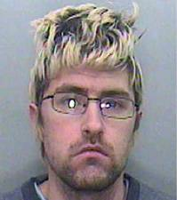
STAYING SAFE ONLINE
Friend or Foe?
Seeing is not believing
Never schedule offline meeting with “online only” friends
Tell your parents if anyone tries to meet with you offline
15-year-old girl on Facebook
Notes:
Recent examples: Man in UK created 8 different fake Facebook profiles to groom “up to 1,000 kids”; NAMBLA pages found on Facebook; in sextortion cases kids are tricked into revealing themselves in some way, and then the person uses the digital content to blackmail them into other things; in other cases the kids are tricked into doing things for other reasons, such as believing someone hacked into their Facebook profile or can get them into trouble somehow.

Slide 5
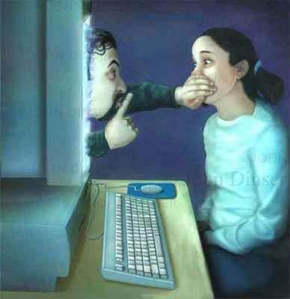
STAYING SAFE ONLINE
Communicate
Don’t bottle it up
Ok to ask questions
Stay away from “adults only” sections of the Internet
Tell your parents about anything that makes you feel uncomfortable
Notes:
Much of the harm done to children could have been prevented if the kids just told a parent or authority figure

Slide 6
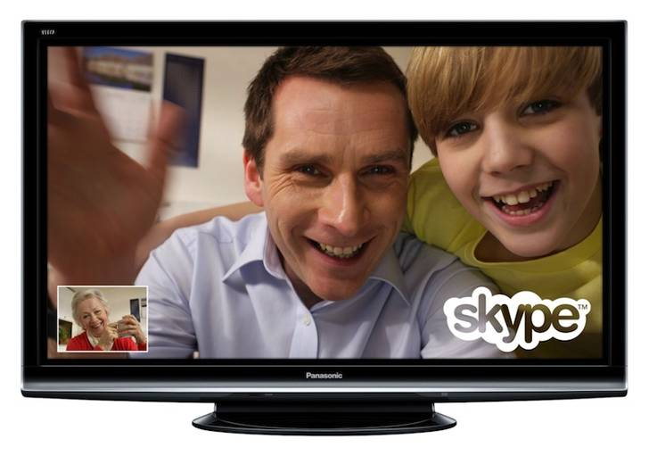
STAYING SAFE ONLINE
Webcam Safety
Never do random chat
Only chat with family and friends
Never do anything on a webcam you wouldn’t want up on this screen
Think before uploading video responses
Notes:
Video chat is often used by people to blackmail kids into doing something they are not comfortable with. Why it is best to only video chat with family and close friends. Stress kids should not do anything that makes them uncomfortable, even for a boyfriend or girlfriend.

Slide 7
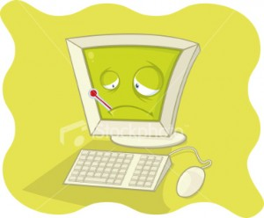
STAYING SAFE ONLINE
Be “Scam Smart”
Don’t open strange emails
Beware “free” downloads
Don’t be a pirate
Notes:
This should be familiar to kids, but stress that piracy can result in lawsuits which could get them into a lot of trouble.

Slide 8
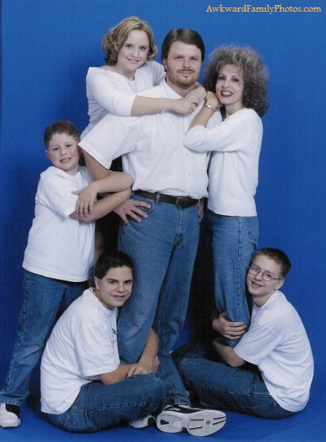
STAYING SAFE ONLINE
Keep It in the Family
Don’t share family/friends photos without permission
Ask before uploading
Notes:
You can make a joke here about the photo ending up on awkwardfamilyphotos.com, lighten mood

Slide 9
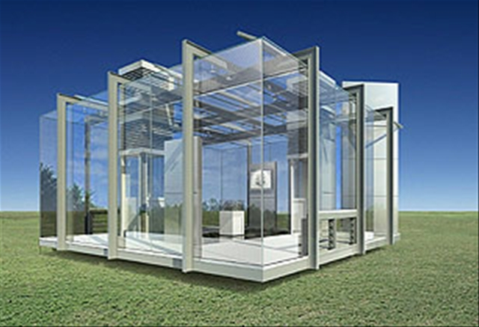
STAYING SAFE ONLINE
Privacy? On the Web?
All media is permanent
All information is available
If you don’t want people to know about it, don’t do it, and especially don’t do it online
Notes:
Glass house symbol for everything you do being visible: being on the Internet is like living in a glass house

Slide 10
CONTENTS
Staying Safe Online
I.
Social Networking
II.
Cyberbullying
III.
Solutions and Strategies
III.

Slide 11
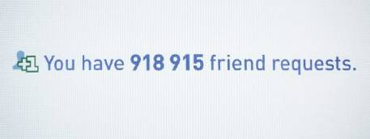
SOCIAL NETWORKING
Choose Your Friends
Only ‘friend’ people you know well
Don’t get into contest for who has the most friends
Keep your group of friends small and get more out of Facebook
Notes:
Smaller group of friends means more relevant info to your life

Slide 12
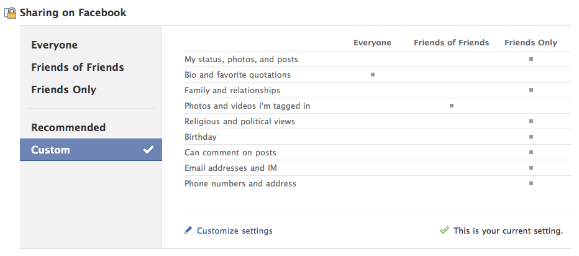
SOCIAL NETWORKING
Protect Your Info
Don’t post phone #
Don’t post address
Avoid status updates with time and place references
Don’t use Places
Set all privacy settings to “Friends Only”
Notes:
Friends only makes sure that only their approved friends can see their photos and updates.

Slide 13
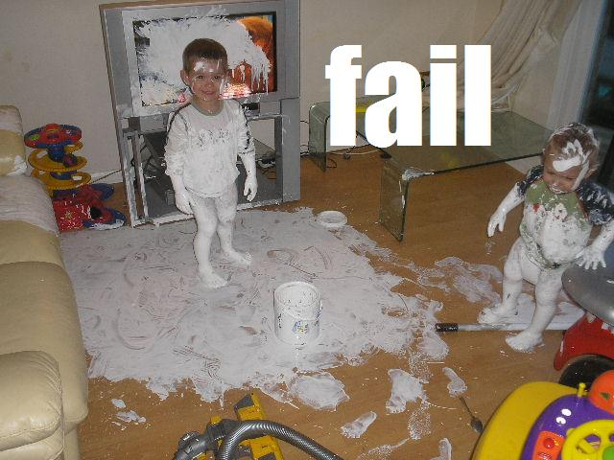
SOCIAL NETWORKING
A picture is worth…
Ask permission to post photos of friends
You can untag yourself
Avoid photos that reveal locations like home and school
Report harmful photos

Slide 14
Social networking
What’s Wrong With This Update?
Bethany is such a loser. She asked in class whether Hitler was around before or after the Last Supper…lol
Notes:
This is a mean or hurtful post which

Slide 15
SOCIAL NETWORKING
What’s Wrong With This Update?
Woohoo! Going to Orlando for a whole week! Be back next Sunday! C-ya!!!
Notes:
This reveals that the kids family is going to be gone for vacation and gives the time they will be gone

Slide 16
SOCIAL NETWORKING
What’s Wrong With This Update?
Just got a new iPhone and want to test my ring. Someone call 555-3425!
Notes:
This post reveals a phone number

Slide 17
SOCIAL NETWORKING
What’s Wrong With This Update?
Hey man, let’s get together after school at my house. 1238 Shadesview Terrace, ATL 45362
Notes:
This gives away an address. Feel free to change the address to one near where you are giving the presentation, but use a fictional address.

Slide 18
CONTENTS
Staying Safe Online
I.
Social Networking
II.
Cyberbullying
III.
Solutions and Strategies
IV.

Slide 19
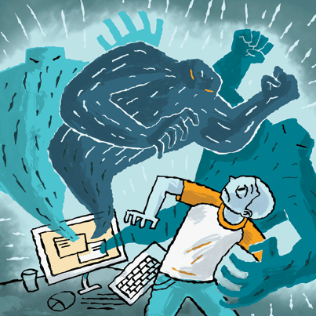
CYBERBULLYING
What Is It?
Bullying through electronic means
Text, Facebook, YouTube common mediums
Against school rules and against the law
Notes:
Define it

Slide 20
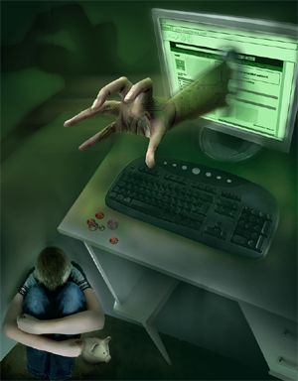
CYBERBULLYING?
Ubiquitous Phones, computers
Public Visible to anyone
Constant School, play, home
Viral Social mediums
Notes:
The four factors that make Cyberbullying even worse than physical bullying

Slide 21
CYBERBULLYING
Response
Don’t react: responding to the bully only makes it worse
Report the bullying to parents, teachers, and site admin
Don’t participate
Encourage others to stand up
Notes:
Photo is of a parent responding directly to cyberbullies, which only makes the problem worse. Use the phrase “Don’t feed the trolls”

Slide 22
CONTENTS
Staying Safe Online
I.
Social Networking
II.
Cyberbullying
III.
Solutions and Strategies
IV.

Slide 23
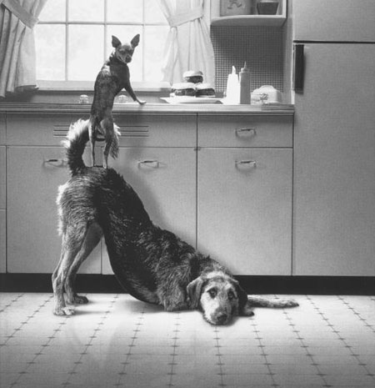
STRATEGIES
Teamwork
Help your parents
Help each other
Communicate
Cooperate
Know when to unplug
Notes:
Help: educate your parents about the Internet; chances are you know more than they do
Help each other: stay safe from predators, stop cyberbullying
Communicate: tell if something bothers you
Cooperate: with monitoring efforts of parents

