Slide 1
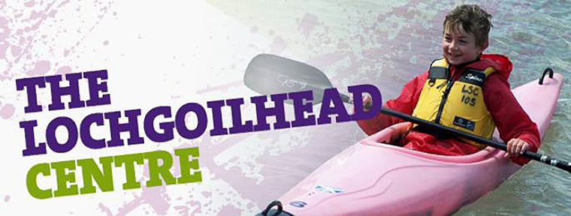
Lochgoilhead Activities
February 2018

Slide 2
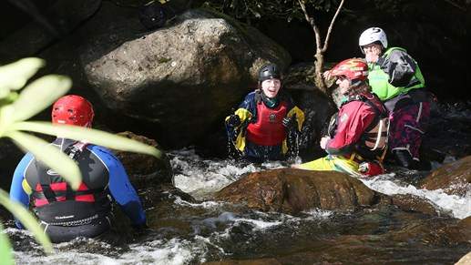
Water Based Activities
The Burn Run is a gorge walking activity that takes place a short walk from the centre, ascending a section of the Donich water. The activity involves walking up the river and climbing a range of waterfalls varying in size and difficulty. The participants will focus on teamwork and communication skills during this activity and will be expected to help, encourage and support other team members to complete the ascent. The instructors will encourage effective teamwork and will ensure safety at all times during the activity.

Slide 3
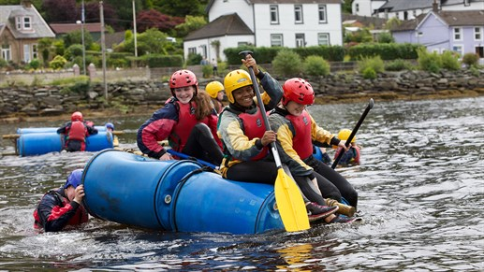
Water Based Activities:
Raft Building is a water based activity offered at Lochgoilhead where teams are challenged to build and race a raft made from logs, ropes and barrels. The team will be given a briefing on design, know tying and safety before being asked to build a raft. The groups will be given a series of challenges tailored to their ability and age which will require them to work as a team to achieve their goals.

Slide 4
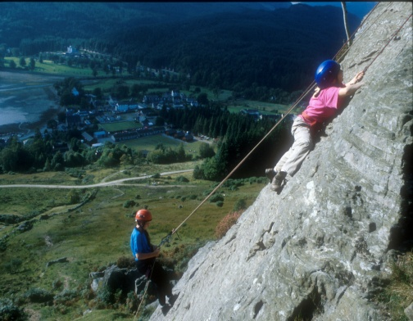
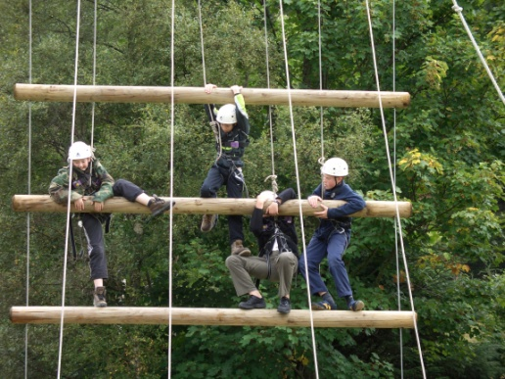
Land based activities:
Rock climbing takes place on a rock crag ten minutes walk above the centre. The session will involve a rock climbing ascent of the rock and an abseiling descent of the rock face. The group will focus on individually challenging their personal fears while showing compassion and support for other members of the group as they approach similar challenges. The group will be taught about safety and risk management, the environment and rock types and formations.
The Jacobs Ladder is a high ropes element that consists of a serious of large suspended logs and increasing intervals. The activity involves a team of four climbing the logs while the remainder of the group is controlling the safety ropes under direct supervision of the instructor. As the gaps between the logs increase the group participants need to help each other to be able to reach the top of the Jacob’s Ladder.

Slide 5
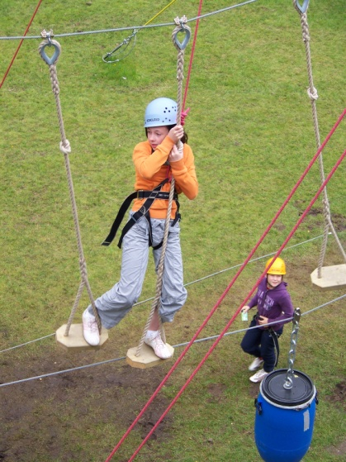
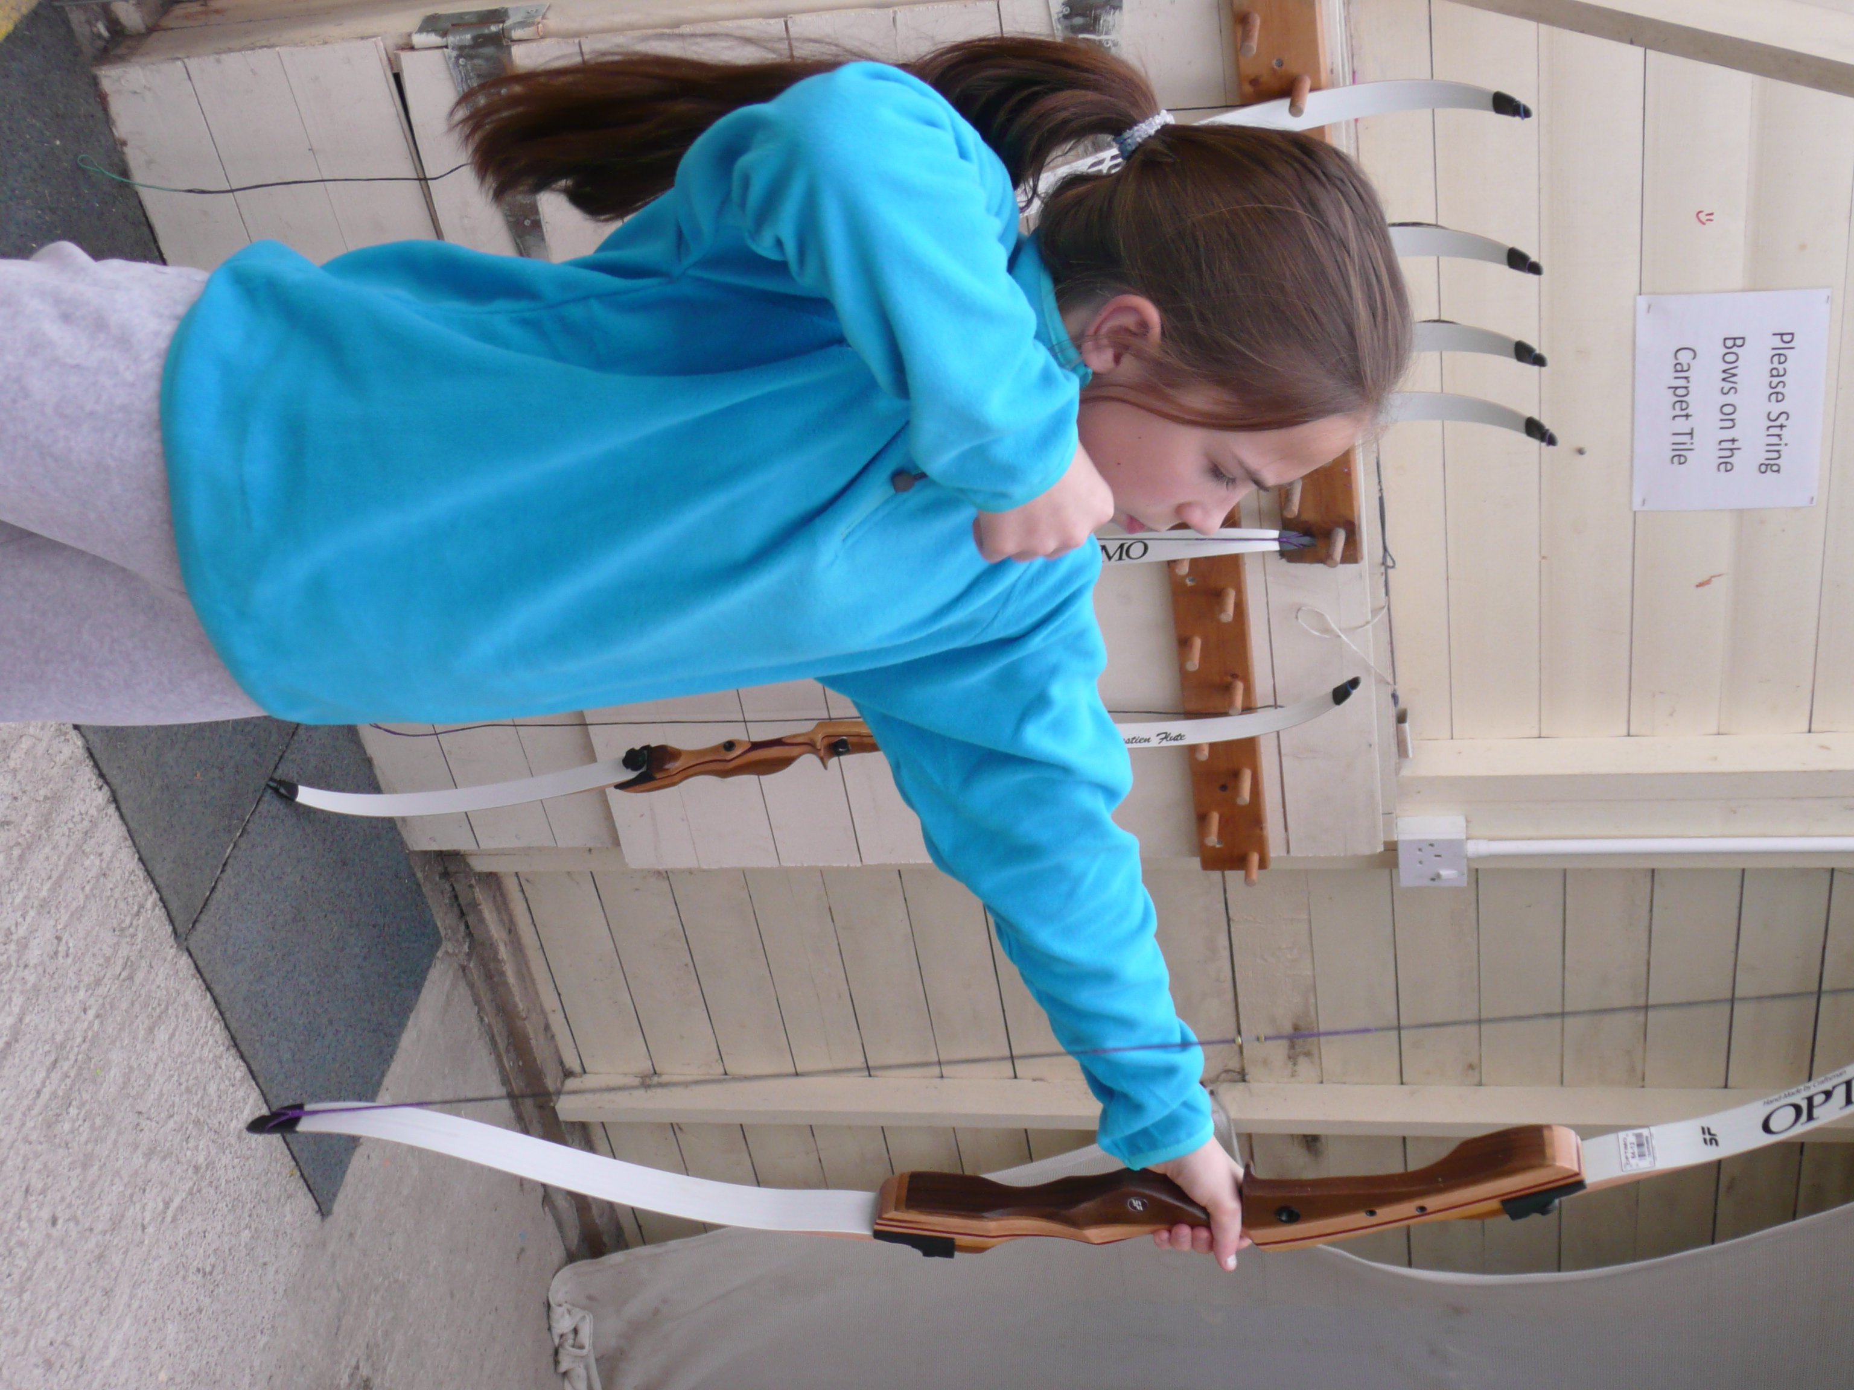
Land based activities:
3 Stack is a high ropes activity that takes place on the centre grounds where participants follow a predetermined path of obstacles gradually increasing in height and difficulty up a purpose built high ropes course. Participants will select their targets within the course and will strive to reach their personalised target. The remainder of the group will help to control the ropes from the bottom under the supervision of the instructor allowing the students to take a level of responsibility and develop trust and supporting nature within the group.
Archery is a target sport that encourages young people to develop accuracy and skill through repetition and instruction. Participants will be required to follow strict rules, clear commands and instructions from the instructor throughout. The group will be expected to develop skill and accuracy through the use of games and challenges designed to progress and develop the participant. The sport of archery involves aspects of mathematics to work out scores and compare and contrast performance against others within the group.

Slide 6
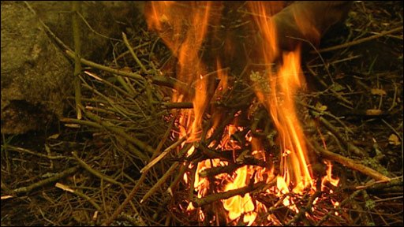
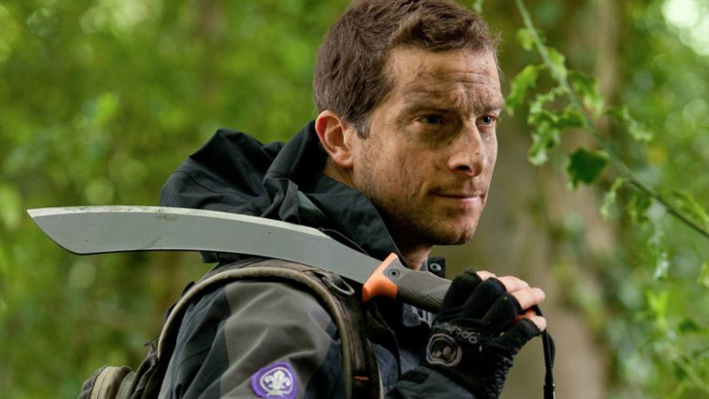
Land based activities:
Bush Craft sessions covers a selection of skills than can include plant and tree identification, animal tracking, natural shelter building, fire lighting, leave no trace and environmental awareness. The participants focus on learning how the environment can be used in a sustainable manor whilst learning wood land skills.

Slide 7
Night time activities:
ACTIVITY | YES | NO | MAYBE
LGH Olympics
Talent Show
Scavenger Hunt
Night Walk
Village Quiz
Water Slide
Disco
Night Line
Egg Drop
Robot Wars

