Slide 1
World Book Day
“YOU ARE A READER”

Slide 2
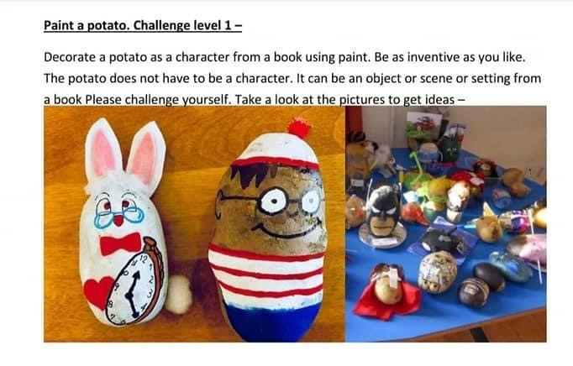
PAINT A POTATO
DECORATE A POTATO AS A CHARACTER OR OBJECT
FROM YOUR
FAVOURITE STORY

Slide 3
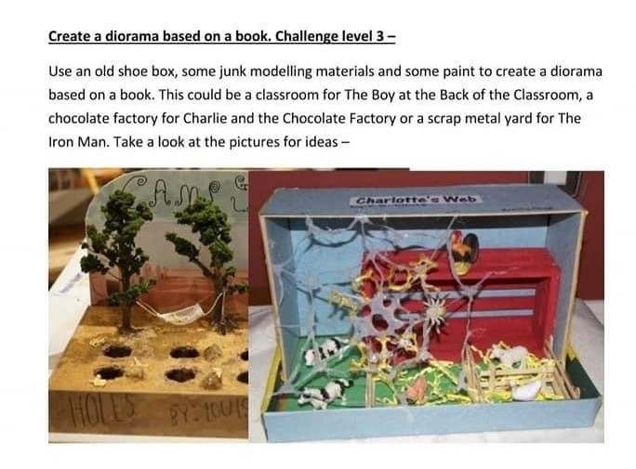
CREATE A DIORAMA
USING AN OLD SHOE BOX, CREATE A DIORAMA REPRESENTING A SCENE
FROM A BOOK

Slide 4
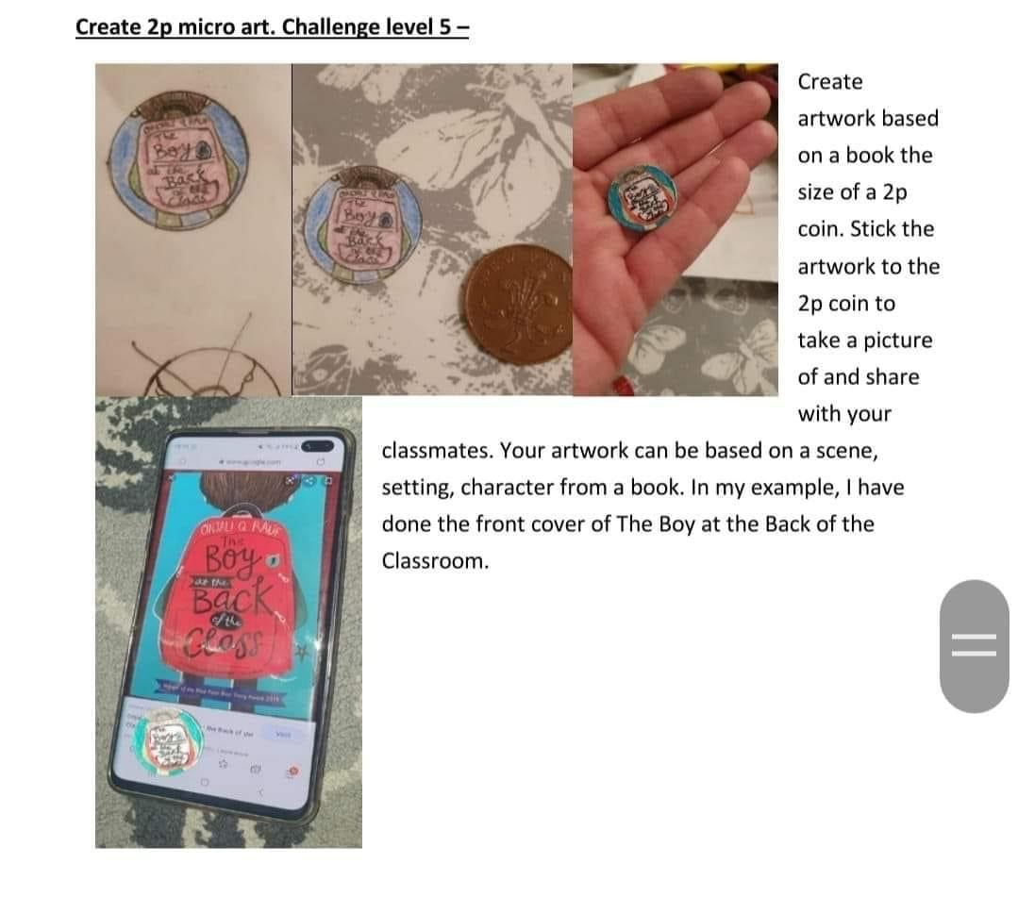
CREATE 2P MICROART
CREATE A TINY ARTWORK THE SIZE OF A 2P BASED ON AN ASPECT OF YOUR CHOSEN BOOK

Slide 5
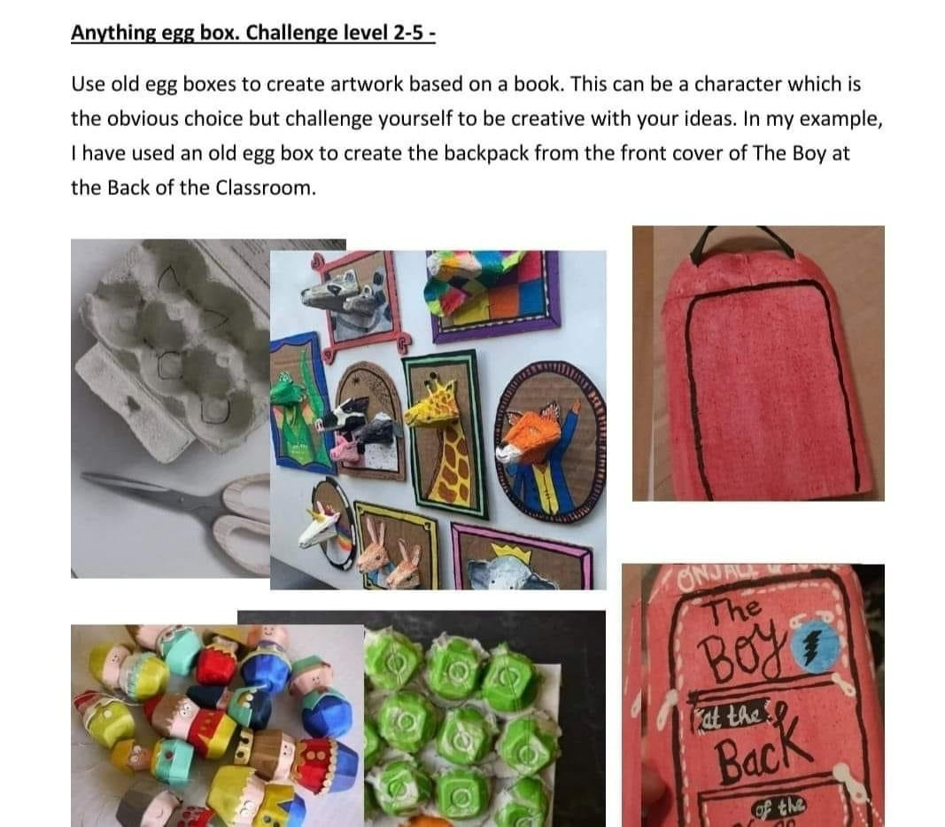
ANYTHING EGGBOX
Create something relating to a story by recycling old egg boxes

Slide 6
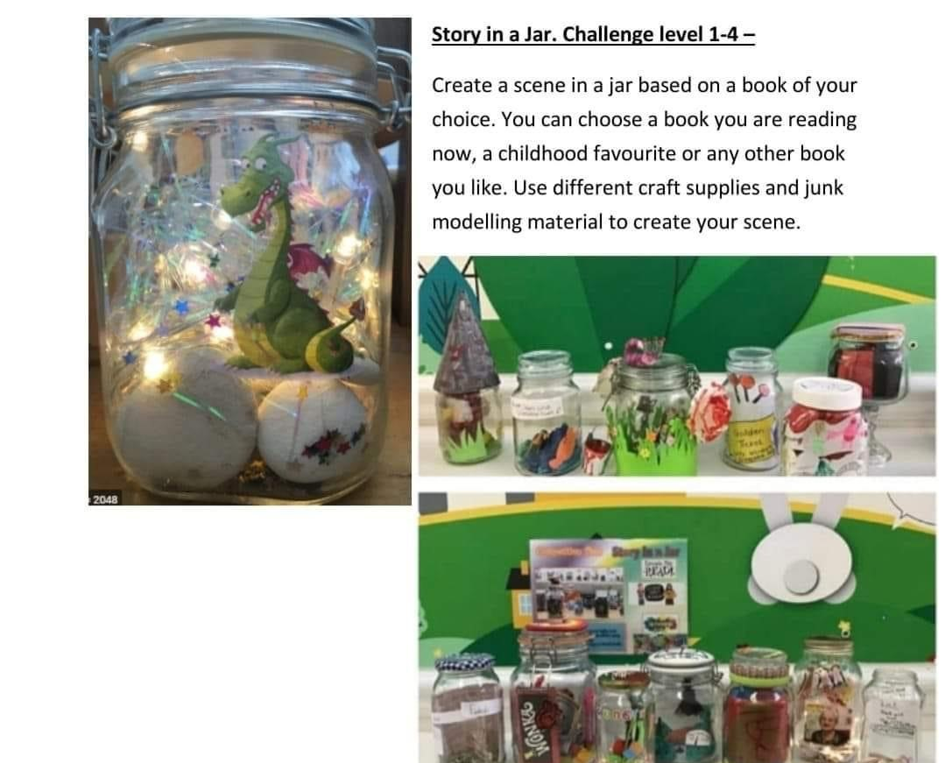
STORY IN A JAR
CREATE A SCENE FROM
A STORY IN A JAR

Slide 7
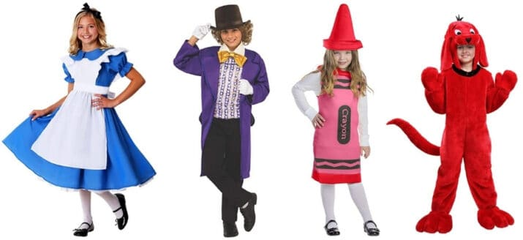
ON WORLD BOOK DAY IN SCHOOL
DRESS UP AS
A BOOK CHARACTER

Slide 8
ON WORLD BOOK DAY IN SCHOOL
BRING A FAVOURITE BOOK TO SCHOOL TO SHARE WITH OTHERS

Slide 9
ON WORLD BOOK DAY IN SCHOOL
BOOK SWAP – SWAP READ OR UNWANTED BOOKS FOR DIFFERENT BOOKS

Slide 10
Ideas for the classroom-created by the literacy committee
Create a lollipop stick character - can create dialogues/role play using same book characters
Create a Plasticine character
Write a book review
Create a video book review
Sketch a book character or scene
Create a book quiz of your class novel
Design an alternative book cover
Act out a scene from a book
Describe a book and see if others can guess it
Bedtime story – older pupils read stories to younger pupils

