Slide 1
Putting the “E” in STEM
Using Kapla and Make Do to Support Engineering in Primary
CLPL Session 27th April 2023
Kirsty Johnson RAiSE Primary Science Development Officer
Kirsty.johnson@renfrewshire.gov.uk
gw11johnsonkirsty@glow.sch.uk
@STEM_Ren

Slide 2
Link to purchase from Findel
Order from Kapla.co.uk

Slide 3
Aims
Consider ways to develop Engineering Habits of Mind.
Provide hands-on learning experiences that teach design, construction and problem solving
Develop a deeper understanding of the application of Engineering Disciplines/Engineering Across the Curriculum

Slide 4
Outline for Today
What is Engineering?
Engineering in the Curriculum
Developing Engineering Habits of Mind
Using the Engineering Design Process
Using the resources
Kapla
Make Do

Slide 5
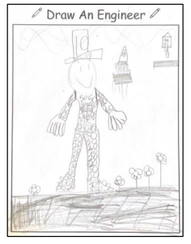
What does an engineer look like?
Draw an Engineer: multiple studies with different ages (from preschool to teachers)
Indicates common perceptions are:
Male
Hard hat wearing
Physical work
Building structures or constructing machinery
Working with vehicles, buildings or tools

Slide 6
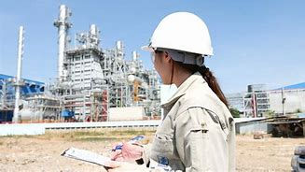
What is Engineering?
engineering (noun)
The branch of science and technology concerned with the design, building, and use of engines, machines, and structures.
engineering (verb)
Design and build.
Engineering is about making things work and making things work better.
(Almost) everything we own and use has involved engineering!

Slide 7
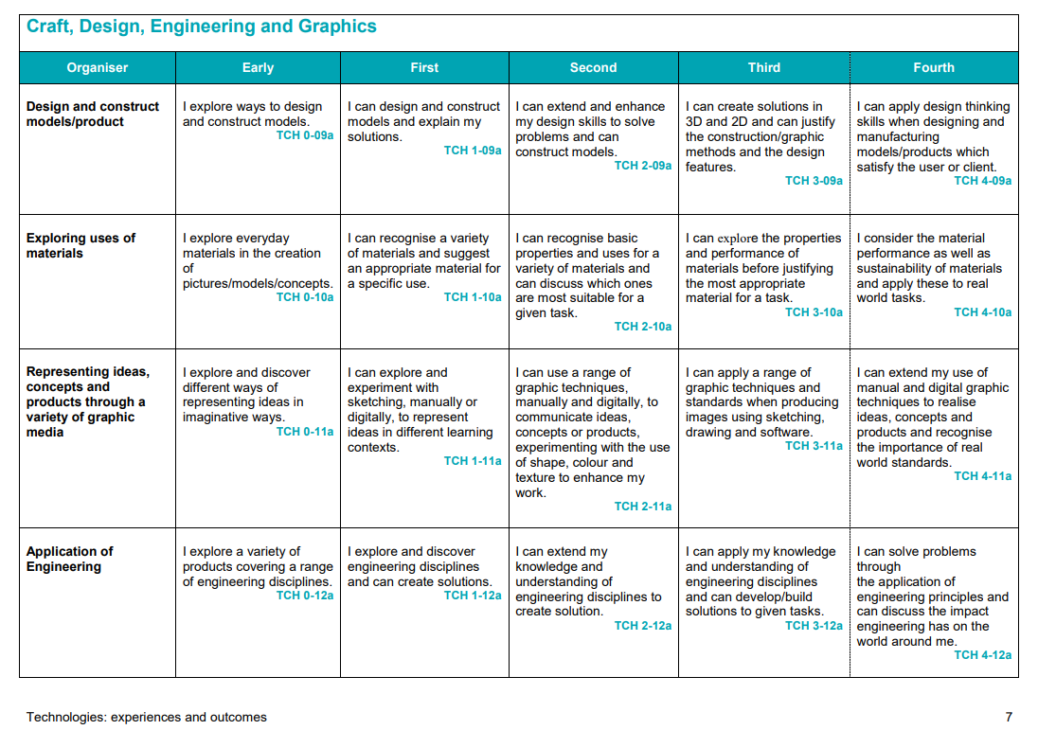

Slide 8
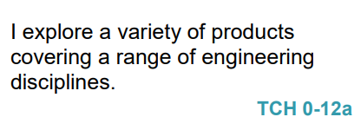
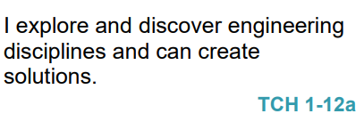
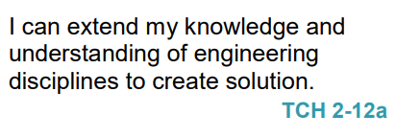
Recognises engineering in the world around them for example bridges, construction, electronics, computers.
Recognises and identify different engineering disciplines.
Builds a solution to a specific task, which has moving parts.
Understands the difference between different engineering disciplines
Understands different energy types.
Builds/simulates solutions to engineering problems.

Slide 9
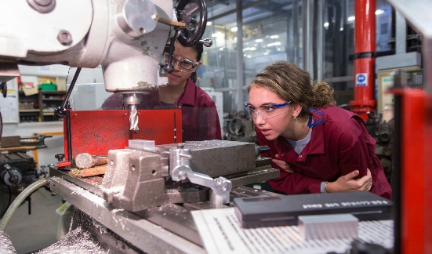
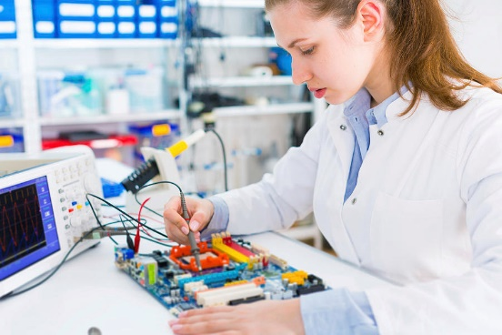
Engineering Disciplines/Engineering Across the Curriculum
Civil – infrastructure, roads, houses, bridges
SOC: People, Place and Environment
TCH: Exploring Uses of Materials, Design and Construct Models
SCI: Forces, Materials
MNU: Measure
EXA: creating objects for specific tasks/solutions to a design problem.
Mechanical – engines, machines, moving parts
TCH: Design and Construct Models
SCI: Forces
MNU: Measure
EXA: creating objects for specific tasks/solutions to a design problem.
Electrical – application of electricity and electronics
SCI: Electricity
Software – computer programming and computational thinking
TCH: Computing Science
MNU: Shape Position & Movement, Chance and Uncertainty
EXA: creating solutions to a design problem.
Other engineering disciplines: Aerospace, Chemical, Biomedical, Biological, Nuclear, Industrial, Agricultural, Structural, Environmental…
HWB: Career education

Slide 10
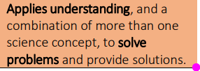
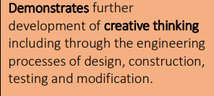
Engineering in the Science Skills

Slide 11
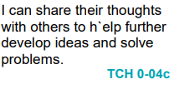
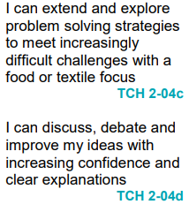
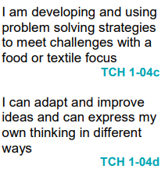
Engineering Across the Curriculum
Food & Textile Technology

Slide 12
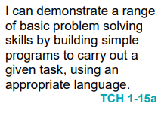
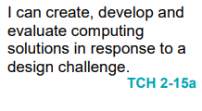
Engineering Across the Curriculum
Computing Science

Slide 13
Engineering Across the Curriculum
Art & Design

Slide 14
How can we encourage pupils to think like and act like engineers and develop the associated skills?
Develop Engineering Habits of Mind
Apply the Engineering Design Process
Make links to real-life engineers and engineering

Slide 15
Engineering Habits of Mind
Developed by The Royal Academy of Engineering
Outlines the skills and attributes employed by Engineers across disciplines.
When used along side the design process, they can be used to develop pupils’ STEM skills and skills that can be used across the curriculum.

Slide 16
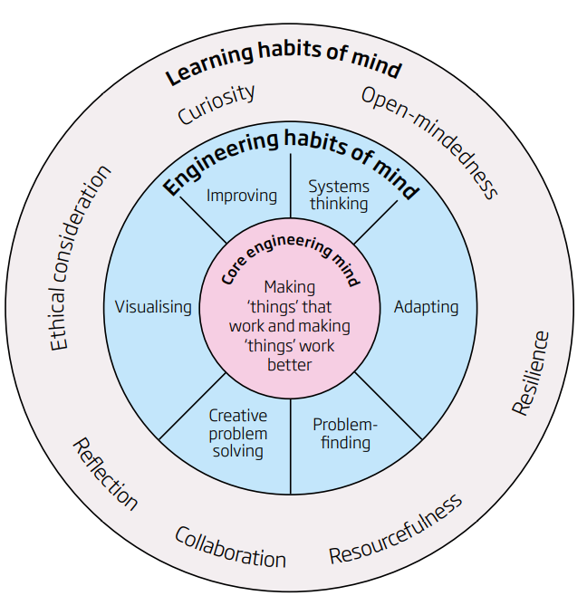
Engineering Habits of Mind
Systems Thinking – Smaller parts coming together to make a whole.
Problem Finding – Finding problems, deciding how to fix them and checking existing solutions.
Visualising – Thinking about how the final product will look.
Creative Problem Solving – Working together to create solutions to problems.
Improving – Making things better.
Adapting – Applying things in a new context.

Slide 17
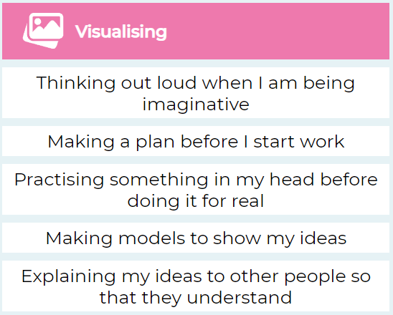
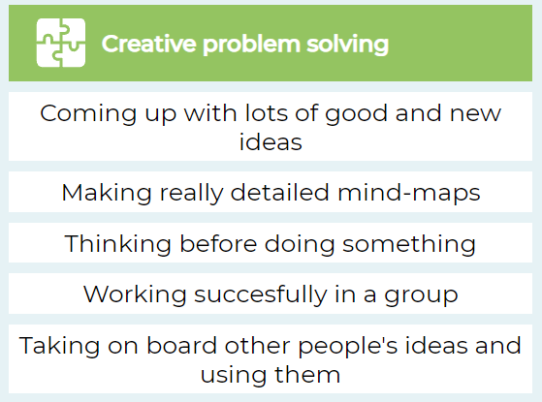
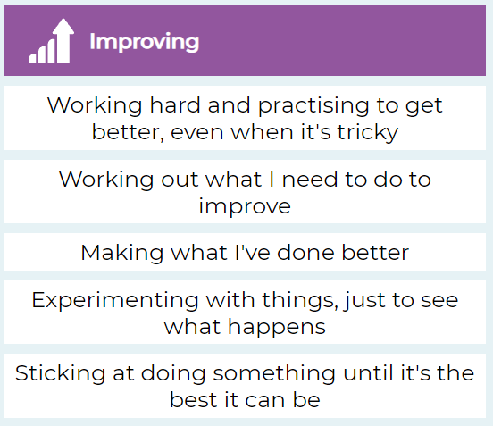
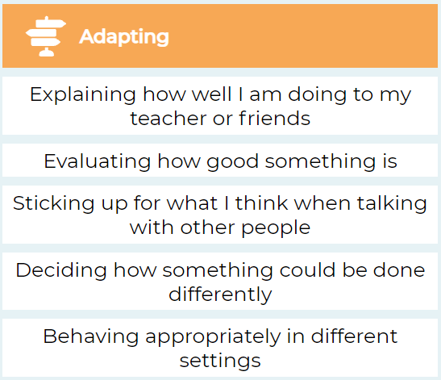

Slide 18
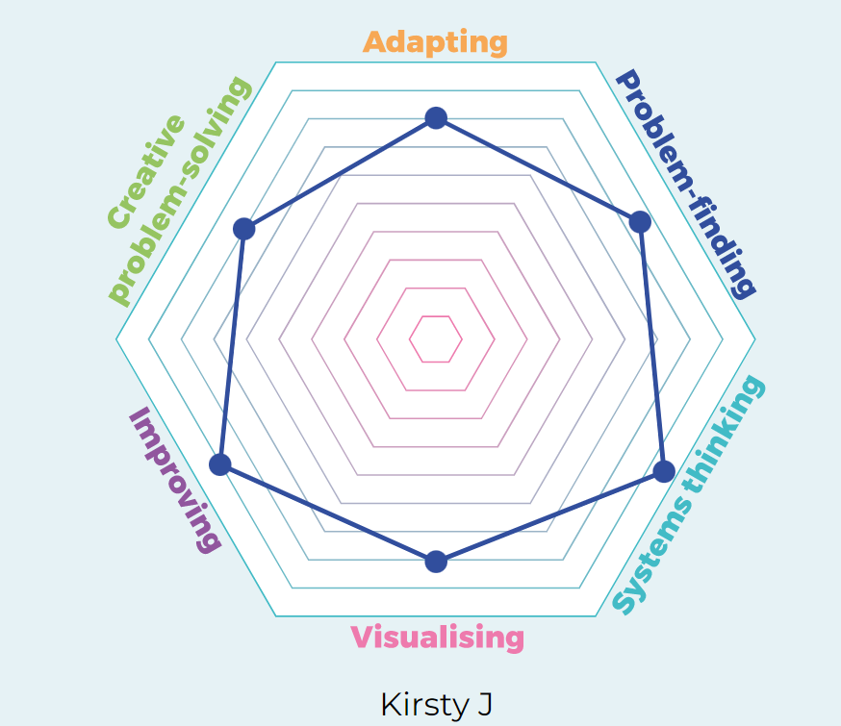
Self Evaluation
Engineering Habits of Mind Quiz

Slide 19
https://blogs.glowscotland.org.uk/glowblogs/stemnation/engineering-habits-of-mind/

Slide 20
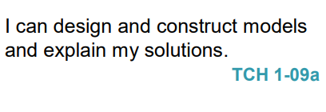
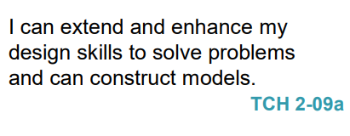
Ask
Imagine
Plan
Create
Test
Improve
Q: How can we develop pupils’ Engineering Habits of Mind?
A: Through the Engineering Design Process

Slide 21
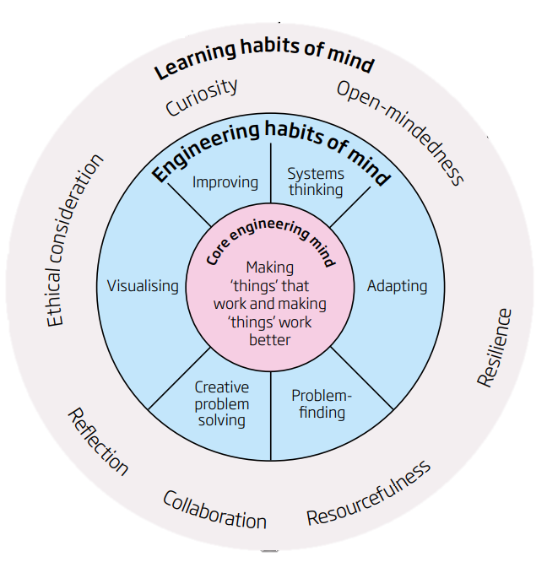
Ask
Imagine
Plan
Create
Test
Improve
Do we give children the time and space to…
Ask questions
Imagine and share ideas
Plan their solution
Create their solution
Test their solution
Improve their design
…and repeat the process?

Slide 22
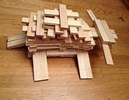
KAPLA is a creative resource with a wide application appeal and suitable for children of all ages.
KAPLA consists of loose parts that are identical pine planks that can be used to create unique models by stacking them. It can be used in classrooms for a wide variety of purposes:
To stimulate creativity
Promote teamwork
Resilience
Perseverance
To teach STEM concepts

Slide 23
Simpler than Lego. There is only one size, one shape, no holes: a sturdy wooden plank precision milled from hardwood
Because of the uniformity of the planks, very large, high and stable structures can be built and quite quickly
A huge variety of structures can be built
They lack the tricky locking device of Lego, and are not tiny, so young children can build with them.

Slide 24
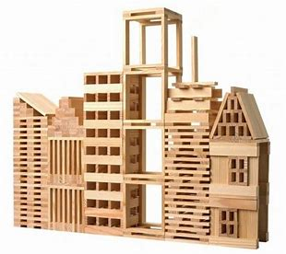
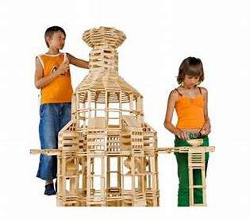
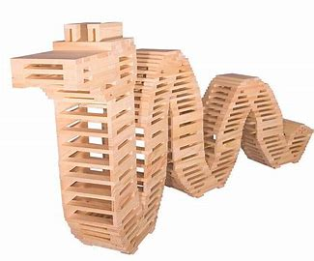
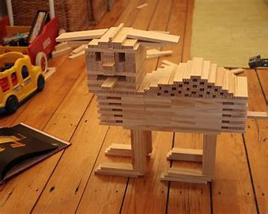
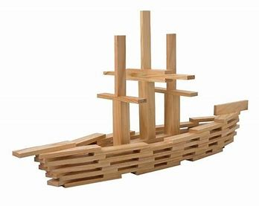
Opportunities are endless……
Kapla Amazing Wooden Toy Construction Sets - YouTube

Slide 25
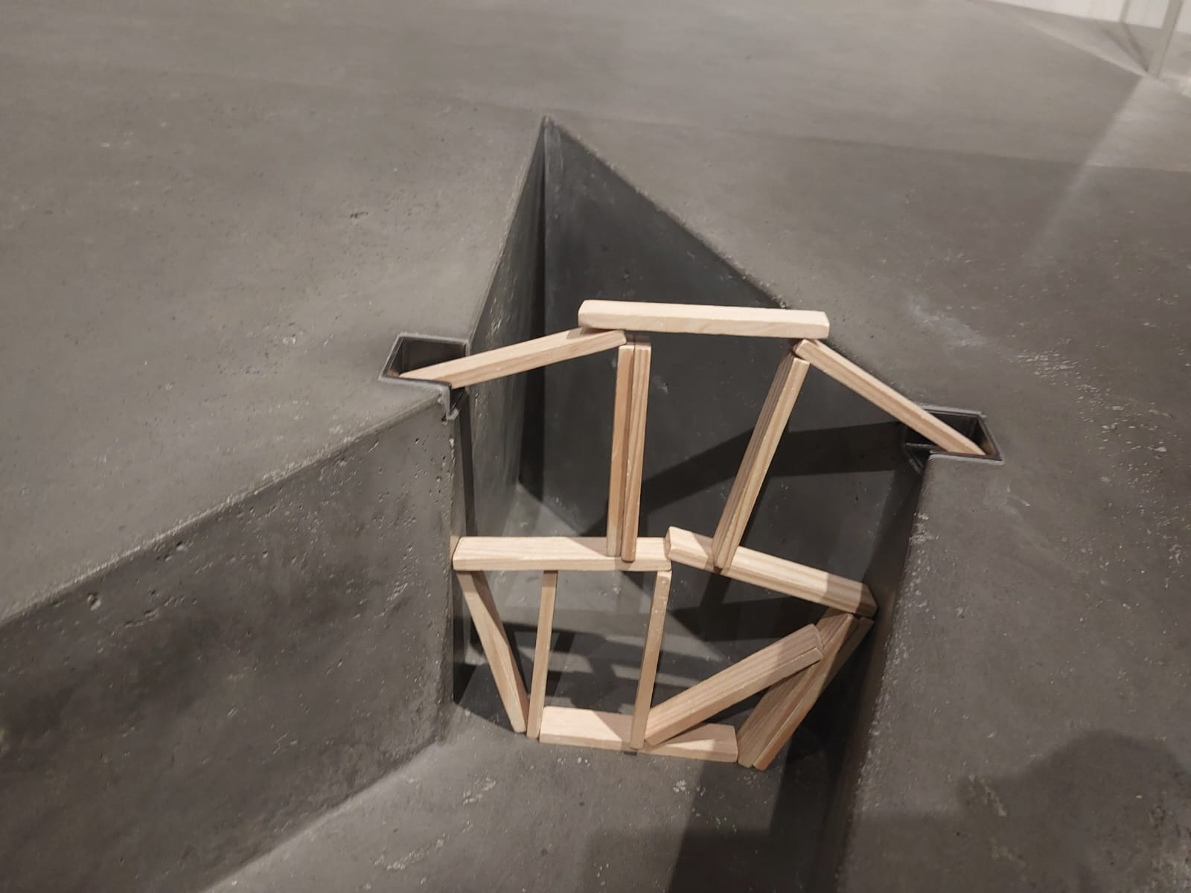
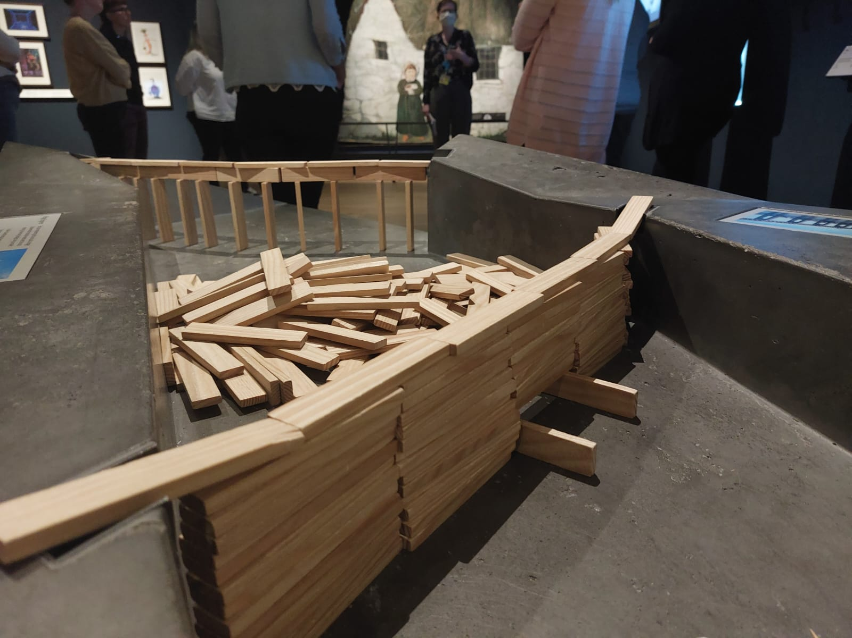
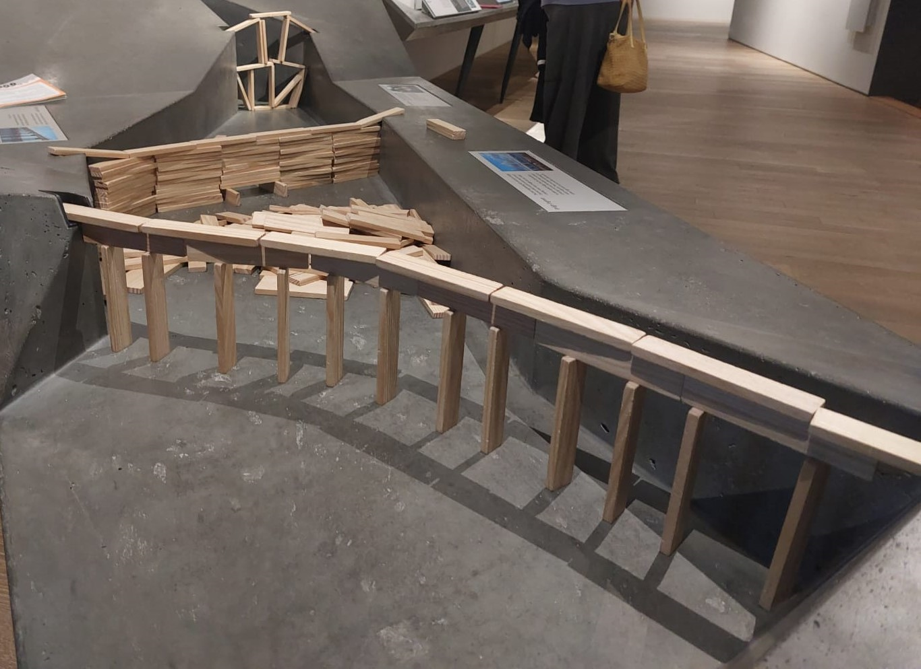
Bridges

Slide 26
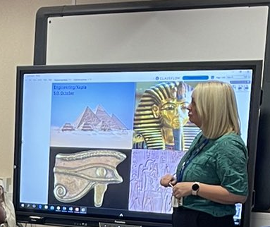
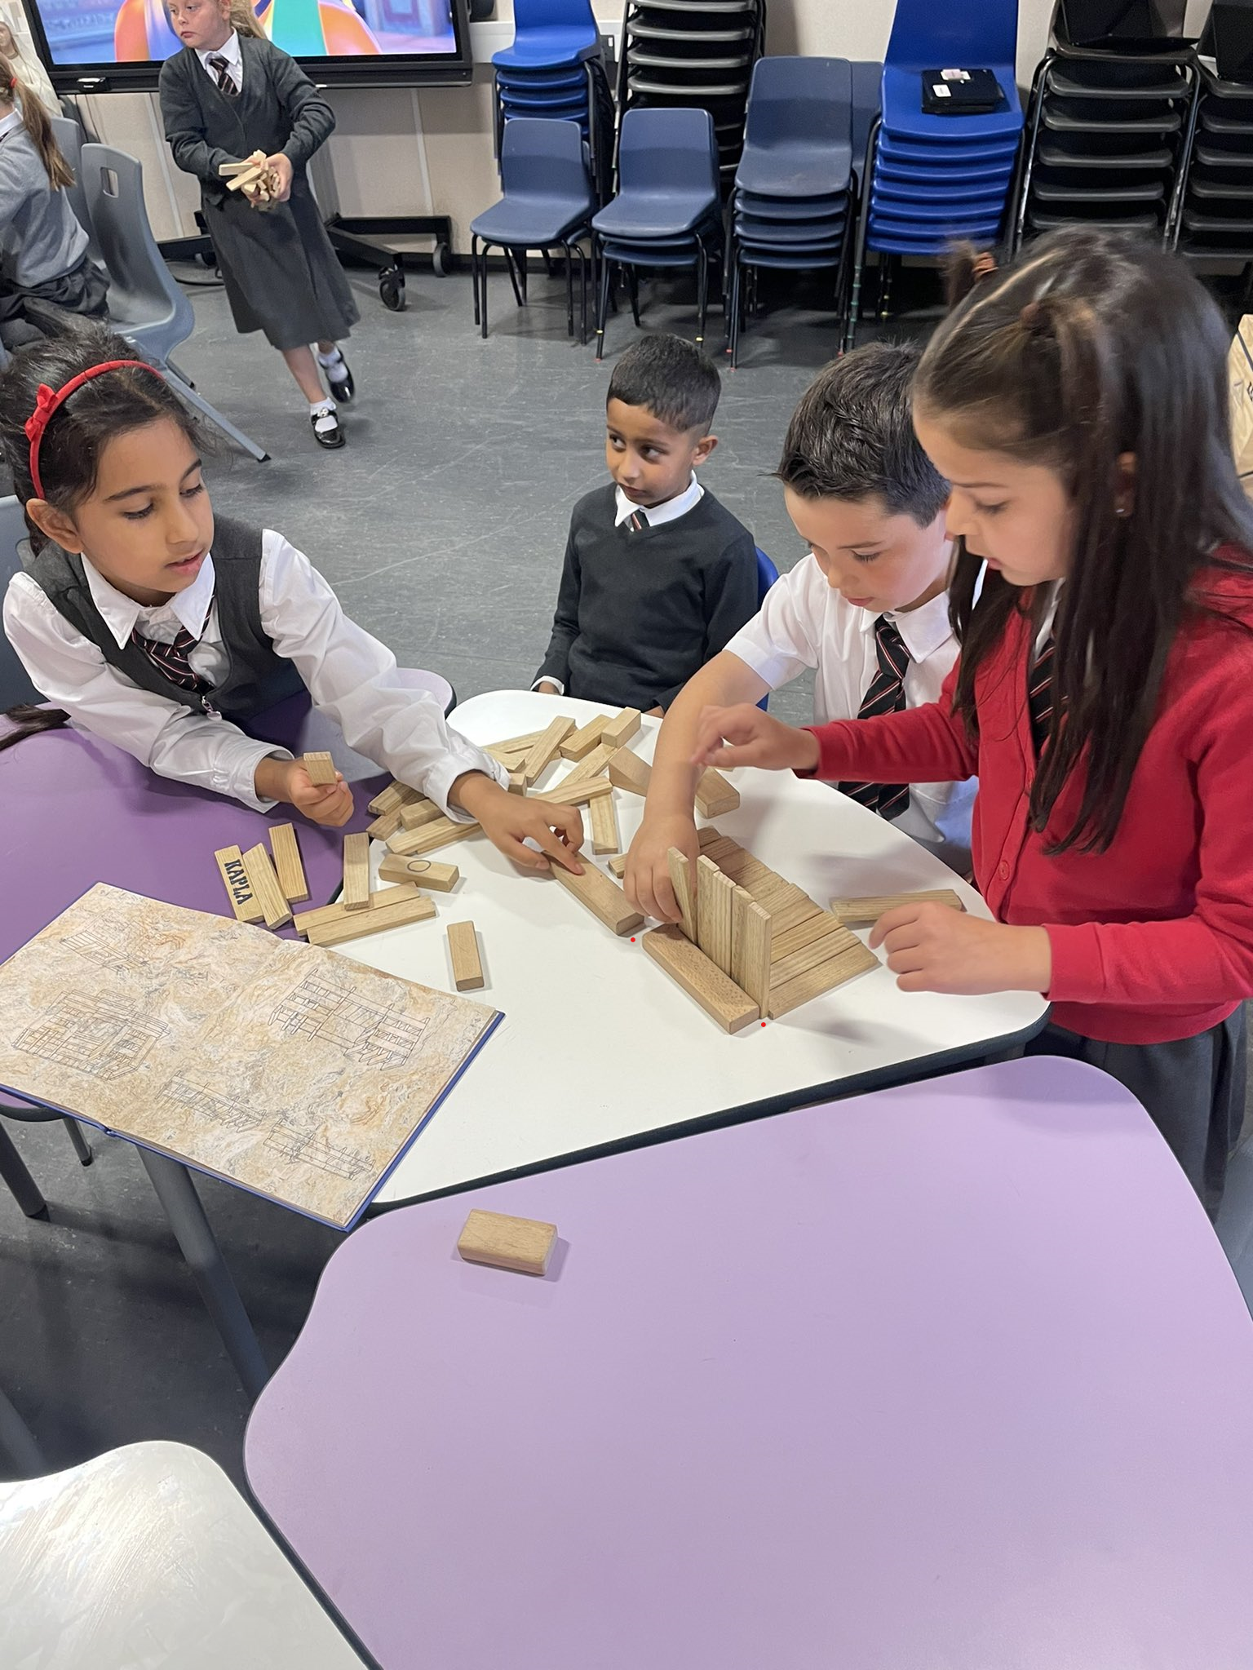
A Primary 3 class using KAPLA blocks to design and build an Ancient Egyptian pyramid or temple. They used the engineering design process, teamwork and communication skills.
Across the Curriculum

Slide 27
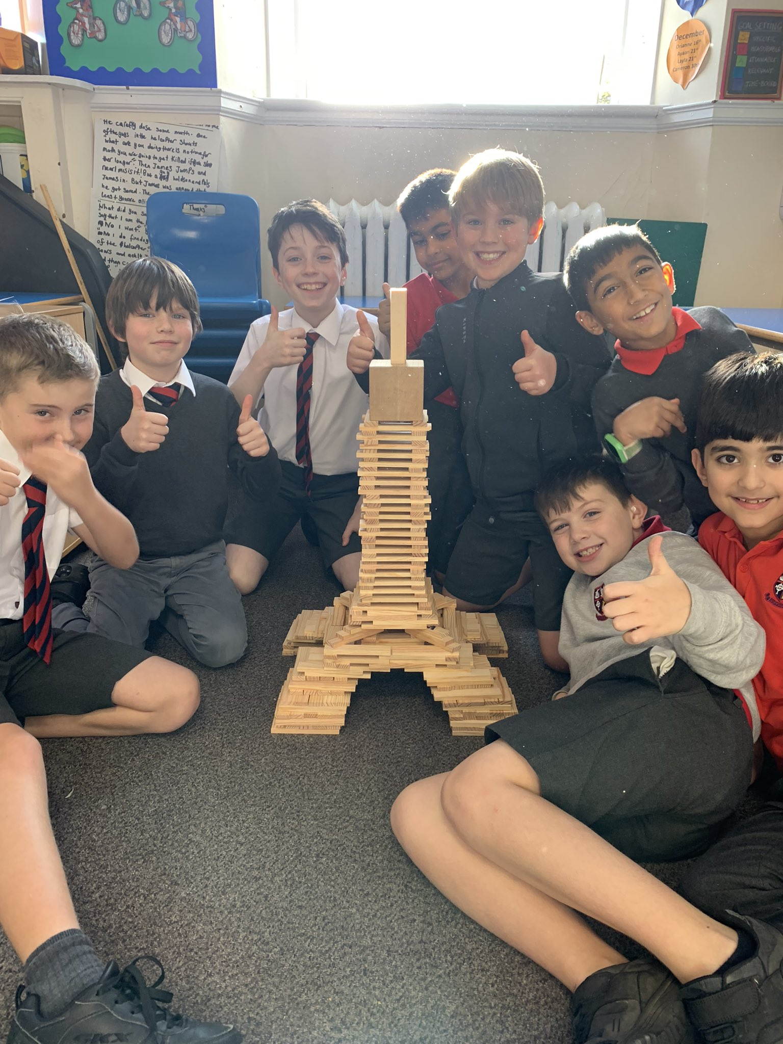
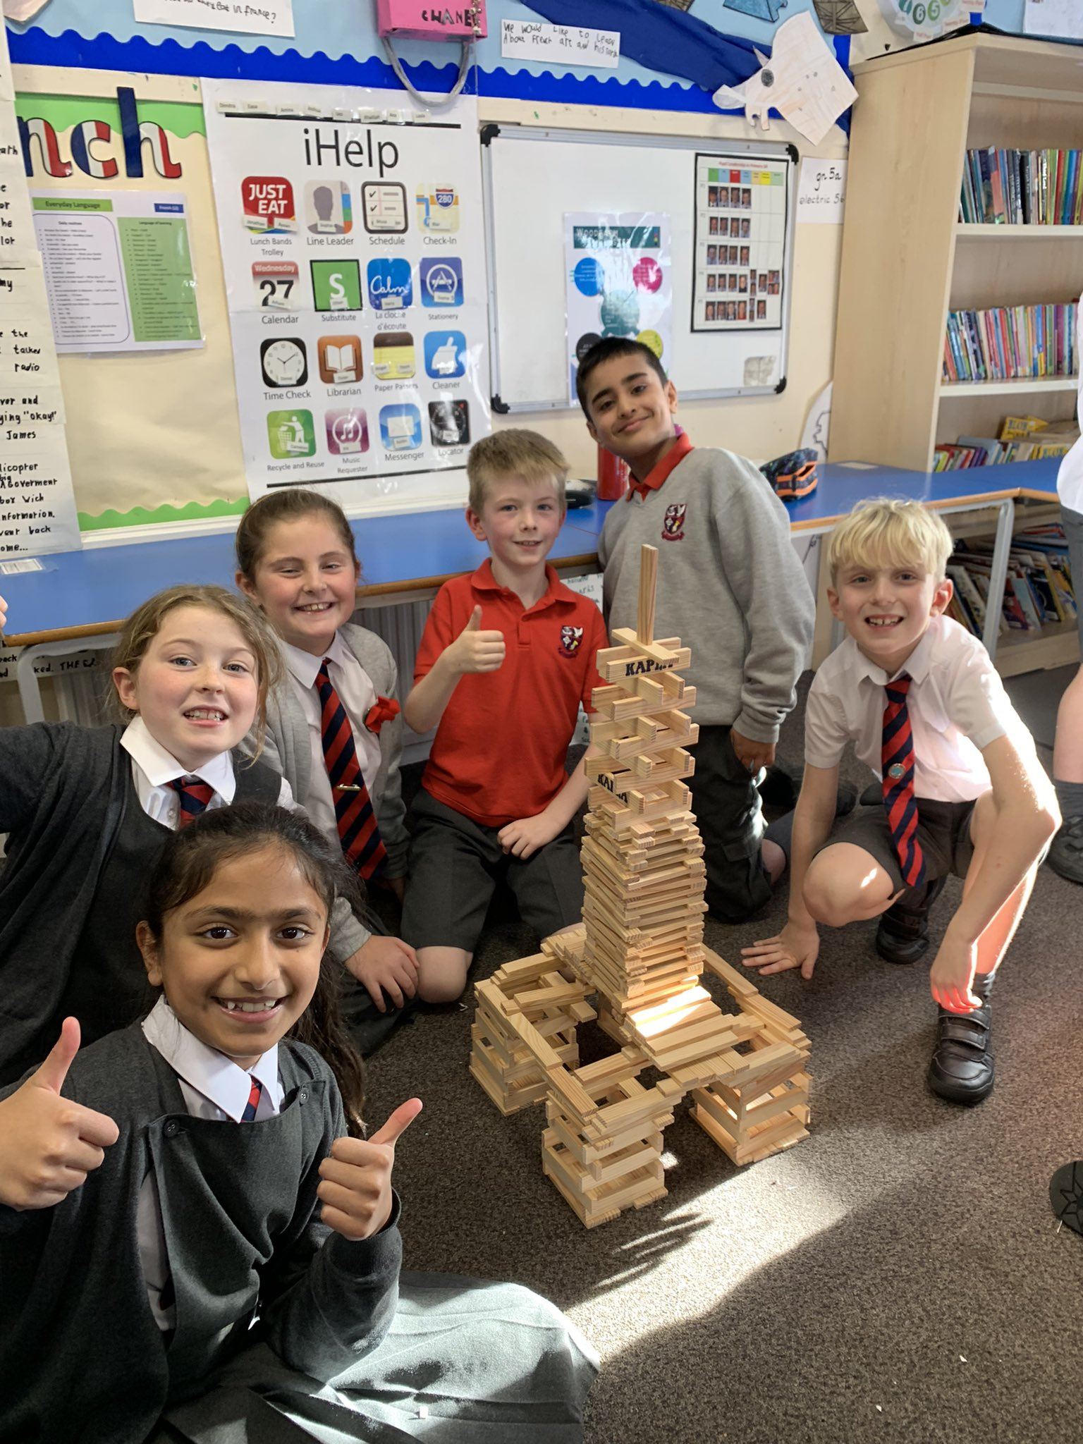
Can you build the Eiffel Tower?
Across the Curriculum

Slide 28
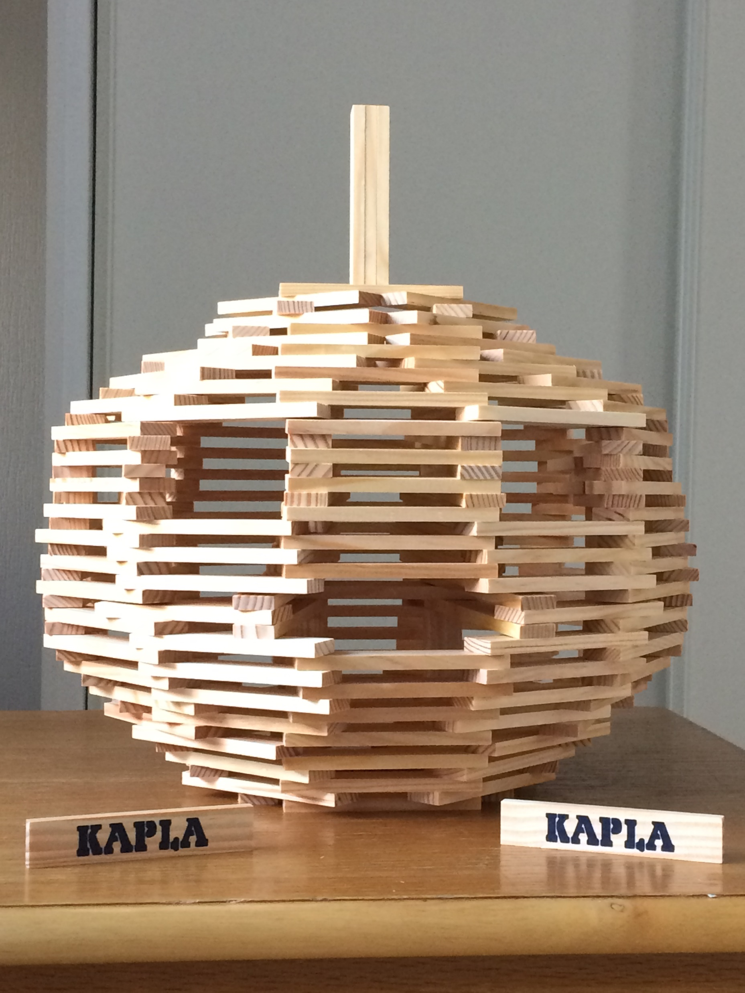
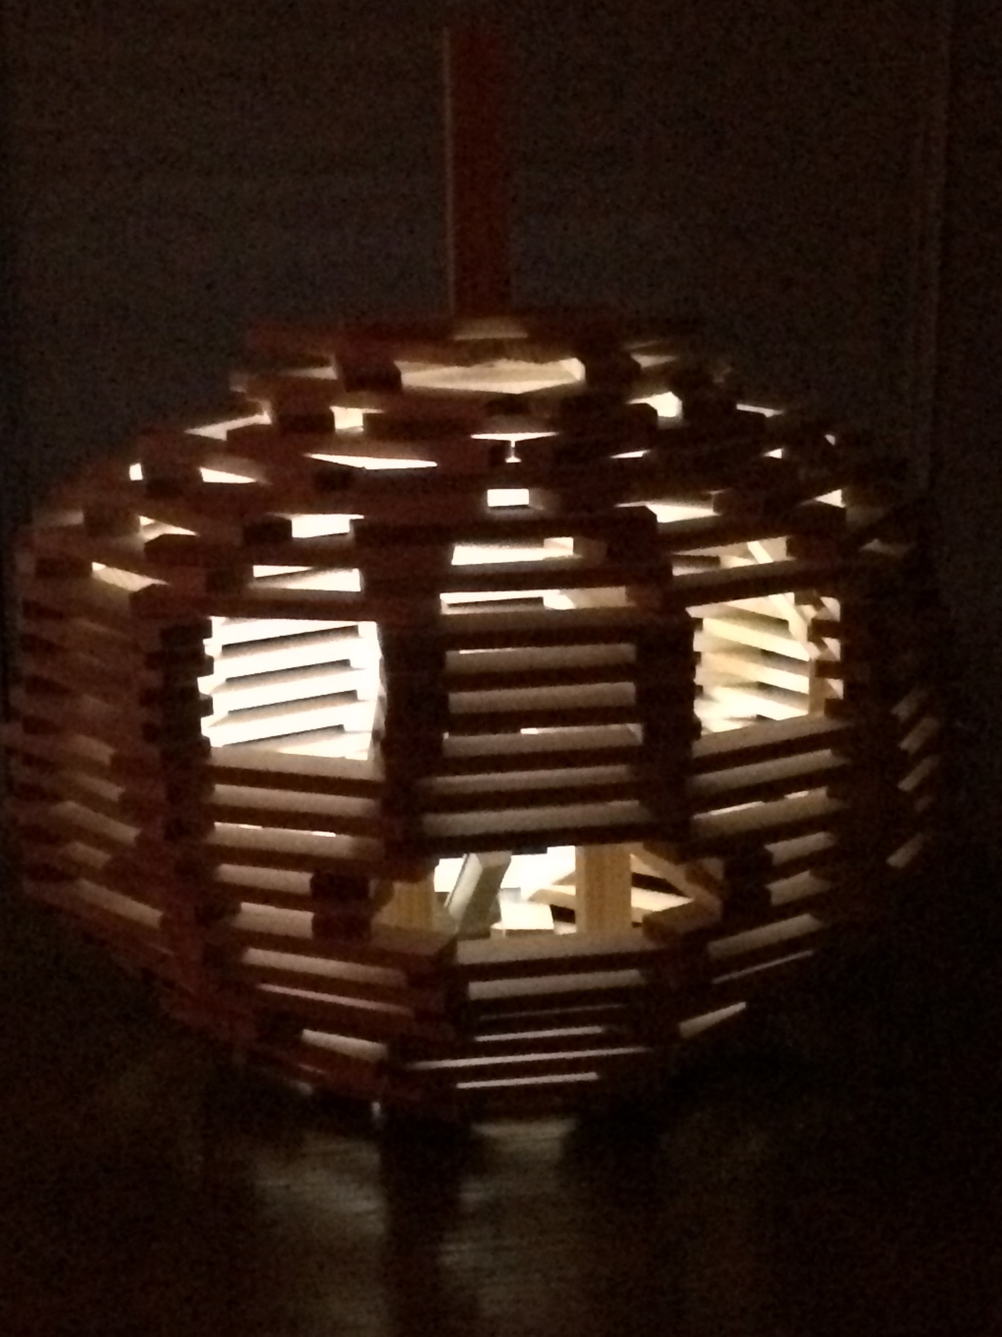
Link to seasonal topics: Halloween!
Across the Curriculum

Slide 29
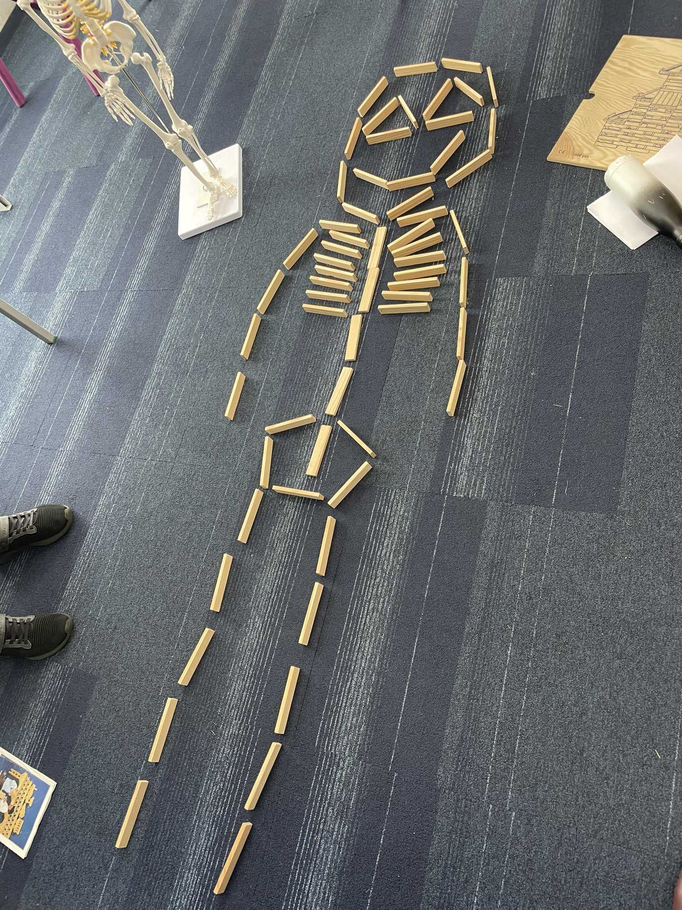
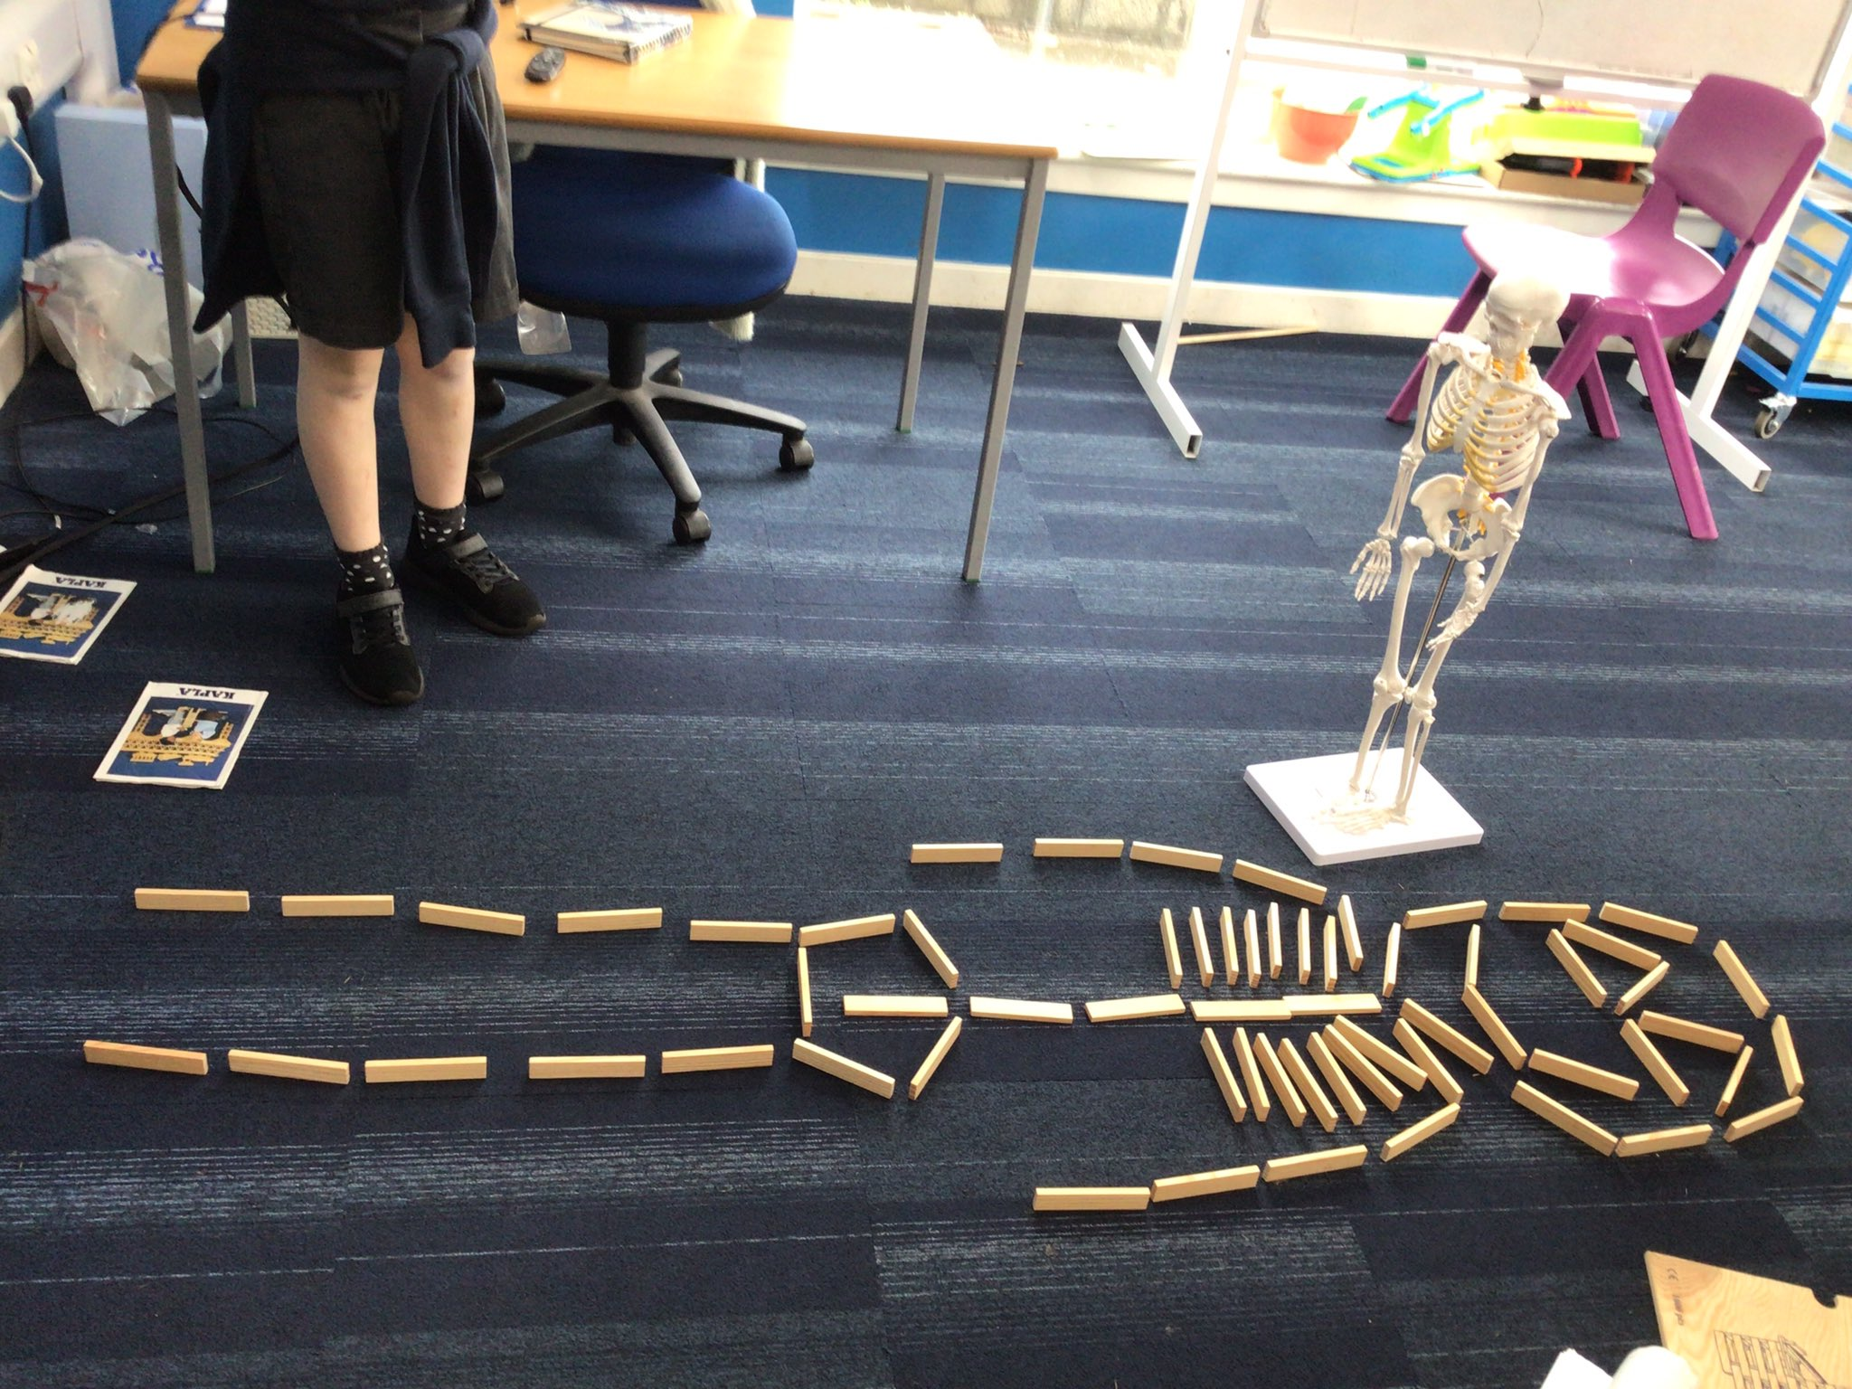
Across the Curriculum

Slide 30
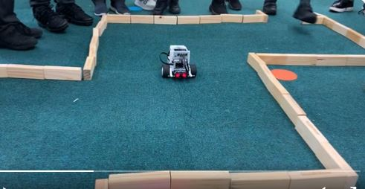
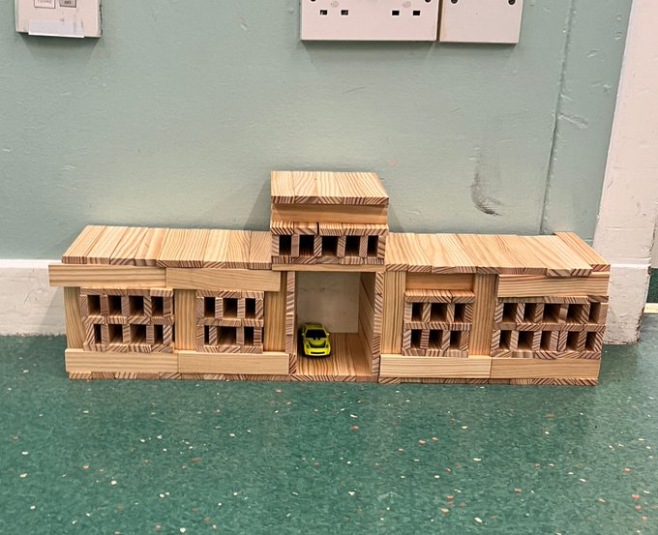
Across the Curriculum

Slide 31
Keva planks
https://www.kevaplanks.com/project-page

Slide 32
More ideas for Kapla
https://www.knextgeneration.co.uk/lessons – progressive 10 block Kapla challenges
https://blogs.glowscotland.org.uk/re/stemrenfrewshire/useful-websites/engineering/ - find links to more Kapla/ WoodenPlank STEM challenges
https://www.kevaplanks.com/project-page – project ideas
https://www.kevaplanks.com/challenges-with-20-planks-or-less

Slide 34
Makedo is a construction system with simple tools that allows children to create models out of cardboard
Cardboard as a building material is sustainable, fully recyclable and can be used again and again. It’s sturdy but pliable enough for small hands to manipulate, and versatile - cardboard can be folded, sawed through and hole-punched without it affecting its durability
Makedo can provide hands-on learning experiences that teach design, construction and problem solving
If fosters children’s imagination, creativity, resilience and perseverance
Makedo can be used across the curriculum and allows for differentiation

Slide 35
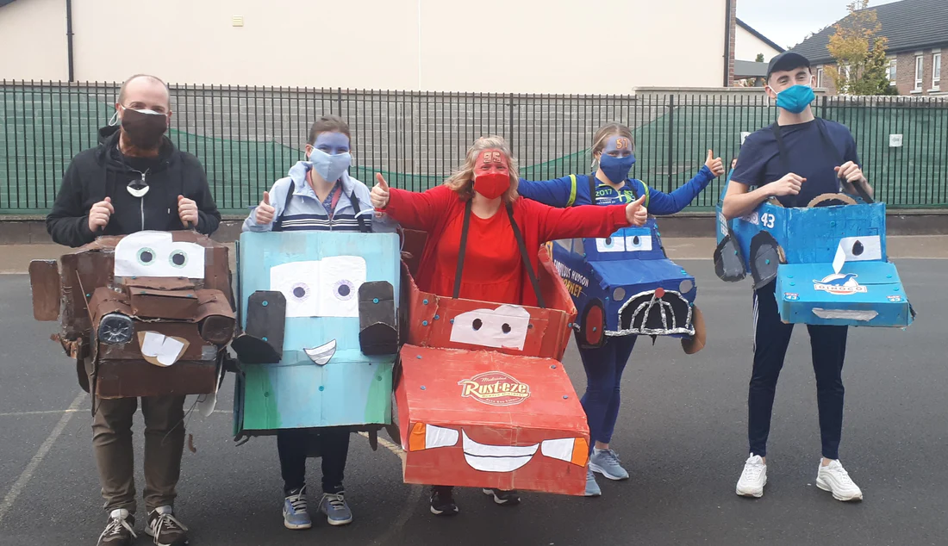
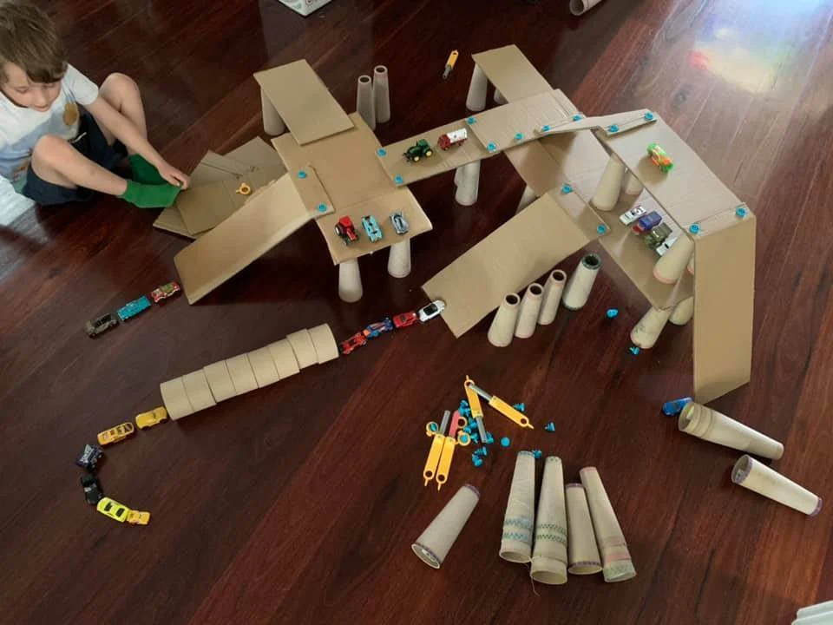
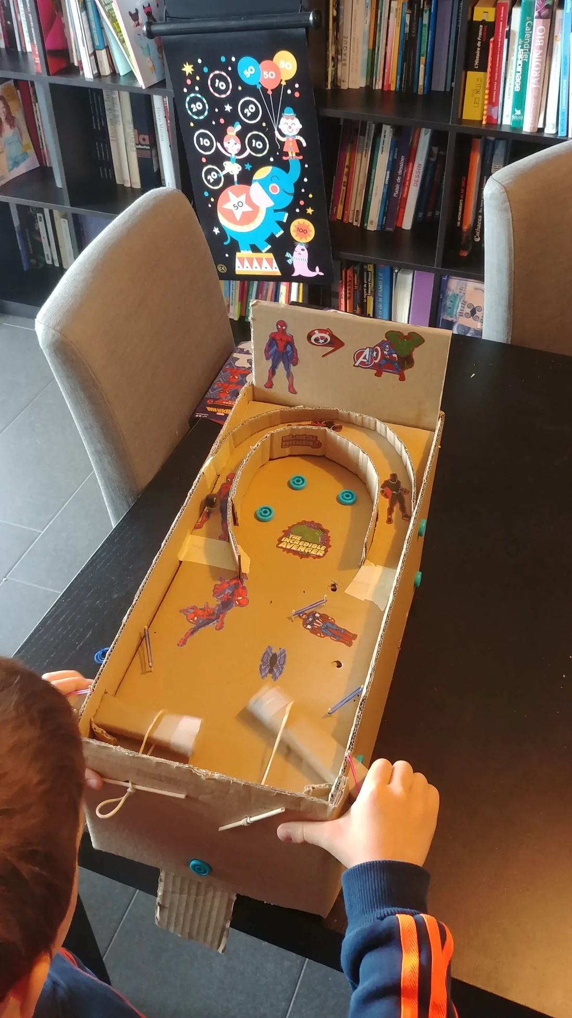
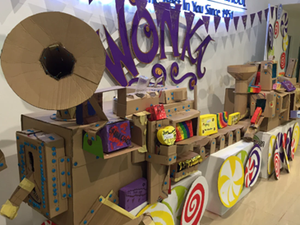
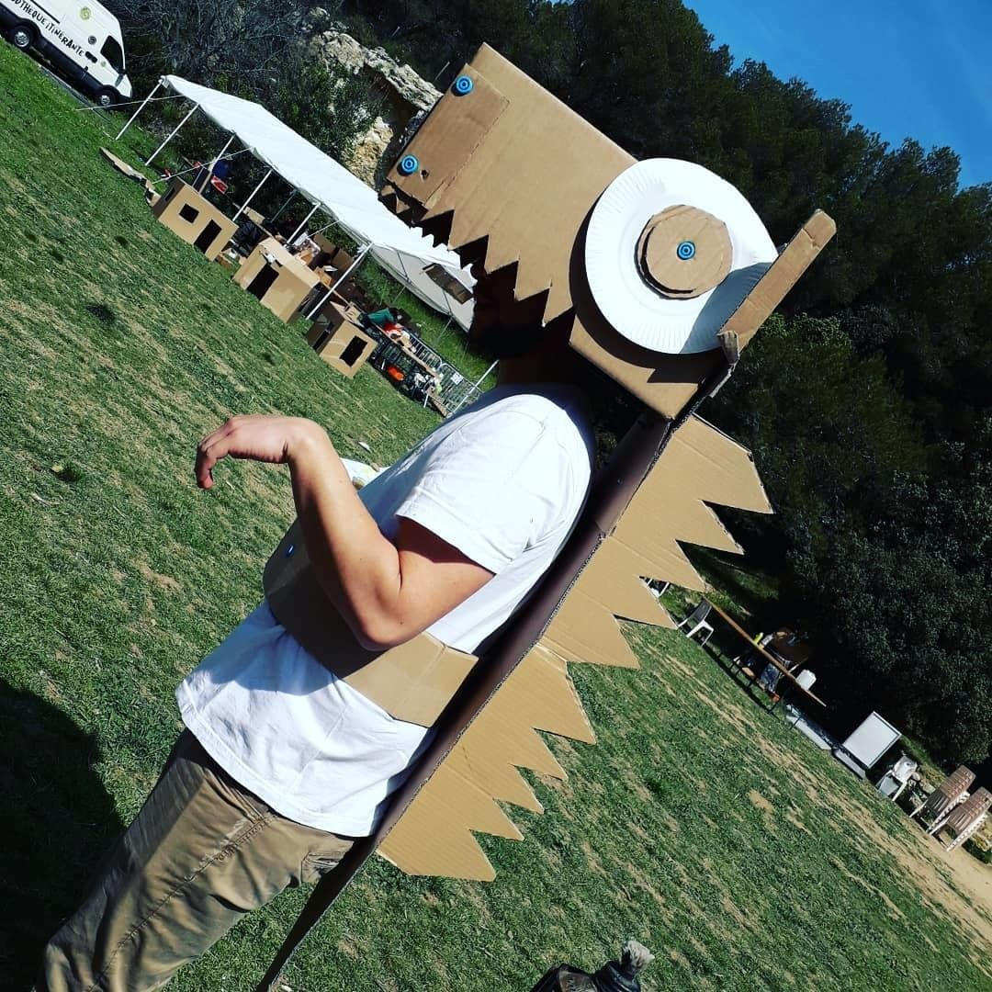
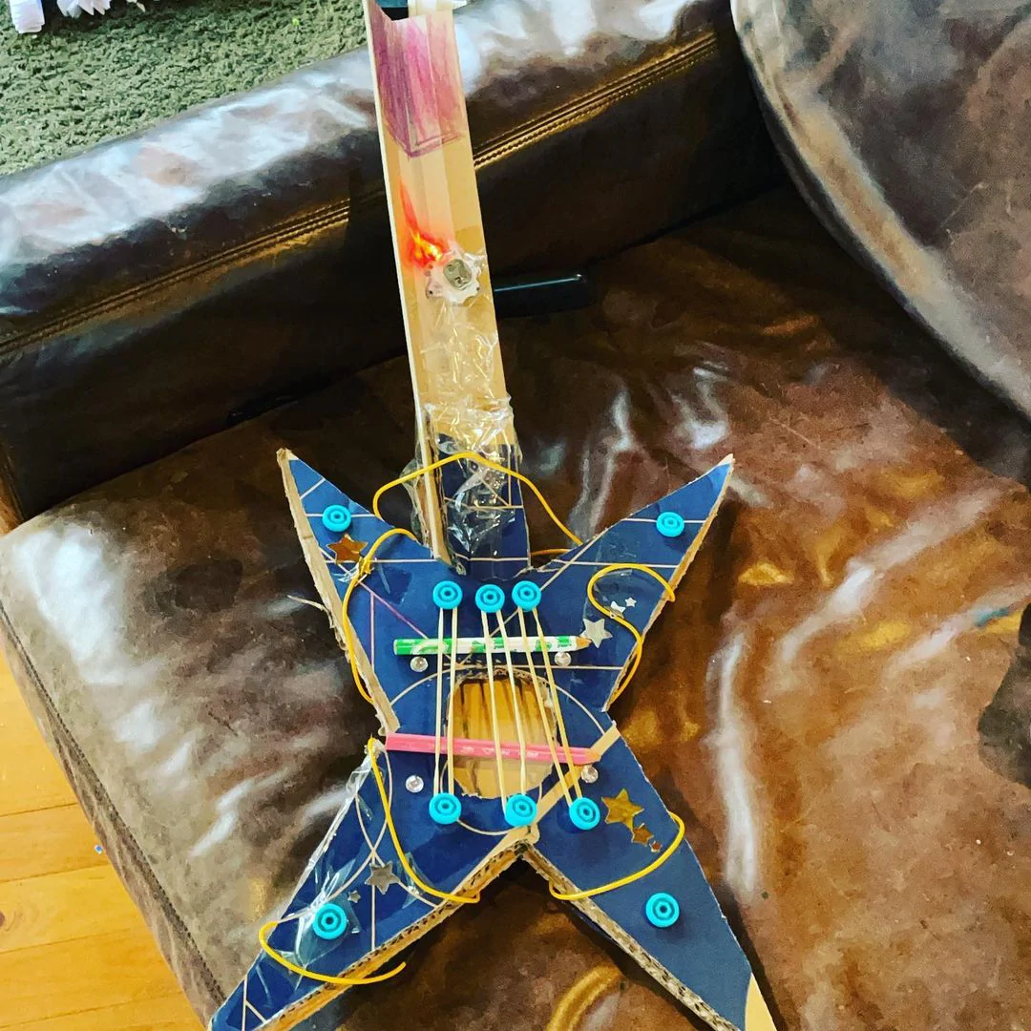
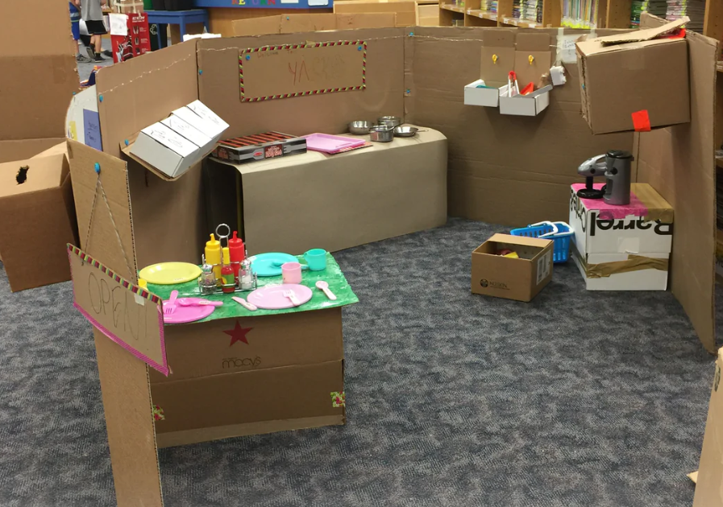
Opportunities are endless……

Slide 36
Makedo Education – make.do/pages/education
Introduction
The Ultimate Cardboard Construction STEAM Teaching and Learning Tool
Resources for Educators
How to use Makedo In Your Classroom
Cardboard As A Building Block
Sourcing Cardboard
Makedo and STEAM
Makedo and the Maker Movement
Join the Makedo Community!
Makedo Education Awards and Testimonials

Slide 37
tools
Scru-driver
Scru: connects up to 3 layers of cardboard
Scru+: connects up to 6 layers of cardboard
Mini-tool
Safe-saw
Fold-roller

Slide 38
Using the engineering design process, your team brief is to design a model with a moving part
ASK: What is the problem, the requirements and constraints?
Problem: design and build a model with a moving part
Constraints: you must use the cardboard boxes
IMAGINE: Brainstorm solutions and research ideas
PLAN: Choose two/three of the best ideas from the brainstormed list and sketch possible designs, then choose a single design to prototype
CREATE: Build the model/prototype
TEST: Evaluate and testing identifying strengths and weaknesses of the design
IMPROVE: Based on the test, make improvements to the design, identify changes and justify the revisions.

Slide 39
Getting Started with Makedo
https://know.make.do/collections/how-to
https://know.make.do/collections/everything/steam-design-challenge
https://know.make.do/collections/classroom/starter-guides
https://know.make.do/collections/classroom/subject-aligned-activities

Slide 40
https://www.teachingexpertise.com/classroom-ideas/cardboard-engineering-projects/
https://www.science-sparks.com/cardboard-stem-challenges/

