Slide 1
Renfrewshire Primary Classroom Assistant CPD Supporting Learners with Science & STEM
Kirsty Johnson
RAiSE Primary Science Development Officer
gw11johnsonkirsty@glow.sch.uk
@STEM_Ren

Slide 2
Plan for Session
The need for STEM
Different types of STEM Learning
Scientific Misconceptions
What is Science Enquiry
Using STEM Challenges in the classroom
Useful resources

Slide 3
Notes:
In a modern and ambitious world like ours, Science and its application are central to our economic future, our health and wellbeing as individuals and as a society.

Slide 4
Why is STEM Learning important?
Key areas of the Scottish Primary Curriculum
STEM Strategy for Scotland
Experiential nature engages learners
Vital for national economic growth
Develop scientific literate citizens
Develop key skills across the curriculum
Notes:
STEM subjects are increasingly important.
As well as being a key part of our Scottish curriculum, STEM skills are essential for our national economic growth.
STEM sectors is the biggest growing area of employment and it is essential that we ensure our young people develop the skills they need for the future
STEM is key to all Scotland’s economic sectors:
Creative industries
Life sciences
Energy
Food and drink
Financial and business
Universities
Tourism​
STEM and science education is important not just for developing Stem skills and fostering potential future STEM careers, but it is also important for developing young people’s understanding of science and how it impacts on their day to day lives, to allow them to make informed decisions about their health and wellbeing and about our planet
STEM learning is such a valuable curricular area for engaging the learners who typically would not normally engage, due to their hands on nature. It can often be the case that learners who may not take part readily in literacy or numeracy lessons, may in fact develop some of these skills through STEM learning
growing our understanding and appreciation of the natural and physical world and the broader universe around us;
interpreting and analysing data and information;
research and critical enquiry – to develop and test ideas;
problem solving and risk assessment;
experimentation, exploration and discovery of new knowledge, ideas and products;
collaboration and working across fields and disciplines;
creativity and innovation – to develop new products and approaches

Slide 5
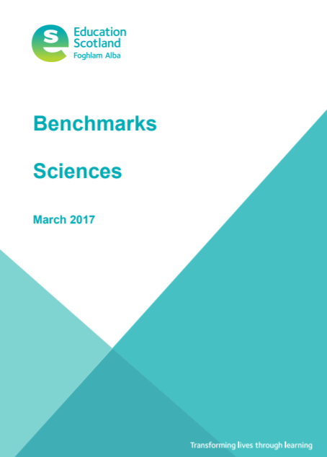
Curriculum for Excellence - Science
Science Experience & Outcomes
Science Benchmarks
Skills progression
Planet Earth
Forces, Electricity & Waves
Biological Systems
Materials
Topical Science

Slide 6
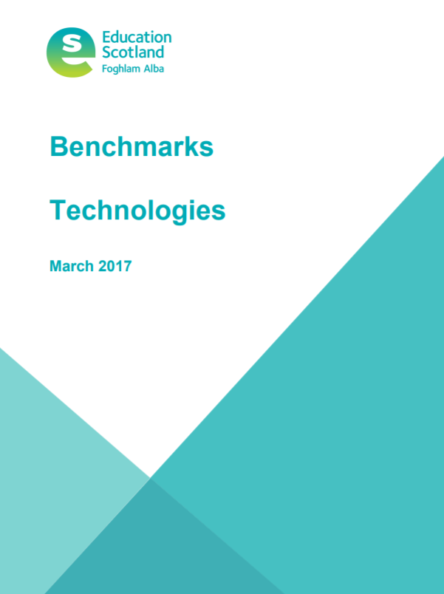
Curriculum for Excellence - Technologies
Technologies Experiences & Outcomes
Technologies Benchmarks
Digital Literacy
Food & Textile Technology
Technological Developments on Society & Business
Craft, Design, Engineering and Graphics
Computing Science

Slide 7
How Science is Delivered in Schools
Schools have different models of planning & delivery:
Timetabled lessons
Non-class contact delivery
IDL Contexts / Topics/ STEM through Stories
One-off lessons, activities or ‘experiments’
STEM Challenges
STEM days/weeks
Science Clubs
Young STEM Leaders

Slide 8
Role of the Classroom Assistant
Develop scientific skills and understanding
Build on learners ideas by using questioning
Supporting practical work (not doing, unless there is a safety issue)
Work with groups or individuals
Support lessons or one-off activities
Help to organise and prepare resources
Provide support with recording results
Making links to supporting literacy and numeracy skills
Any more?

Slide 9
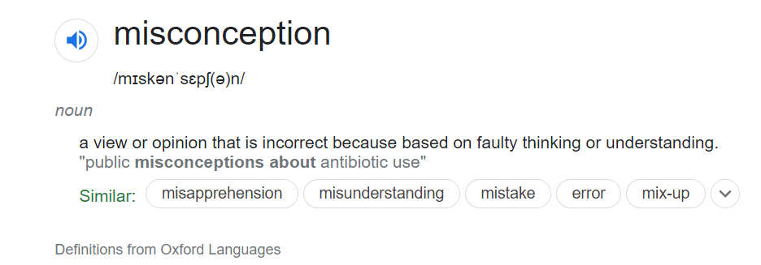
Misconceptions
Be careful about accidentally reinforcing scientific misconceptions in your teaching

Slide 10
Common Misconceptions
All metals are attracted to a magnet
Things that float are lighter than water
You can see and hear a distant event at the same moment
The sun disappears at night

Slide 11
What is Science Enquiry?

Slide 12
What is Science Enquiry?
“Children take part in scientific investigations and enquiries which develop their understanding of the underlying scientific concepts…
They develop a growing awareness of themselves and the world around them through observation, collecting specimens and carrying out experiments.”
(Sciences: Principles and Practice, Education Scotland)

Slide 13
The foundation of science is to ask questions about the natural world and then seek answers.
Children explore and investigate to form their own questions
Role of the adult is to use questioning
- to check for understanding
probe children’s thinking
activate prior knowledge
encourage thinking
make them curious
e.g. where do the stars go during the day?

Slide 14
Types of Enquiry
Observing over Time
Identifying and Classifying
Pattern Seeking
Research
Fair Testing
“The science enquiry process is essentially the same whatever the age and maturity of the children, but the skills that they use when doing science enquiry should develop as the move through school”
(It’s not fair-or is it? ASE)

Slide 15
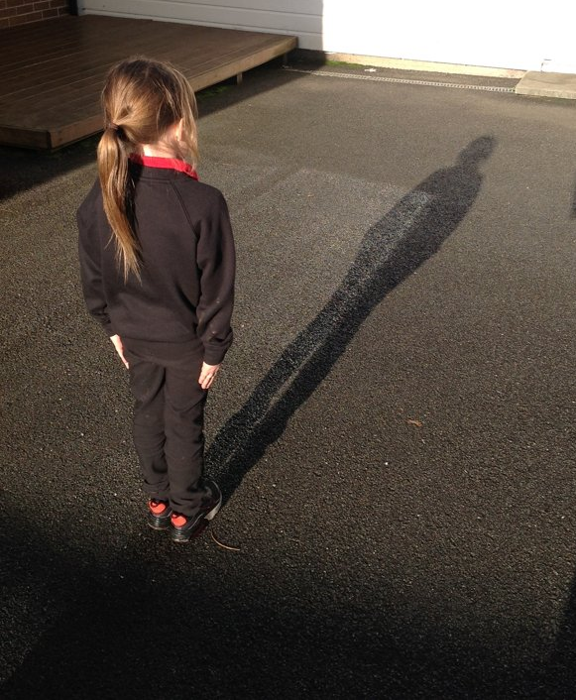
Observing over time
Changes in plants and habitats
What happens to food left out
Ice and snow melting
Puddles evaporating
Shadows changing position during the day

Slide 16
Identifying and Classifying
Sorting objects
Sorting leaves and natural objects
Minibeast guides
Grouping objects

Slide 17
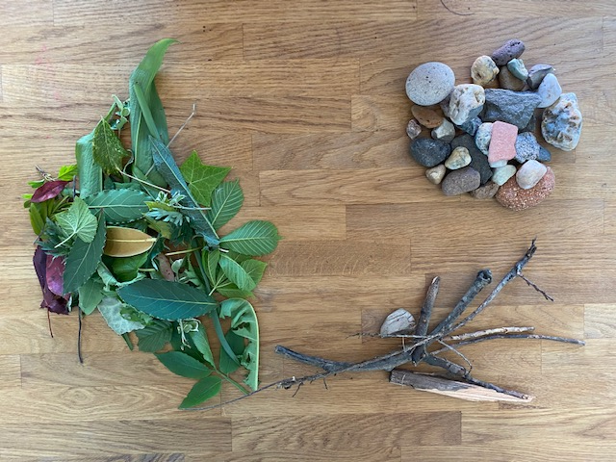
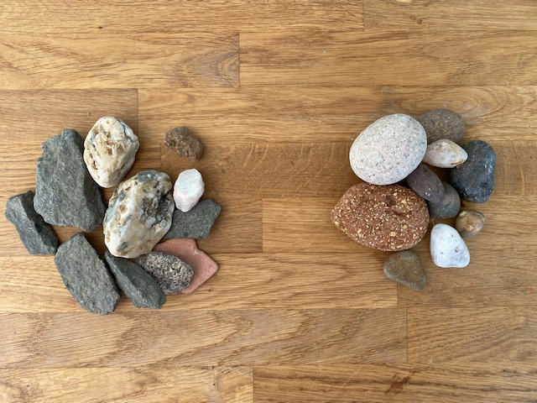
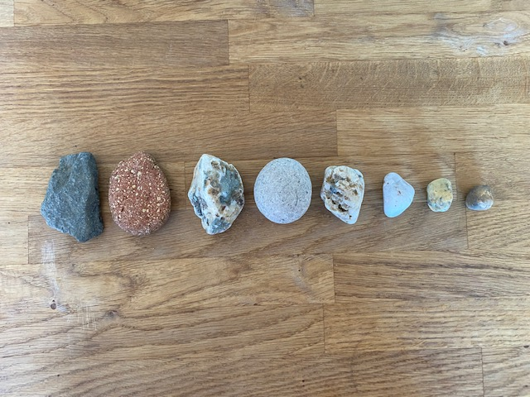
Early Level
Sticks / Stones / Leaves
Rough / Smooth
Order by size
NL STEM

Slide 18
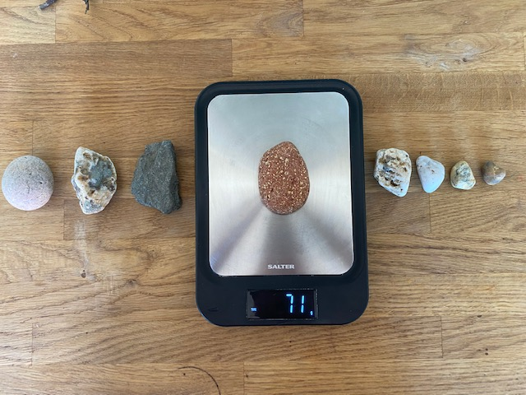
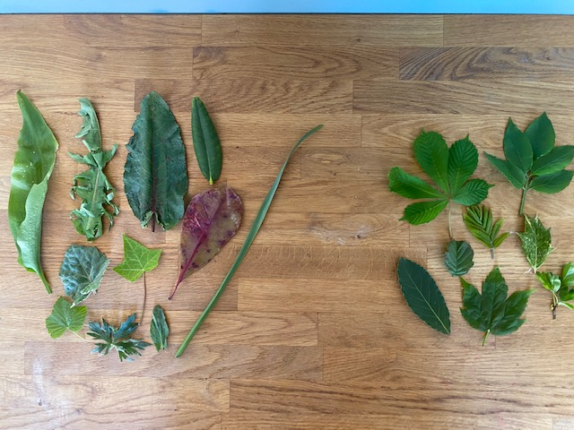
First Level
Living / Non Living / Once Living
Order by mass (weight)
Plant leaves / Tree leaves
NL STEM

Slide 19
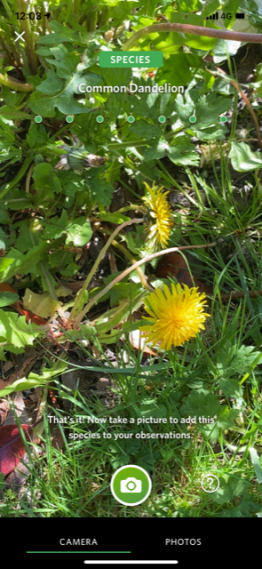
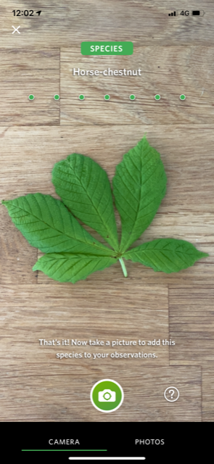
Second Level
Local Plants
Ground Plants
Trees
Horse Chestnut
Elder
Wild Garlic
Dock
Rhododendrons
Dandelion
Rowan
Holly
Birch
Colts-foot
Ivy
Daffodil
Hawthorn
Bay Laurel
Bramble
Sorrel
Sycamore
iNaturalist Seek App
Buttercup
NL STEM

Slide 20
Pattern Seeking
Do all flowers have the same number of petals?
Birds are coming to our bird table, do different birds come at different times of the day?
Do tall people always have bigger feet?
The litter always collects in one corner of the playground, does the wind always blow in that direction?
Notes:
These types of enquiry often provide scope of making links to numeracy
Counting, Measuring, recording time, data handling, charts, averages

Slide 21
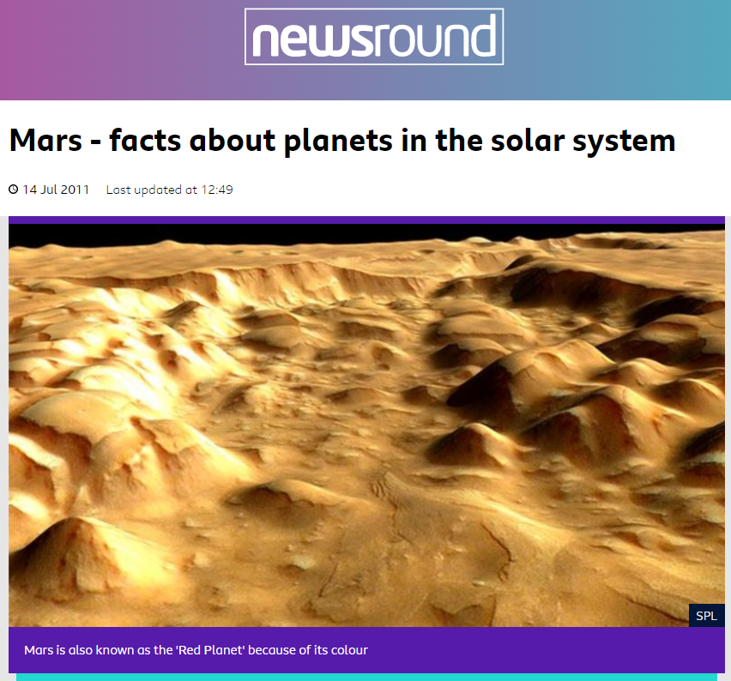
Research
Enquiries where the answer is found using a secondary source or when
questions are impossible or unsafe for children to answer using first hand experience
How did the Egyptians move heavy rocks to build the pyramids?
How cold is it on Mars?
How does a submarine work?

Slide 22
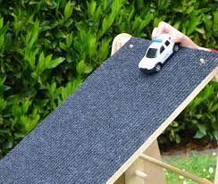
Comparative & Fair Testing
Explores relationships between variables
What is the effect of changing ramp height on the toy car’s speed?
What happens to the bubbles if we change one of the ingredients in the mixture?
Do potatoes grow better in tubs or the ground?

Slide 23
STEM Challenges
A STEM Challenge is a problem which requires learners to use their skills and knowledge from Science, Technology, Engineering and Maths to design, build test and improve a solution

Slide 24
STEM Challenges
Adult facilitates but does not give ideas or answers
Use questions
Encourages
Child led; learners take responsibility and make their own decisions
Learners are confident to take risks and try new ideas
Interdisciplinary
Open-ended exploration but within constraints
Stimulates curiosity
Draws on Prior learning

Slide 25
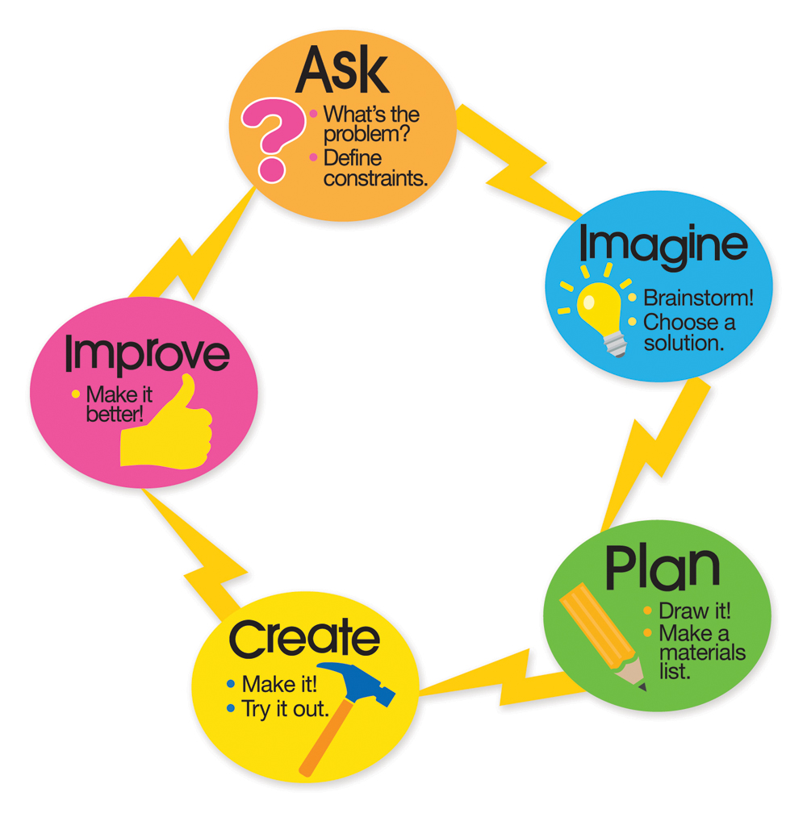

Slide 26
You have 10 minutes to work with your shoulder partner to design and build a phone holder to hold your phone at least 10cm above your desk
Materials: 3 sheets of A4 paper, Sellotape, scissors
Think about…..
Identify emotions a learner may experience while carrying out a STEM challenge
What skills are learners developing through doing a STEM challenge?

Slide 27
The Challenge with STEM Challenges!
Determined
Sense of Achievement
Inspired
Supported
Enjoyment
Engaged
Confident
Equity
Fun
Frustrated
Angry
Worried
Overwhelmed
Overpowered
Shy
Upset
Some children may experience some uncomfortable feelings and emotions and will need support

Slide 28
Transferable Skills
Collaboration
Communication
Critical Thinking
Creativity
Resilience
Key skills for life!
Notes:
From Skills 4.0
We have termed these skills for the future ‘meta-skills’, and define them as timeless, higher order skills that create adaptive learners and promote success in whatever context the future brings. These are the skills that enable individuals to perform highly today; in a changed world of work they will be required by all of us.

Slide 29
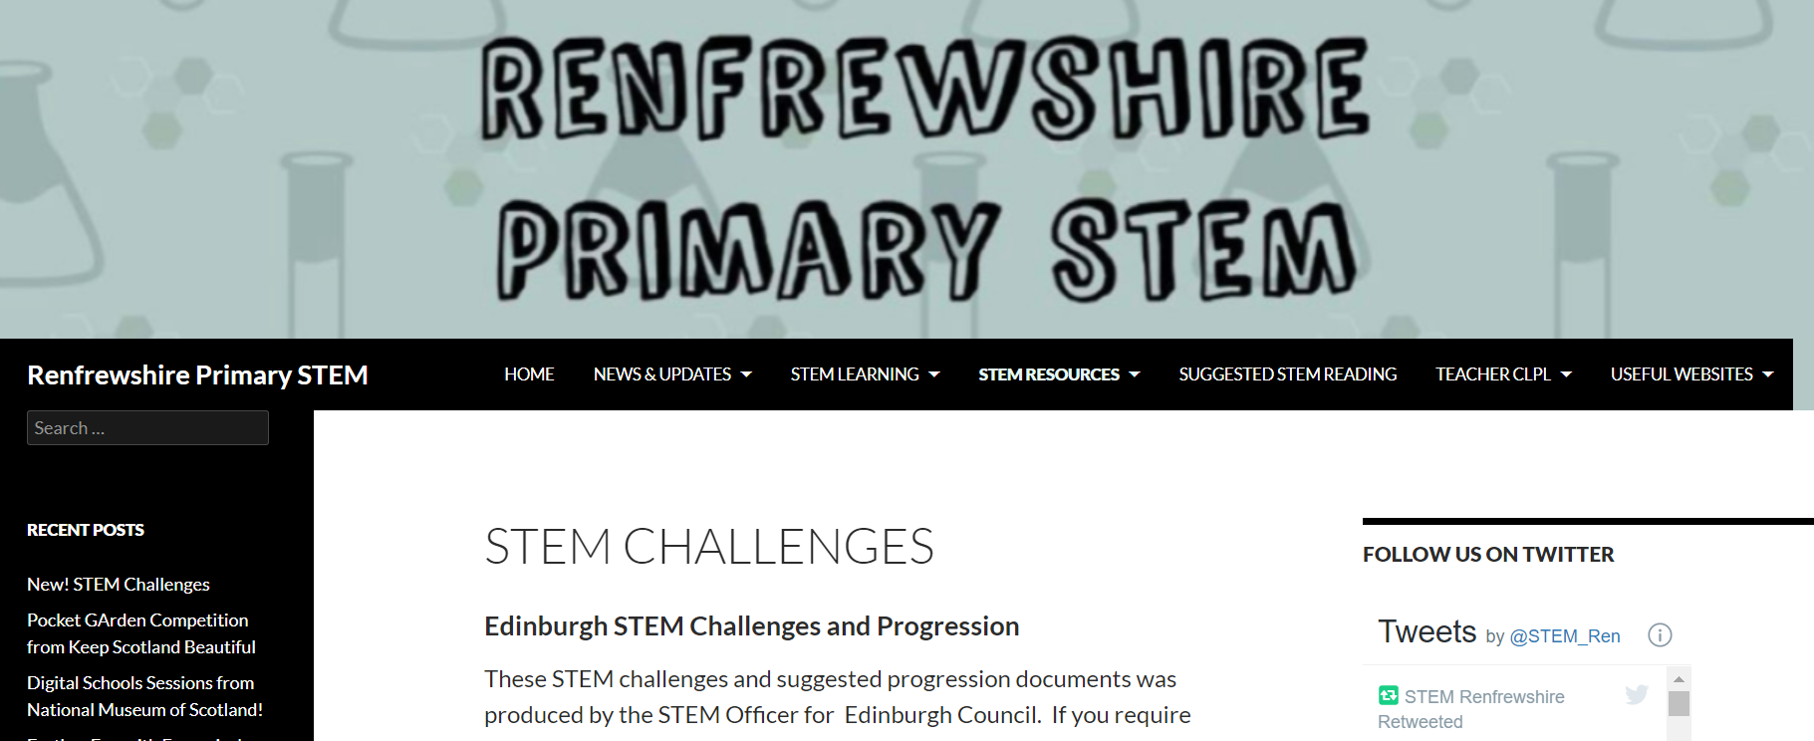
STEM Challenges
Find links to lots of STEM challenges to use with you learners on the Renfrewshire Primary Science Glow Blog
https://blogs.glowscotland.org.uk/re/stemrenfrewshire/resources/stem-challenges/

Slide 30
STEM Challenges
Useful for 1:1 or small groups
Easy to adapt to children’s different needs
Accessible for most learners
Often need very little resources
Open ended
Engaging
Often can be taken outdoors

Slide 31
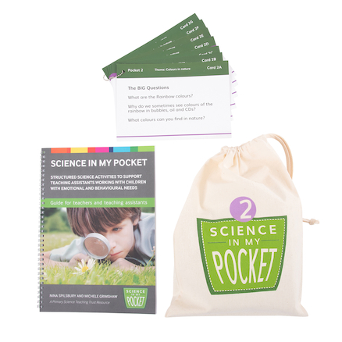
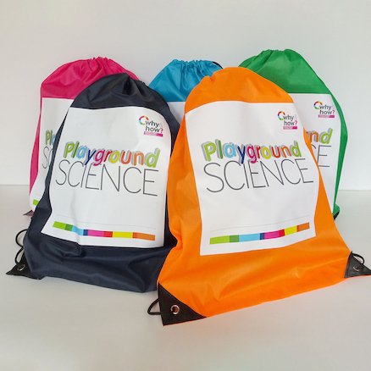
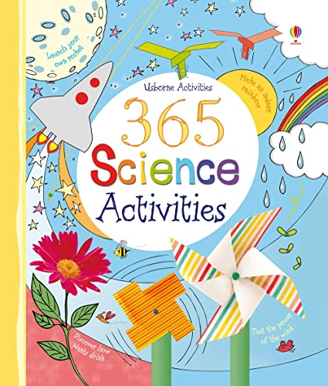
Resource ideas for Classroom Assistants
Playground Science Activity Sacks from TTS
Science in my Pocket

Slide 32
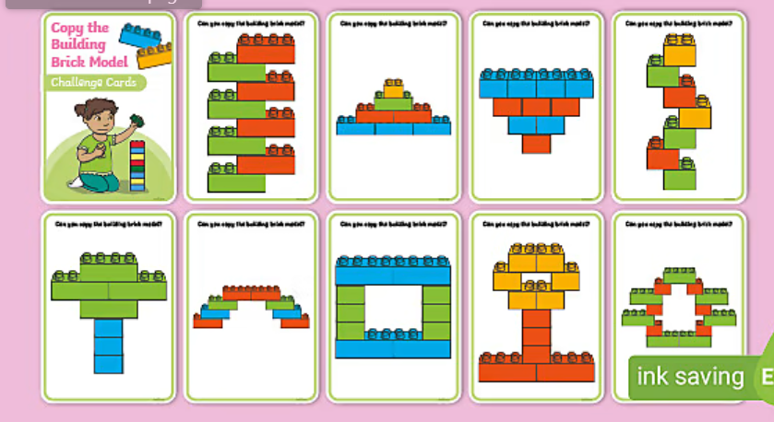
Downloadable STEM challenge cards

Slide 33
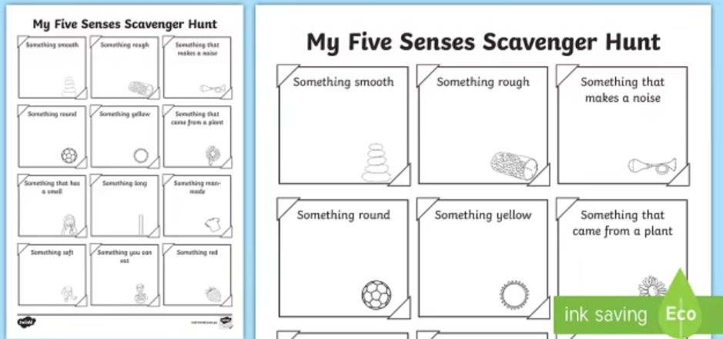
Downloadable STEM scavenger hunts

Slide 34
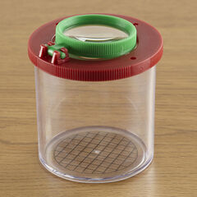
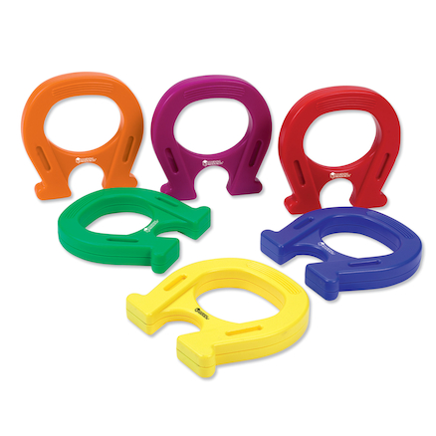
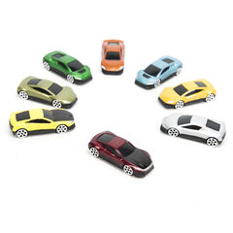
1:1 Science Kit
My Science Log Book

Slide 35
Resources – have a look!
Kapla
Botley
Rocks
Digital Microscope
Lego STEAM Parks
Science Books
However – most science uses day to day materials e.g.
Straws
Paper plates
Play doh
Marbles
Water
String
Lolly sticks
Natural materials
Paper clips

Slide 36
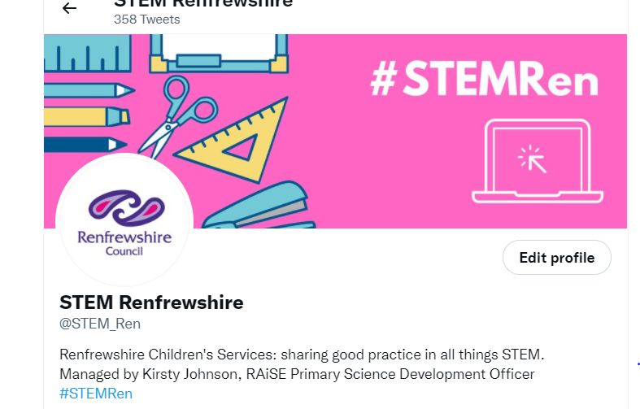
Remember to Tweet!
@STEM_Ren
Sharing good practice

