Slide 1
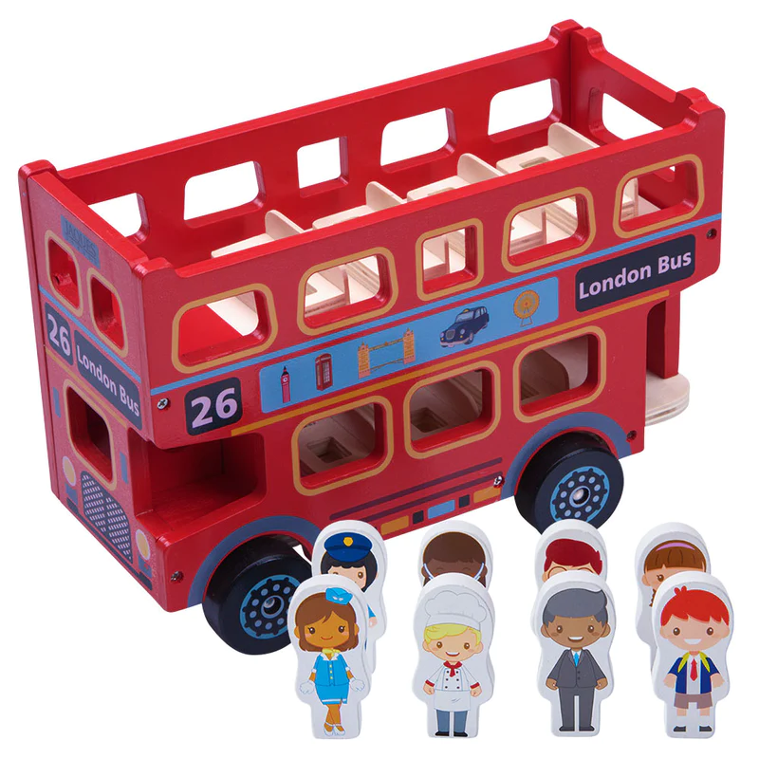
New Toy Challenge
The elves want some ideas for new toys that they can make this year and they thought the best people to ask were YOU!
Can you design a new toy that the elves can build for Santa to deliver to children across the world.
The elf elders will choose the best toy designs to make.
Draw a picture of your toy idea and label it so the elves will know how to make it.

Slide 2
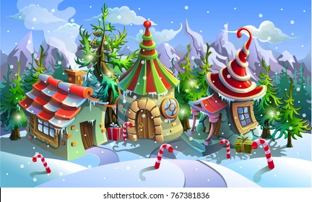
North Pole House Challenge
With the number of children round the world increasing the elves have been recruiting new toy makers and wrappers for their workshops in the North Pole.
All the new elves need somewhere to live and so they want you to design some brand new North Pole Elf houses.
Draw a picture of your house design and label the key features of it. Think about what the elves will need and how they will keep warm living in the North Pole.

Slide 3
Self Decorating Tree Challenge
A recent survey of over 1,000,000 people across Europe showed that decorating the Christmas tree is one of the least favourite Christmas activities.
A large online shop has asked you to design a Self decorating Christmas tree, or a Christmas tree decorating robot, to save people time at Christmas.
Draw a picture of your tree design and label the key features of it.
Think about how to get the lights on and the high up decorations.

Slide 4
Wrapping Machine Challenge
Everybody hates wrapping presents!* So a major UK supermarket chain wants you to design an automated Present Wrapping Machine.
The machine must be able to wrap at least 600 presents an hour, add bows and gift tags and be eco friendly with the amount of wrapping paper it uses.
*Well I do anyway!
Draw a picture of your wrapping machine and label the key features showing how it works.

Slide 5
Santa Suit Challenge
Santa has decided that his current red suit with the white fur trim is out of fashion and no longer fit for the job he has to do.
He has put out a plea for someone to design him a new, fashionable, fit for purpose, 21st Century suit for him to wear on Christmas Eve. It needs to keep him warm, allow him up and down chimneys and be able to carry all the tools he needs for his long journey.
Draw a picture of your Santa suit design and label the key features of it.
Think about how his suit can be fit for purpose and carry all the tools Santa needs.

Slide 6
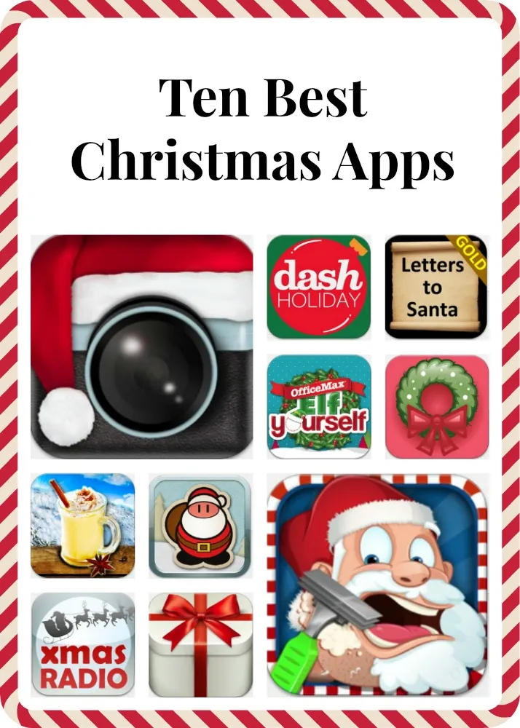
Christmas App Challenge
There are so many things that we all have to remember to do at Christmas, and in between all the jobs we want to relax and have fun.
The big mobile phone companies have decided they need a new Christmas App, or collection of Apps, that make this time of year easier for everyone.
Draw some screen shots of your Christmas App and label the key features of it.
Think about what it is going to do and how it will be useful for people getting ready for Christmas.

Slide 7
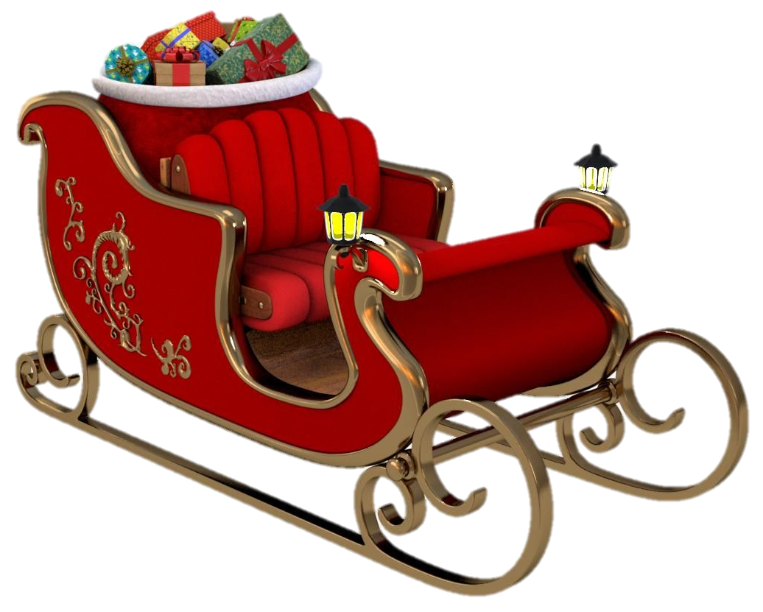
New Sleigh Challenge
Over 24 hours on Christmas Eve Santa has to fly over 50 million miles to deliver over 1 million tonnes of presents to nearly 800 million children around the world.
His reindeer have had to retire and Santa is in the market for a new hi-tech sleigh.
Your challenge is to design a new sleigh for Santa capable of flying at the edge of space, at speeds of up to 56,000 mph and holding over 1 tonne of presents!
It also needs to look good.
Produce a concept drawing and a labelled diagram of your design.

