Slide 1
Engineering Design Process
In the Primary Classroon

Slide 2
Engineering Design Process
A cycle of thinking, working, and sharing that is used by engineers, inventors, and anyone looking to solve a problem.
Engaging in collaborative dialogue and creative thinking about problems and working to solve them.
Pupils will tap into their imaginations as they design items or processes to help others.
Develops creativity, communication, collaborative skills while solving real-world problems.

Slide 3
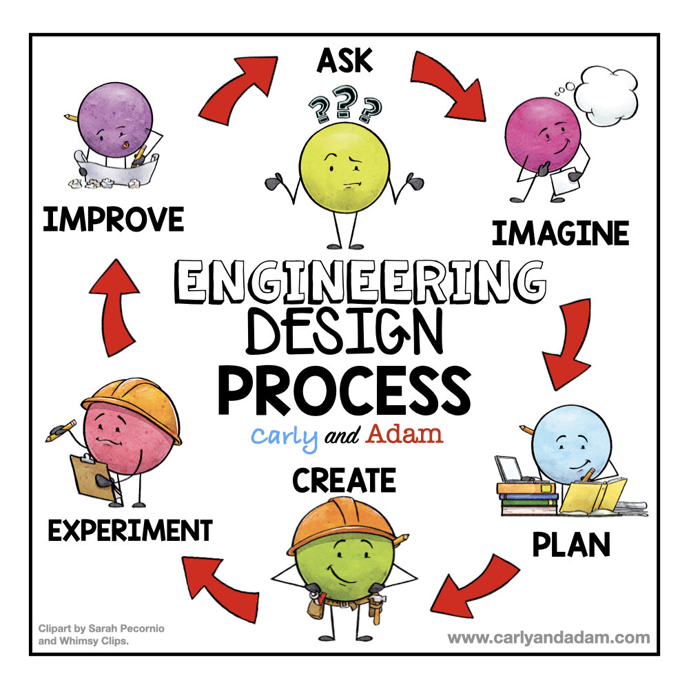
Notes:
The engineering design process, by definition, is a series of steps that engineers use to find a solution to a problem. These steps include: defining the problem, brainstorming solutions, designing and building a prototype of the solution, testing the solution, and improving it.

Slide 4
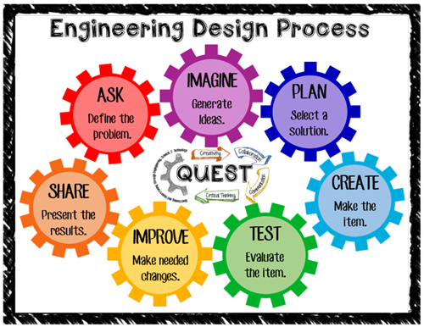
Notes:
various versions of the engineering design process exist
May define and label these parts of the process slightly differently
Most include 5-8 steps, including some degree of thinking, planning, building, testing, and sharing as a part of this cycle.
At the heart of it is the opportunity for students to engage in thinking and communication about a problem and potential solutions, then coming up with different designs to determine if that solution can work. Student engineers then build or create some object, process, or experience as a solution. The process is ongoing and may include the repeated movement back and forth between various steps.

Slide 5
Notes:
Does not always have to be applied to strictly engineering

Slide 6
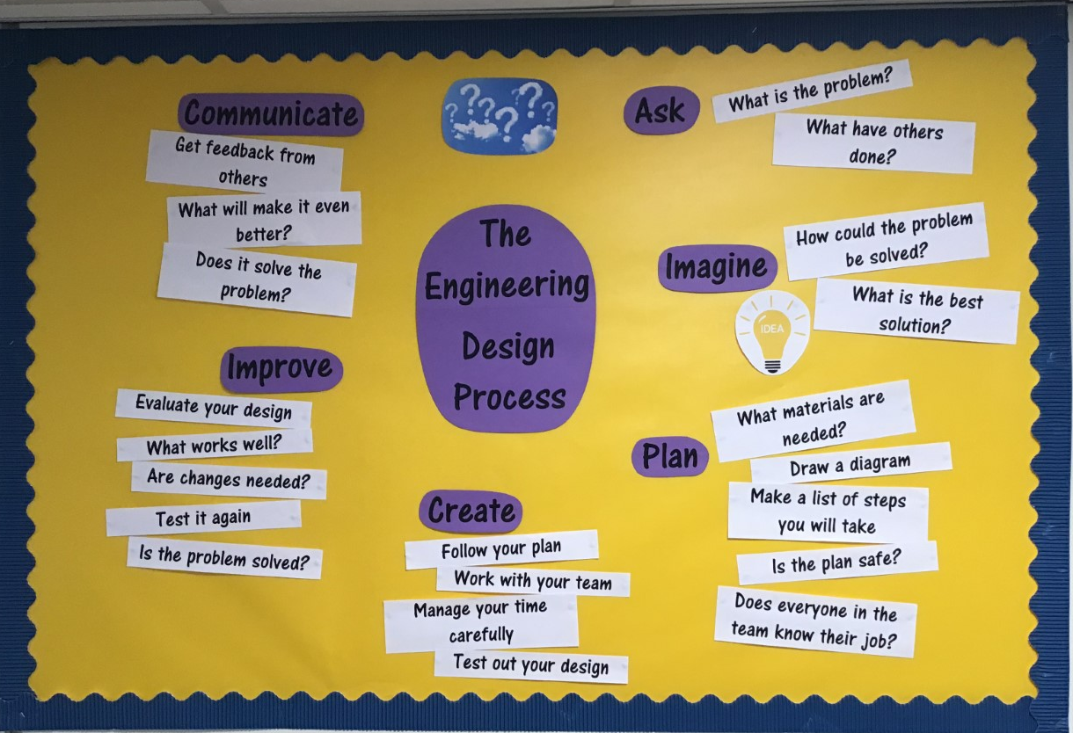

Slide 7
