Slide 1
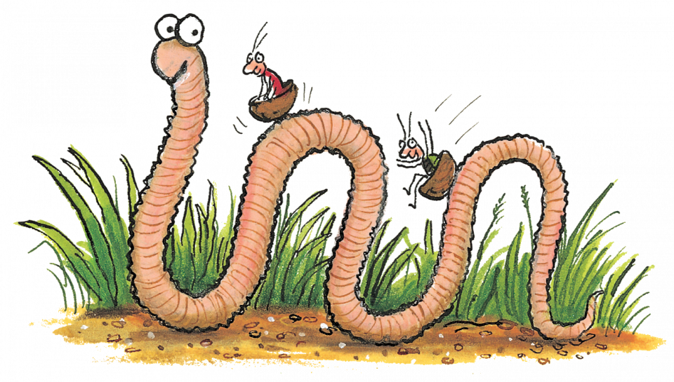
Super worm STEM Trail By Emma Brown NAC STEM Team

Slide 2
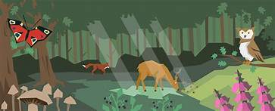
1.Habitats. Go for a walk around your school, grounds and look at places that would be good for a worm to make its home. What other habitats can you see on your walk?
Trees
Mud
Rocks
Water
Long grass
Sunny places
Habitats – provide places for animals and plants to live.
Worms and other wildlife like safe, sheltered places.

Slide 3
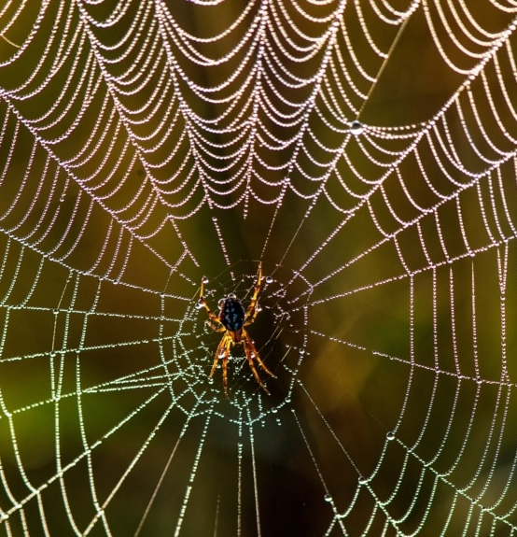
2. Wildlife
A wildlife area is an environment created naturally or man made that serves as a sustainable haven for surrounding wildlife.
Wildlife areas contain a variety of habitats that cater to native and local plants, birds, insects, mammals and so on.
Can you spot any clues about some of the animals that might have been in your wildlife area?
A Spiders web
A pond/ stream for a toad
A leaf nibbled by a caterpillar
A slimy trail left by a slug

Slide 4
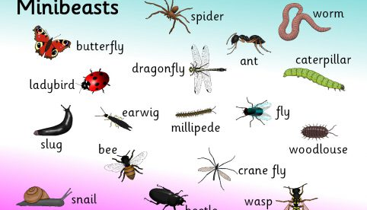
3.Super Search “Toads and beetles, bees and bugs, brother snails and sister slugs.”
Minibeasts are small creatures like worms, snails, insects and spiders. The scientific term is ‘invertebrate’.
Look under logs and stones, in trees or on the ground: remember to treat the minibeast gently and put them back where you found them.
How many different kinds of minibeasts can you find?

Slide 5
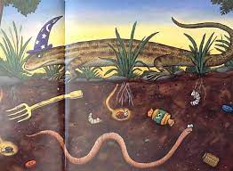
10. Digging in the soil. ”You must tunnel, writhe and coil to find me treasure in the soil.”
Get a spade and have dig.
What did you find in the soil?

Slide 6
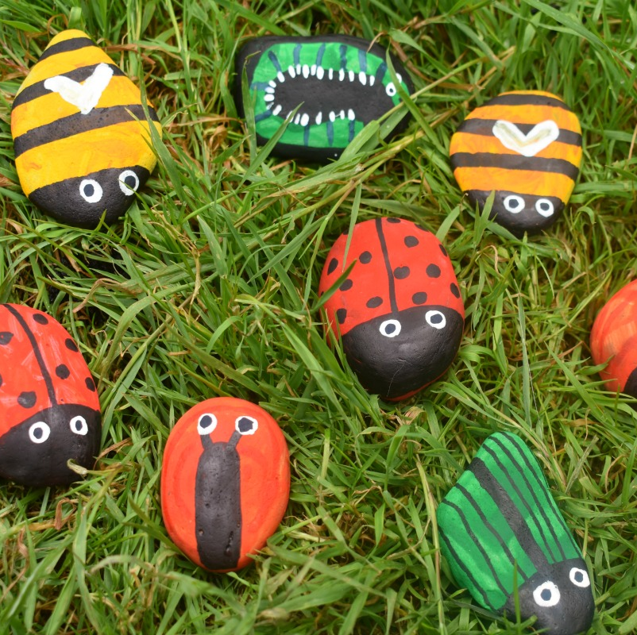
4. Minibeasts stones.
Find a stone and create your own minibeast for your garden or outdoor area.

Slide 7
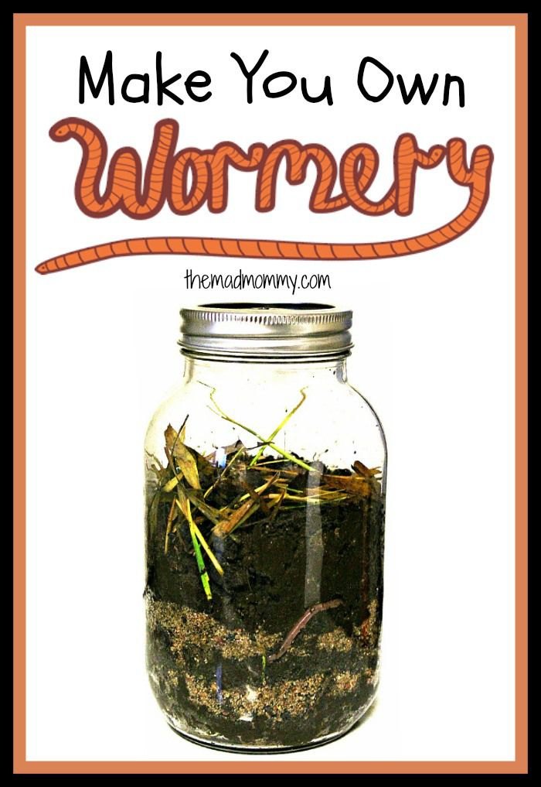
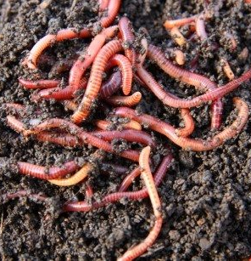
5.Food Waste
When earthworms tunnel through the ground they bring air to the soil. This allows plant roots to grow more easily. They eat almost anything that was once living and is now dead. Worms help our enviroment, they are nature’s composters.
Create your own compost jar.
Find leaves, sticks, dead flowers, grass cuttings, decaying fruit/ peelings. Put them into the jar and add soil on top.
Leave for a few weeks and what do you notice has happened?

Slide 8
6. Super Powers. Hip, Hip Hooray! For super worm”
Worms are our super heroes. They put air ways into the soil, they eat other pests , they fertilize the soil and they make compost.
Imagine you are a superhero. What would your superpowers be?

Slide 9
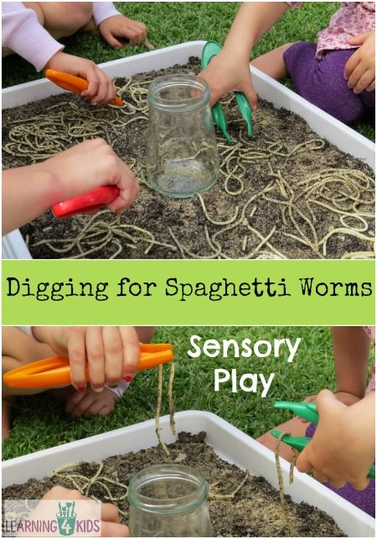
7. Digging for spaghetti worm Digging for Spaghetti Worms Sensory Play . Kids will have so much fun catching all the slippery and slimy spaghetti worms with tweezers and putting them into a jar. Either in a mud kitchen area or in large container, add soil and cooked spaghetti.

Slide 10
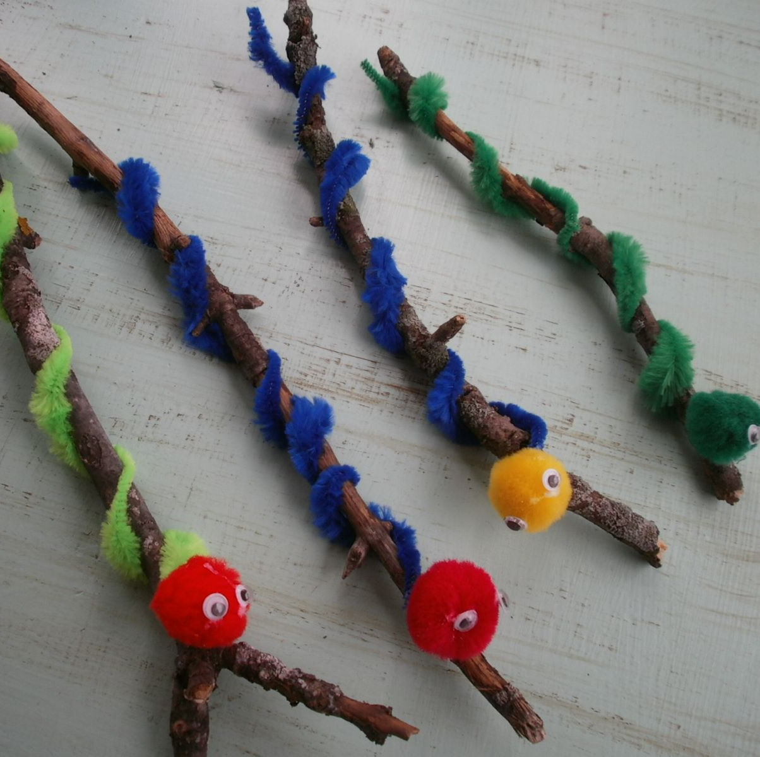
8.Stick worm craft.
Use stones, sticks, leaves to make a super worm.
Can you make a worm as long as a stick?
Can you make a worm as wide as a stone?

Slide 11
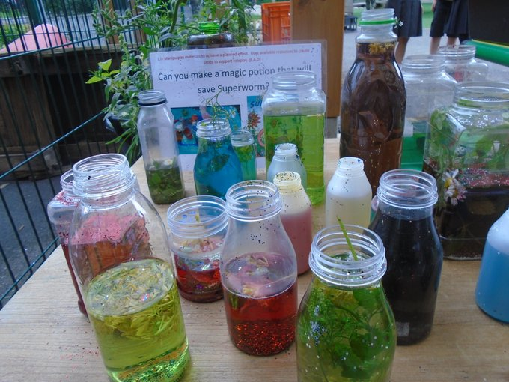
10. Potions “The wizard waves his magic flower, now, superworm you’re in my power”
Create a potion. Use a container , add some water. Put is leaves and soil etc, mix with a stick and chant your magic rhyme.
DANGER- there are lots of poisonous plants around us that can be harmful. Nettles can sting- ouch!, berries can make you very sick, mushrooms can be very harmful. Always ask an adult before touching or picking a plant or berry.

