Slide 1
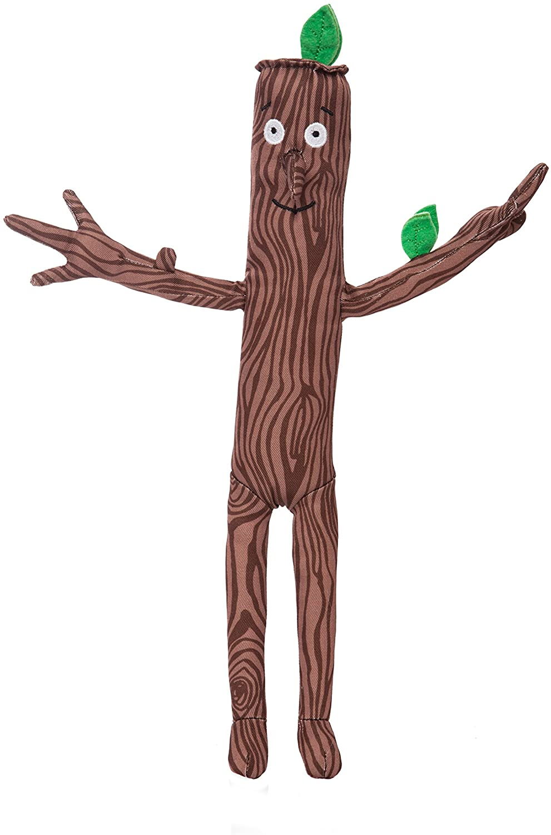
Stickman Stem Trail
By Emma Brown
NAC STEM Team

Slide 2
Trail Start
Follow the trail and join Stick Man on his adventures.

Slide 3
1. An Excellent Stick
Find a stick.
Put a stick or pine cone on the ground about 3cm in front of you. Then take turns to throw sticks as close to the target as possible.
Closest stick wins!

Slide 4
2. Water For Life
All animals need water to survive. In summer you might see butterflies drinking from the edge of small puddles. Many other animals, such as birds, frogs, fish and dragonflies make their home in ponds, streams and rivers.
Pick up sticks
Collect 15 thin sticks and put them on a pile on the ground. Can you take turns to pick up a twig without moving the others?
OR
Pooh sticks
If there is a stream or river nearby play pooh sticks!. Throw your stick in a see how fast it travels downstream.

Slide 5
3. Make a nest.
Did you know that trees provide a great home for birds. Many birds such as blue tits, sparrows and blackbirds, make their nests in branches at the top of trees, while woodpeckers nest in holes in tree trunks. Other birds make their nests on the ground!
Collect twigs, sticks from the ground and place them in a circle to make a nest. Look for leaves and feathers to make an extra comfy nest.

Slide 6
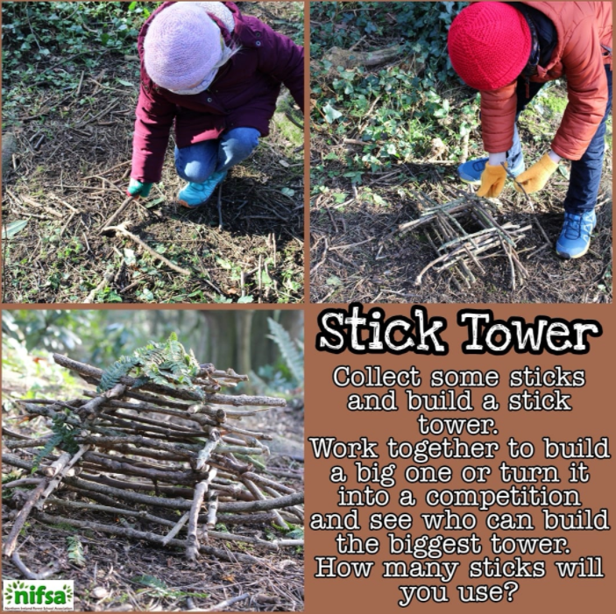
4. Build a tower.
Wood is a great building material and used to make lots of other things to. Which things are made from wood?
Attach a leaf to a stick to make a flag pole.

Slide 7
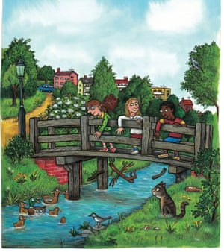
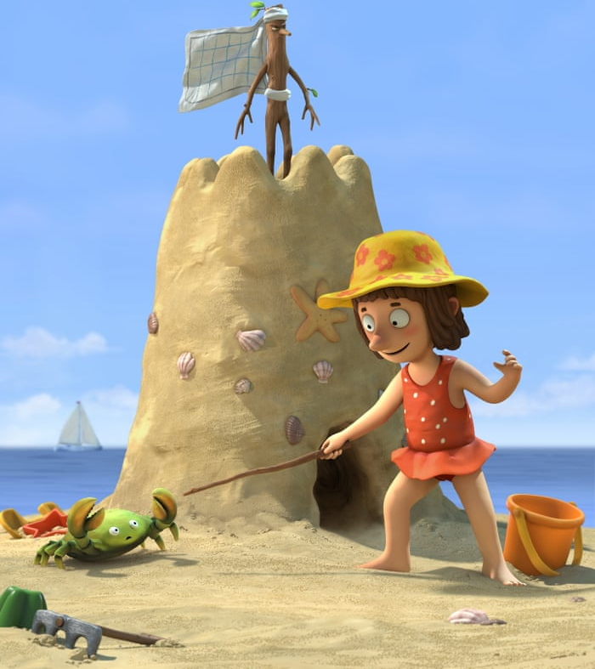
5. Fun with sticks. “I’m not a silly old flag, or a sword for a knight…or a hook for a bag”
Can you think what else a stick could be used for?

Slide 8
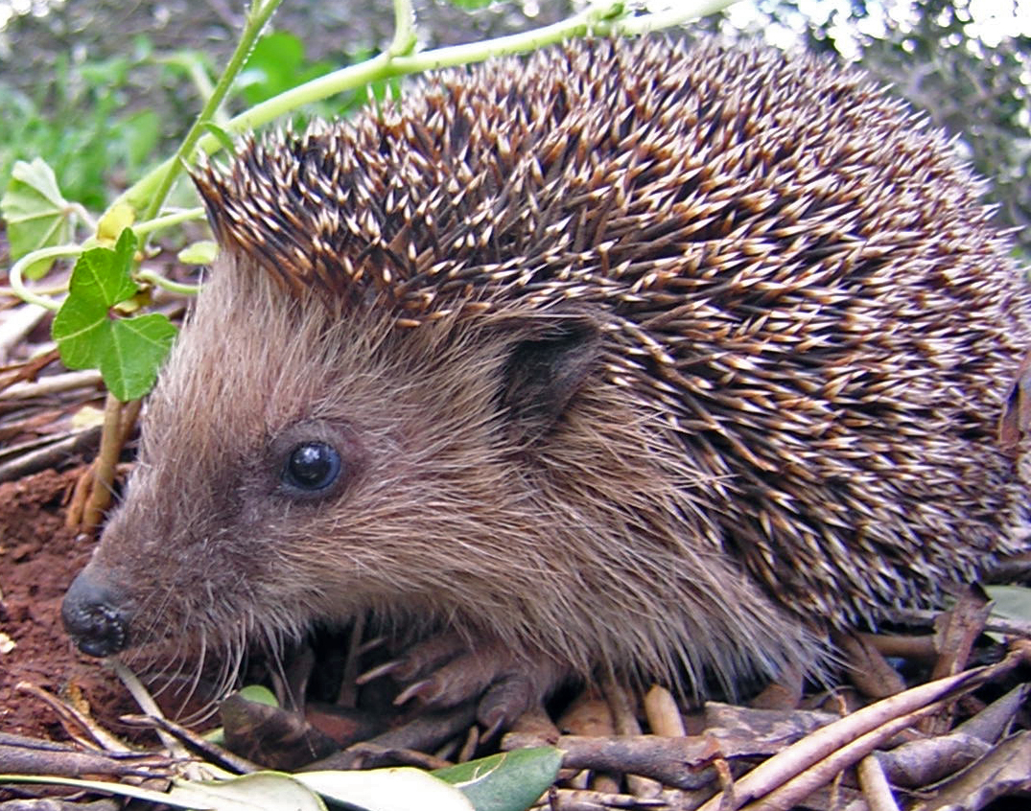
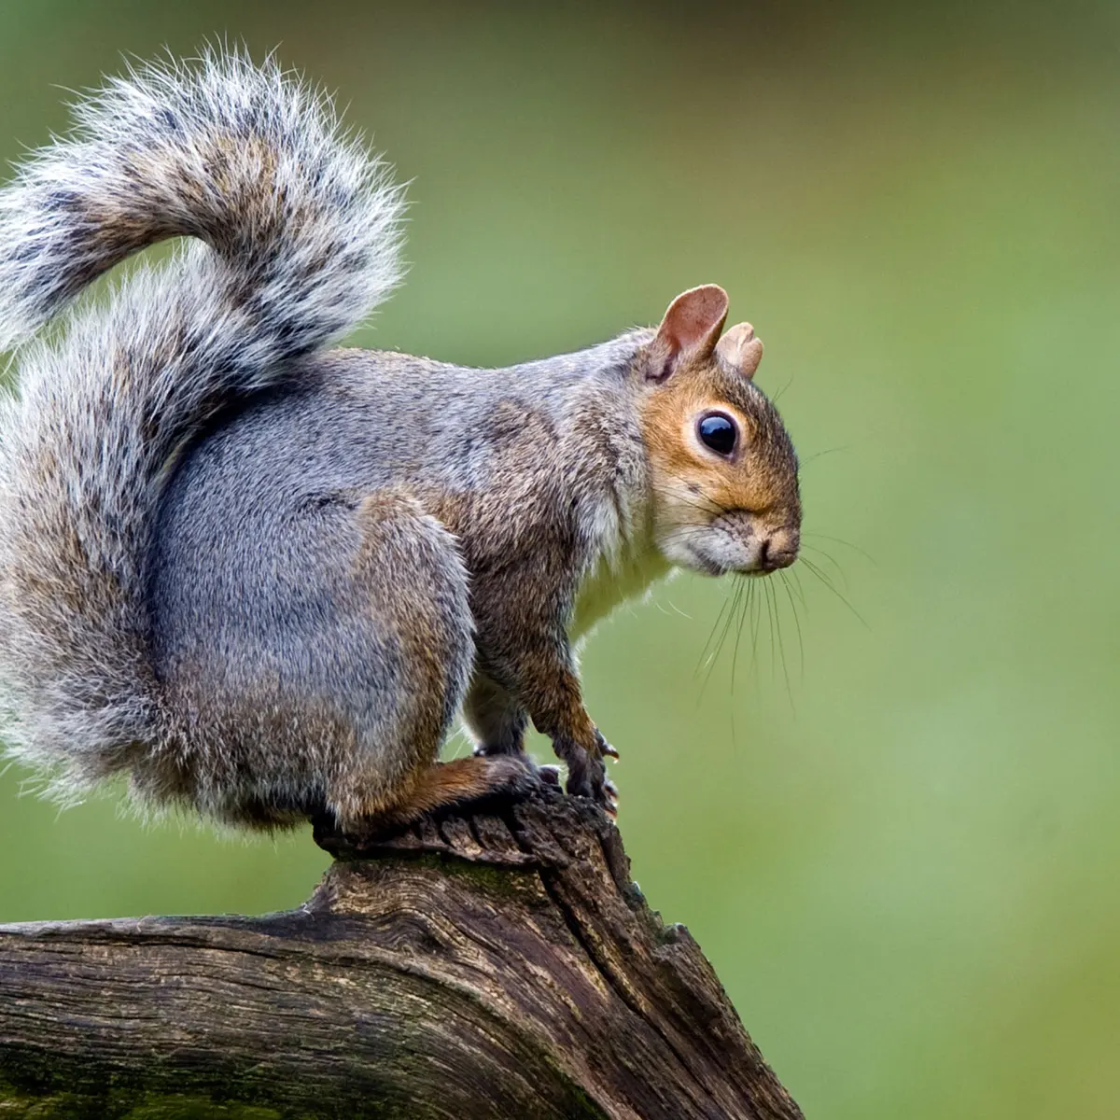
6. Animals in Winter.
Homes for wildlife. Fallen trees, branches and leaves provide excellent homes for wildlife.
What can you find? Collect some leaves of different sizes and colours. How many ways can you sort them?
In Winter, some animals hibernate. What do these animals do to stay warm and safe?

Slide 9
7. Keeping Warm.
Sticks can be used as fuel for a fire to keep warm. Can you think how else you might keep warm? What are you wearing today?
Keeping warm. Can you do 10 star jumps? Jogging on the spot etc
Are you warm yet?

Slide 10
8.Bark Rubbing
Sticks and trees can be bumpy, rough or smooth.
Close your eyes and feel the bark or stick with your hands. How does it feel? Do all trees, sticks feel the same?
Get a piece of paper and a crayon and do a bark rubbing of a tree.
Now make your own Stick Man rubbing.

Slide 11
9. Make your own Stick Man or lady. “ I’m Stick Man , I’m Stick Man, That’s Me!.

