Slide 1
Percy Park Keeper Stem Trail
Emma Brown
NAC STEM Team

Slide 2
Percy and the Lost Tools
Percy is a Park keeper. His job is to look after the park and the animals that live in it.
Percy lives in a hut and has many tools that he uses to help with his jobs around the park.
Percy has left some of his tools around the park. Can you help Percy and his animal friends find them?
*Take a wheelbarrow or bucket with you to collect the tools that Percy has forgotten.

Slide 3
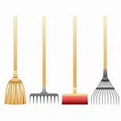
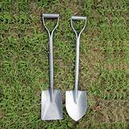
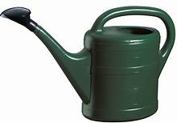
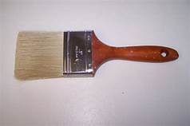
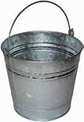
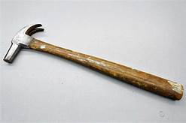
Percy’s tools
Owl finds a brush/ rake
Rabbit finds a spade/ trowel
Duck finds a watering can
Fox finds a paintbrush
Squirrel finds a bucket
Mouse finds a hammer

Slide 4
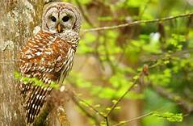
Owl’s idea
Owl has spotted one of Percy’s tools from the tree.
Percy has been using it to sweep the leaves. Can you guess what tool it is?
Have a go at sweeping up the leaves. Make a big pile to jump in.
Can you use the leaves to make leaf animal picture?
*Watch out! Hedgehog might be sleeping under the leaves.

Slide 5
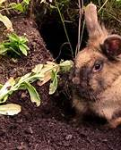
Rabbit’s Find
Rabbit has been having fun digging in the garden.
He has found a digging tool that Percy has been using whilst planting some new flowers in the park.
Can you guess what tool it is?
*Have a go at digging some holes. Maybe you can plant some seeds, bulbs or plants.

Slide 6
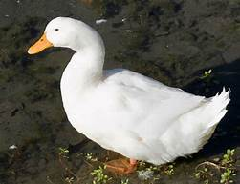
Duck’s splash.
Duck has been having fun splashing in the water.
Duck has found one of Percy’s tools. He has been using it to water the plants in the park.
Can you guess what tool it is?
*Have a go at watering some of the plants around you. Make sure you don’t give them too much water.

Slide 7
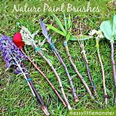
Fox’s tail
Fox has been sneaking around Percy’s Hut.
Percy has been painting the hut and has left a tool behind.
Can you guess which one of Percy’s tools fox has found?
Find a stick and attach a leaf or flower to the end with wool to create your own paintbrush.
*Read One Spring Day

Slide 8
Squirrel’s Seeds
Squirrel has been playing hide and seek with his friends. They have been hiding nuts around the park.
By the bench the squirrel’s have found an empty container that Percy uses to collect water in. Sometimes he puts seeds or bread in it to feed the birds.
Can you guess what Percy has left behind?
*Use the seed or bread in the bucket to feed the birds. Percy likes to sit on the bench at lunchtime and feed the birds. Sometimes he gives them some of his sandwich.

Slide 9
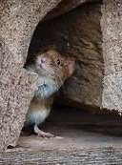
Mouse holes
Mouse has found some holes in the fence.
There are pieces of wood and screws on the floor.
Percy has been trying to mend the holes and has left his tool here. Well spotted mouse!
Can you guess what tool it is?
*Using the loose parts and tools can you build a tool box for Percy so that he doesn’t forget his tools again?

Slide 10
Time to relax
You have all worked hard and helped Percy and his animal friends find all the tools he left in the park.
Now it is time for you all to have a rest and enjoy Percy’s favourite resting task- Cloud Watching.
Lie back and look at the clouds. What do they look like? Big and fluffy, thin and wispy? Can you see any shapes appear?
*At nighttime some of the animals sneak back out to the park to gaze at the stars. Have a look out of your window at home and see if you can see any stars tonight.

Slide 11
Percy The Park Keeper Rationale

