Slide 1
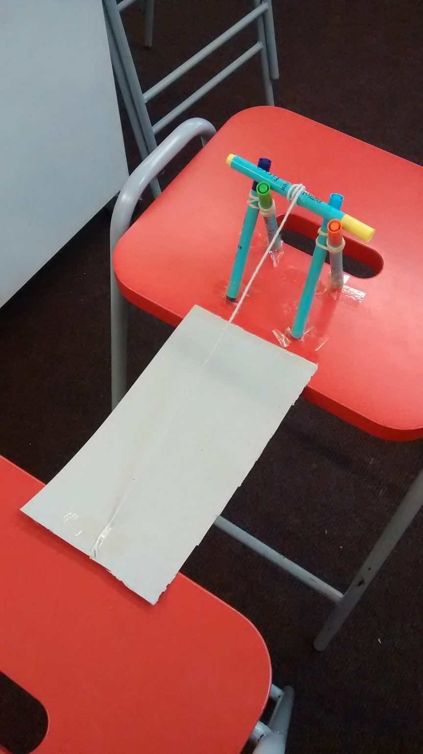
Teacher notes
You will probably need to demonstrate how to connect (lash) pens together using elastic bands in a figure of 8 to create the structure, and how to balance a pen on top to wind the string up and down.
The structure will need to be taped firmly on to the top of the stool.
The engineering and problem solving challenge here comes from observing that the pen holding the string keeps falling off and coming up with ways to secure it, as well as engineering a more sophisticated winding mechanism e.g. a wheel or handle on one or both ends of the pen. It is not just building the design in the photo.
Some groups also included ways to secure the string to hold the drawbridge up, or used two strings like the two chains in the PowerPoint drawbridge photo.
Card – half the top of a pizza box works well

Slide 2
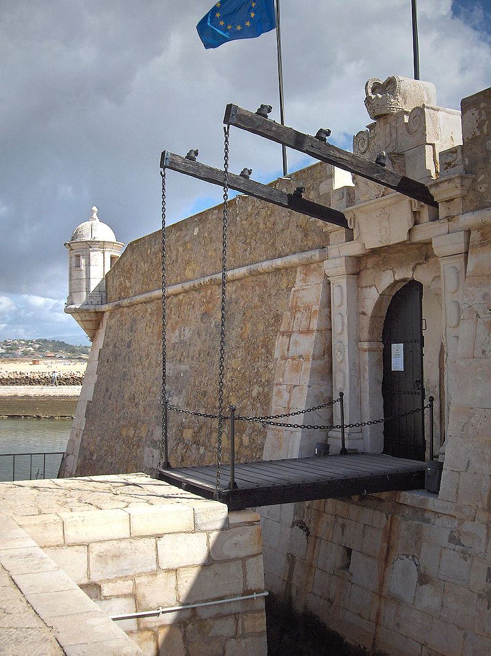
STEM Challenge Project
Drawbridge
challenge
Winding mechanisms part 1

Slide 3
Learning Intentions
To build up our STEM skills:
Teamwork
Communication
Creativity
Critical Thinking
Resilience
To use the engineering design process to solve a problem

Slide 4
What are your success criteria for this project?
I would like to get better at
teamwork
communication
creativity
critical thinking
resilience
How can you get better at this? Write down some strategies for yourself.
At the end you will decide if you have been successful.

Slide 5
Drawbridge challenge
A drawbridge is a type of moveable bridge often used at the entrance to castles.
The castle was surrounded by a moat and the drawbridge could be raised and lowered.
You are a drawbridge engineer who has been asked to design a drawbridge for a castle.

Slide 6
Drawbridge challenge
What are the problems with this task?
What can you predict being difficult?
Imagine how you could solve this problem.

Slide 7
Drawbridge challenge
Design and build a drawbridge between 2 stools.
You must be able to raise and lower the drawbridge using a winding mechanism.
The bridge must be at least 20cm long.
You will be given a choice of materials:
Card – 1 piece
Felt-tip pens – max 5
Elastic bands – max 2
Lollypop sticks – max 6
Paperclips – max 4
String – 2 pieces
Sellotape
Test your drawbridge and try to improve it
Extra challenge – how much weight can it hold?

Slide 8
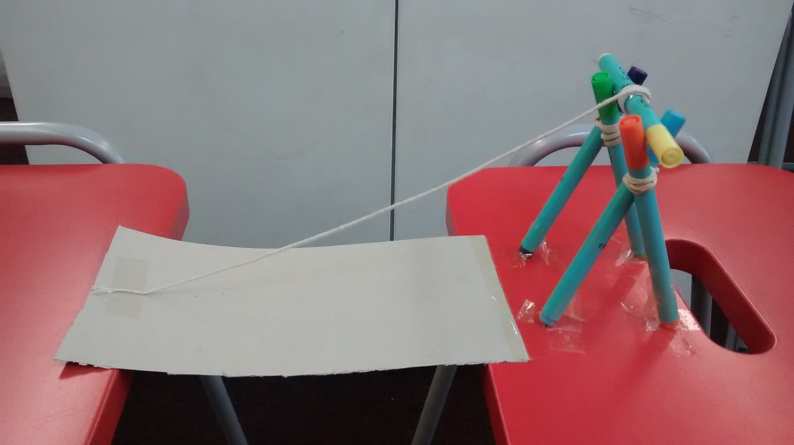
Basic drawbridge

Slide 9
What can you learn from others?
Learning loop – look at other people’s work.
How did other groups tackle the STEM challenge?
Which ideas did you see that were successful?
What did you see that hadn’t worked, or that you wouldn’t use?

Slide 10
Evaluation
Discuss how your team approached the STEM challenge today
What did you learn today?
Which STEM skills did you develop?
How could you improve your design?
Can you think of another similar STEM challenge you could set yourself to try at home?

Slide 11
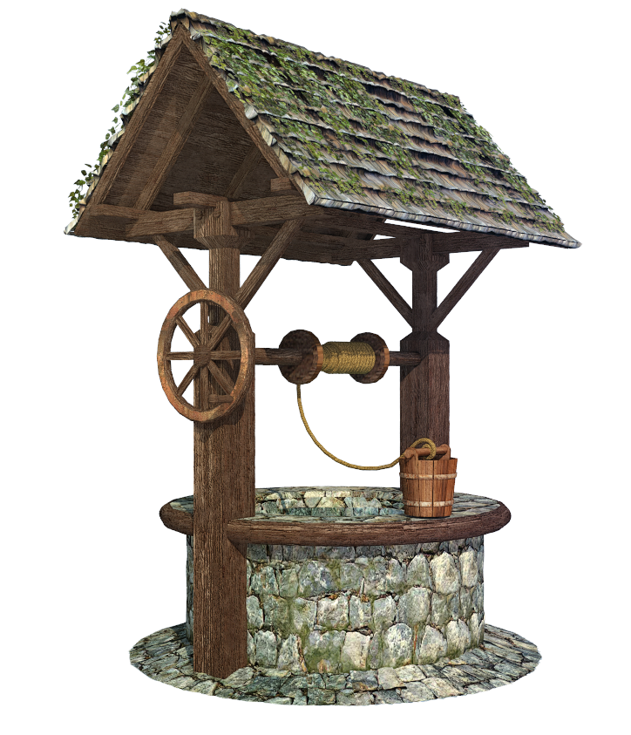
STEM Challenge Project
Build a well
challenge
Winding mechanisms part 2

Slide 12
Learning Intentions
To build up our STEM skills:
Teamwork
Communication
Creativity
Critical Thinking
Resilience
To use the engineering design process to solve a problem

Slide 13
What did we learn last lesson?
How did other groups tackle the STEM challenge?
Which ideas did you see that were successful?
What did you see that hadn’t worked, or that you wouldn’t use?

Slide 14
Well
http://no-ads-youtube.com/video/wildfilmsindia/villagers-collecting-water-from-bore-well-using-a-pulley-in-uttar-pradesh?v=HDzbKfVQKa4 1 min

Slide 15
Build a well challenge
Design and build a bucket to collect water from a well.
You must be able to raise and lower the bucket using a winding mechanism.
The winding mechanism will sit on the edge of a stool and you will lower the bucket down, collect water from a jug, and raise the bucket up again.
You will be given a choice of materials:
Felt-tip pens – max 5
Elastic bands – max 2
String – 1 long piece
Foil – 1 piece
Straws – max 4
Lollypop sticks – max 6
Paperclips – max 4
Card scraps – max 1
Sellotape
Jug of water
Test your design and try to improve it

Slide 16
Winding mechanism
You will need to use a similar winding mechanism as you used for your drawbridge.
What went wrong with the basic winding mechanism?
How will you improve the winding mechanism and its structure?
How will you adapt your design to create a well?

Slide 17
What can you learn from others?
Learning loop – look at other people’s work.
How did other groups tackle the STEM challenge?
Which ideas did you see that were successful?
What did you see that hadn’t worked, or that you wouldn’t use?

Slide 18
Evaluation
Discuss how your team approached the STEM challenge today
What did you learn today?
Which STEM skills did you develop?
How could you improve your design?
Can you think of another similar STEM challenge you could set yourself to try at home?

Slide 19
Self-assessment at end of project
We have been developing our STEM skills by doing STEM challenges:
Collaboration
Communication
Critical thinking
Creativity
Resilience
Use a felt-tip pen to update your previous self-assessment sheet.
Tick the boxes to show how you feel about each STEM skill.
Circle the STEM skills you feel you have developed during these STEM challenges.

