Slide 1
Teacher notes
These are VERY simple pulleys!
You could extend this by investigating more complicated pulleys using e.g. cotton reels.
The first challenge could be extended by building a strong structure to support the pulley instead of a beam. (However I was surprised how long this seemingly simple challenge took!)
The lift challenge could be self-contained in a cereal box etc.

Slide 2
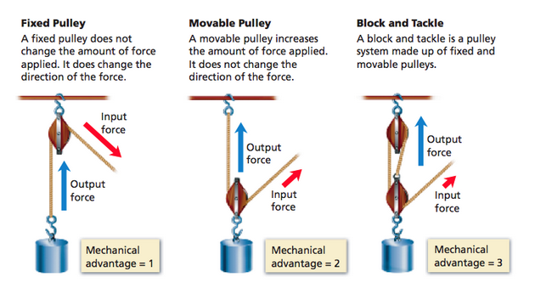
Teacher notes

Slide 3
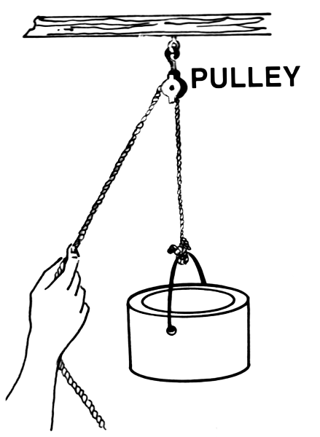
STEM Challenge Project
Lifting weights
challenge

Slide 4
Learning Intentions
To build up our STEM skills such as teamwork and communication
To use the engineering design process to solve a problem

Slide 5
How will you be successful today?
What does successful teamwork look like?
What can you do to be a good communicator?

Slide 6
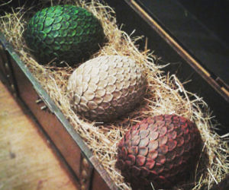
Lifting challenge
You are a dragon researcher investigating a new dragon nesting site at the top of a cliff, with 3 abandoned dragon eggs.
You need to lower the eggs down and bring research items up carefully.
You have been advised to build a lifting machine with a pulley to make this easier.
If the eggs or research equipment break or fall out you will not be able to complete your research.

Slide 7
What is a pulley?
http://no-ads-youtube.com/video/scishow-kids/need-a-lift-try-a-pulley?v=Nj4J7QNeBNk Very simple pulley for lift, crane, flag 3m30

Slide 8
Lifting Challenge
Build a strong beam at least 30cm wide between 2 stools.
Engineer a lifting machine using a pulley which can safely carry the items up and down.
You will be given a choice of materials:
Newspaper – max 4 sheets
A4 paper – max 4 sheets
Lollypop sticks – max 4
String – 1m long piece
Paperclips – max 2
Pipecleaner – max 1
3 marbles in a pot (dragon eggs) – you cannot use the pot
Beanbag (research equipment)
Sellotape
Test your lifting machine and try to improve it

Slide 9
Lifting challenge
What are the problems with this task?
What can you predict being difficult?
Imagine how you could solve this problem.

Slide 10
What can you learn from others?
Learning loop – look at other people’s work.
How did other groups tackle the STEM challenge?
Which ideas did you see that were successful?
What did you see that hadn’t worked, or that you wouldn’t use?

Slide 11
STEM Challenge Project
Lifting weights
challenge
Part 2

Slide 12
Learning Intentions
To build up our STEM skills such as teamwork and communication
To use the engineering design process to solve a problem

Slide 13
How will you be successful today?
What does successful teamwork look like?
What can you do to be a good communicator?

Slide 14
Homemade pulley
http://no-ads-youtube.com/video/shae-haylen/video-how-to-make-a-pulley?v=rc0cpp3i8GA watch up to 1m40

Slide 15
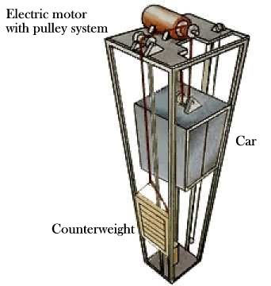
Lift Challenge
Design and build a lift which can safely carry 3 dragon eggs up and down
This needs to include a pulley
You will be given a choice of materials:
Milk bottle lid with hole in centre x 1
Skewer x 1
A4 card – max 1
Circles to draw around to make pulley
Long thin card boxes – max 1
Paperclips – max 2
Lollypop sticks – max 5
String – 1 long piece (your current string should do)
Sellotape
Test your lift and try to improve it

Slide 16
What can you learn from others?
Learning loop – look at other people’s work.
How did other groups tackle the STEM challenge?
Which ideas did you see that were successful?
What did you see that hadn’t worked, or that you wouldn’t use?

Slide 17
Evaluation
Discuss how your team approached the STEM challenge today
What did you learn today?
Which STEM skills did you develop?
How could you improve your design?
Can you think of another similar STEM challenge you could set yourself to try at home?

Slide 18
Self-assessment at end of project
We have been developing our STEM skills by doing STEM challenges:
Teamwork
Communication
How do you think you have developed your STEM skills?
Which skills do you still need to improve?

