Slide 1
Teaching notes
This activity is good for discussing 2D and 3D shapes – cone, cylinder, circular base
In the first challenge children will find that it is hard to construct thin tent poles from paper! They only need to make a few to construct the teepee shape – even a pyramid frame from 3 poles would be fine. You could discuss the minimum number of poles required for this task.
Including a base really helps put the structure together.
NB a wigwam is not the same shape as a teepee – common misconception

Slide 2
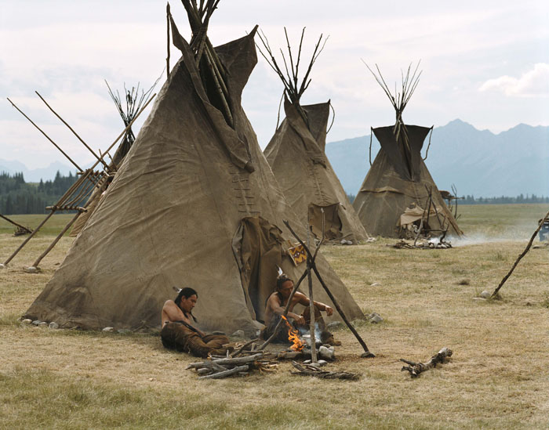
STEM Challenge Project
Teepee
challenge

Slide 3
Learning Intentions
To build up our STEM skills such as teamwork and communication
To use the engineering design process to solve a problem

Slide 4
How will you be successful today?
What does successful teamwork look like?
What can you do to be a good communicator?

Slide 5
Teepee challenge
A teepee is a special kind of tent made from wooden poles in a cone shape, covered in material (originally animal skins). They were used by some Native American tribes.
Your job is to design and build a teepee with flaps for a door.
What would a good teepee look like?
What shapes can you see?

Slide 6
Teepee challenge
What are the problems with this task?
What can you predict being difficult?
Imagine how you could solve this problem.

Slide 7
Teepee Challenge
Design and build a teepee.
You must make flaps for a door.
You must make sure there are no other gaps in the material.
You will be given a choice of materials:
Newspaper – max 2
A4 paper – max 4
Tissue paper and crepe paper scraps – max 1
Elastic band – max 1
Sellotape
Evaluate your teepee and try to improve it.

Slide 8
What can you learn from others?
Learning loop – look at other people’s work.
How did other groups tackle the STEM challenge?
Which ideas did you see that were successful?
What did you see that hadn’t worked, or that you wouldn’t use?

Slide 9
STEM Challenge Project
Teepee
challenge
Part 2

Slide 10
Learning Intentions
To build up our STEM skills such as teamwork and communication
To use the engineering design process to solve a problem

Slide 11
How will you be successful today?
What does successful teamwork look like?
What can you do to be a good communicator?

Slide 12
What did we learn last lesson?
How did other groups tackle the STEM challenge?
Which ideas did you see that were successful?
What did you see that hadn’t worked, or that you wouldn’t use?

Slide 13
Teepee Challenge
Design and build an improved, waterproof teepee.
You must make flaps for a door.
You must make sure there are no other gaps in the material.
You will be given a choice of materials:
Art straws – max 6
Plastic straws – max 6
A4 card – max 2
Plastic nappy bag – max 3
Elastic band – max 1
Sellotape
Evaluate your teepee and try to improve it.

Slide 14
What can you learn from others?
Learning loop – look at other people’s work.
How did other groups tackle the STEM challenge?
Which ideas did you see that were successful?
What did you see that hadn’t worked, or that you wouldn’t use?

Slide 15
Evaluation
Discuss how your team approached the STEM challenge today
What did you learn today?
Which STEM skills did you develop?
How could you improve your design?
Can you think of another similar STEM challenge you could set yourself to try at home?

Slide 16
Self-assessment at end of project
We have been developing our STEM skills by doing STEM challenges:
Teamwork
Communication
How do you think you have developed your STEM skills?
Which skills do you still need to improve?

