Slide 1
Teaching notes
I’ve seen this activity done with marshmallow astronauts. Personally I prefer to use a small wooden block about 3x3x3cm to represent the astronaut. In fact you can use anything that will fall out and tumble away when you drop a plain disposable cup from knee-height with the astronaut inside.

Slide 2
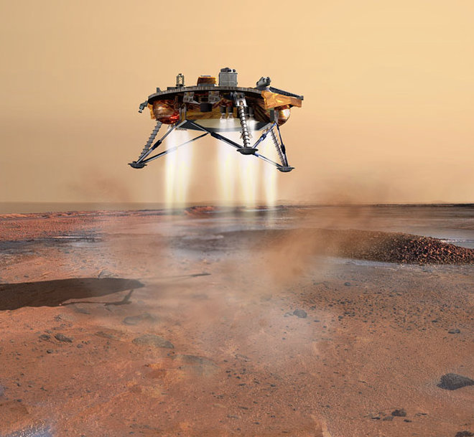
STEM Challenge Project
Mars lander
challenge

Slide 3
Learning Intentions
To build up our STEM skills:
Teamwork
Communication
Creativity
Critical Thinking
Resilience
To use the engineering design process to solve a problem

Slide 4
What are your success criteria for this project?
I would like to get better at
teamwork
communication
creativity
critical thinking
resilience
How can you get better at this? Write down some strategies for yourself.
At the end you will decide if you have been successful.

Slide 5
Mars lander clips
http://no-ads-youtube.com/video/heli/how-to-get-to-mars-very-cool-hd?v=XRCIzZHpFtY 6m32 – first level. This shows Spirit, landed 2004
https://www.youtube.com/watch?time_continue=13&v=Ki_Af_o9Q9s 5m07 – second level. This shows Curiosity, landed 2012

Slide 6
Mars lander challenge
You are a space engineer working on getting astronauts safely to Mars.
The spacecraft engineers have already built the main part of the spacecraft.
You have been given the task of making sure that the spacecraft lands safely on Mars. You are only allowed to attach things to the outside of the spacecraft.
You must make sure that the astronaut is safe.

Slide 7
Mars lander challenge
What are the problems with this task?
What can you predict being difficult?
Imagine how you could solve this problem.

Slide 8
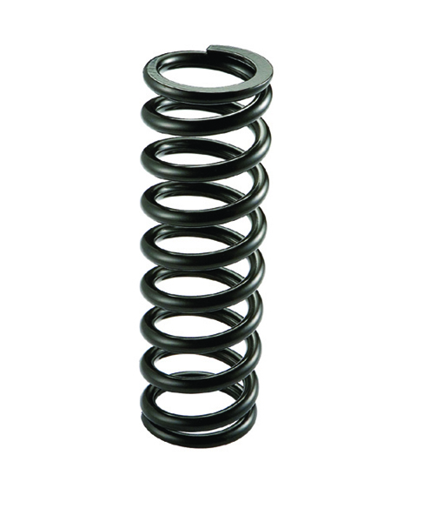
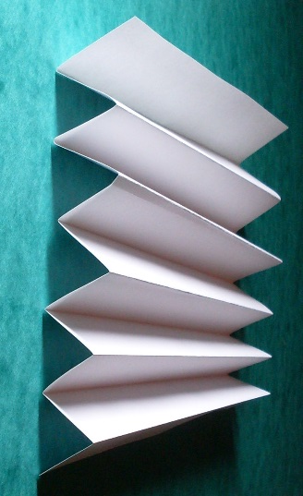
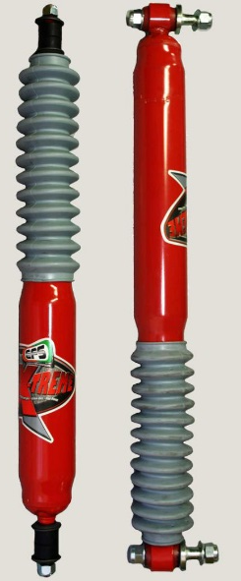
Shock absorbers
Shock absorbers reduce some of the forces felt by the astronaut when the spacecraft lands
Spring
Concertina – we can make one out of card
Cushion – made from a soft, squashable material

Slide 9
STEM Challenge
Design and build a Mars lander which can land safely using shock absorbers.
You must make sure the cube does not fall out or bounce out.
You are not allowed to stick the cube down or strap it in, or cover the cup.
You are only allowed to stick things to the outside of the spacecraft, at the bottom.
You will be given a choice of materials:
Plastic cup with wooden cube
A6 card – max 4
Straws – max 4
Cotton wool – max 1 piece
Sellotape
Test your Mars lander by dropping it from different heights and try to improve it. Start at knee height. Only drop on to the floor.

Slide 10
What can you learn from others?
Learning loop – look at other people’s work.
How did other groups tackle the STEM challenge?
Which ideas did you see that were successful?
What did you see that hadn’t worked, or that you wouldn’t use?

Slide 11
STEM Challenge Project
Mars lander
challenge
Part 2

Slide 12
Learning Intentions
To build up our STEM skills:
Teamwork
Communication
Creativity
Critical Thinking
Resilience
To use the engineering design process to solve a problem

Slide 13
What did we learn last lesson?
How did other groups tackle the STEM challenge?
Which ideas did you see that were successful?
What did you see that hadn’t worked, or that you wouldn’t use?

Slide 14
STEM Challenge
Design and build a Mars lander which can land safely using shock absorbers and a parachute.
You must make sure the cube does not fall out or bounce out.
You are not allowed to stick the cube down or strap it in, or cover the cup.
You are only allowed to stick things to the outside of the spacecraft
You will be given a choice of materials:
Plastic cup with wooden cube
A6 card – max 4
Straws – max 4
Cotton wool – max 1 piece
Bubble wrap – max 1 piece
Plastic bag – max 1
Bin bag pieces – max 1
String
Sellotape
Test your Mars lander by dropping it from different heights and try to improve it. Start at knee height. Only drop on to the floor.

Slide 15
What can you learn from others?
Learning loop – look at other people’s work.
How did other groups tackle the STEM challenge?
Which ideas did you see that were successful?
What did you see that hadn’t worked, or that you wouldn’t use?

Slide 16
Evaluation
Discuss how your team approached the STEM challenge today
What did you learn today?
Which STEM skills did you develop?
How could you improve your design?
Can you think of another similar STEM challenge you could set yourself to try at home?

