Slide 1
Teaching notes
I’ve seen this activity done with marshmallow astronauts. Personally I prefer to use a small wooden block about 3x3x3cm to represent the astronaut. In fact you can use anything that will fall out and tumble away when you drop a plain disposable cup from knee-height with the astronaut inside.

Slide 2
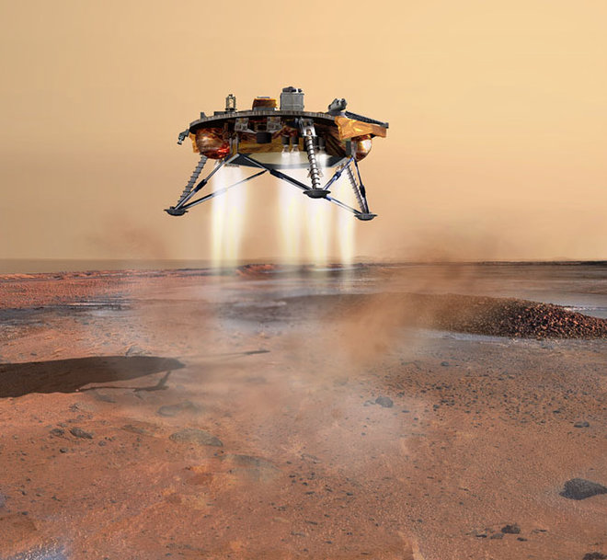
STEM Challenge Project
Mars lander
challenge

Slide 3
Learning Intentions
To build up our STEM skills such as teamwork and communication
To use the engineering design process to solve a problem

Slide 4
How will you be successful today?
What does successful teamwork look like?
What can you do to be a good communicator?

Slide 5
Mars lander challenge
You are a space engineer working on getting astronauts safely to Mars.
The spacecraft engineers have already built the main part of the spacecraft.
You have been given the task of making sure that the spacecraft lands safely on Mars. You are only allowed to attach things to the outside of the spacecraft.
You must make sure that the astronaut is safe.

Slide 6
Mars lander challenge
What are the problems with this task?
What can you predict being difficult?
Imagine how you could solve each problem.

Slide 7
STEM Challenge
Design and build a Mars lander which can land safely.
You must make sure the cube does not fall out or bounce out.
You are not allowed to stick the cube down or strap it in, or cover the cup.
You are only allowed to stick things to the outside of the spacecraft, at the bottom.
You will be given a choice of materials:
Plastic cup with wooden cube
A4 paper – max 3
Straws – max 5
Card scraps – max 2
Sellotape
Test your Mars lander by dropping it from different heights and try to improve it. Start at knee height. Only drop on to the floor.

Slide 8
What can you learn from others?
Learning loop – look at other people’s work.
How did other groups tackle the STEM challenge?
Which ideas did you see that were successful?
What did you see that hadn’t worked, or that you wouldn’t use?

Slide 9
STEM Challenge Project
Mars lander
challenge
Part 2

Slide 10
Learning Intentions
To build up our STEM skills such as teamwork and communication
To use the engineering design process to solve a problem

Slide 11
How will you be successful today?
What does successful teamwork look like?
What can you do to be a good communicator?

Slide 12
What did we learn last lesson?
How did other groups tackle the STEM challenge?
Which ideas did you see that were successful?
What did you see that hadn’t worked, or that you wouldn’t use?

Slide 13
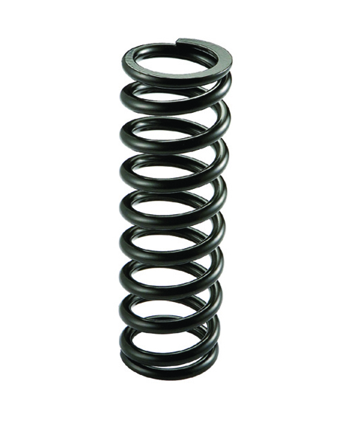
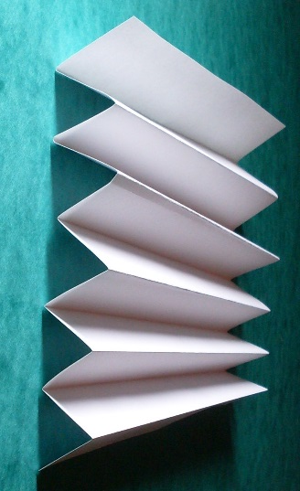
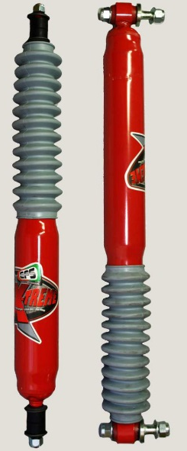
Shock absorbers
Shock absorbers reduce some of the forces felt by the astronaut when the spacecraft lands
Spring
Concertina – we can make one out of card
Cushion – made from a soft, squashable material

Slide 14
STEM Challenge
Design and build a Mars lander which can land safely using shock absorbers.
You must make sure the cube does not fall out or bounce out.
You are not allowed to stick the cube down or strap it in, or cover the cup.
You are only allowed to stick things to the outside of the spacecraft, at the bottom.
You will be given a choice of materials:
Plastic cup with wooden cube
A6 card – max 4
Straws – max 4
Cotton wool – max 1 piece
Sellotape
Test your Mars lander by dropping it from different heights and try to improve it. Start at knee height. Only drop on to the floor.

Slide 15
Evaluation
Discuss how your team approached the STEM challenge today
What did you learn today?
Which STEM skills did you develop?
How could you improve your design?
Can you think of another similar STEM challenge you could set yourself to try at home?

Slide 16
Mars lander clips
http://no-ads-youtube.com/video/heli/how-to-get-to-mars-very-cool-hd?v=XRCIzZHpFtY 6m32 – first level. This shows Spirit, landed 2004
https://www.youtube.com/watch?time_continue=13&v=Ki_Af_o9Q9s 5m07 – second level. This shows Curiosity, landed 2012
https://www.nasa.gov/pdf/418011main_OTM_Touchdown.pdf - original STEM activity material

