Slide 1
Teaching notes
There are 3 parts to this project.
For projects 2 and 3, soft foam balls about tennis ball size work well.
This is a good opportunity to learn about wide bases, using 3-D shapes in design, spires, pillars...

Slide 2
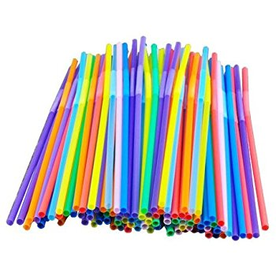
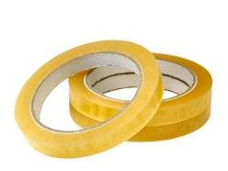
STEM Challenge Project
Tall towers
Part 1

Slide 3
Learning Intentions
To build up our STEM skills such as teamwork and communication
To use the engineering design process to solve a problem

Slide 4
How will you be successful today?
What does successful teamwork look like?
What can you do to be a good communicator?

Slide 5
STEM challenge
To build the tallest structure you can
You can only use
3 straws
3 sheets of paper
Sellotape
Your structure must not be sellotaped to the table
Consider how to make your structure strong and stable – which 3-D shapes could you use?
Work as a team!

Slide 6
What can you learn from others?
Learning loop – look at other people’s work.
How did other groups tackle the STEM challenge?
Which ideas did you see that were successful?
What did you see that hadn’t worked, or that you wouldn’t use?

Slide 7
STEM Challenge Project
Supporting a
weight
Part 2

Slide 8
Learning Intentions
To build up our STEM skills such as teamwork and communication
To use the engineering design process to solve a problem

Slide 9
How will you be successful today?
What does successful teamwork look like?
What can you do to be a good communicator?

Slide 10
What did we learn last lesson?
How did other groups tackle the STEM challenge?
Which ideas did you see that were successful?
What did you see that hadn’t worked, or that you wouldn’t use?

Slide 11
STEM challenge
To build the tallest structure you can which will support a ball
You can only use
3 straws
4 sheets of paper
Sellotape
Your structure must not be sellotaped to the table and you cannot tape the ball on
Consider how to make your structure strong and stable – which 3-D shapes could you use?
Measure up to the top of the ball

Slide 12
What can you learn from others?
Learning loop – look at other people’s work.
How did other groups tackle the STEM challenge?
Which ideas did you see that were successful?
What did you see that hadn’t worked, or that you wouldn’t use?

Slide 13
Evaluation
Discuss how your team approached the STEM challenge today
What did you learn today?
Which STEM skills did you develop?
How could you improve your design?
Can you think of another similar STEM challenge you could set yourself to try at home?

Slide 14
STEM Challenge Project
Supporting a
weight
Part 3

Slide 15
Learning Intentions
To build up our STEM skills such as teamwork and communication
To use the engineering design process to solve a problem

Slide 16
How will you be successful today?
What does successful teamwork look like?
What can you do to be a good communicator?

Slide 17
What did we learn last lesson?
How did other groups tackle the STEM challenge?
Which ideas did you see that were successful?
What did you see that hadn’t worked, or that you wouldn’t use?

Slide 18
STEM challenge
Design and create a structure that can hold a ball on top of your head
You can use
3 pieces of A4 paper
2 pieces of A5 card
3 straws
Sellotape
Someone in your team must be able to wear the design
The ball must be able to be lifted in and out

Slide 19
What can you learn from others?
Learning loop – look at other people’s work.
How did other groups tackle the STEM challenge?
Which ideas did you see that were successful?
What did you see that hadn’t worked, or that you wouldn’t use?

Slide 20
Evaluation
Discuss how your team approached the STEM challenge today
What did you learn today?
Which STEM skills did you develop?
How could you improve your design?
Can you think of another similar STEM challenge you could set yourself to try at home?

