Slide 1
Teaching notes
We used wooden 10x10x10 cubes and 10x10 squares as weights
Safety – look out for falling weights

Slide 2
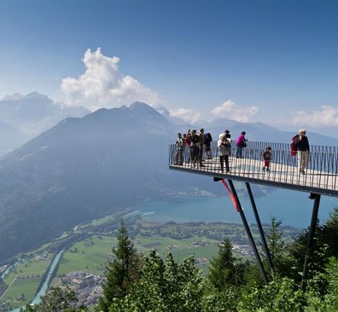
STEM Challenge Project
Viewing platform
challenge

Slide 3
Viewing platform challenge
Switzerland
Beijing, China

Slide 4
Learning Intentions
To build up our STEM skills:
Teamwork
Communication
Creativity
Critical Thinking
Resilience
To use the engineering design process to solve a problem

Slide 5
What are your success criteria for this project?
I would like to get better at
teamwork
communication
creativity
critical thinking
resilience
How can you get better at this? Write down some strategies for yourself.
At the end you will decide if you have been successful.

Slide 6
STEM Challenge:
Build a viewing platform from your table – no safety barriers
At least 20 cm long, from the table to the front edge of the platform
Your platform must be as strong as possible – it must hold a minimum of 5 wooden squares
It must not be attached to anything apart from your table
You will be given a choice of materials
Poster paper max 2
A4 paper max 2
String max 4
Scrap card max 2
Small boxes max 2 – these cannot be used as boxes – cut open
Sellotape
Test your platform using wooden blocks to find out how strong it is
Cube = 10 points Square = 1 point All wood must be balanced on the platform
Add 1 point per extra cm if your platform is over 20 cm from table to front edge
Work out your total points and write your score on your design sheet

Slide 7
STEM Challenge Project
Viewing platform
challenge
Part 2

Slide 8
Learning Intentions
To build up our STEM skills:
Teamwork
Communication
Creativity
Critical Thinking
Resilience
To use the engineering design process to solve a problem

Slide 9
What have you learned so far?
Did anything go wrong with your design last time? How did you fix it?
How could you make a strong platform?
How can you hold up your viewing platform to make it stronger?

Slide 10
STEM Challenge
Build a viewing platform from your table – no safety barriers
At least 20 cm long, from the table to the front edge of the platform
Your platform must be as strong as possible – it must hold a minimum of 5 wooden squares
It must not be attached to anything apart from your table
You will be given a choice of materials
Poster paper max 2
A4 paper max 2
String max 4
Scrap card max 2
Small boxes max 2 – these cannot be used as boxes – cut open
Sellotape
Test your platform using wooden blocks to find out how strong it is
Cube = 10 points Square = 1 point All wood must be balanced on the platform
Add 1 point per extra cm if your platform is over 20 cm from table to front edge
Work out your total points and write your score on your design sheet

Slide 11
Evaluation
What is good about your design?
What could you improve about your design?
How could you make the platform stronger?
What different materials could you use?
How would you change your design if you did this challenge again?
How could you change the STEM challenge next time?

Slide 12
Self assessment
Did you meet the Success Criteria you set yourself?
☺ | Yes – I was successful
😐 | Almost – I need some help
☹ | Not yet – I need to keep working on this

Slide 13
Instructions
Write or draw instructions so someone else could build your design
Number each step
You could draw labelled pictures to show how to build your design

