Slide 1
Teaching notes
This is likely to be a longer project – it took 2 STEM sessions of 1h45 to complete.
At the second session take some time to evaluate prior learning and learn from each other.

Slide 2
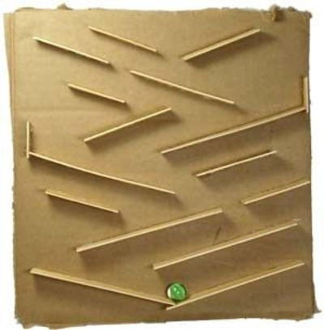
STEM Challenge Project
Vertical marble runs

Slide 3
Learning Intentions
To build up our STEM skills:
Teamwork
Communication
Creativity
Critical Thinking
Resilience
To use the engineering design process to solve a problem

Slide 4
What are your success criteria for this project?
I would like to get better at
teamwork
communication
creativity
critical thinking
resilience
How can you get better at this? Write down some strategies for yourself.
At the end you will decide if you have been successful.

Slide 5
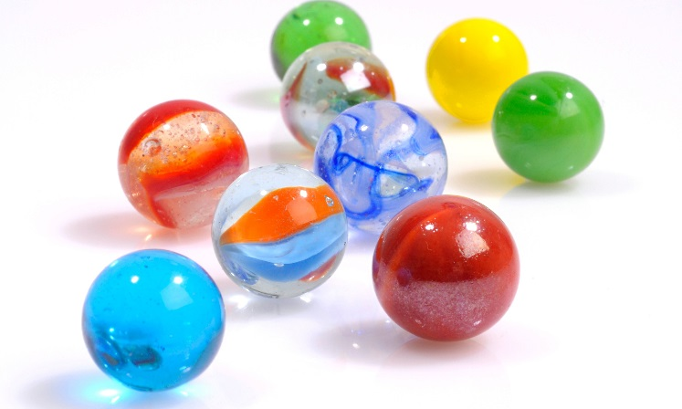
STEM Challenge
Design and build a vertical marble run with a marble catcher at the bottom
The marble must take as much time as possible to travel down
You will be given a choice of materials and a budget of £100
A4 paper £10
Straw £5 (max 5)
Piece of scrap card £10 (max 3)
Round tube £10 (max 1)
Long box £10 (max 1)
Lollypop stick £5 (max 5)
You will use a cereal box as the backing – free
Sellotape is free
You will win 10 points per second your marble takes to travel from the top to the marble catcher
Test your structure using your marble and consider how you could improve it

Slide 6
What have you learned so far?
Did anything go wrong with your design last time? How did you fix it?
How did you keep the marble on the ramp?
How did you make sure the marble run was stable?
How did you make a marble catcher? Could this be improved?

Slide 7
Evaluation
What is good about your design?
What could you improve about your design?
How could you make the marble run more complicated?
What different materials could you use?
How would you change your design if you did this challenge again?
How could you change the STEM challenge next time?

Slide 8
Self assessment
Did you meet the Success Criteria you set yourself?
☺ | Yes – I was successful
😐 | Almost – I need some help
☹ | Not yet – I need to keep working on this

Slide 9
Instructions
Write or draw instructions so someone else could build your design
Number each step
You could draw labelled pictures to show how to build your design

