Slide 1
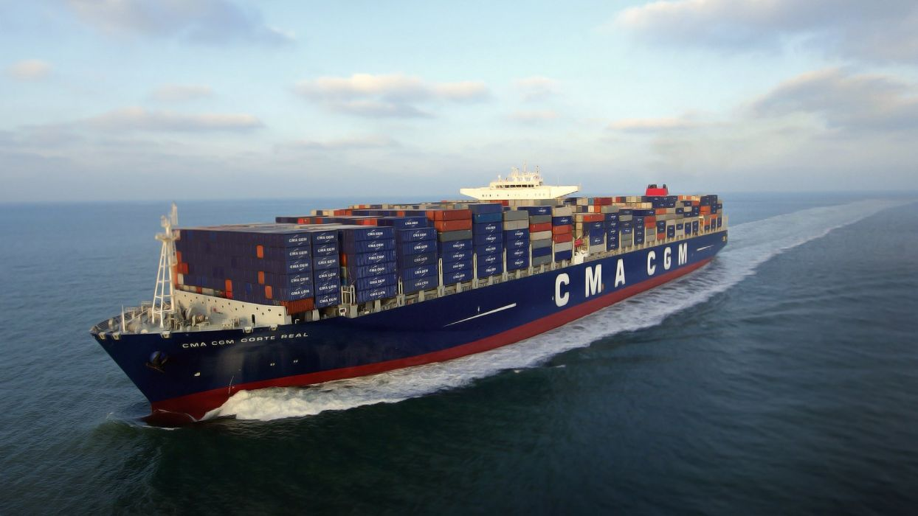
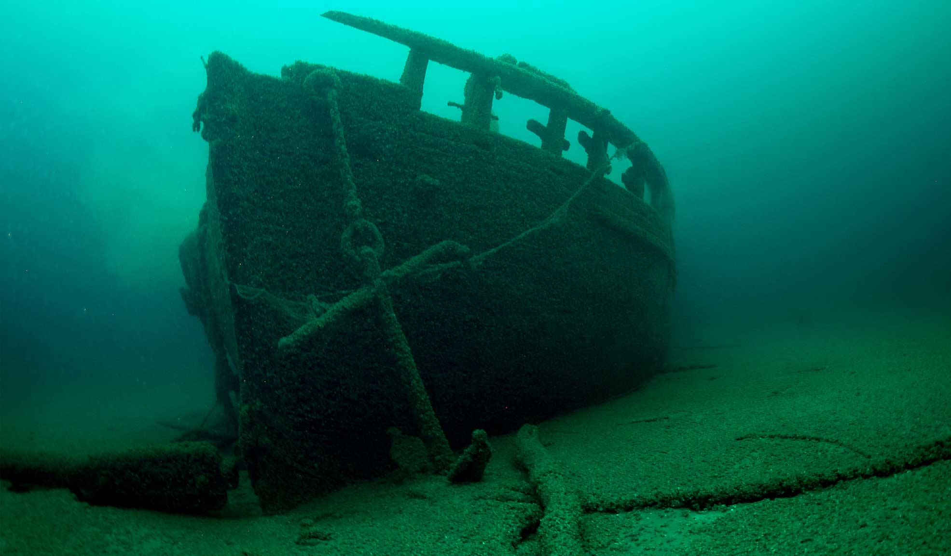
STEM Challenge Project
Shipwreck
challenge

Slide 2
Learning Intentions
To build up our STEM skills such as teamwork and communication
To use the engineering design process to solve a problem

Slide 3
How will you be successful today?
What does successful teamwork look like?
What can you do to be a good communicator?

Slide 4
STEM Challenge
Design and build a foil boat which can float and carry as much weight as possible without being shipwrecked!
You will only be given:
Foil and scissors
No sellotape!
No flags, sails etc
What can you use to test your boat?
Test your boat and try to improve it
Try different shapes and sizes

Slide 5
STEM Challenge Project
Shipwreck
challenge
Part 2

Slide 6
Learning Intentions
To build up our STEM skills such as teamwork and communication
To use the engineering design process to solve a problem

Slide 7
How will you be successful today?
What does successful teamwork look like?
What can you do to be a good communicator?

Slide 8
What did you learn last lesson?
How did your group tackle the STEM challenge?
Which ideas did you have that were successful?
What didn’t work?
What would you change about your design to improve it?
How could you make the boat carry more weight?
What different materials could you use?

Slide 9
STEM Challenge
Design and build an even better boat which can float and carry as much weight as possible without being shipwrecked!
You will be given:
Foil 1 piece
Plastic tub scraps 1
Lollypop sticks 5
Straws 5
Plastic bags 1
Sellotape
No flags, sails etc
Test your boat and try to improve it

Slide 10
What can you learn from others?
Learning loop
How did other groups tackle the STEM challenge?
Which ideas did you see that were successful?
What did you see that hadn’t worked, or that you wouldn’t use?

Slide 11
Evaluation
What is good about your design?
What could you improve about your design?
How could you make the boat carry more weight?
What different materials could you use?
How would you change your design if you did this challenge again?
How could you change the STEM challenge next time?

Slide 12
Self-assessment
Did you meet the Success Criteria you set yourself?
☺ | Yes – I was successful
😐 | Almost – I need some help
☹ | Not yet – I need to keep working on this

Slide 13
Instructions
Write or draw instructions so someone else could build your design
Number each step
You could draw labelled pictures to show how to build your design

Slide 14
http://no-ads-youtube.com/search?q=scikids+displacement

