Slide 1
Teaching notes
You will need several water trays to test the rafts – washing up bowls, class trays etc. The water does not need to be very deep. Let children see the size of the trays before they design so they don’t make their rafts too big. You’ll also need towels to dry up.
Scrap plastic pieces = fruit punnets etc cut up into smaller pieces
Plastic bags – some children like to include them wrapped around the base of the raft – they tend to fill with water and sink – they are better used as sails – let them find this out for themselves!
Remind children to avoid adding flags, people, lifebelts… anything that is not part of the challenge.

Slide 2
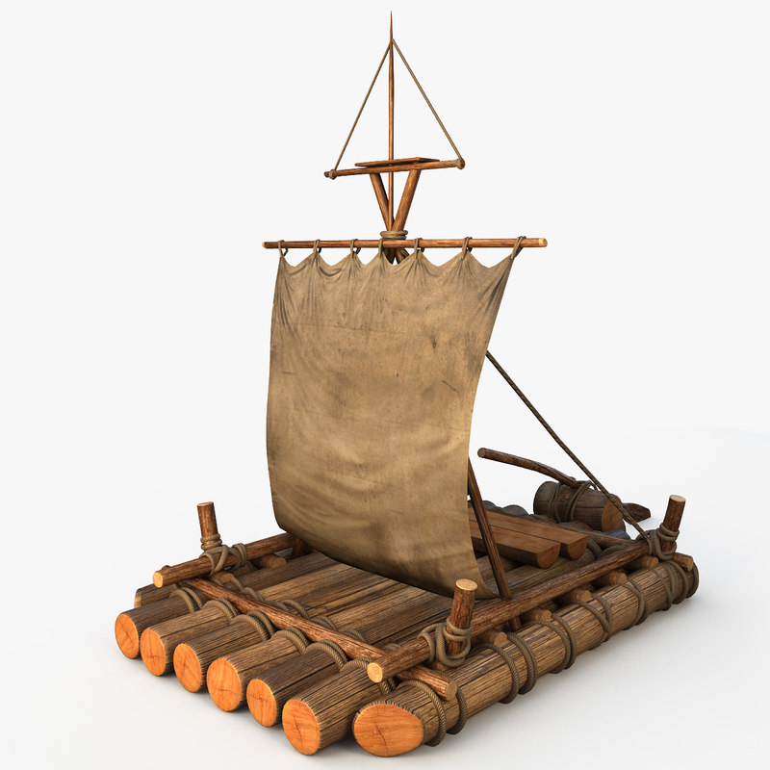
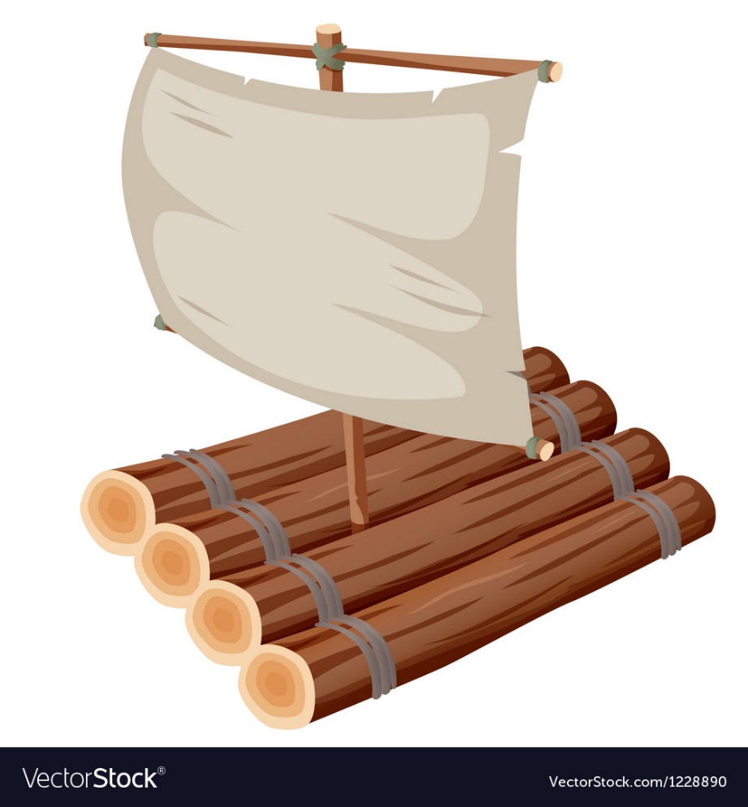
STEM Challenge Project
Rafts

Slide 3
Learning Intentions
To build up our STEM skills such as teamwork and communication
To use the engineering design process to solve a problem

Slide 4
How will you be successful today?
What does successful teamwork look like?
What can you do to be a good communicator?

Slide 5
STEM Challenge
Design and build a raft which you can blow across the water
You will be given a choice of materials:
Straws max 5
Lollypop sticks max 5
Yoghurt pot 1
Scrap plastic pieces 1
Plastic bags 1
Foil 1 piece
Sellotape
Test your raft and try to improve it

Slide 6
What can you learn from others?
Learning loop – look at other people’s work.
What good ideas did you see?
What did you see that hadn’t worked, or that you wouldn’t use?

Slide 7
STEM Challenge Project
Rafts
Part 2

Slide 8
Learning Intentions
To build up our STEM skills such as teamwork and communication
To use the engineering design process to solve a problem

Slide 9
How will you be successful today?
What does successful teamwork look like?
What can you do to be a good communicator?

Slide 11
What did you learn last lesson?
Which materials floated really well?
What was good about your raft?
What didn’t work?
Did you add anything to your raft that you could leave out?
What would you change about your design to improve it?
How could you make the raft float better?
Could you improve the way the raft moves?
What different materials could you use?

Slide 12
STEM Challenge
Design and build a new and improved raft which you can blow across the water
You will be given a choice of materials:
Straws max 5
Lollypop sticks max 5
Yoghurt pot 1
Scrap plastic pieces 1
Plastic bags 1
Foil 1 piece
Sellotape
Test your raft and try to improve it
Finding this too easy? How could you challenge yourself?

Slide 13
What can you learn from others?
Learning loop – look at other people’s work.
What good ideas did you see?
What did you see that hadn’t worked, or that you wouldn’t use?

Slide 14
Evaluation
Discuss how your new team approached the STEM challenge today
What had you learned from last week?
What did you learn from working with different team members?
How could you improve your design?
Can you think of another similar STEM challenge you could set yourself to try at home?

Slide 15
Self-assessment
How did you get on with
Teamwork
Communication
☺ | Yes – I was successful
😐 | Almost – I need some help
☹ | Not yet – I need to keep working on this

Slide 16
Instructions
Write or draw instructions so someone else could build your design
Number each step
You could draw labelled pictures to show how to build your design

