Slide 1
Teaching notes
A good pillar has to be strong and stable. The way is it made contributes to this – cutting and sticking needs to be done carefully, making sure that the bottom and top of the pillar are level. Wide (fat) cylinders are more stable than narrow (thin) cylinders – children will soon learn this. A strong pillar needs several layers of paper so a long rectangle is a good starting point. Children will also learn quickly that a stable pillar is not necessarily a tall pillar!
Children can investigate different 3D shapes for pillars – good for discussing shape.
Bridge deck – investigate strength of A4 paper when it is flat, as opposed to when the 2 long sides are folded up (about 3-4cm). Again, layering paper so the bridge deck is thicker increases strength.
You could provide a river/canal made of blue paper etc for each team.
Safety – watch out for falling weights while testing. Children could test their pillars / bridges on the floor. You could set a maximum amount children can use for testing.

Slide 2
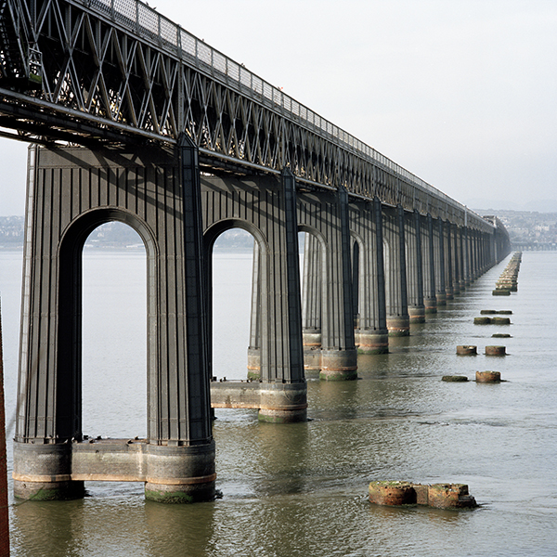
STEM Challenge Project
Perfect pillars

Slide 3
Learning Intentions
To build up our STEM skills such as teamwork and communication
To use the engineering design process to solve a problem

Slide 4
How will you be successful today?
What does successful teamwork look like?
What can you do to be a good communicator?

Slide 5
STEM Challenge
Design and build a pillar which can hold as much weight as possible
You will be given:
A4 paper
Sellotape
Test your pillar using wooden cubes and squares and try to improve it
What makes a perfect pillar?

Slide 6
What can you learn from others?
Learning loop – look at other people’s work.
What good ideas did you see?
What did you see that hadn’t worked, or that you wouldn’t use?
What makes a perfect pillar?

Slide 7
STEM Challenge Project
Perfect pillars
Part 2

Slide 8
Learning Intentions
To discuss what we learned from last week and create a strong, stable structure
To continue building up our STEM skills such as teamwork and communication
To use the engineering design process to solve a problem

Slide 9
How will you be successful today?
What does successful teamwork look like?
What can you do to be a good communicator?

Slide 10
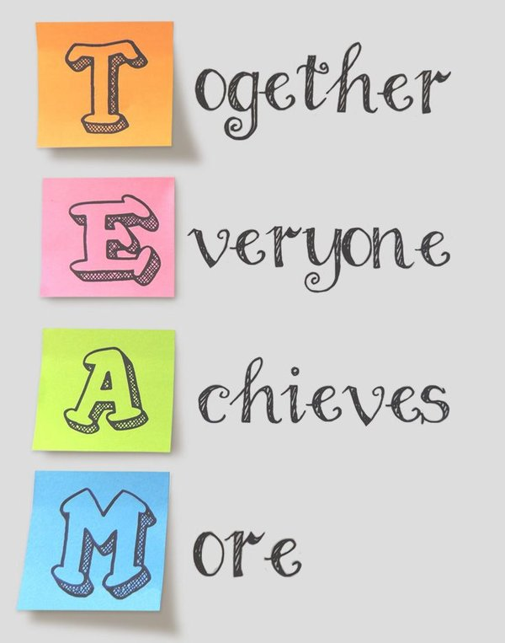

Slide 11
What did you learn last lesson?
What shape does your paper need to be before you roll it up?
How do you need to roll the paper?
How can you make a strong pillar?
How can you make a stable pillar?
What makes a perfect pillar?

Slide 12
Pairs of perfect pillars
Look at the pillars in this rail bridge near Dundee
Pairs of perfect pillars can make a structure more stable

Slide 13
STEM Challenge
Design and build a strong and stable bridge which can support a toy car. No ramps are needed.
You will be given a choice of materials:
A4 paper
Poster paper
Sellotape
Test your bridge and try to improve it
If your bridge can support a car, try using wooden squares and cubes to test it. How much weight can your bridge support?

Slide 14
What can you learn from others?
Learning loop – look at other people’s work.
What good ideas did you see?
What did you see that hadn’t worked, or that you wouldn’t use?

Slide 15
Evaluation
Discuss how your team approached the STEM challenge today
What had you learned from last week?
What did you learn from working with different team members?
How could you improve your design?
Can you think of another similar STEM challenge you could set yourself to try at home?

Slide 16
Self-assessment
How did you get on with
Teamwork
Communication
☺ | Yes – I was successful
😐 | Almost – I need some help
☹ | Not yet – I need to keep working on this

Slide 17
Instructions
Write or draw instructions so someone else could build your design
Number each step
You could draw labelled pictures to show how to build your design

Slide 18
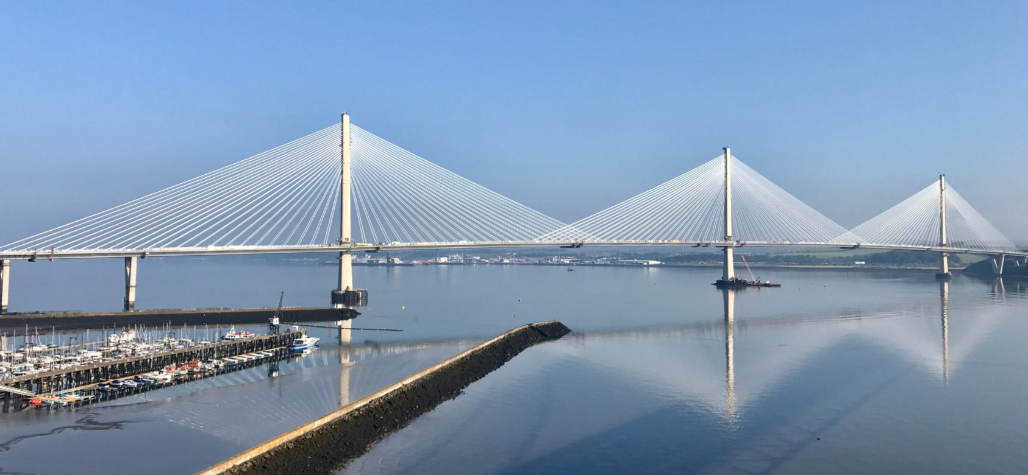
Queensferry Crossing

