Slide 1
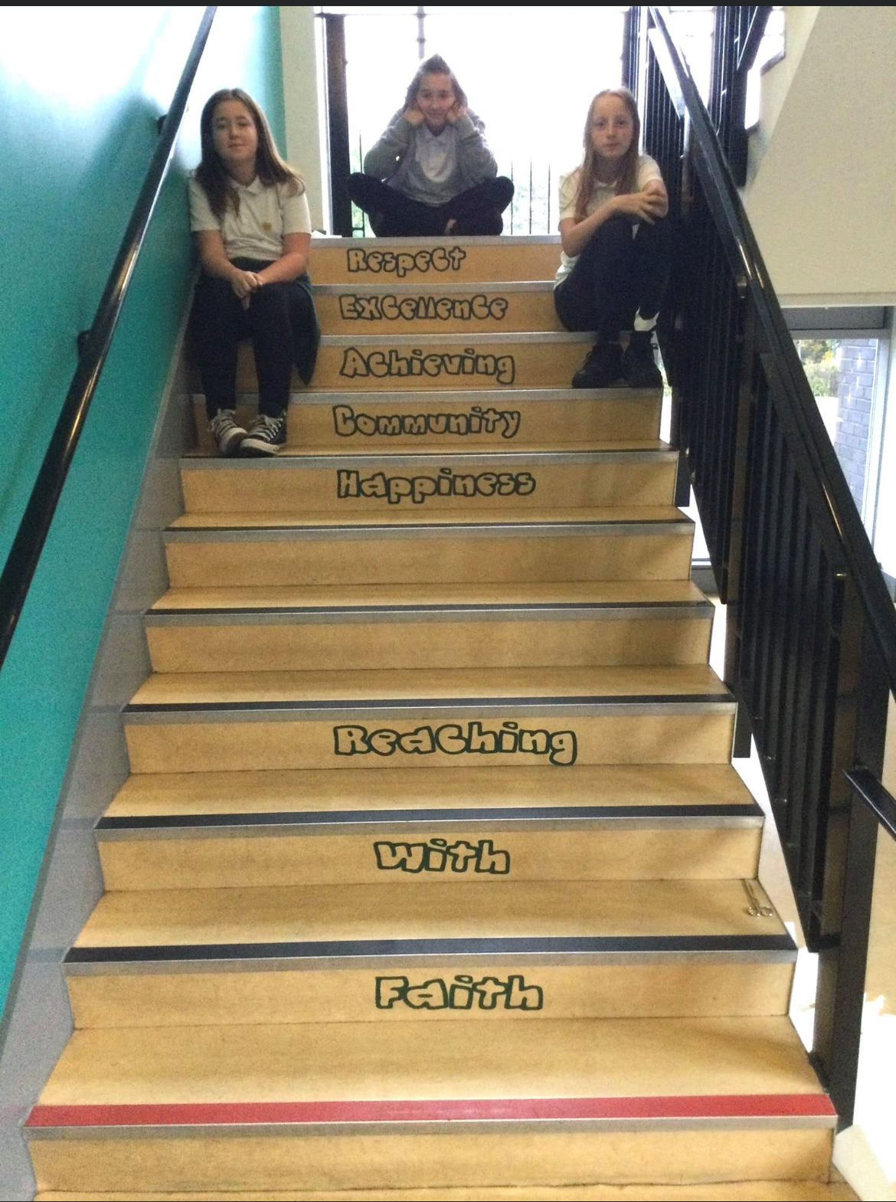
St David’s Primary School Weekly Notices
Week Beginning Monday 1st November 2021
TRANSITION TO HIGH SCHOOL
On Monday 8th November our P6 and P7 pupils will go for their second visit to St Benedict’s High School. They had a great time on their last visit, meeting staff, touring the school and having an assembly with the Head Teacher. We can’t wait to see what they get to do on their next visit.
OUR SCHOOL VALUES
We walk our School Values every day in St David’s Primary School.
Feast of All Saints
Primary 6 and 7 children are walking to St Margaret’s Church on Monday 1st November for 10am Mass. They will meet up with P6 and P7 pupils from St Margaret’s Primary.
If you have any questions, please contact us:
0300 300 0198
stdavidsenquiries@renfrewshire.gov.uk

