Slide 1
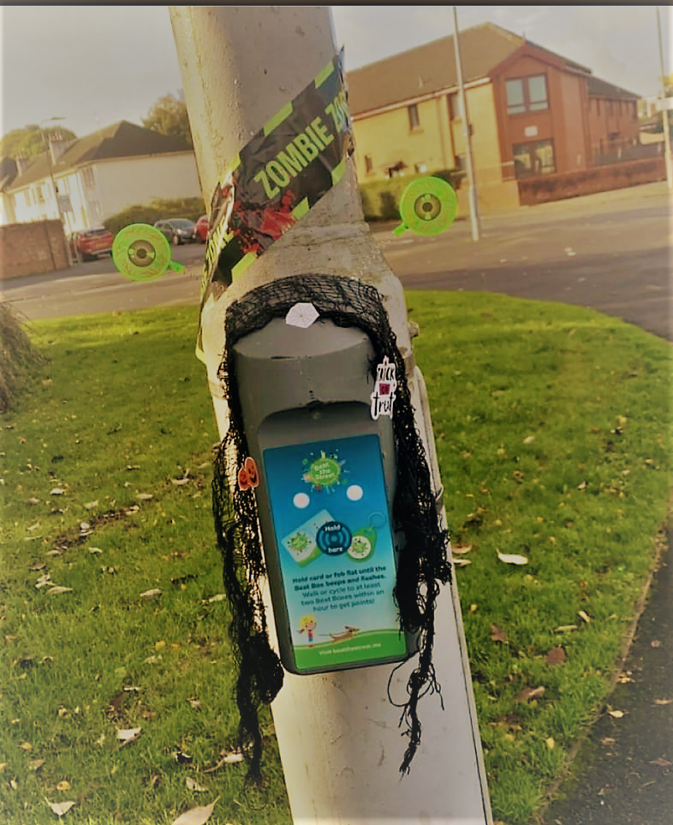
St David’s Primary School Weekly Notices
Week Beginning Monday 25th October 2021
Social Media
We are currently updating our Social media communication. We will be posting updates from classes on Twitter. Please follow us.
@StDavidsPS
We will also update our weekly notices on our blog.
Our Facebook page is being updated. Follow us on
https://www.facebook.com/StDavidsPS
Beat the Street
Well done to everyone who is taking part in Beat the Street! Our children have really enjoyed the project. It is the final week so keep beeping!
See Beat the Street Renfrewshire on Facebook for info on spooky Halloween boxes!
Halloween Fun Day
Children can wear Hallowe’en costumes to school on Friday 29th October. They should not bring props to school. We don’t want props broken or lost before the 31st. Our Parent Council are giving every child a party bag of treats. Thank you!!
If you have any questions, please contact us:
0300 300 0198
stdavidsenquiries@renfrewshire.gov.uk

